Slide 1
Introduction

Slide 2
Install Git
Mac Install:
https://github.com/brynportella/RAP-210308/blob/main/environment-setup/git-install-mac.md
Windows Install:
https://github.com/brynportella/RAP-210308/blob/main/environment-setup/git-install-windows.md

Slide 3
File System
Your file system informs how files are stored, named and accessed.
Typically forms a tree like structure with some root or top level directory and then directories nested within that.
In Unix, your root directory is represented by the / character
The . character represents the current directory. Furthermore, .. represents the parent directory.
Not every user will have access to the entire filesystem and some may actually only be able to view a select section of the file system.

Slide 4
Absolute and Relative Paths
When structure can be represented as a tree, like a file system, you can express the location of something in that structure with a path.
Absolute: path is “measured” from a root or globally fixed point
C:\Programs\Web\helloWorld.html
/Users/Revature/Documents/file.txt
Relative: measured from the location of another file or directory
../styles/stylesheet.css

Slide 5






Absolute and Relative Paths
Folder A
Cat.html
Folder B
Folder C
Pig.html
Dog.html
Frog.html
Notes:
Use this image to talk through the relative path from one file to another. What if Folder A was the root? Then what’s the absolute path to any of the files?

Slide 6
Tree Structure (Filesystems)
Folder-a
Cat.html
Folder-b
Folder-c
Dog.html
Pig.html
Frog.html

Slide 7
Command Line
To execute commands for your operating system you will use a command line tool.
Command Prompt
PowerShell
Unix shell
Terminal
GitBash < this is the one we will use
Commands will be specific to your command line tool
Usually there’s an equivalent command in each
You begin with your commands executing from a particular position in your file system.

Slide 8
Commands
pwd
Print working directory command
Prints the full name of the directory you are currently working in.
ls
list directory
see the contents of a particular directory
cd
change directory
mkdir
make directory

Slide 9
clear
the clear command usually prints a number of blank lines such that all previous commands are no longer on the screen. There is a shortcut for this command, ctrl-l
echo
the echo command will print a string or the result of a command to the console.
>
The > operator will redirect the output of a command to a file. The file will be created or overwritten if it already exists. ex. ls . > log.txt
>>
The >> operator acts the same way as the > operator but appends output to the file instead of overwriting if it exists.
grep
the grep command prints any lines in a file or files that match a given pattern. By default, grep interprets the pattern as a basic regular expression.
Print all lines in hello.txt that contain the word goodbye: grep goodbye hello.txt

Slide 10
cat - the concatenate command prints the contents of a file to the console. cat hello.txt
head - the head command prints the first ten lines of a file to the console. head hello.txt
tail - the tail command prints the last ten lines of a file to the console. tail hello.txt
touch - the touch command allows you to modify the timestamp of a file. This command is usually used to create empty files, as an empty file is created if touch is given a file name that does not exist. touch hello.txt

Slide 11
• cp - the copy command creates a copy of the specified file at the location specified. If the recursive glag is used, it will operate on directories.
- copy a hello.txt to goodbye.txt: cp hello.txt goodby.txt
- copy the hello directory to the goodbye directory: cp -r hello goodbye
• mv - the move command will rename or move a file or entire directory with the recursive flag.
-.txt
- move hello.txt to the goodrename a hello.txt to goodbye.txt: mv hello.txt goodbyebye directory: mv hello.txt goodbye/.
- rename the hello directory to goodbye: mv -r hello goodbye
• rm - the remove command will delete a file. If you use the recursive flag, it can delete a directory. The force flag will cause the command to delete files without prompting the user if there are warnings. The command rm -rf . is extremely dangerous.
remove hello.txt: rm hello.txt
remove the hello directory: rm -r hello

Slide 12
wc - the word count command will print the number of words in a file. This command has several flags available
-c, --bytes - prints the byte count
-m, --chars - prints the character count
-l, --lines - prints the lines
-w, --words - prints the word count (default)
ln - the link command creates a link between files. This allows you to make a shortcut to a file in one location without copying it over.

Slide 13
Getting help with the command line
man command in unix [ help in gitbash]
help nameofcommand
Quick google search
Be sure and break down your action into granular steps
Search each step

Slide 14
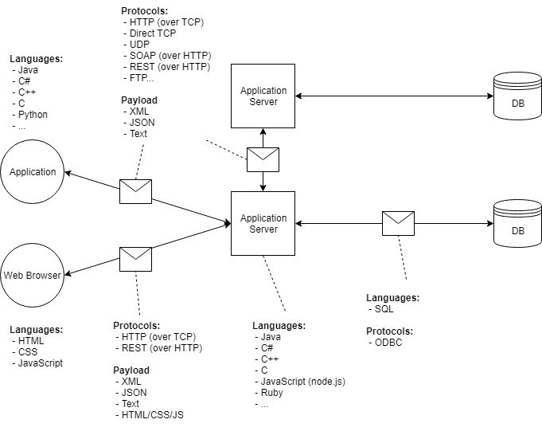
Client-Server-Database Architecture

