Slide 1

Cucumber
BDD Framework

Slide 2
Behavior Driven Development
Approach to development where we use “ubiquitous” language to bridge the gap between business and development teams
Developers implement features through the point of view of non-technical stakeholders
BDD is a superset of TDD (meaning TDD is a part of BDD)
BDD takes it further by encouraging effective communication between all parties such that everyone has a strong shared understanding of an application’s behavior not only the development and QA (testing) teams

Slide 3
Steps of developing features
Business Analysts (BAs) and stakeholders collaborate with developers and testers to document expected behaviors in plain language (English-like) syntax (“Ubiquitous language”)
Developers/testers write tests to validate the behaviors described
Developers then write code to pass the test (TDD)

Slide 4
BDD benefits
Encourages documentation that is understandable to both technical and non-technical parties. BDD is commonly referred to as “living documentation” because it evolves with the software itself
Emphasize effective communication between non-technical and technical members of a team
BDD allows us to easily generate test cases from provided scenarios

Slide 5
Implementing BDD w/ Cucumber
Developers/BAs first write feature files in Gherkin. Feature files define the various scenarios and steps that define a system’s behavior at a high level
Once a developer has drafted the feature file, they should run the feature file to generate the “glue-code”. Glue-code refers to the potential test/automation methods that are associated with a scenario’s steps. A developer can then choose whether or not the implement those methods.
Once a developer has generated glue code and written tests, they should choose a test runner to run the steps

Slide 6
Some Cucumber Terminologies
Feature file: A file with a .feature extension that contains Gherkin syntax in the form of scenarios
Glue code / Step definition file: Actual Java implementations of our features
Test Runner: a class that contains configuration regarding where to find feature files and step definition files and will actually run these steps as tests

Slide 7
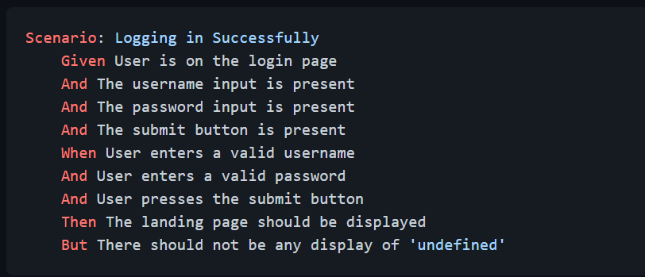
Gherkin Example

Slide 8
Cucumber Parameterization
It is possible to define parameters that you want to pass into your glue code methods themselves from the feature files. This allows us to define parameters that are visible from the perspective of the Gherkin itself and couple it with our tests
The ability to pass parameters “inline”
The ability to pass parameters in a table (similar to the below example, but for a single step) “x rows of data, run that single step x times”
The ability to define a “scenario outline” that will run multiple times for each “row” of data
If we have x rows of data, run that scenario x times

