Slide 1
Encapsulation, Algorithms and Complexity

Slide 2
Algorithms
An algorithm is just a step-by-step approach to solving a problem.
You have an array of numbers, and you want to sort them from lowest to highest. How do you do it?
There is no programming tricks here. Talk it out, like your explaining it to a child.
Do you…
Search for the lowest value first
Move it to the front
Repeat for the remainder?
Or do you…
Check every two adjacent elements
Swap them if the right is smaller than the left
Repeat until done?

Slide 3
Pseudocode
Planning and organization are key to creating efficient algorithms. To plan the logic for an algorithm, pseudocode is often used.
Pseudocode is an informal, artificial, text-based, and self-descriptive language that is used to describe the steps of an algorithm prior to the actual implementation.
In other words, pseudocode is used to explain the steps of an algorithm without worrying about the specific programmatic syntax/grammar (pseudocode cannot be compiled or executed).

Slide 4
Pseudocode – How to…
Limit one statement per line
All statements showing “dependencies”/”hierarchies” are indented (i.e. flow control statements and their associated blocks of code).
Statements are language agnostic (refrain from using keywords specific to a particular programming language)
Describe with words rather than programmatic symbols
Keep it simple, concise and readable.

Slide 5
Pseudocode - Examples
Bad:
Good:
if arrayNotNull = true
for y = 0 to arrayLength-1
if (array[index] = odd)
print
array[index]
if array is not null
for each element of array
if array index is odd
print
value of array index
input double[] scores
output double average
int total = 0
int count = 0
if scores.length > 1
while count < scores.length-1
total += scores[index]
count++;
return total/count;
input array of scores as doubles
output average as double
initialize total to zero
Initialize count to zero
If array length greater than 1
while count is less than array length
add array index to total
increment count
return total divided by count

Slide 6
Pseudocode - Considerations
Advantages:
Improves readability and organization when problem solving
Pseudocode acts as a bridge between program and algorithm.
Creates easier to understand document for individual developers and groups
Focus on explanation of code allows for easier construction of actual code.
Disadvantages:
There are no well-defined formats/standards when writing pseudocode
Use of pseudocode requires additional maintenance of documentation

Slide 7
Simple Algorithms
Create an Algorithm that will print all even numbers between a minimum and maximum value provided.
input min value
input max value
initialize index to min
while index is less than or equal to max
if index is evenly divisible by two
print index

Slide 8
Simple Algorithms (cont…)
Create an Algorithm that will display the first, and last letter of every word within an array of String objects.
input array of strings
for each string in array
print character at index zero
print character at one minus index length

Slide 9
Simple Algorithms (cont…)
Create an Algorithm that will swap the position of the first and last item within an array.
Alter the algorithm to take two index positions and swap the values at those locations instead of the first and last.

Slide 10
Swapping Elements - Psuedocode
input array of values
initialize first with element at array index zero
initialize last with element at array length minus one
change element at index zero to last
change element at last index to first
input array of values
input indexposition_left as whole number
input indexposition_right as whole number
if indexposition_left is greater than zero AND indexposition_left is less than length of array
initialize first with element at array indexposition_left
if indexposition_right is greater than zero AND indexposition_right is less than length of array
initialize last with element at array indexposition_right
change element at index zero to last
change element at last index to first

Slide 11
Common Algorithms – Linear Search
Searching algorithms are methods used to find an element within some collection or list.
Linear search is the most basic searching algorithm, which functions by checking each element of a collection in sequence until a match is found or until the whole list has been searched.

Slide 12
Linear Search
public static int linearSearch(int target, int[] collection) {
int index = -1;
for (int i = 0; i < collection.length; i++) {
if (collection[i] == target) {
index = i;
}
}
return index;
}

Slide 13
Common Algorithms – Binary Search
A Binary Search (a.k.a. half-interval search) is another common algorithm used to find elements within a sorted collection.
Binary search finds the position of an element by looking at the element halfway between the recognized minimum and maximum value and eliminating half of the remaining elements if the target value is less than or greater than this halfway point.
The algorithm ends after finding the target value is found or all elements have been eliminated.

Slide 14
Binary Search
public static int binarySearch(int target, int[] collection) {
int left = 0;
int right = collection.length-1;
while (left <= right) {
int mid = (right+left)/2
if (target < collection[mid]) {
right = mid - 1;
} else if (target > collection[mid]) {
left = mid + 1;
} else {
return mid;
}
}
return -1;
}

Slide 15
Target =35
10
35
100
150
173
200
Right = 1
Left = 1
Mid = 1

Slide 16
Common Algorithms – Bubble Sort
Bubble Sort is one of the simplest sorting algorithms, used to organize elements of a collection into a particular order.
Bubble Sort organizes elements by repeatedly comparing and swapping adjacent elements if they are in the wrong order.

Slide 17
Bubble Sort
public static void bubbleSort(int[] arr) {
int n = arr.length;
for (int i = 0; i < n – 1; i++) {
for (int j = 0; j < n – i - 1; j++) {
if (arr[j] > arr[j+1]) {
int temp = arr[j];
arr[j] = arr[j+1];
arr[j+1] = temp;
}
}
}
}

Slide 18
Common Algorithms – Selection Sort
Selection Sort is another common sorting algorithm that organizes elements within a collection.
The Selection Sort works by repeatedly finding the smallest element of a collection and moving the found element forward by swapping the position of the left-most element, with the smaller.

Slide 19
Selection Sort
public static void selectionSort(int[] arr) {
for (int i = 0; i < n – 1; i++) {
int minIndex = i;
for (int j = minIndex+1; j < arr.length - 1; j++) {
if (arr[minIndex] > arr[j]) {
minIndex = j;
}
}
int temp = arr[i];
arr[i] = arr[minIndex]
arr[minIndex] = temp;
}
}

Slide 20
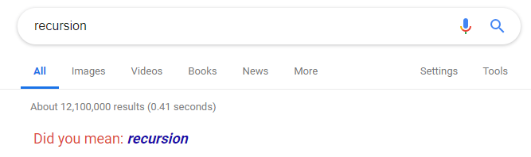
What is Recursion?
A recursive function is a function that calls itself, and returns the output
Successive executions are added to the execution stack
There must exist a base case at which the recursion stops, otherwise you will get a stack overflow
When the base case is found, values are returned down the execution stack, potentially being transformed along the way.

Slide 21
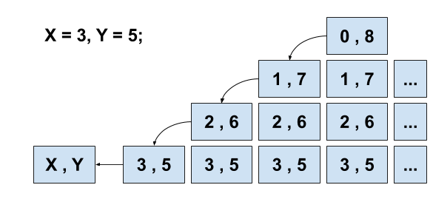
Simple Recursion – Peano Addition
public int peanoAddition(int x, int y) {
if (x == 0)
return y;
else
return peanoAddition(--x, ++y);
}

Slide 22
Recursion - Fibonacci Sequence
The Fibonacci sequence is a series of numbers that starts “0, 1, …” and every subsequent number is the sum of the prior two. (0, 1, 1, 2, 3, 5, 8, 13, 21…)
Goal: Calculate the nth index of the Fibonacci sequence.
Base case: n === 0 -> 0
Base case: n === 1 -> 1
Otherwise: fib(n-2)+fib(n-1)
function fib( n) {
if (n <= 0)
return 0; else if (n === 1)
return 1;
else
return (fib(n-2) + fib(n-1));

Slide 23
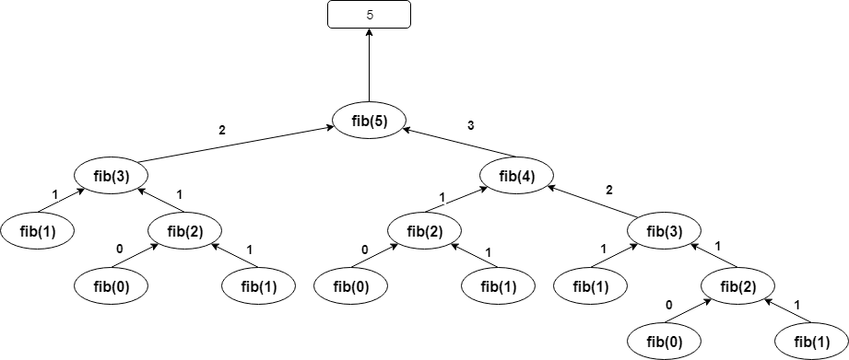
Fib(5)

Slide 24
Common Algorithms – Merge Sort
The Merge Sort is a more complex sorting algorithm that organizes elements of a collection by dividing continually dividing a collection into two halves, and then merging the split collections back together in sorted order.

Slide 25
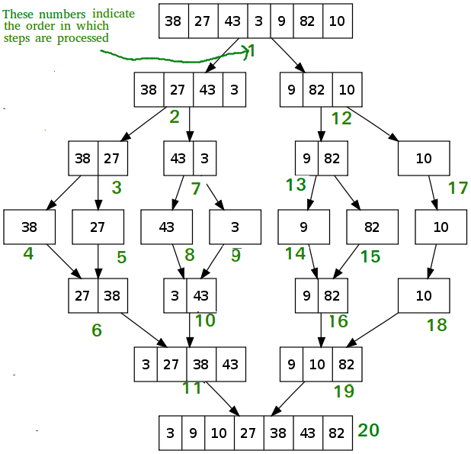
Merge Sort

Slide 26
Common Algorithms – Quick Sort
Similarly, to the Merge Sort, the Quick Sort is a more complex sorting algorithm that organizes elements of a collection by dividing elements into smaller collections.
A Quick Sort works by selecting a ‘pivot’ element and then iterating through a collection moving elements lower than the pivot value to the left, and elements higher than the pivot value to the right.

Slide 27
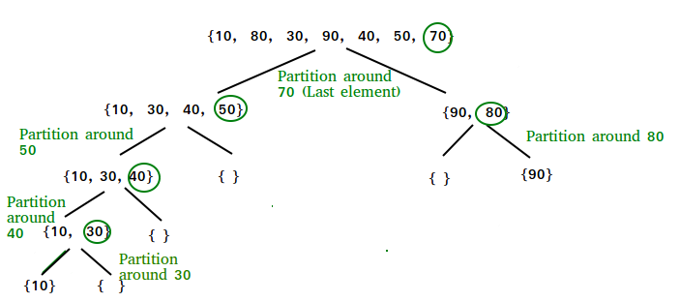
Quick Sort

Slide 28
Practice Makes Perfect
The only real way to get more proficient creating algorithms is to practice and work through different problems.
The links below are some popular resources that provide algorithm practice problems.
https://www.hackerrank.com/
https://www.codingame.com/
https://leetcode.com/
https://codesignal.com/

Slide 29
Algorithms can be Complex…
Previously, we stated that “Flow control statements can balloon the execution time of a program.”, because you are continuously executing lines of code, sometimes multiplicatively (recursively).
We measure the rate of increase in number of inputs and call this measurement “complexity”.
More inputs/time = more complex.
We can then express this complexity as an equation, referred to as Big-O notation.

Slide 30
Big O Notation
O(1) – Constant scaling
O(n) – Linear scaling
1 input = 1ms, 2 input = 2ms, etc…
O(log(n)) – Logarithmic scaling
Generally base-2
O(n * log(n)) – Quasilinear scaling
log(n) steps for each input
O(n^k) – Polynomial scaling
K number of nested loops
O(k^n) – Exponential scaling
Recusively called k times.
O(n!) – Factorial scaling
Every permutation of every input (might as well guess at this point)
Notice there are no concrete units in these equations…that is because program execution is reliant on hardware and other factors.

Slide 31
Memory Structure
Variables are stored in memory
A specific location in memory is called an “address”
Each address stores a single byte of data
Most variables then occupy multiple addresses
The number of addresses reserved for a single variable is determined by the variable’s type
An int always reserves 4 bytes
The number of addresses/bytes reserved determines value range (because binary)

Slide 32
Reference Variables…
Reference variables store the memory address or reference to an object in memory.
Objects have to reserve enough memory to hold all the variables stored for that single object.
The memory reserved for an object might contain references to other objects in memory, which contain their own objects…
This confusion and messiness is why Java lets you ignore memory management.
The reference variable is not the object, it’s the door through which the object is accessed

Slide 33


Let’s take the following program
public class Dog {
//instance variable- state of a Dog object
public double size = 6.5;
}
public class TestDog{
public static void main(String[] args){
int number = 9;
Dog dog = new Dog();
Dog dog2 = new Dog();
dog2.size = 40.0;
}
}
Stack
dog2
dog
number = 9
main
size =6.5
40
size =6.5
Heap

Slide 34
Class vs. Object vs. Reference
A class is a template used to instantiate objects. It's also called a type in some circumstances, such as when used with a reference variable.
An object is an instance of a class in memory. Accessed through a reference, not directly.
A reference variable is a variable that stores the reference to an object in memory.
Dog someVar = new Dog(); 1 2 3
The class/type of the reference variable
The name of the reference variable
The instantiation of a new object using the "new" keyword to invoke a constructor. A reference to the new object is stored in “someVar”.

Slide 35
The Object Class
Provides baseline functionality for all objects and classes.
All classes from Java implicitly inherit from the Object class. (we will cover inheritance in more detail later).
Through inheritance, every class has access to the Object class’ methods.
Every class can also override these methods to provide a unique implementation (This is an example of polymorphism, which is another topic will examine in more detail later)
For some methods, this is expected.

Slide 36
Object Class Methods
hashCode() : generates an integer that uniquely identifies an object from all other objects of a class. By default, typically uses the memory address of the object (JVM-specific).
equals() : determines if two objects are equivalent, i.e. whether or not they have the same values in every variable. Uses the result of hashCode() by default.
toString() : returns a String representation of the object. By default, prints the class name and the memory address of the object.
finalize() : called by the garbage collector when there are no more references to the object, just before the instance is destroyed.

Slide 37
Wrapper Classes
Allow you to treat primitives like objects
Each object created from the following classes wraps a single primitive value of the corresponding type
Byte
Short
Integer
Float
Long
Double
Boolean
Character

Slide 38
Autoboxing
NOTE: This is autoboxing.
public class TestWrapperClasses{
public static void main(String[] args){
int number = 9;
//Declare wrapper class variables
Integer num = number;
Integer num2 = new Integer(9);
Integer num3 = 9;
printMe(9);
}
public static void printMe(Object o){
System.out.println(o);
}
}
Console Output:
9

Slide 39
Unboxing
NOTE: This is unboxing.
public class TestWrapperClasses{
public static void main(String[] args){
Integer number = 9;
int num = number;
int num2 = unbox(number);
System.out.println(num);
System.out.println(num2);
}
public static int unbox(int i){
return i;
}
}
Console Output:
9
9

Slide 40
4 Pillars of Object-Oriented Programming
Abstraction: The process of hiding implementation and processes of an entity to reduce complexity or increase understanding of a system’s properties.
Polymorphism: The ability for objects, classes, variables and/or methods to alter functionality while maintaining structure.
Inheritance: The ability for entities to adopt variables (fields) and/or methods (behavior) from a parent (super) class, allowing for instantiation of child objects from said parent class.
Encapsulation: The act of wrapping code into a single unit and then selectively exposing and restricting access to that code based on functionality or use within classes.

Slide 41
Encapsulation
Encapsulation: an OOP design principle
Classes should allow minimum necessary access to their members.
Access to class variables should be done through methods that can perform validation or are designed specifically to perform mutation or accessing functionality.
These methods are commonly referred to as ‘Accessor’ and ‘Mutator’ methods, also known as ‘Getter’ and ‘Setter’ methods, respectively.

Slide 42
Access Modifiers
Public: visible to all classes, everywhere
Protected: visible to all classes in the same package, and within subclasses
Default (Package-Private): visible to all classes in the same package
Private: visible only within the current class
Access modifiers on variables can be bypassed by more-visible methods that return or set their values

Slide 43
Accessing Class Members
package one;
public class Dog {
double size = 6.5;
void myMethod(){
System.out.println(“Running my method.”);
}
}
public
public
package two;
public class TestDog{
public static void main(String[] args){
Dog dog = new Dog();
//Access size
dog.size = 10.5;
//Access myMethod
dog.myMethod();
}
}

Slide 44
Accessing Class Members
PACKAGE-PRIVATE
!!
package one;
public class Dog {
double size = 6.5;
void myMethod(){
System.out.println(“Running my method.”);
}
}
package one;
package two;
public class TestDog{
public static void main(String[] args){
Dog dog = new Dog();
//Access size
dog.size = 10.5;
//Access myMethod
dog.myMethod();
}
}

Slide 45
Accessing Class Members
Private
!!
package one;
public class Dog {
private double size = 6.5;
private void myMethod(){
System.out.println(“Running my method.”);
}
}
package one;
public class TestDog{
public static void main(String[] args){
Dog dog = new Dog();
//Access size
dog.size = 10.5;
//Access myMethod
dog.myMethod();
}
}

Slide 46
Accessing Class Members
package one;
public class Dog {
private double size = 6.5;
public double getSize(){
return this.size;
}
public void setSize(double size){
this.size = size;
}
}
This allows us to access the private field indirectly
!!
package two;
public class TestDog{
public static void main(String[] args){
Dog dog = new Dog();
dog.setSize(9.0);
System.out.println(dog.getSize());
}
}

Slide 47
Accessor and Mutator Methods
As previously stated, the proper convention regarding encapsulation is to provide some form of accessor and/or mutator method(s):
Getters and Setters / Accessors and Mutators have the following naming conventions:
getVariableName() and setVariableName(). Some libraries expect this pattern to be followed.
Capitalization and naming of getters/setters is important
private int someVar;
// getter
public int getSomeVar() {
return someVar; }
// setter
public void setSomeVar(int someVar) { this.someVar = someVar;
}

