Slide 1

Automation Testing Assignment

Slide 2
What did we just create?
We just created a Test Automation Framework: “scaffolding that is laid to provide an execution environment for the automation test scripts” that we will write
Page Object Model (POM): This is a design pattern to organize the different pages that Selenium will be interacting with into different classes
TestNG: a testing framework similar to JUnit 4 or Jupiter (JUnit 5) that gives us the ability to write tests (assertions, annotations such as @BeforeMethod, @AfterMethod, @BeforeClass, @AfterClass, etc). It also helps us to run the tests as well
Selenium: contains an API and functionality to communicate with the WebDriver in order to automate browser actions
Cucumber: BDD framework that provides the ability to easily organize our automation scripts around the user stories (primarily, the acceptance criteria of each user story)

Slide 3
User Stories
As a user, I should be able to log in, so that I can book a tour (user story)
Acceptance Criteria: a set of predefined requirements to mark a user story as complete
You can treat each acceptance criteria as a cucumber “scenario”
Given that I am on the homepage
When I type into the username input the value of “mercury”
And I type into the password input the value of “mercury”
And I click the submit button
Then I should see the landing page with a header of “Login Successfully”
As a user, I should be able to log out, so that I can end my current browsing session (user story)
Given that I am on the homepage
When I type into the username input the value of “mercury”
And I type into the password input the value of “mercury”
And I click the submit button
Then I should see the landing page with a header of “Login Successfully”
When I click the sign-off button
Then I should be back on the homepage

Slide 4
Cucumber
Behavior Driven Development: we base our tests around user stories (in particular, the acceptance criteria)
Cucumber is a framework that allows us to connect the user stories written in plain English to the actual Java code (Cucumber also works with other languages as well like JavaScript, etc).
The plain English that the acceptance criteria is written in is in the form of feature files written using Gherkin syntax
Gherkin syntax is easy for everyone to read and understand (Business Analysts, Product managers, Product owners, Developers, Testers, etc.)

Slide 5
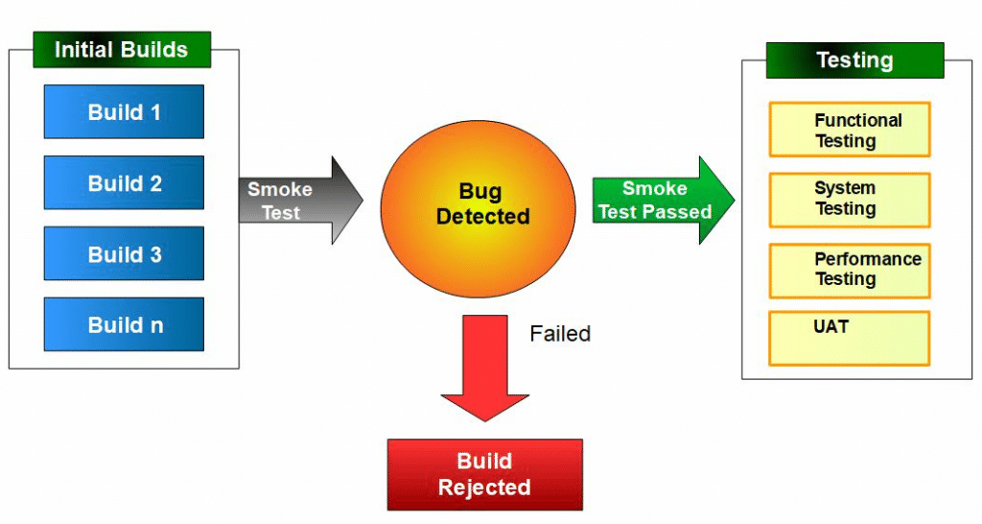
Test Categories
Regression Testing: re-run previous tests to make sure that nothing broke with new additions to the software. We are testing to make sure that the application did not “regress”.
Smoke Testing: preliminary testing to see if it is even worth our time to execute other tests (for example, if login is broken, you probably can’t do anything else either)
Sanity Testing: usually unscripted, and is a quick narrow
test on functionality to see if it is working at a glance

Slide 6
One-on-ones for Tomorrow
10 that were not selected is top priority
What questions were asked, what was your own impression after the interview, and given the knowledge now, do you think that you would pass on a second try?
Technical question
Agile/Scrum/SDLC (week 4 notes)
Testing Topics (types of tests, defect lifecycle, testing lifecycle, etc) (week 7 notes)
Selenium (syntax, general ideas)
TestNG (what annotations do we have, how are tests structured)
Cucumber (what types of files do we have related, what is the idea of BDD, etc.)
SQL (queries, conceptual knowledge of joins, clauses, SELECT FROM WHERE GROUP BY HAVING ORDER BY, etc.) (sqlzoo.net)
Java (potentially)

