Slide 1


JavaScript
JavaScript is a single-threaded, multi-paradigm, “prototype” object oriented language
Multi-paradigm: JavaScript can be run as a server-side application or a purely browser-based application
What is the most commonly used JavaScript engine used to run JavaScript?
V8! V8 is an engine developed by Google, which Chrome uses as well as Node.js
So, typically people think of JavaScript as interpreted. This means it is not a compiled language, but instead something known as an interpreter will read the code line by line, and then figure out what to do
So, this is not strictly true in modern JavaScript, especially for a cutting edge engine like V8.
Instead, V8 does what is known as JIT (just-in-time) compilation, whereby it actually does do compilation on the fly and execute these bits of compiled code as we go along. This helps make JavaScript more performant

Slide 2
Why is JavaScript so Weird????
One guy basically made JavaScript in 10 days
He really didn’t think it would become the most used language for the web
There were so many bugs and quirks with it, that just stuck over time and never got fixed
In particular, one example would be the hoisting of “var” variables
Which is just an artifact of the usefulness of hoisting functions

Slide 3
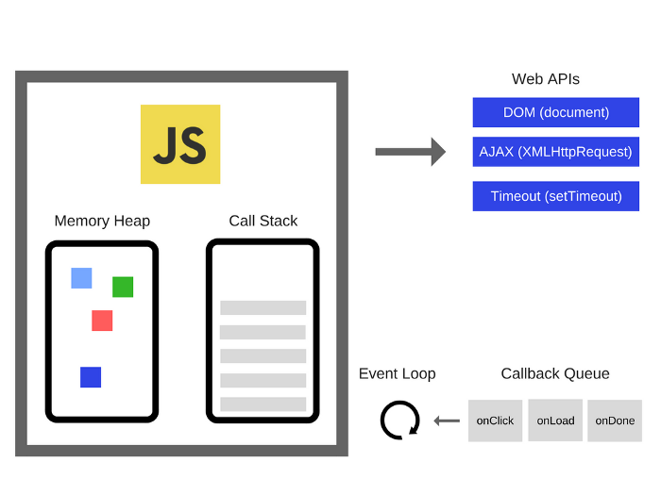
JavaScript Execution Environment
Every function running has its own execution context
Notice how in JS, we can have code that exists outside of functions
That code will be part of the Global EC
Every EC contains
The variable environment
Let, const, and var
Functions
The “arguments” object
The scope chain
For example, a nested function (a function inside another function), can access variables in the parent function as well as the global scope
this keyword
helloLog EC
Global EC

Slide 4
Scoping
Scopes in JavaScript are “lexical”, meaning that the variable scopes are controlled by the placement of functions and blocks
Global scope
Function scope
Block scope: (let and const in ES6)
The Scope chain keeps track of the chain of access that inner scopes have of the outer scopes
Everything that is nested deeper has access to everything in the outer

Slide 5
This keyword
This is a special variable that is created for each EC (aka every function)
It points to what is calling the function
So, if we call the function without having an object calling the function, this will be undefined (in strict mode)
‘this’ will refer to the window object in non-strict mode if you don’t have an object calling the function

Slide 6
ECMAScript v. JavaScript
ECMAScript: this is the standard for JavaScript. ECMA is the European Computer Manufacturer’s Association. They are the ones responsible for maintaining what standard JavaScript should conform to.
There are different versions of the ECMAScript standard. The higher the number, the more recent
ES6 is ECMAScript 6, which is the most significant update to JavaScript
Adds the idea of let and const variable declarations
Adds arrow functions
Adds class declarations
Template Strings
Destructuring
Etc.

Slide 7
Ways to declare functions
function <function name>() {}: a normal function declaration
let x = function() {}: anonymous function being assigned to a variable
() => {}: arrow functions
Arrow functions treat ‘this’ differently
It uses the ‘this’ from its parent EC, instead of having its own

Slide 8
Prototypal inheritance
In JavaScript we have this idea of prototypal inheritance
This is different than the “class as a blueprint” and objects as an instance model of OOP
So, JavaScript does not follow the classical OOP like Java does
Every object has a __proto__ property, which is linking to some other object from which methods can be used
In the case of function constructors, these functions have a prototype property that is an object w/ a collection of methods
Car1 object
__proto__
Car.prototype

Slide 9
HTML/CSS/JavaScript
HTML is the noun
CSS is the adjective
JavaScript is the verb

