Slide 1
Ship Manager (Pirate) Project Revamped

Slide 2
User Stories
As a user, I would like to be able to log in and see the ships that belong to me
As a user, I would like to be able to add a new ship of a certain type. Whenever this ship is created, it should have a status of pending
As an admin, I should be able to log in and see which ships need to be approved for construction

Slide 3
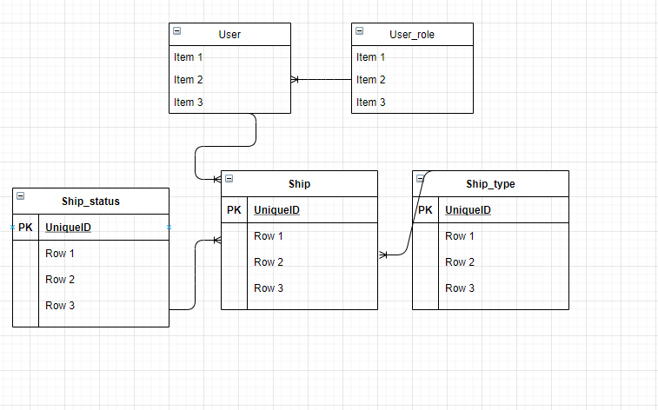
Entity Relationship Diagram (ERD)

Slide 4
Endpoints
For all users:
POST /login
POST /user/1/ship: add a ship
GET /user/1/ship: get all ships
For Admins:
PATCH /user/1/ship/10?action=approve
PATCH /user/1/ship/10?action=deny

