Slide 1

ROSA THE SHOPPING ASSISTANT ROBOT
Gabriel Alfaro
Hassan Baraka

Slide 2
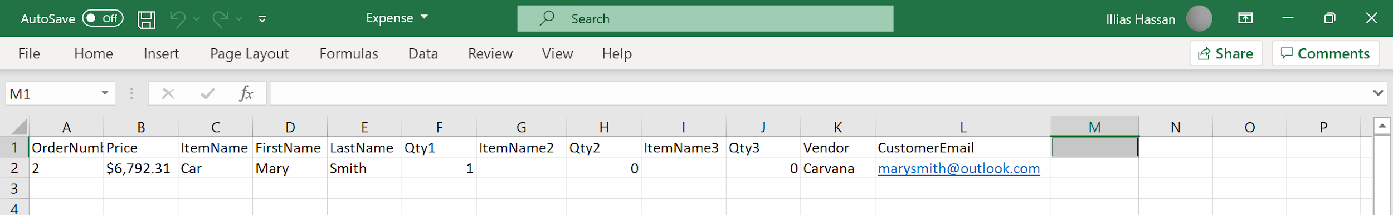
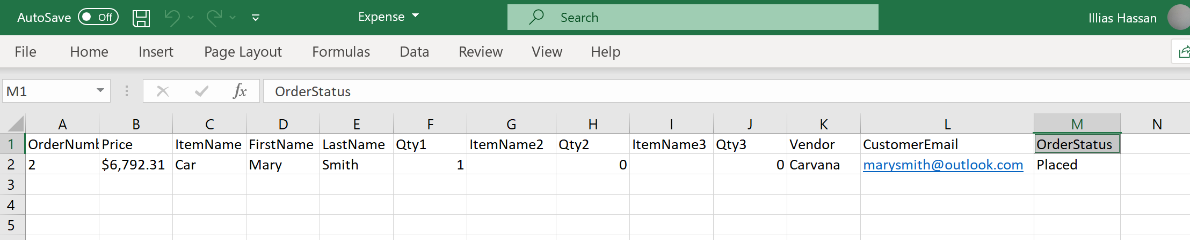
MVP:
1- Robot should be able to take client shopping lists and place orders on the appropriate vendors.

Slide 3
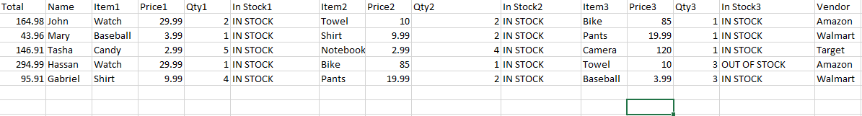
2- Robot should record the total expense of each shopping trip for each client

Slide 4
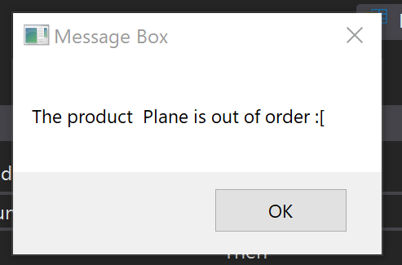
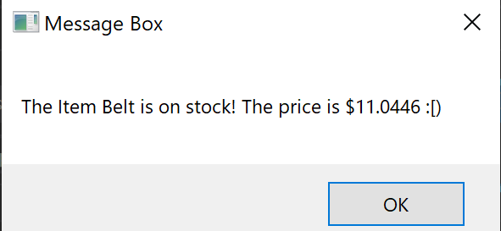
3- Robot should be able to record any items that were out of stock or not found

Slide 5
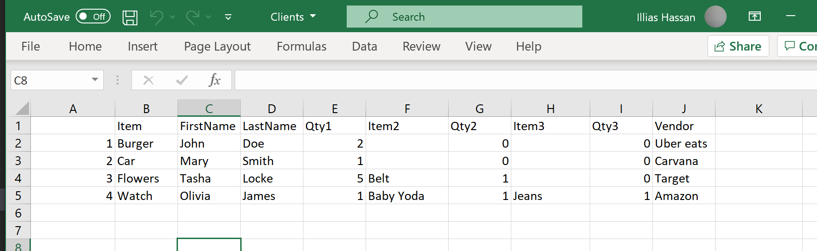
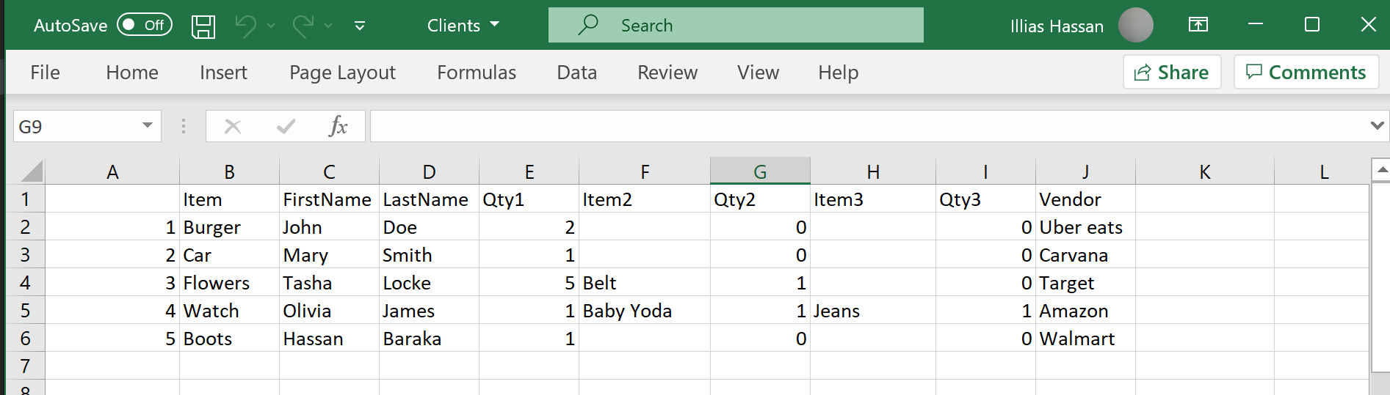
4- Robot should be able to add clients to the existing client list and take in their shopping order

Slide 6
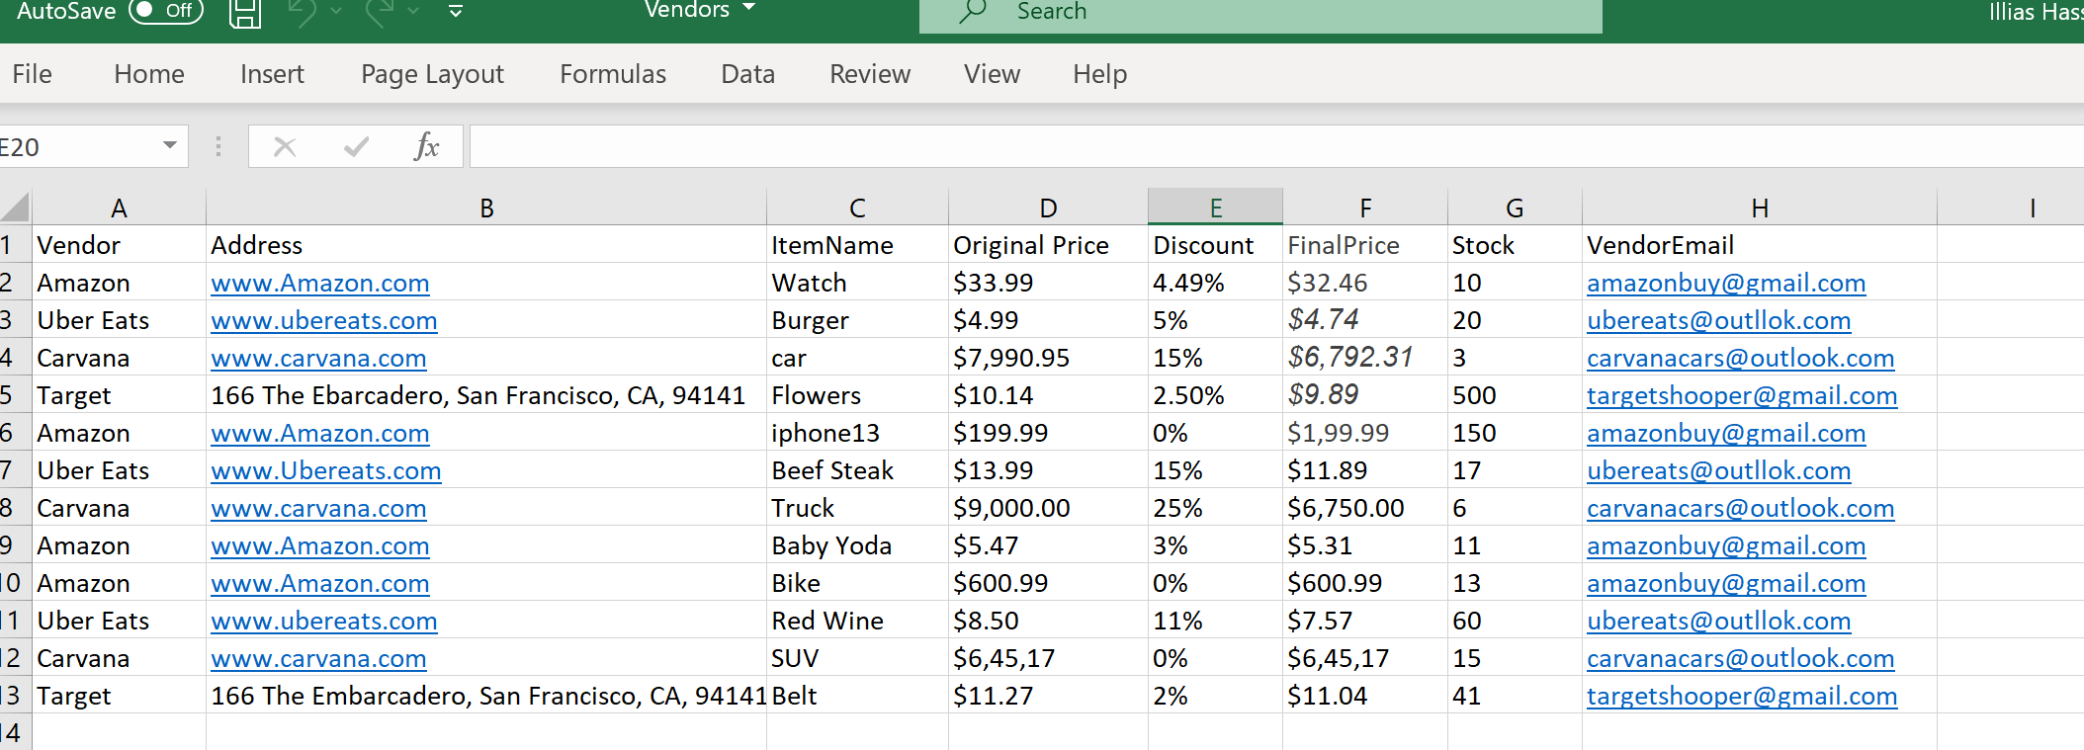
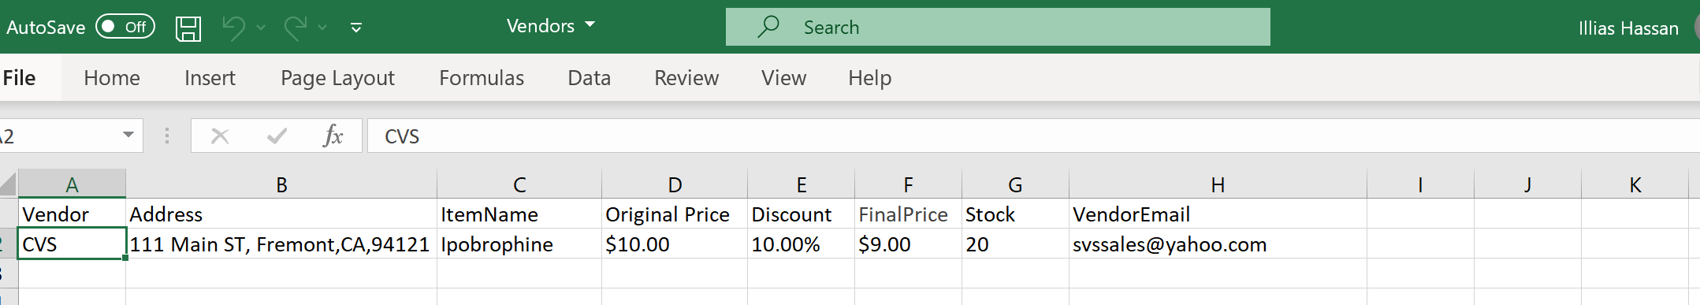
5- Robot should be able to add more vendors in the existing vendor collection

Slide 7
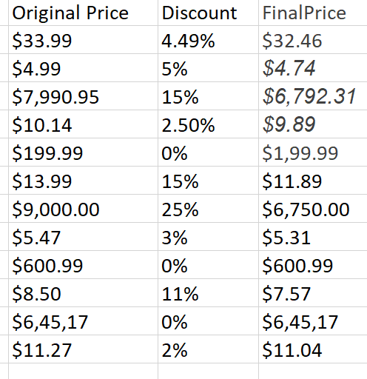
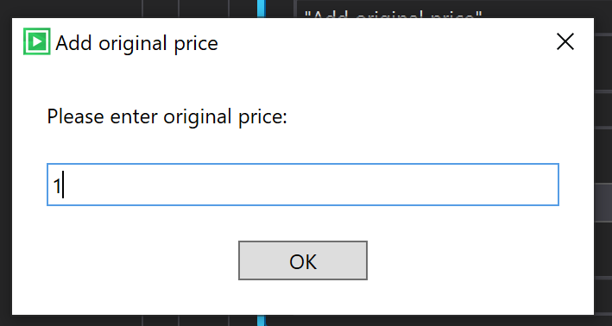
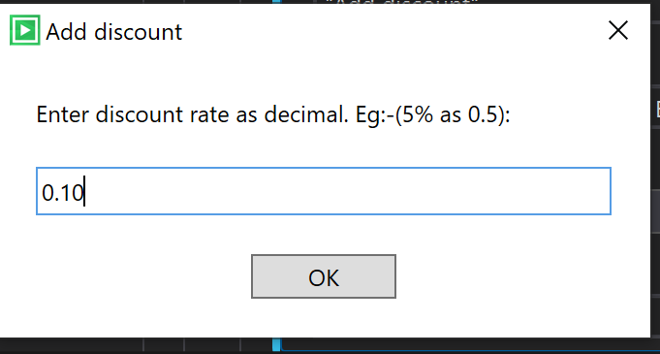
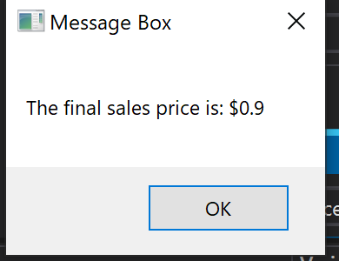
Robot should be able to take in account discounts noted by the vendors

Slide 8
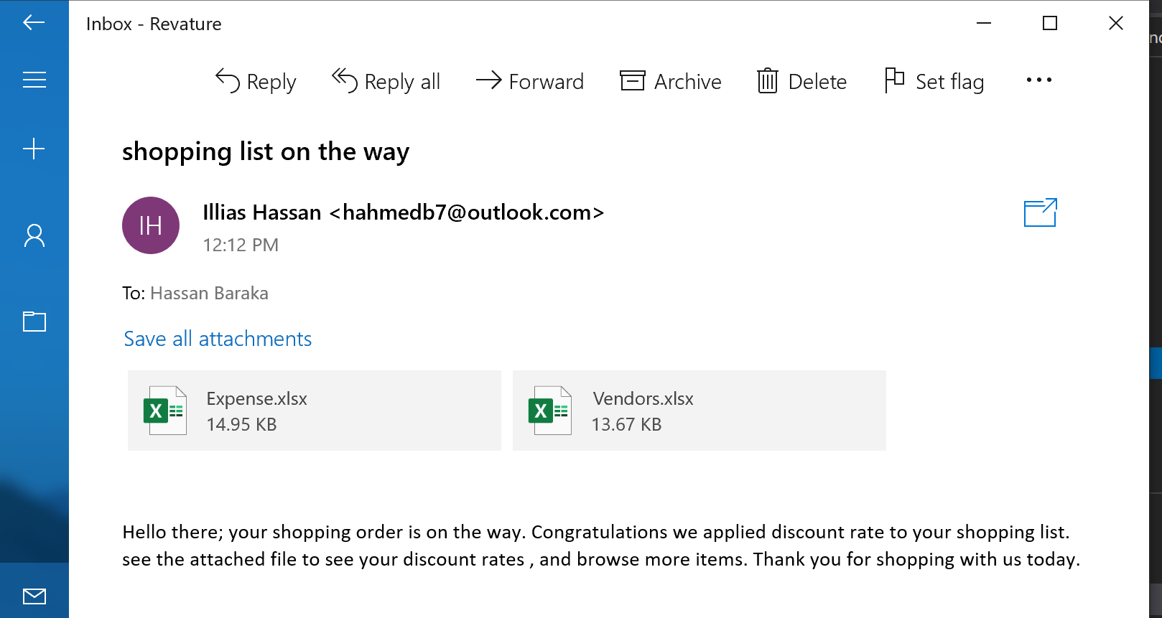
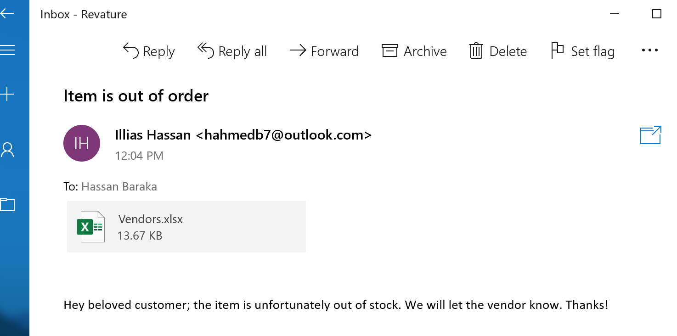
STRETCH GOALS:
Sending emails to clients about their shopping order
Notify clients about vendor discounts/sales

Slide 9
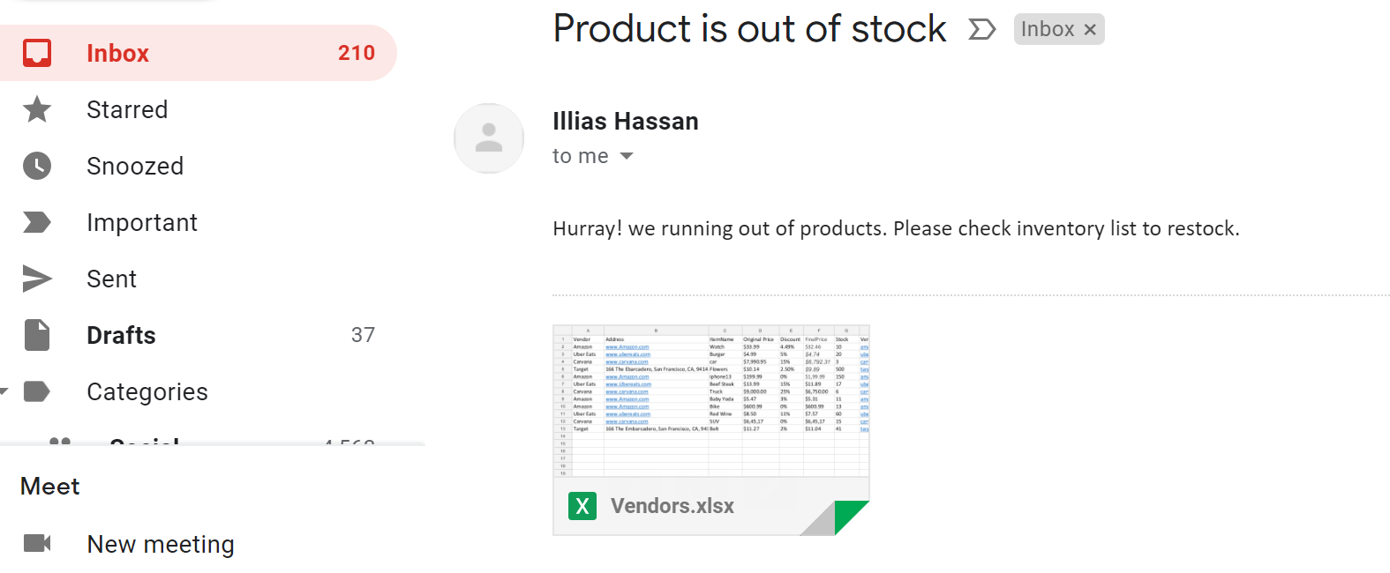
Email vendors about out-of-stock items

Slide 10
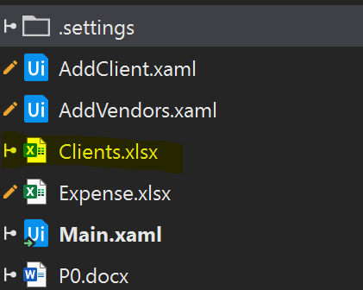
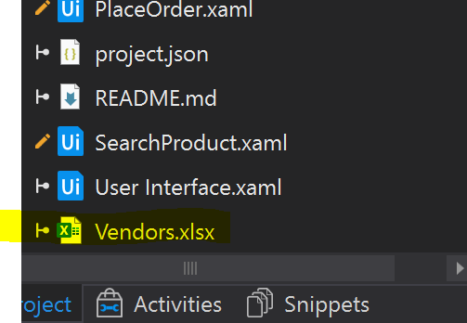
Vendor information should be stored in a worksheet
Constraints:
Client information should be stored in a worksheet:

Slide 11
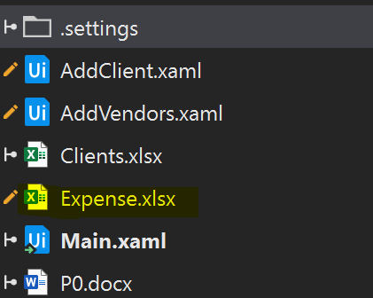
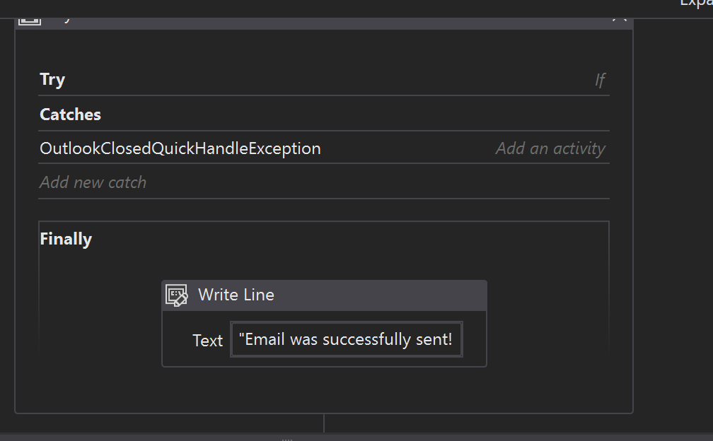
Automations should have exception handling enabled THE END.
Expense Reports should be stored in a worksheet

