Slide 1


Flowcharts
By: The Decepticons
Robots in Disguise

Slide 2
Overview
What Flowcharts Are?
Why Flowcharts are important?
When to use Flowcharts?
- Conditional Loops
How to use Flowcharts

Slide 3
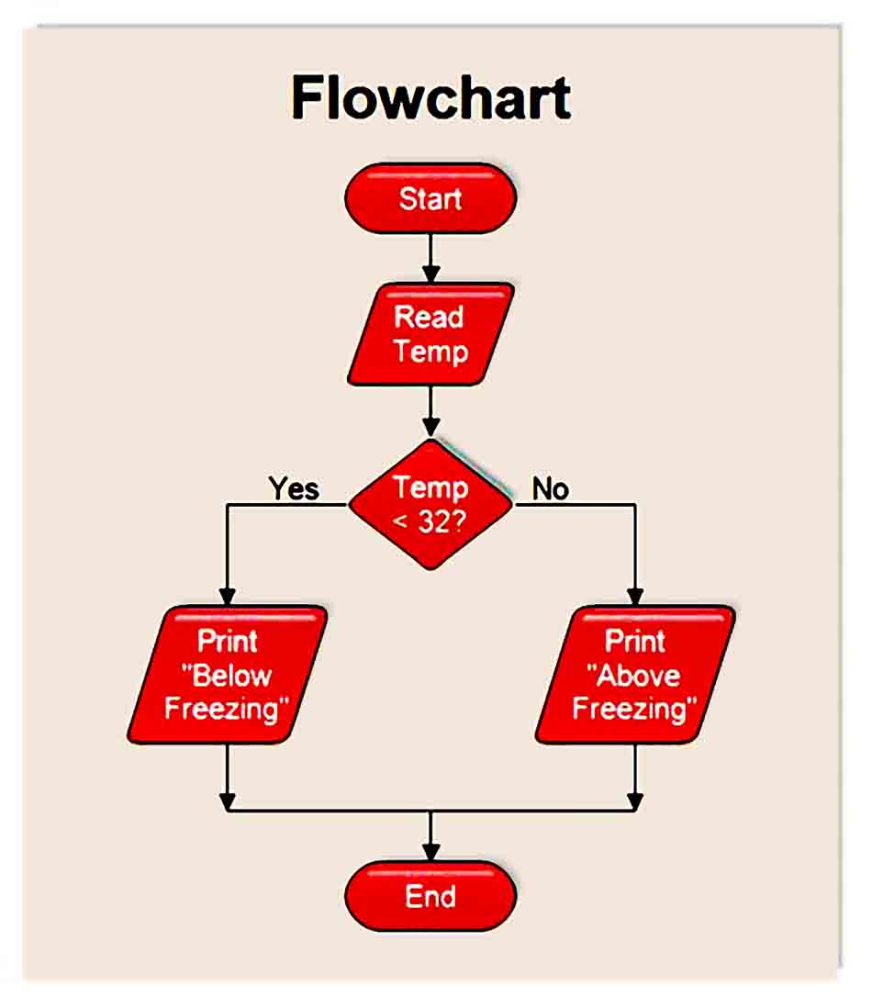
What are Flowcharts
Flowcharts are one of the four diagrams for integrating activities into a working structure
Unlike sequences, they present multiple branching logical operators, that enable you to create complex business processes and connect activities in multiple ways.
Flowcharts

Slide 4
Why Flowcharts are Important
Flowcharts offer more flexibility for connecting activities and tend to lay out a workflow in a plain two-dimensional manner.
Flowcharts are best suited for visually showcasing decision points within a process.

Slide 5
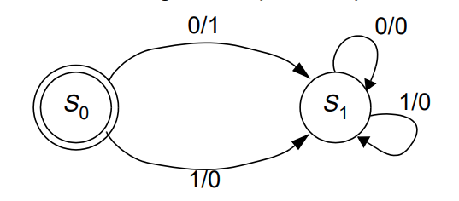
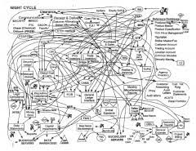
When to Use Flowcharts
Workflow
Flow Charts
State Machines
Flowcharts are basic structures, best suited for showcasing decision points within a process
Large workflows in Flowcharts are prone to chaotic interweaving
State Machine are more complex structures that can be seen as a flowchart with conditional arrows, called transitions.
They enable a more compact representation of logic best suited for high-level process diagrams

Slide 6

Flowchart Activities
Flowchart Decision - A conditional statement based on the value of a Boolean being True or False
Flowchart Switch - A switch statement that depends on a case

Slide 7
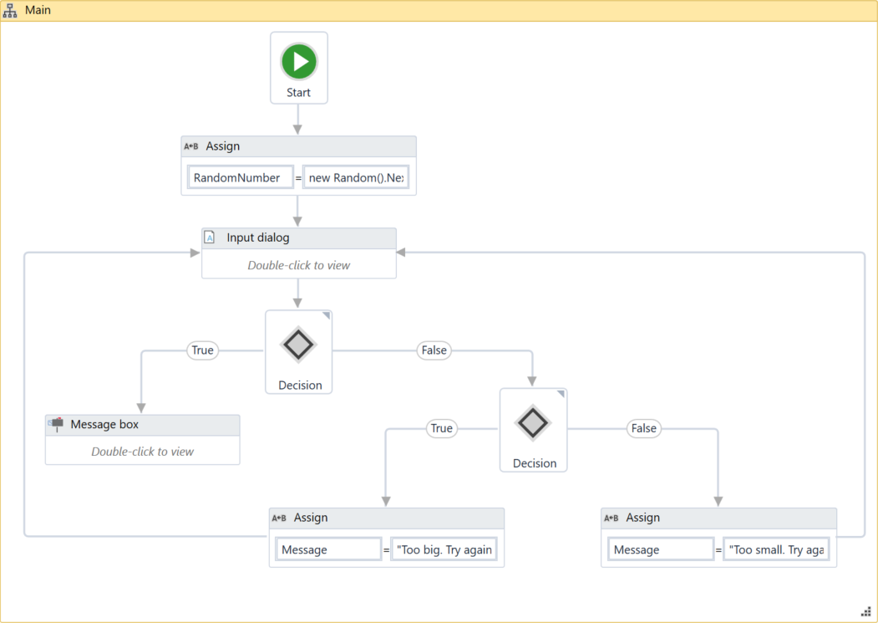
How to use a Flowchart
Using a Flowchart with the Message Box, and Input Dialogue
Creating a Random Number Generator loop, through a flowchart
Step-by-Step Random Num Generator

Slide 8
Discussion Questions
What are Flowcharts?
How to create a Flowchart?
In what situation can a Flowchart be used?
When to use a Flowchart over a Sequence? .. Over State Machine?

