Slide 1
BIOHARBOR
“Discover Your Wellness Sanctuary at BioHarbor”

Slide 2
TEAM MEMBERS
2110030056 -B.Akshita
2110030059 -K.PAANI chowdary
2110030147 -G.MAHITHA
2110030457 -V.CHARISHMA

Slide 3
Agenda
INTRODUCTION
OBJECTIVE
SCOPE
KEY FEATURES
STAKE HOLDERS

Slide 4
Agenda
MARKET ANALYSIS
FINANCIAL ANALYSIS
PARTNERS AND COLLABORATIONS
FUTURE WORK
CONCLUSION

Slide 5

Introduction
BioHarbor, a pioneering startup dedicated to revolutionizing personalized health and wellness. In an age where individual health needs are increasingly recognized as unique and multifaceted, BioHarbor emerges as a beacon of innovation, offering comprehensive solutions tailored to each person's specific requirements.

Slide 6
Objective
Our mission is to empower individuals to take control of their well-being by providing expert dietary guidance, offering a curated selection of high-quality health products, and delivering cutting-edge genetic testing services.
Whether you're managing a medical condition, seeking weight management support, or aiming to optimize your health through preventive measures, BioHarbor is here to guide you on your journey towards a healthier, happier life.

Slide 7
Scope
Personalized Health Solutions: BioHarbor aims to offer a wide range of personalized health solutions tailored to individual needs, including personalized dietary guidance, genetic testing services, and specialized wellness products.
Target Audience: The scope of BioHarbor extends to a diverse range of individuals seeking proactive approaches to managing their health, including those with chronic conditions, individuals interested in preventive healthcare, and those looking to optimize their well-being.
Market Expansion: BioHarbor's scope includes expansion into both local and global markets, leveraging advancements in technology to reach a broader customer base and provide personalized health solutions to individuals worldwide.

Slide 8
Key Features
1. Genetic Analysis:
Partner with genetic testing companies to offer customers the option of submitting genetic data for a more precise understanding of their nutritional needs. Use this information to identify potential genetic predispositions and tailor supplements accordingly.
2. Customizable Subscription Plans:
Offer subscription plans that deliver monthly supplies of personalized supplements to customers' doorsteps. Allow users to modify their subscription plans based on changing health goals or preferences.
3. Continuous Monitoring:
Integrate a monitoring system that tracks users' progress over time. Leverage feedback from users, as well as any updated health information, to adjust and optimize supplement formulas for ongoing effectiveness.
4. Ingredient Transparency:
Emphasize transparency in ingredient sourcing and production processes. Provide detailed information about the sources, quality, and benefits of each ingredient used in the personalized supplements.

Slide 9
Stake HOLDERs
• Healthcare professionals
• Nutritionists
• Dietitians
• Genetic Testing Partners
• Food and wellness product suppliers

Slide 10
Market Analysis
Rising Demand for Personalized Health Solutions: Increasing consumer interest in tailored approaches to health and wellness presents a significant market opportunity for BioHarbor.
Growing Prevalence of Chronic Diseases: The global rise in chronic conditions underscores the need for proactive healthcare measures, aligning with BioHarbor's focus on preventive health solutions.
Advancements in Genetic Testing Technology: Technological advancements have made genetic testing more accessible, enabling BioHarbor to offer valuable insights into individuals' genetic predispositions for various health conditions.
Increasing Consumer Interest in Wellness: A rising consumer interest in wellness and holistic health solutions aligns with BioHarbor's comprehensive approach to well-being, encompassing diet, genetics, and lifestyle.

Slide 11
Market Analysis
Competitive Landscape: BioHarbor faces competition from both established players in the healthcare industry and emerging startups offering similar personalized health services.
Global Market Potential: With the increasing globalization of healthcare services, BioHarbor has the opportunity to expand its reach beyond local markets and tap into a global customer base.
Regulatory Considerations: Compliance with regulatory standards and guidelines is essential for BioHarbor to ensure the safety, efficacy, and legality of its health services and products.
Partnerships and Collaborations: Forming strategic partnerships with healthcare providers, research institutions, and technology companies can facilitate BioHarbor's growth and innovation in the personalized health space.
Customer Education and Engagement: Educating consumers about the benefits of personalized health solutions and engaging them through targeted marketing efforts are crucial for BioHarbor to attract and retain customers in a competitive market.

Slide 12
StATISTICS

Slide 13
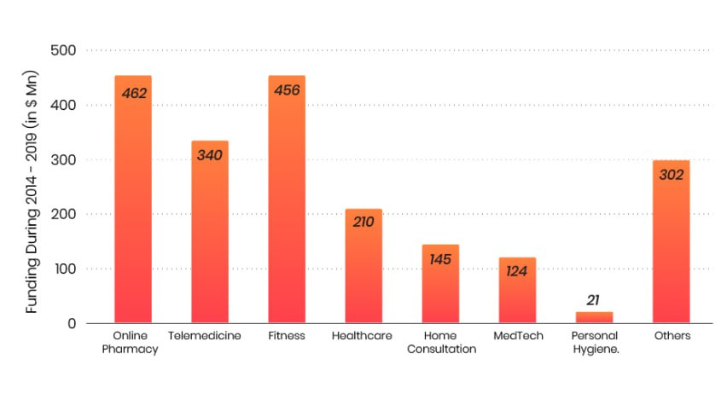
Health and Fitness apps prove investor favourite in India

Slide 14
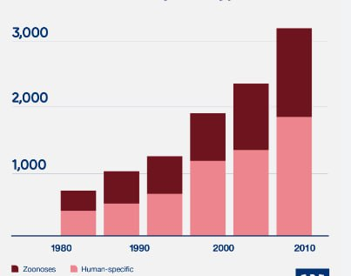
Disease outbreak by host type

Slide 15
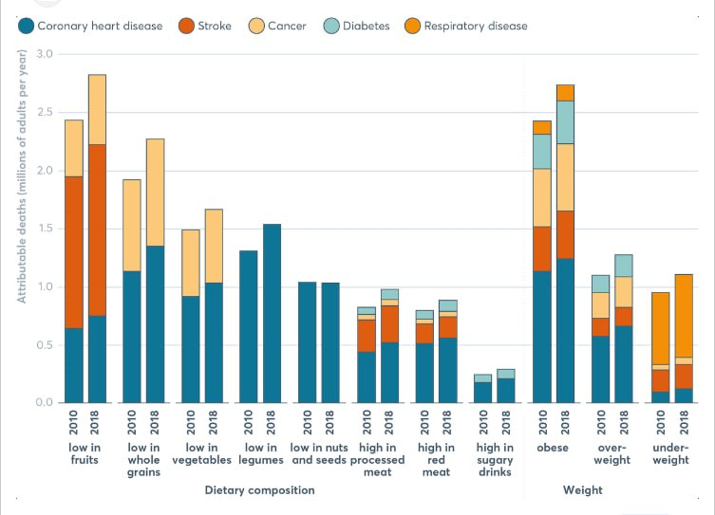
Global Nutrition Report

Slide 16
Financial Analysis
Revenue Projections:
Personalized Health Consultations: ₹15,00,000 annually
Genetic Testing Services: ₹11,25,000 annually
Wellness Product Sales: ₹7,50,000 annually
Cost Structure:
Staffing: ₹9,00,000 annually
Marketing: ₹2,25,000 annually
Technology Infrastructure: ₹1,50,000 annually
Regulatory Compliance: ₹1,12,500 annually
Product Sourcing: ₹3,75,000 annually

Slide 17
Financial Analysis
Profit Margin Analysis:
Personalized Health Consultations: 60%
Genetic Testing Services: 70%
Wellness Product Sales: 40%
Cash Flow Management:
Initial Investment: ₹30,00,000
Monthly Expenses: ₹2,50,000

Slide 18
Financial Analysis
Investment Requirements:
Startup Costs: ₹20,00,000
Ongoing Funding: ₹10,00,000 annually
Financial Projections:
Projected Annual Revenue: ₹33,75,000
Projected Annual Expenses: ₹17,75,000
Projected Annual Profit: ₹16,00,000

Slide 19
Partners And Collabrations
BioHarbor collaborates with healthcare providers, laboratories, technology companies, and research institutions to enhance its offerings and expand its reach.
These partnerships allow BioHarbor to leverage expertise, resources, and networks to drive innovation and growth.

Slide 20
Future Work
Implementation and Execution
Idea and Research
Business Development and Growth
Scaling and Expansion
Community Engagement and Brand Building

Slide 21
Future Work
Initiate the implementation phase to execute the operational plan and bring BioHarbor's services and products to market.
Establish operational processes, procure necessary resources, and launch marketing campaigns to attract customers and generate revenue.
Business Development and Growth:
Focus on business development efforts to expand BioHarbor's customer base and market presence.
Explore opportunities for strategic partnerships, collaborations, and alliances to enhance service offerings and reach new market segments.

Slide 22
Future Work
Technology Integration and Optimization:
Invest in technology infrastructure to streamline operations, enhance customer experience, and ensure data security and privacy.
Explore innovative technologies such as AI-driven health analytics and telemedicine platforms to improve service delivery and scalability.
Continuous Improvement and Adaptation:
Continuously monitor market trends, customer feedback, and competitive dynamics to identify opportunities for improvement and adaptation.
Regularly review and update operational processes, financial strategies, and marketing initiatives to optimize performance and maintain competitiveness.

Slide 23
Future Work
Scaling and Expansion:
Develop strategies for scaling BioHarbor's operations and expanding into new markets, both regionally and internationally.
Evaluate potential growth opportunities, including franchising, licensing, or opening new branches, to capitalize on market demand and maximize profitability.
Research and Innovation:
Invest in research and development initiatives to enhance service offerings, product development, and genetic testing technologies.
Stay abreast of advancements in personalized medicine, nutrition science, and genetic research to remain at the forefront of innovation in the industry.

Slide 24
Future Work
Community Engagement and Brand Building:
Engage with the community through health education initiatives, outreach programs, and social responsibility projects to build brand awareness and goodwill.
Foster strong customer relationships and brand loyalty through personalized communication, exceptional service, and ongoing support.

Slide 25

Conclusion
In conclusion, BioHarbor represents a groundbreaking venture poised to revolutionize the personalized health and wellness industry. Our strategic approach, backed by extensive market analysis and innovative solutions, positions us as a leader in delivering tailored health consultations, genetic testing services, and wellness products. With a relentless commitment to scientific rigor, compassionate care, and customer satisfaction, BioHarbor is dedicated to empowering individuals to optimize their well-being and lead healthier lives. As we embark on this journey, we invite you to join us in shaping the future of personalized health. Together, let's unlock the potential of genetic insights and personalized interventions to transform healthcare and improve lives worldwide.

Slide 26
Thank you

