Slide 1


Slide 2

Database Management Systems
Tracking System For
Missing Person
By
2110030351_H.Manasa
2110030352_T.Nikitha Reddy
2110030449_A.SriVarshini
2110039476_Sai Nived
Under the guidance of
-Mr. Sumit Hazra

Slide 3
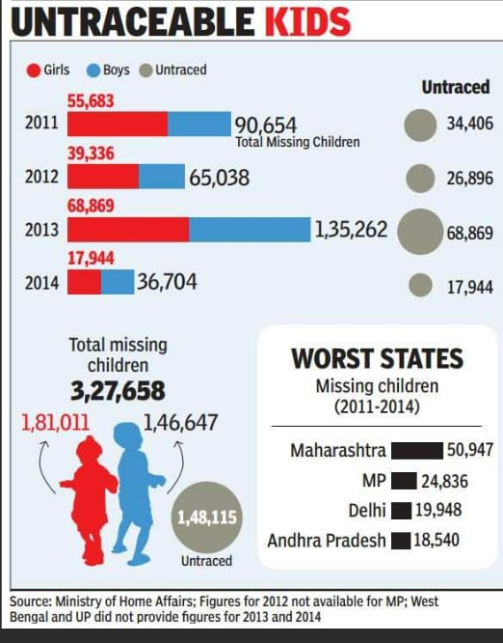
Problem statement and domain
More time is require for
launching an FIR in Police Station
to find lost person. Also during
manual process number of
manpower for searching lost
person is less.
To overcome from this ,
we wanted to develop an
application which makes the
task easier to find the missing
person.

Slide 4
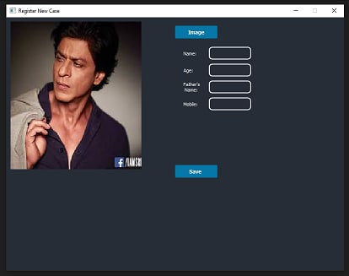
Existing solutions/ Naïve solutions
There are many lost and found systems which are more concerned with things like mobile phones, watches, wallets, etc.
The names of such systems are vFound, etc.
The US National Institute of Justice’s National Missing and Unidentified Persons System (NamUs) is a national centralized repository and resource center for missing persons.

Slide 5
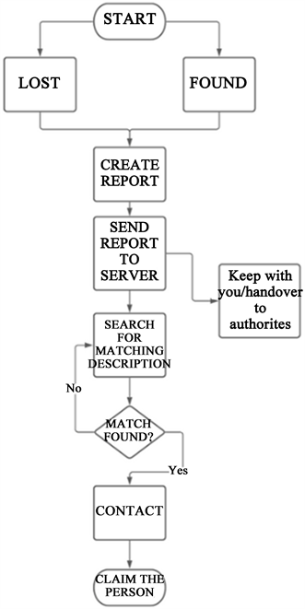
Proposed Algorithm Design Technique
Our web application takes requirerd information of a lost person and matches with the others , and then it displays the result.
The main advantage is that was easy to upload the complaint and view it.
And the drawback is that it requires internet connection and an Android phone with camera.

Slide 6
Data Structures needed
Database is responsible for storing all information in well-defined format. Also it responses to the queries fired by client to add, update, remove or search records. In Our project we have used
Eclipse
SDK
JDK
XAMPP Server with APACHE and MYSQL
PSP database to store information.

Slide 7

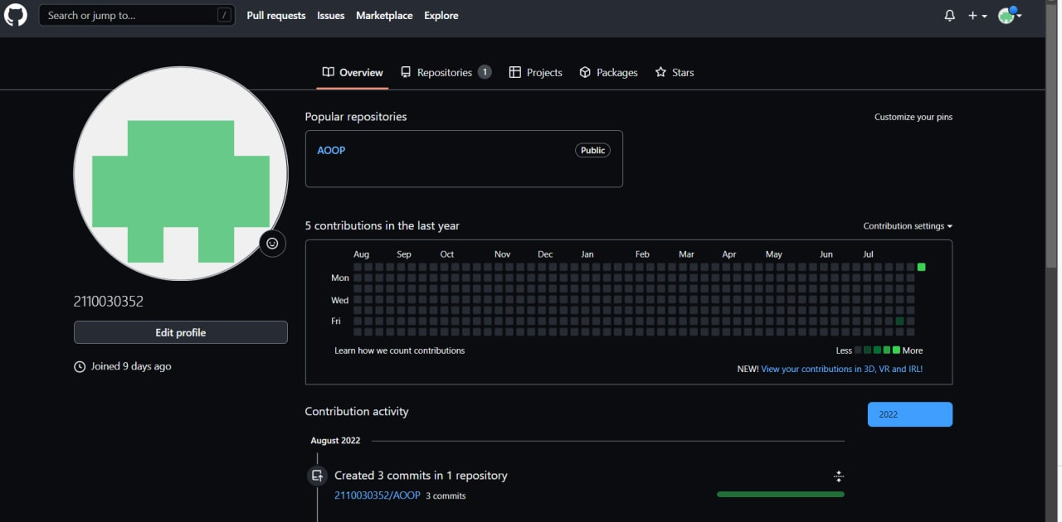
Github setup

Slide 8



Slide 9
Division of work among
the group members
2110030351 - H.Manasa -
2110030352 - T.Nikitha Reddy -
2110030449 - A.SriVarshini -
2110039476 - Sai Nived -

