Slide 1
How have we been running JavaScript?
Creating an html file and linking to a .js file
This .js file is then executed
Browser is executing the JavaScript
If we’re using Chrome, the V8 engine is what runs the JavaScript
“V8 is an open-source JavaScript engine developed by the Chromium Project for Google Chrome and Chromium web browsers”

Slide 2
Node.js
Node.js is another runtime environment for JavaScript that exists outside of the browser
Utilizes the V8 engine as well
It’s a way to execute JS without a browser
Ex: creating a backend server that is coded w/ JavaScript as the language
It’s also something that we commonly utilize with other tools in order to build various JavaScript based projects (such as Angular projects)
We will heavily utilize a tool called npm (node package manager)

Slide 3
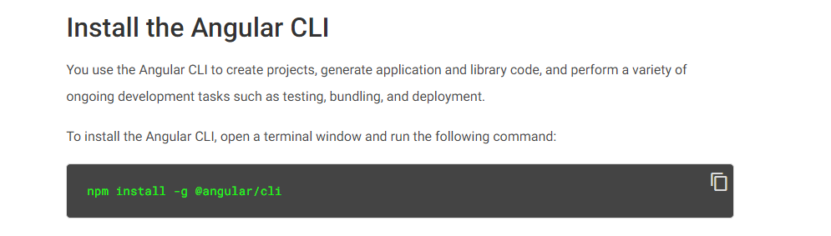
Angular CLI
Angular CLI = Angular Command line interface
When we install Angular CLI (using npm, node package manager), gives us the ng command that allows us to quickly create Angular projects and different “pieces” that we need for an Angular application
The –g flag when running the `npm install –g @angular/cli` basically is installing this CLI to our entire machine. –g = global

Slide 4
Creating an Angular Project
ng new <project name>
This will generate all of the files that form the “skeleton” of our Angular project

Slide 5
Important files/directories inside of Project folder
node_modules (folder/directory): contains all of the dependencies that the Angular project requires
Any dependencies that you install using `npm install` will be placed into the node_modules folder
node_modules can be large in size
So, we should not be pushing the node_modules folder to github
package.json: contains a list of all the dependencies that need to be installed (npm related file)
Analogous to the pom.xml file
When we are inside of the directory that contains the package.json file, we can run `npm install` with no other arguments to go ahead and install all of the necessary dependencies
Two types of dependencies:
dependencies: dependencies required in the final application
devDependencies: dependencies that are only required when you are developing the application (testing dependencies, etc.)
There is a scripts section inside of the file that will contain different “scripts” that you can run using `npm run <script name>`
These scripts will correspond to particular commands such as the start script being associated with ng serve
Ex. npm run start

Slide 6
Important files/directories inside of Project folder (continued)
package-lock.json: stores an “exact, versioned dependency tree”
Detailed version of package.json
angular.json: contains different settings for the angular project
src directory: contains the actual code that we will be working with primarily when developing an Angular application
HTML, TS, CSS
Index.html: this is the html file that will form the actual “single page” for our SPA (single page application)
main.ts: code that initially executes when first starting up an Angular application
styles.css: global styling file
assets directory: images and whatever other files you want to include will be stored here
App directory: the folder that contains our initial main component in the application

Slide 7
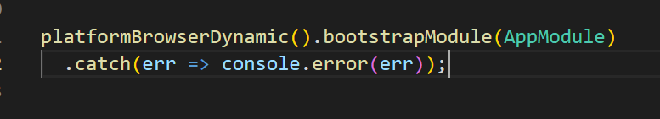
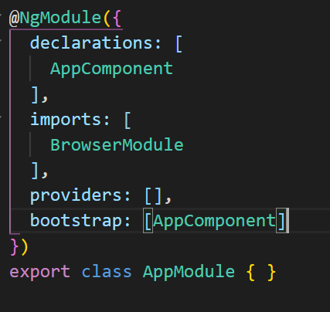
Angular Bootstrapping Process
When the index.html first loads up, the script tags for the .js files will be executed
The .js files contain all of the HTML, CSS, and other logic that is defined in the different components that we have
The code inside of main.ts is then executed. In particular, a module known as the AppModule is loaded up “or bootstrapped”
The AppModule file contains a property called bootstrap, which contains the AppComponent that needs to be instantiated and loaded into the DOM

Slide 8
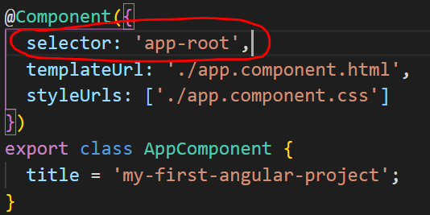
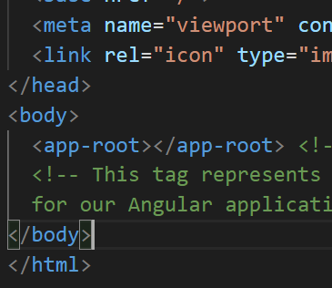
Angular Boostrapping Process (Continued)
Once the AppComponent is loaded up based on the boostrap property inside of AppModule, the “selector” property inside of AppComponent itself will be identified
Going back to the index.html, there is a tag called <app-root></app-root>
This directly corresponds with the “selector” property defined in the AppComponent
Therefore, Angular will take this component and render it in-place of the app-root tag

Slide 9
Angular Component files
4 different files associated with an Angular component
<component name>.component.html
Contains the HTML for our particular component
<component name>.component.css
Contains the CSS for our particular component
<component name>.component.ts
Contains all of the programming logic for our component
Utilizing TypeScript (JavaScript but with strong typing)
<component name>.component.spec.ts
For writing unit tests on our methods in our component.ts file

