Slide 1
Low Cost Waveguide Design

Slide 2
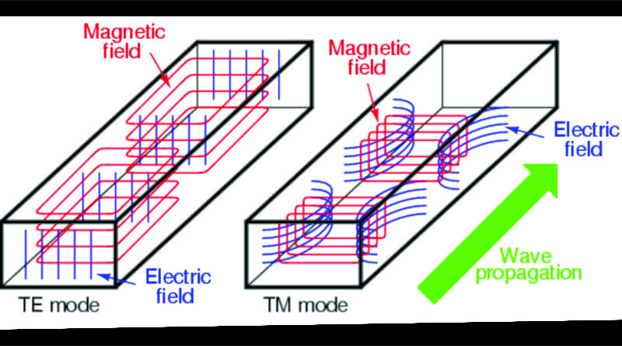
TE & TM Mode in Rectangular Waveguide

Slide 3
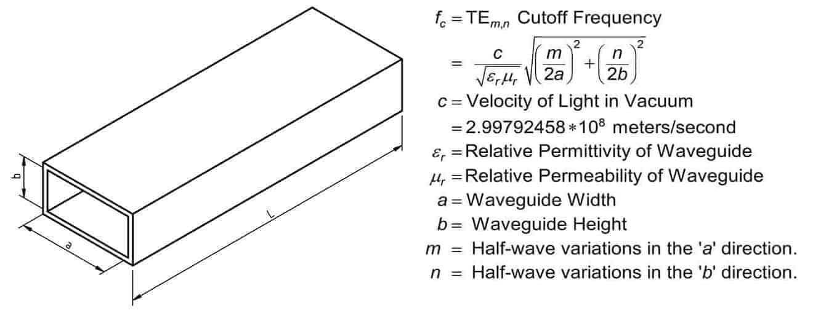
Cut-off Frequency

Slide 4
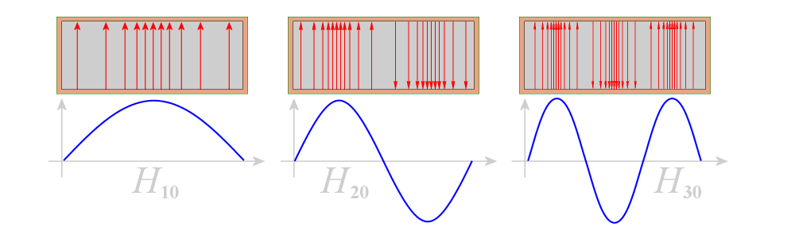
Different Type of TE modes

Slide 5
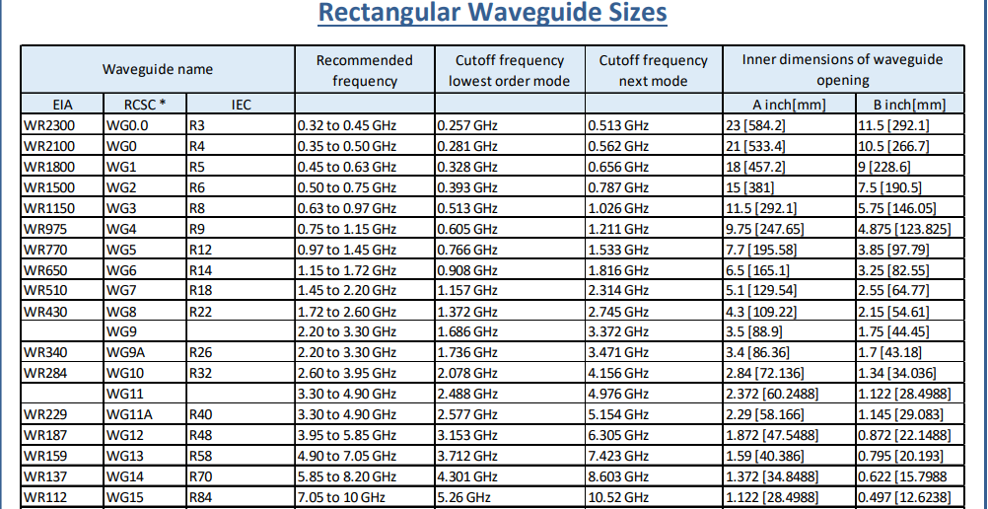
Size VS Frequency

Slide 6

Calculation
For TE mode, dominant mode is TE₁₀ mode because of having lowest cut off frequency.
From this equation,
f_{c,10} = 1.66 GHz if, a=9cm

Slide 7
Calculation
In suggested model, b is taken as 2 cm.
So, the value of a/b > √3 which is over √3 than next dominant mode after TE₁₀ is TE₂₀ .
For TE₂₀
f_{c,20} = 3.33GHz if, a=9cm
Magnetron having frequency of f₀ = 2.45GHz
As, f_{c,10} < 2.45GHz < f_{c,20}

Slide 8
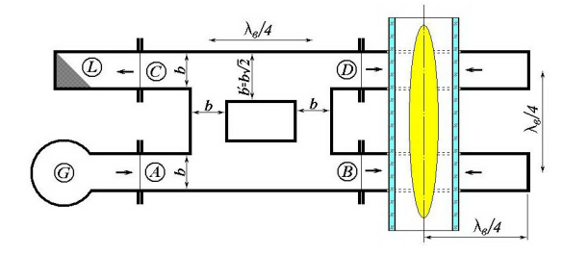
Suggested Model

Slide 9
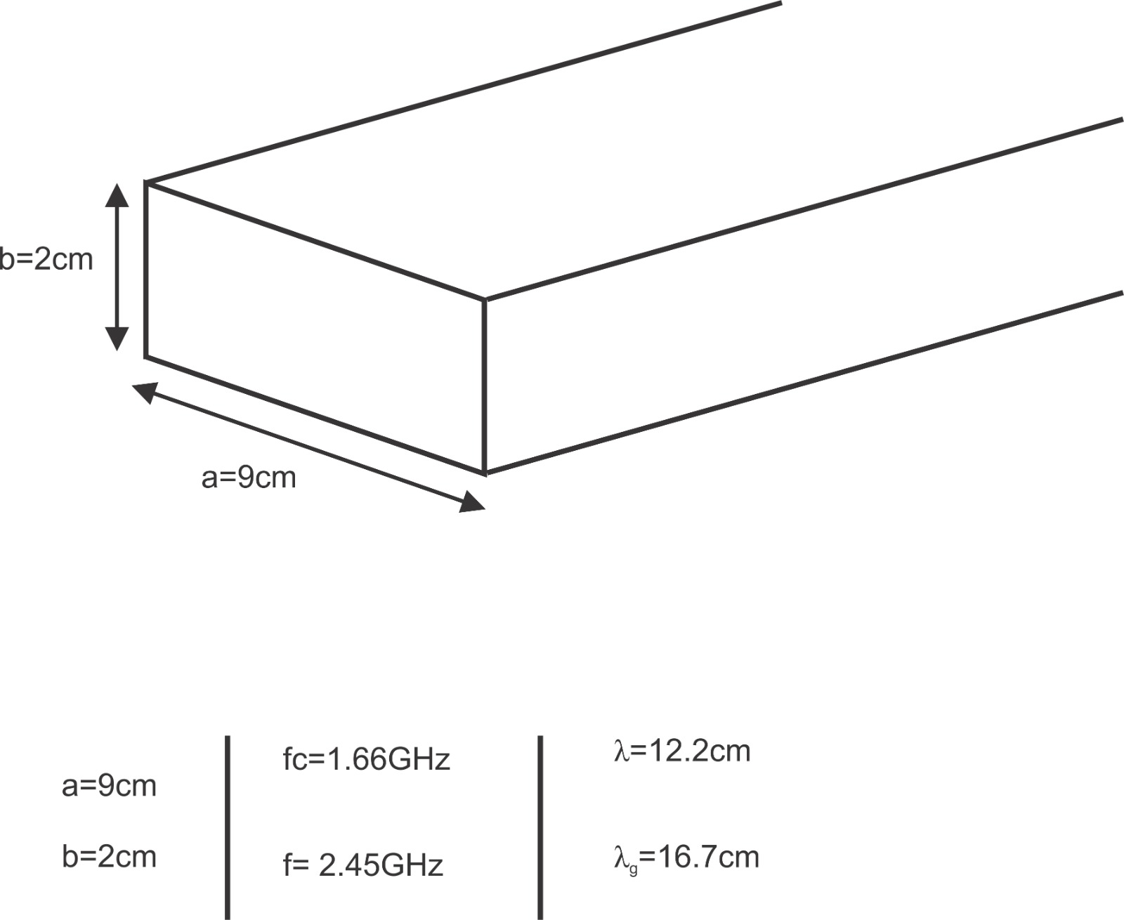
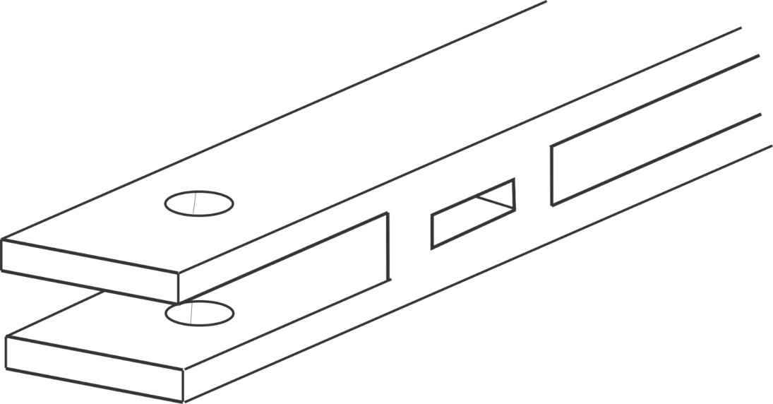
Suggested value of a and b

Slide 10
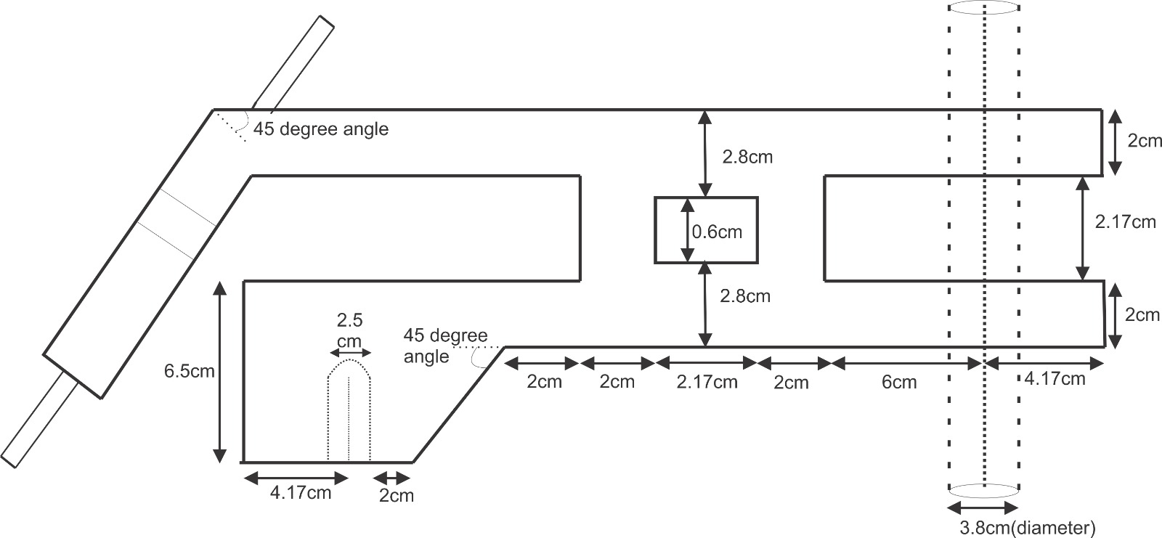

Slide 11

Reflection Coefficient and VSWR
The range of values for VSWR is from 1 to ∞ . A VSWR value under 2 is considered suitable for most antenna applications. The antenna can be described as having a “Good Match”. So when someone says that the antenna is poorly matched, very often it means that the VSWR value exceeds 2 for a frequency of interest.

Slide 12
Simulation Result

Slide 13
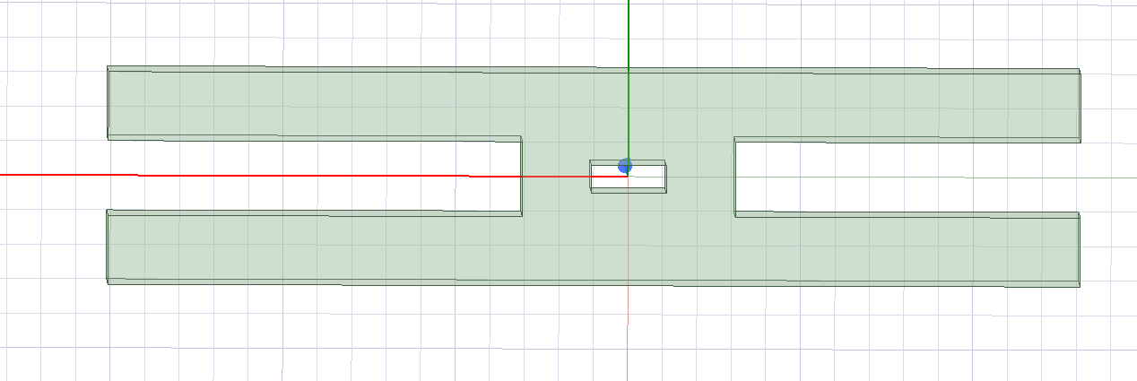
Waveguide Design in HFSS
b + λ_{guide} /4
λ_{guide} /4
b
Left Arm(LF)
Right Arm(LR)

Slide 14
Choosing the Value of a
Here,
b=17mm, LF=150mm, LR=120mm
a(mm) | S₁₁ | VSWR
89 | 0.09 | 1.21
90 | 0.02 | 1.03
91 | 0.06 | 1.12
92 | 0.13 | 1.28
93 | 0.18 | 1.44
94 | 0.23 | 1.58

Slide 15
Choosing value of Right Arm(LR)
When,
a=90mm, b=17mm, LF=150mm
L_{Right} (mm) | S11(Reflection Coefficient) | VSWR
100 | 0.53 | 3.25
110 | 0.53 | 3.25
120 | 0.01 | 1.02
130 | 0.42 | 2.44
140 | 0.65 | 4.71
150 | 0.79 | 8.52
160 | 0.87 | 14.38
Acceptable value of VSWR is less than 2.

Slide 16
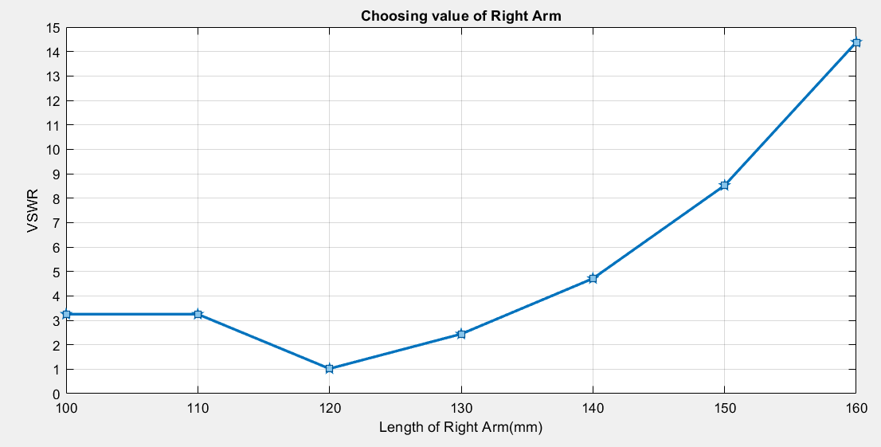

Slide 17
Tolerance of Right Arm(LR)
L_{Right} (mm) | S₁₁ (Reflaction Coefficient) | VSWR
118 | 0.12 | 1.27
119 | 0.08 | 1.17
120 | 0.01 | 1.02
121 | 0.05 | 1.10
122 | 0.10 | 1.22
Here,
LR= 120+-(2) mm is showing VSWR is within limit.

Slide 18
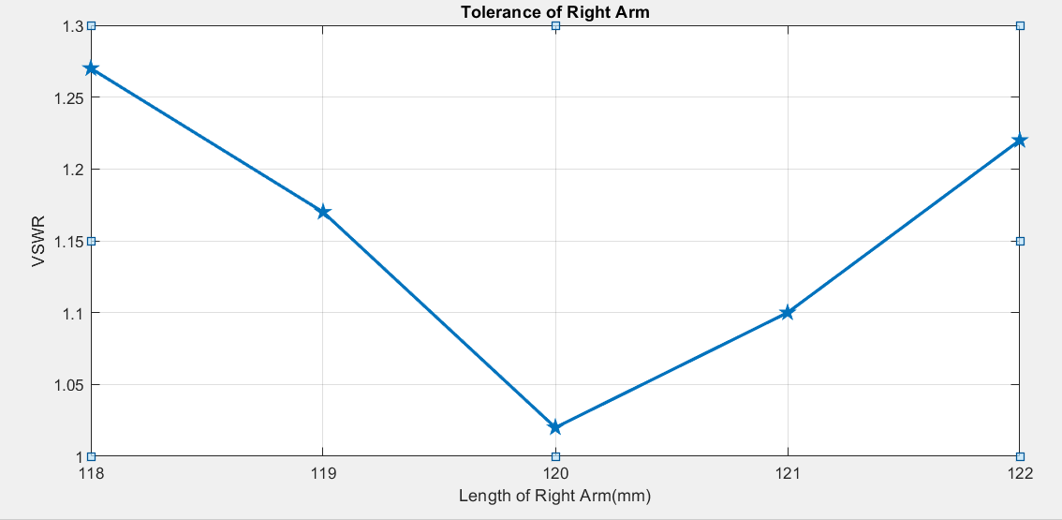

Slide 19
Choosing Value of Left Arm(LF)
When,
a=90mm, b=17mm, LR=120mm
LF(mm) | S11(Reflection Coefficient) | VSWR
100 | 0.02 | 1.04
120 | 0.02 | 1.04
140 | 0.01 | 1.02
160 | 0.01 | 1.02
180 | 0.02 | 1.04
According to simulation,
Left Arm(Magnetron Side) is showing there is negligible impact on VSWR.

Slide 20
Choosing value of b
When,
a=90mm, LR=120mm, LF=150mm
b(mm) | S₁₁ (Reflection Coefficient) | VSWR
15 | 0.05 | 1.10
16 | 0.04 | 1.08
17 | 0.02 | 1.04
18 | 0.02 | 1.04
19 | 0.04 | 1.08
20 | 0.05 | 1.10
21 | 0.07 | 1.15
22 | 0.09 | 1.19
23 | 0.10 | 1.22

Slide 21
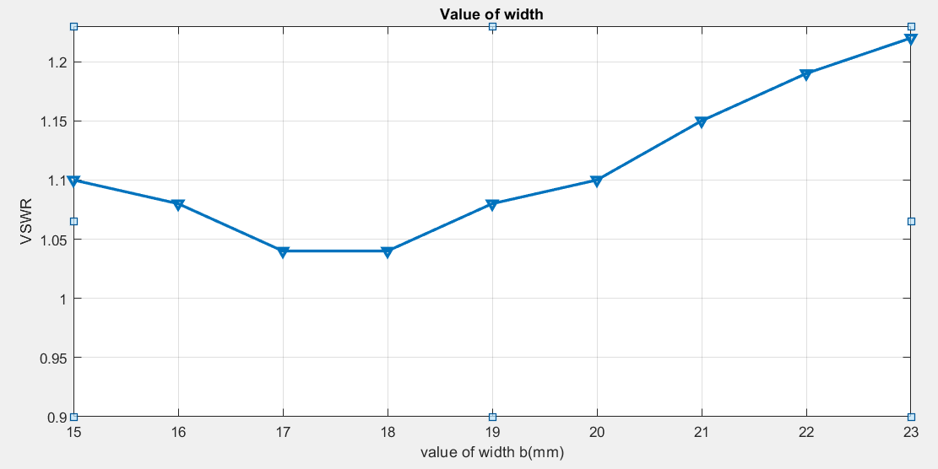

Slide 22
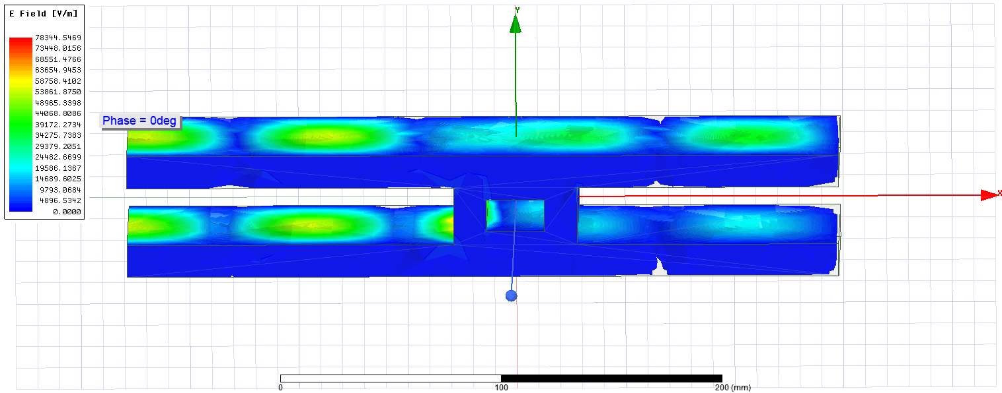
When b=15mm

Slide 23
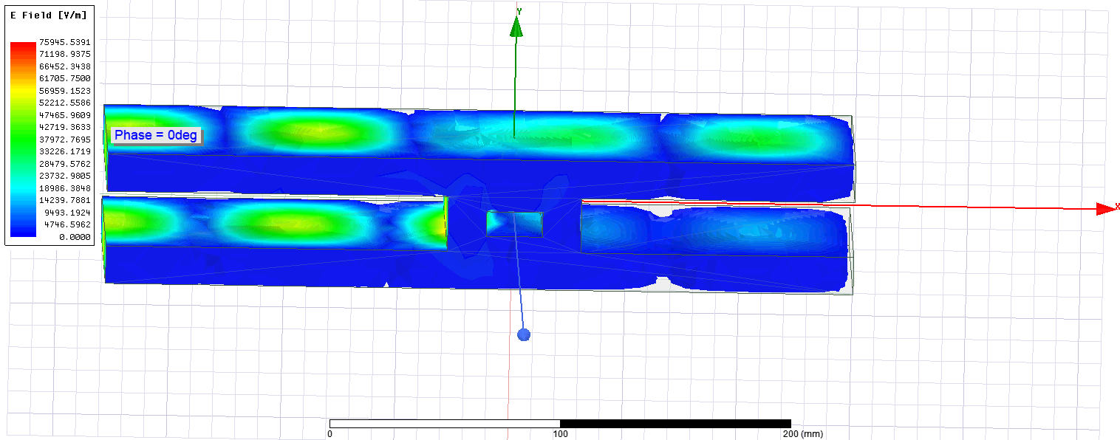
When b=17mm

Slide 24
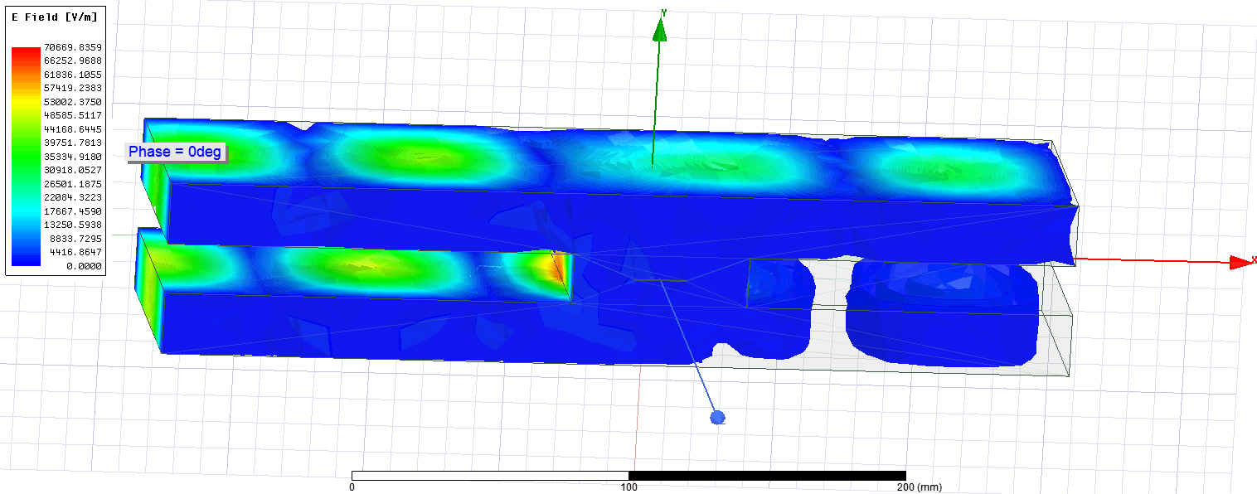
When b=23mm

Slide 25
LR Value Calculation
N*λ_{guide} /2
12mm
approx.
λ_{guide} /4+b
LR
N*λ_{guide} /2 = LR + λ_{guide} /4+b – 12
83.4*N = LR + 41.7+17-12
LR = 83.4*N – 46.7 mm
For
N = 2; LR =120mm
N = 3; LR =204mm
N = 4; LR =287mm
Here,
b=17mm
λ_{guide} = 166.8 mm
*NB: Calculated value will provide lowest VSWR

Slide 26
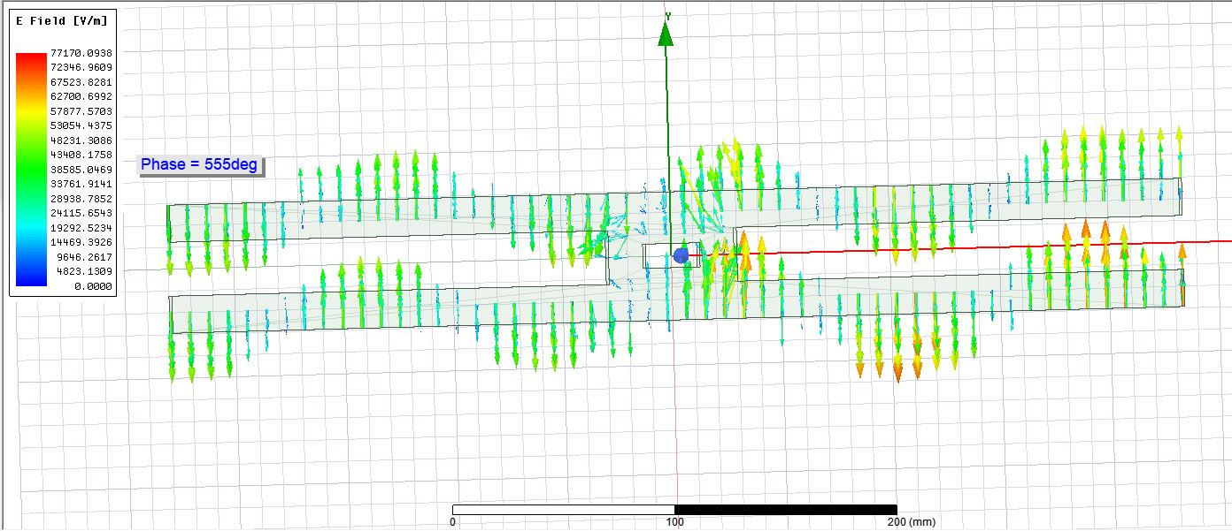
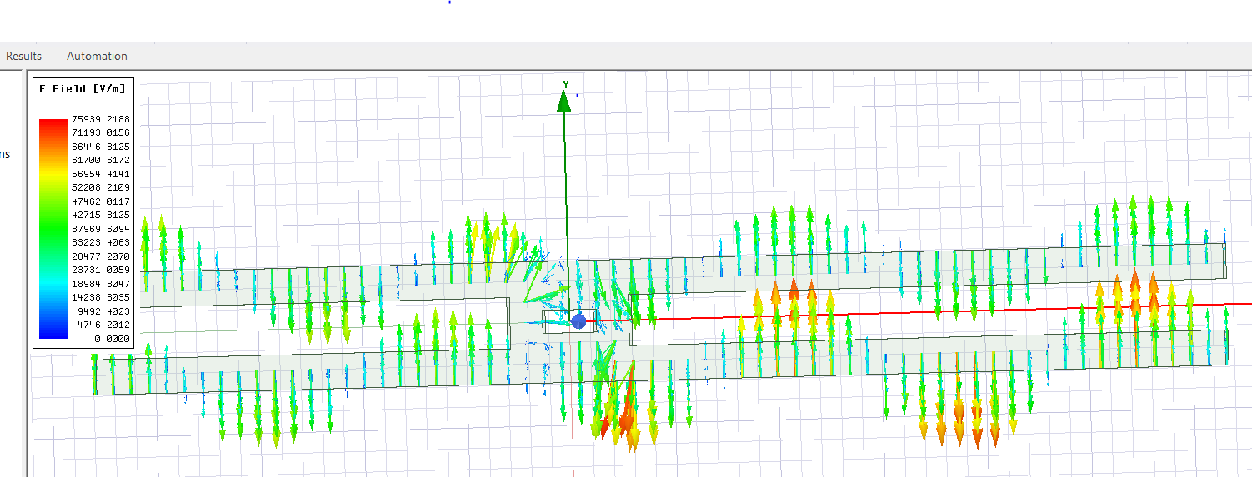
With LR=204mm & 287mm

Slide 27
Checking by Simulation
LR | S11 | VSWR | Max E field (V/m)
120 | 0.01 | 1.02 | 75,945
204 | 0.03 | 1.06 | 77,170
287 | 0.02 | 1.04 | 76,712

Slide 28
Discussion
According to the Simulation in Ansys HFSS,
we may choose,
a= 89-93 mm (for cut off freq)
b=15 to 20 mm ( Field intensity)
Right Arm = 83.4*N – 46.7 mm (b=17mm)
Left Arm = any (Negligible impact)

Slide 29
Possible Difficulties in Practical Application
Fabrication error during making.
Impact of Quartz tube and it’s thickness.
Position of Magnetron.
Temperature and humidity.

Slide 30
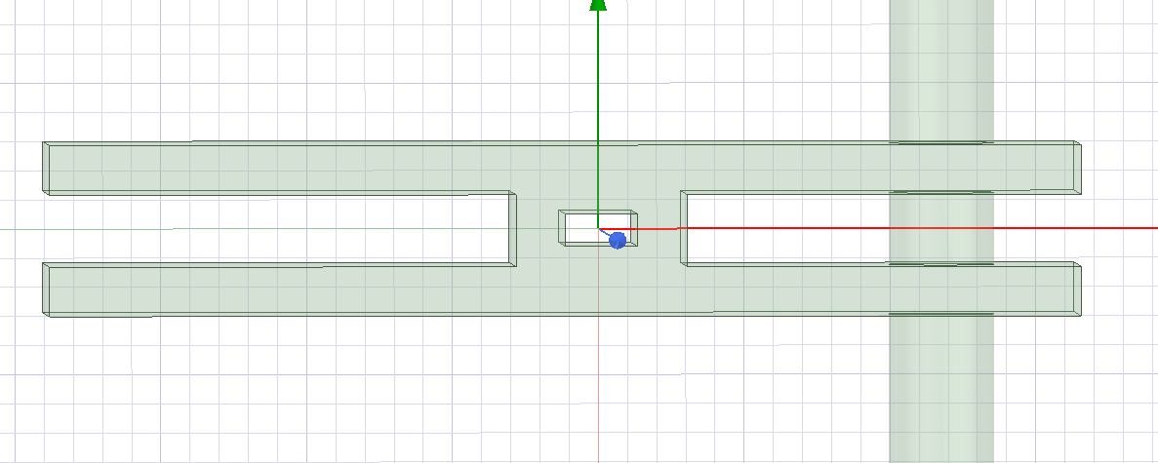
With Air Tube

Slide 31
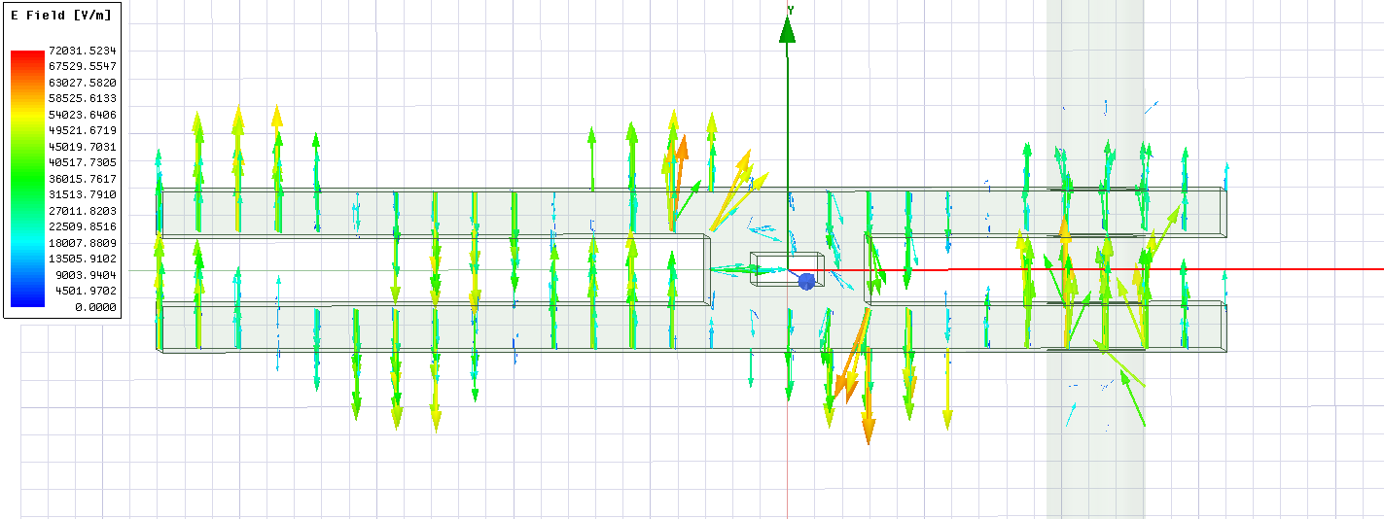
Electric Field

Slide 32
Simulation Result
LR(mm) | Radius(mm) | Position of tube for wall(mm) | S11
120 | 18 | 41.7+5 | 0.49
125 | 18 | 41.7+5 | 0.26
130 | 18 | 41.7+5 | 0.09
135 | 18 | 41.7+5 | 0.32

Slide 33
Effect of radius
Radius(mm) | LR(mm) |  | S11
18 | 130 |  | 0.09
12 | 130 |  | 0.33
12 | 125 |  | 0.12
5 | 125 |  | 0.24
5 | 120 |  | 0.03
0 | 120 |  | 0.02

Slide 34
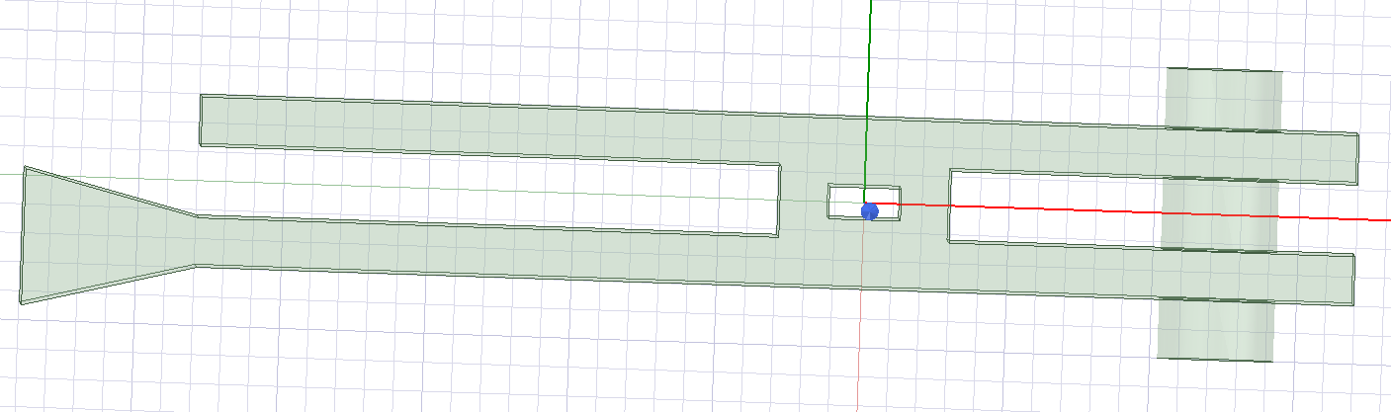
Practical POV of Magnetron side
Lower angle is showing better VSWR
Length of left arm is impacting VSWR which was not in the previous model.

Slide 35
Thank You

