Slide 1
OOP 2
Guided Exercises
GridLayout, GroupLayout
Week 7

Slide 2
Guided Problem No. 1
Create a JFrame class (GridLayout1) that contains 6 JButtons. Set the JFrame size to 300x200. Use GridLayout(3,2).
Later:
add 2 more JButtons to the JFrame
change column to 0

Slide 3
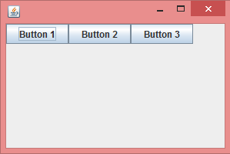
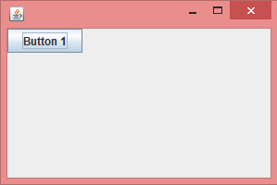
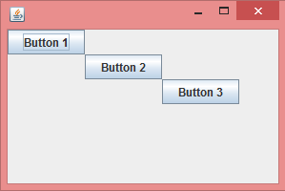
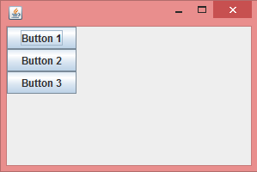
GroupLayout
layout.setHorizontalGroup(layout.createSequentialGroup() .addComponent(b1) .addComponent(b2) .addComponent(b3) ); layout.setVerticalGroup(layout.createParallelGroup() .addComponent(b1) .addComponent(b2) .addComponent(b3) );
layout.setHorizontalGroup(layout.createParallelGroup() .addComponent(b1) .addComponent(b2) .addComponent(b3) ); layout.setVerticalGroup(layout.createParallelGroup() .addComponent(b1) .addComponent(b2) .addComponent(b3) );
layout.setHorizontalGroup(layout.createSequentialGroup() .addComponent(b1) .addComponent(b2) .addComponent(b3) ); layout.setVerticalGroup(layout.createSequentialGroup() .addComponent(b1) .addComponent(b2) .addComponent(b3) );
layout.setHorizontalGroup(layout.createParallelGroup() .addComponent(b1) .addComponent(b2) .addComponent(b3) ); layout.setVerticalGroup(layout.createSequentialGroup() .addComponent(b1) .addComponent(b2) .addComponent(b3) );
Sequential
Parallel
Parallel
Parallel
Sequential
Sequential
Parallel
Sequential
Notes:
Horizontal – sequential ( o o o ) vs parallel ( o )
Vertical – sequential o vs parallel ( o )
o
o

Slide 4
Guided Problem No. 2
Similar to the figure on the right, create a JFrame class (GroupLayout1) that contains 3 JButtons inside a JPanel. Set the JFrame size to 300x200. Use GroupLayout for the JPanel.
Later, change the verticalGroup to SequentialGroup and observe the result

Slide 5
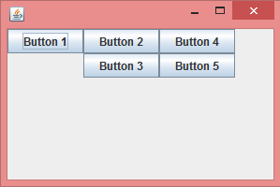
Guided Problem No. 3
Continue with the previous problem and make it similar to the figure below with 2 more JButtons added.
Notes:
//notice that there should now be 3 groups horizontally (group 1 has button1, group 2 has buttons 2&3, group 3 has buttons 4&5)
//notice that there should be 2 groups vertically (group 1 has buttons 1,2&3, group 2 has buttons 3&5)

Slide 6
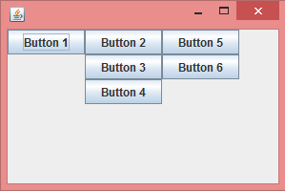
Guided Problem No. 4
Continue with the previous problem and make it similar to the figure below with 1 more JButton added.
Notes:
//notice that there should still be 3 groups horizontally (group 1 has button1, group 2 has buttons 2,3&4, group 3 has buttons 5&6)
//notice that there should now be 3 groups vertically (group 1 has buttons 1,2&5, group 2 has buttons 3&6, group 3 has button 4)

