Slide 1
Schola₹Shopy: A Second-Hand Marketplace for College Students
Internship Assessment Project
Presented by: Amar Gupta
Roll Number: 2100271540009
Ajay Kumar Garg Engineering College

Slide 2
Introduction
Objective: To create a cost-effective, secure platform for college students to buy and sell second-hand items.
Purpose:
- Save costs and time for students.
- Promote sustainability through reuse.
- Build a trustworthy student-exclusive marketplace.

Slide 3
Problem Statement
Challenges:
- High costs due to third-party involvement.
- Lack of secure platforms for student-exclusive transactions.
- Inefficient resource utilization and environmental waste.
Solution: A platform tailored for students to directly connect buyers and sellers.

Slide 4
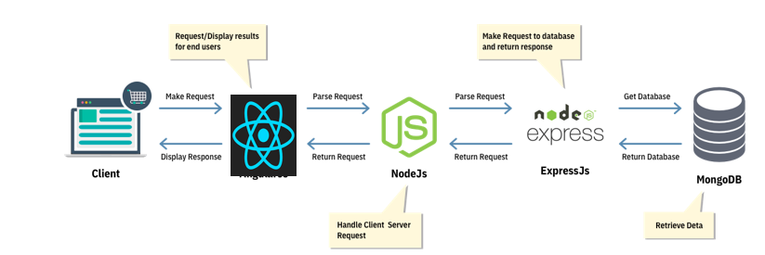
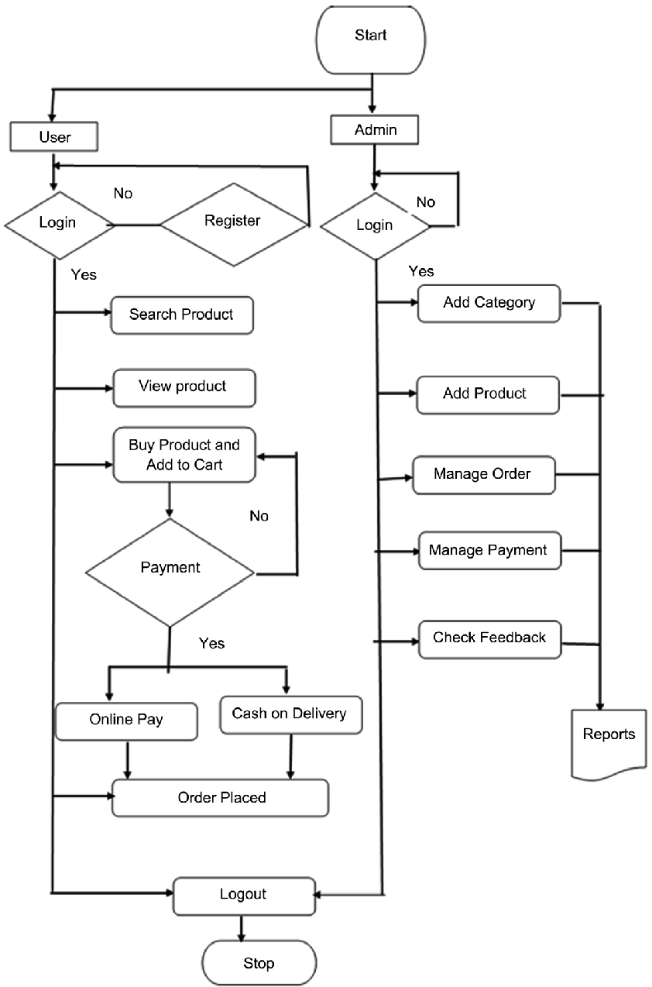
Technical Stack
Frontend:
- ReactJS for responsive design.
- Context API for efficient state management.
Backend:
- Node.js with Express for RESTful APIs.
- MongoDB for flexible data storage.
Integration:
- Gemini API for real-time pricing (future scope).
- Google Maps API for geolocation services
(future scope).

Slide 5
Key Features
1. User-Friendly Interface: Easy browsing, listing, and purchasing.
2. User Authentication & Security:
- JWT for secure sessions
- SSL/TLS encryption
- Bcrypt for password hashing
3. User/Admin Dashboards:
- Manage orders, profiles, and inventories.
4. Secure Payment Gateway: Razorpay integration (future scope).

Slide 6
Societal Impact
Sustainability Goals:
- Reduce waste and environmental pollution.
- Conserve resources by reusing products.
- Lower carbon emissions through decreased manufacturing.
Economic Benefits:
- Cost-effective solutions for students.
- Support for a circular economy.

Slide 7
Project Feasibility
Cost Efficiency:
Minimal setup requirements (only a computer or laptop needed).
Target Audience: College students seeking affordable resources.
Long-Term Impact: Enhanced resource utilization and eco-conscious behavior.

Slide 8
AI and Future Enhancements
AI Features:
- Machine Learning for personalized recommendations.
- Advanced analytics for inventory management (future scope).
Real-Time Chat: Direct communication between buyers and sellers (future scope).
Payment Gateway: PCI DSS-compliant secure transactions with Razorpay (future scope).

Slide 9
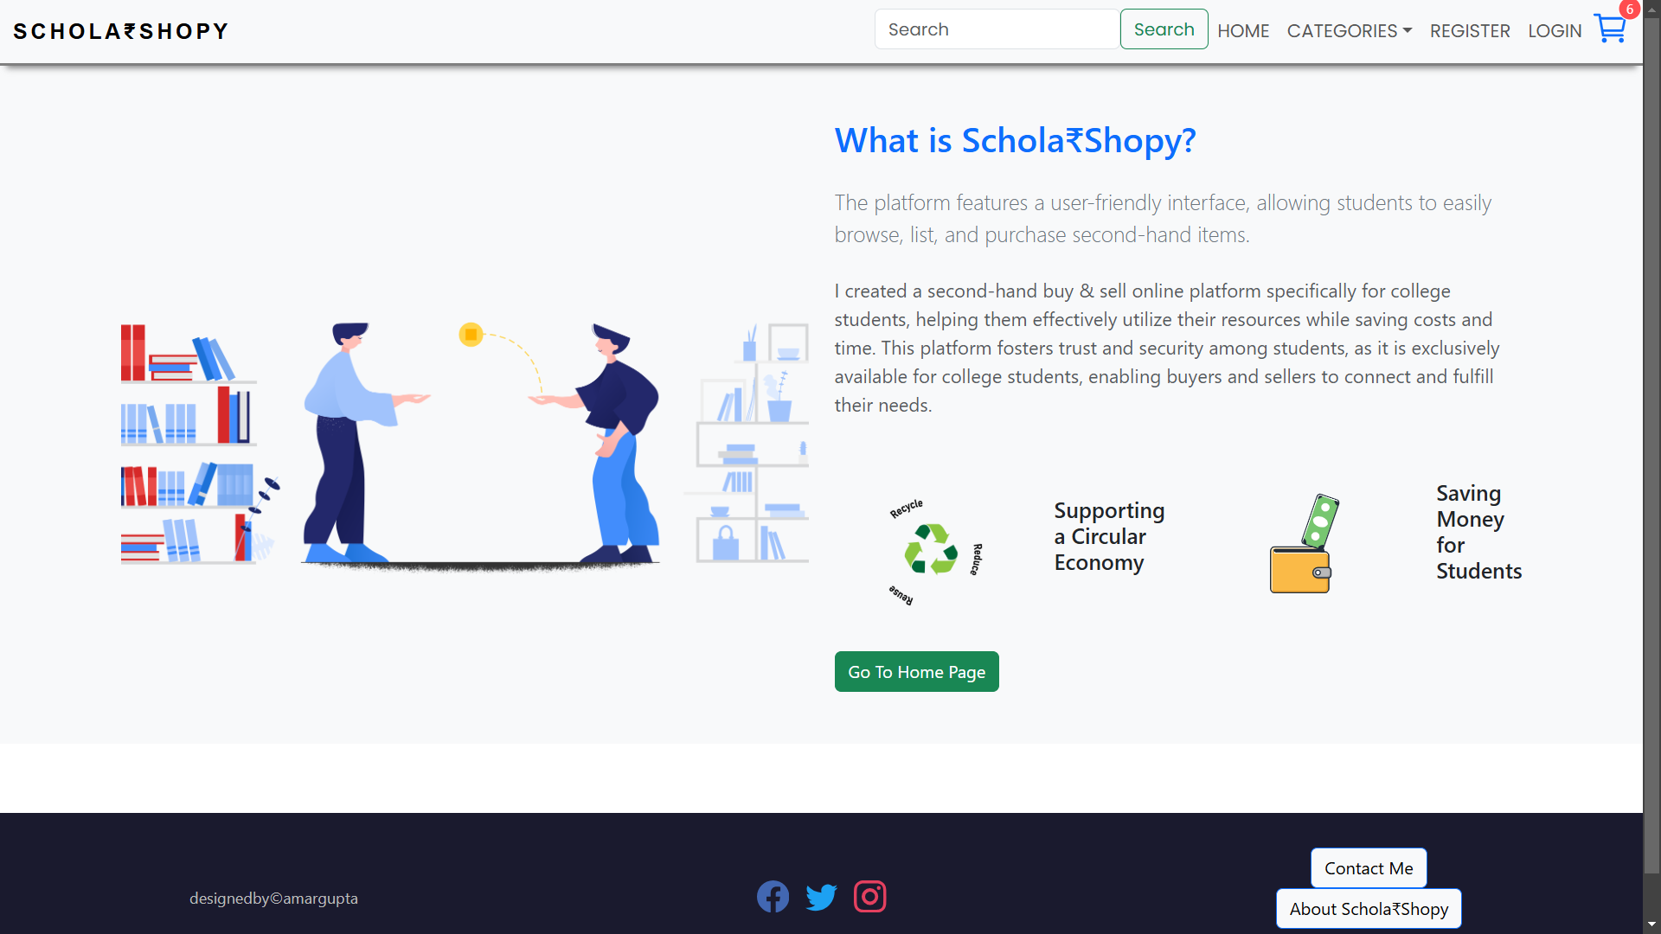

Slide 10
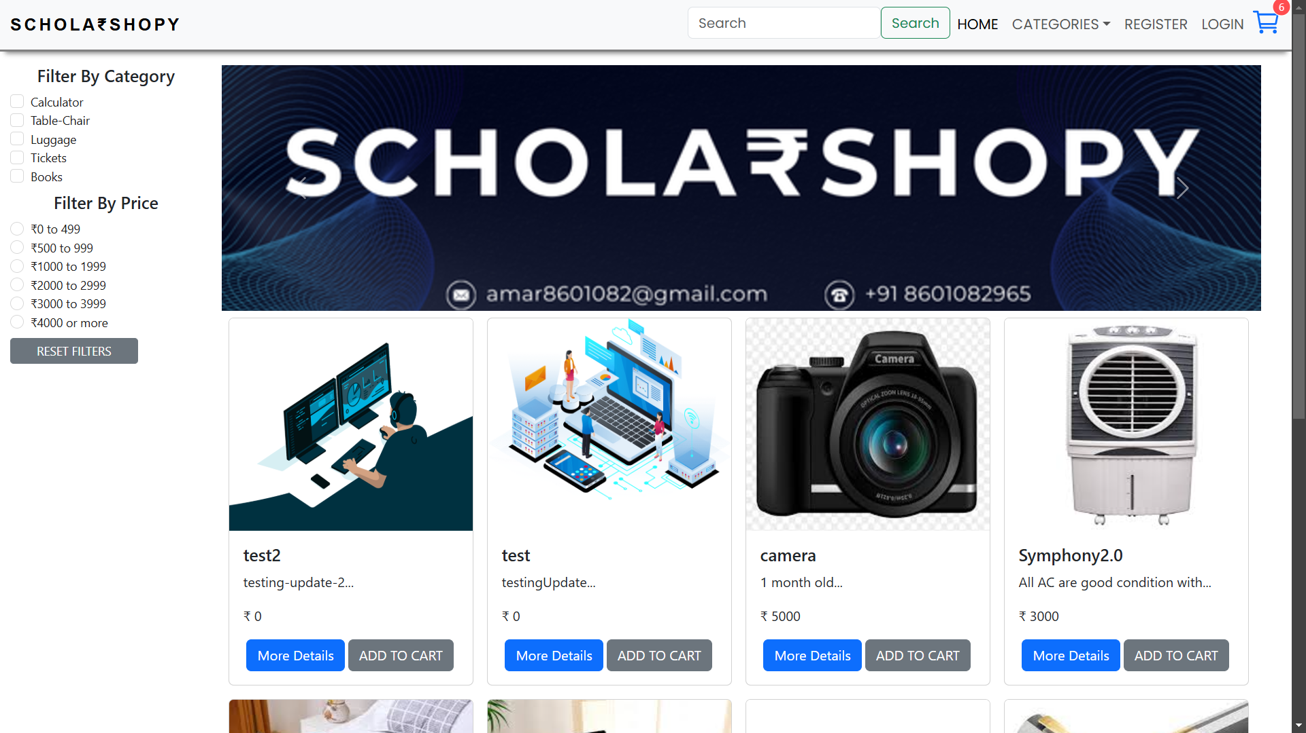

Slide 11
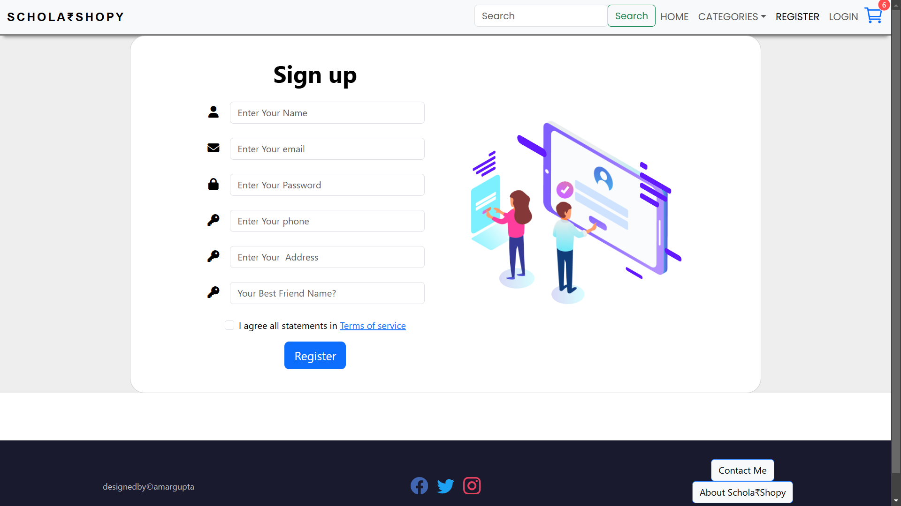

Slide 12
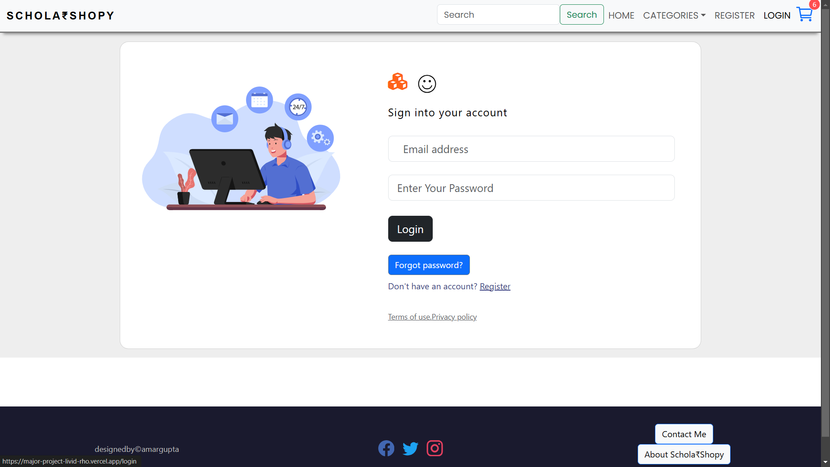

Slide 13
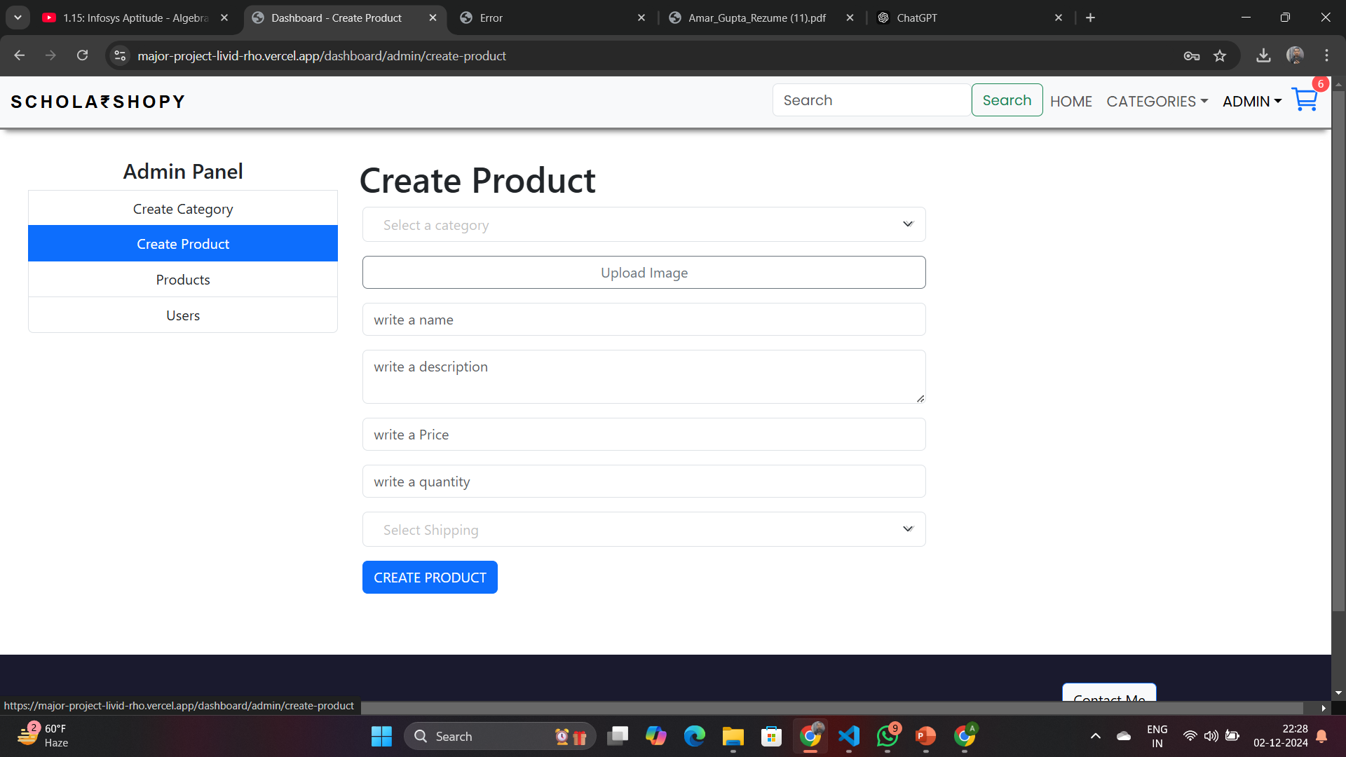

Slide 14
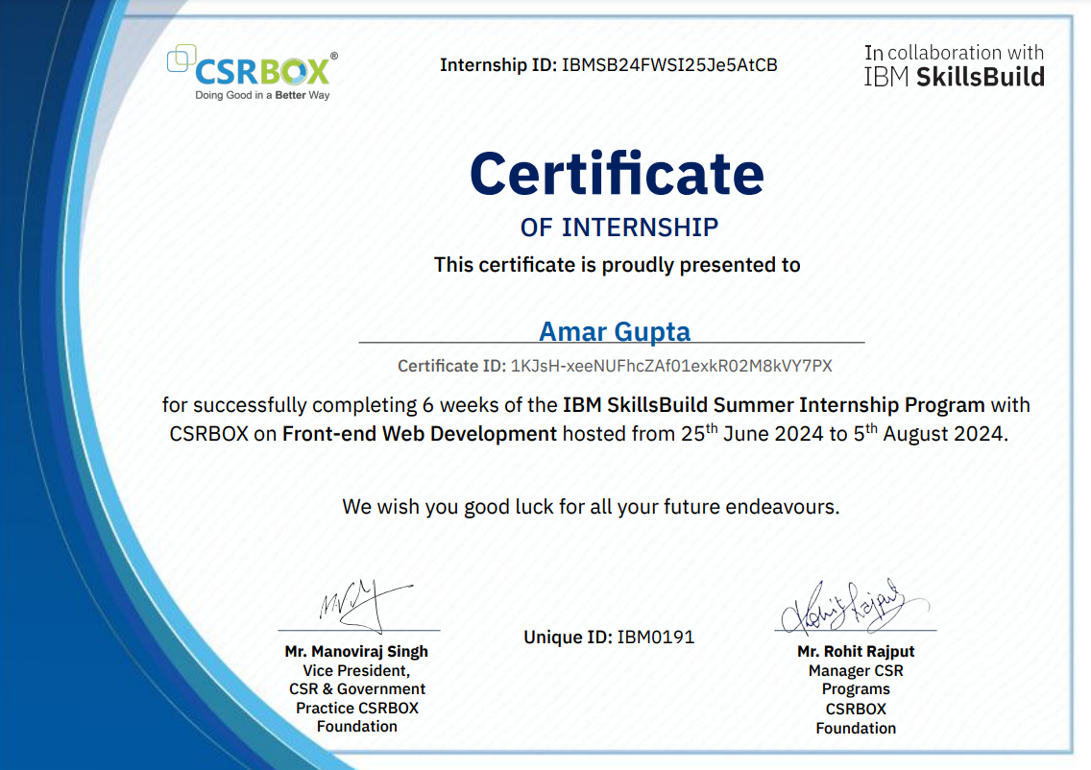

Slide 15
Conclusion
Summary: Schola₹Shopy is a comprehensive solution promoting cost savings, sustainability, and trust within the student community.
Future Vision:
- Expand functionality with AI and geolocation.
- Introduce mobile applications.
- Enhance payment and security systems.

