Slide 1
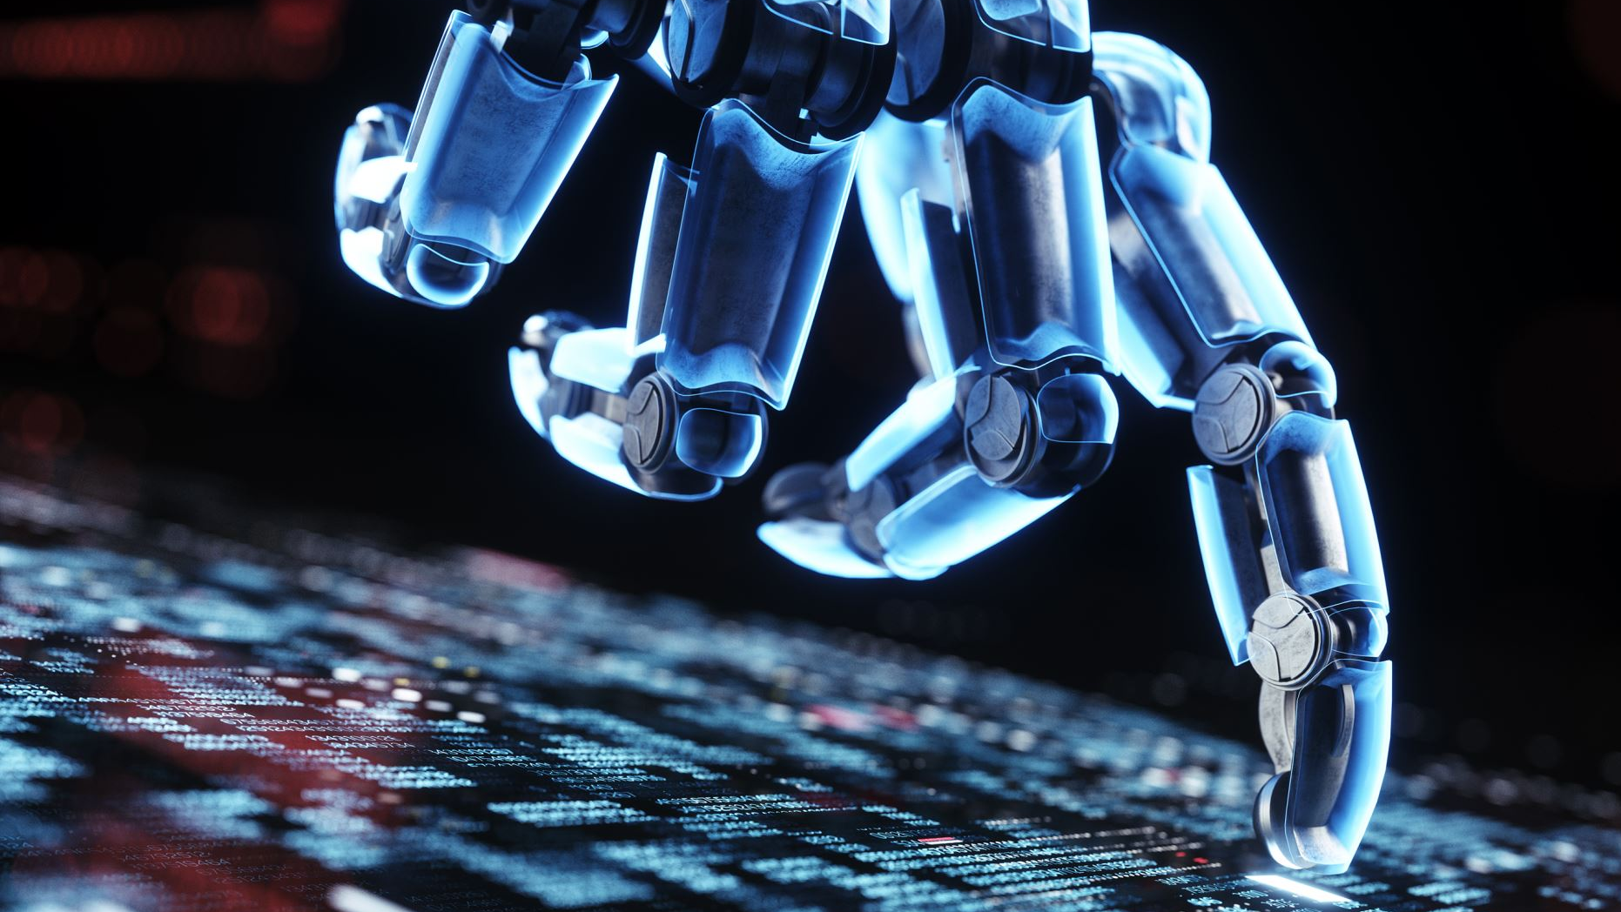
AI & Artificial General Intelligence (AGI)
By Miguel Mora, Hashim Sayed Hoosini, Michael Garcia
Date: 07/14/2025
Course: ITAI 2372

Slide 2
Introduction to AI & AGI
Artificial Intelligence(AI) is a simulation of human intelligence in machines.
They are systems designed to perform specific tasks such as Siri answering your voice commands.
Artificial General Intelligence (AGI) are machines with human-like flexibility across tasks.
AGI can perform any intellectual task a human can such as learning or adapting.
EX: A robot that can paint portraits or debate arguments all without a task-specific programming.

Slide 3
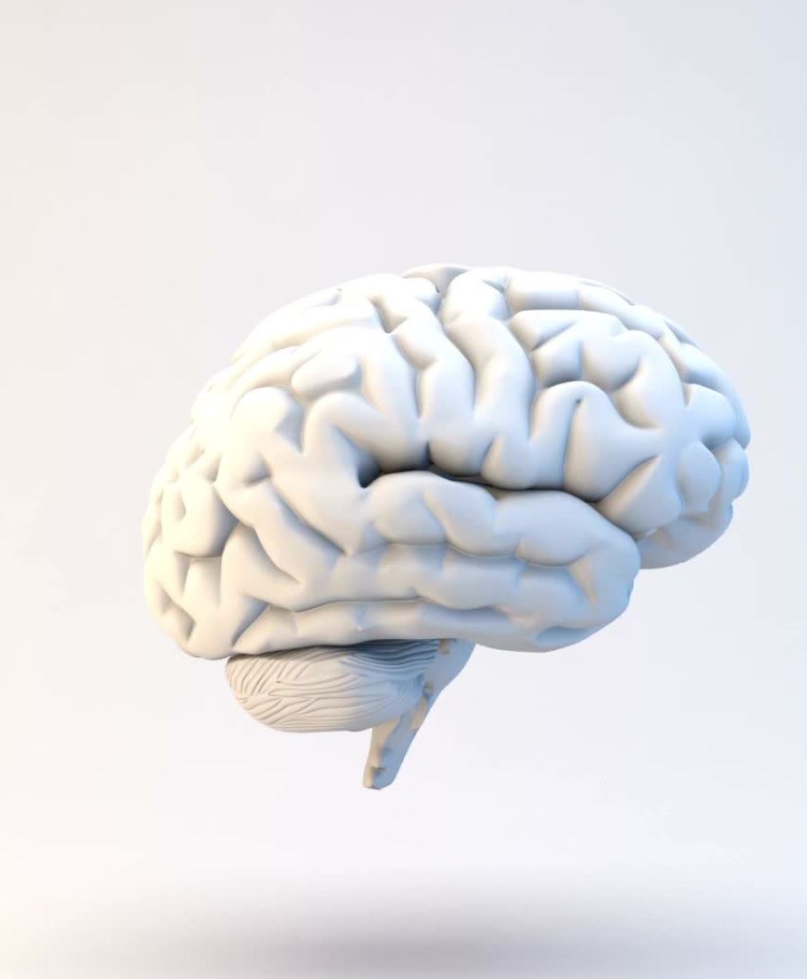
Domain Overview & Importance
AI
AI excels at narrow tasks using large dataset and learning patterns
AI is already embedded into your daily life, like Face ID
AGI revolutionize knowledge, creativity, and decision making
AGI aims to be like a human brain mastering understanding and learning.
AGI adapts to any domain even the ones it wasn’t trained for
AI contributes billions to the global economy
Depending on how it is guided, AGI could be humanity's most powerful tool or most serious ethical challenges

Slide 4
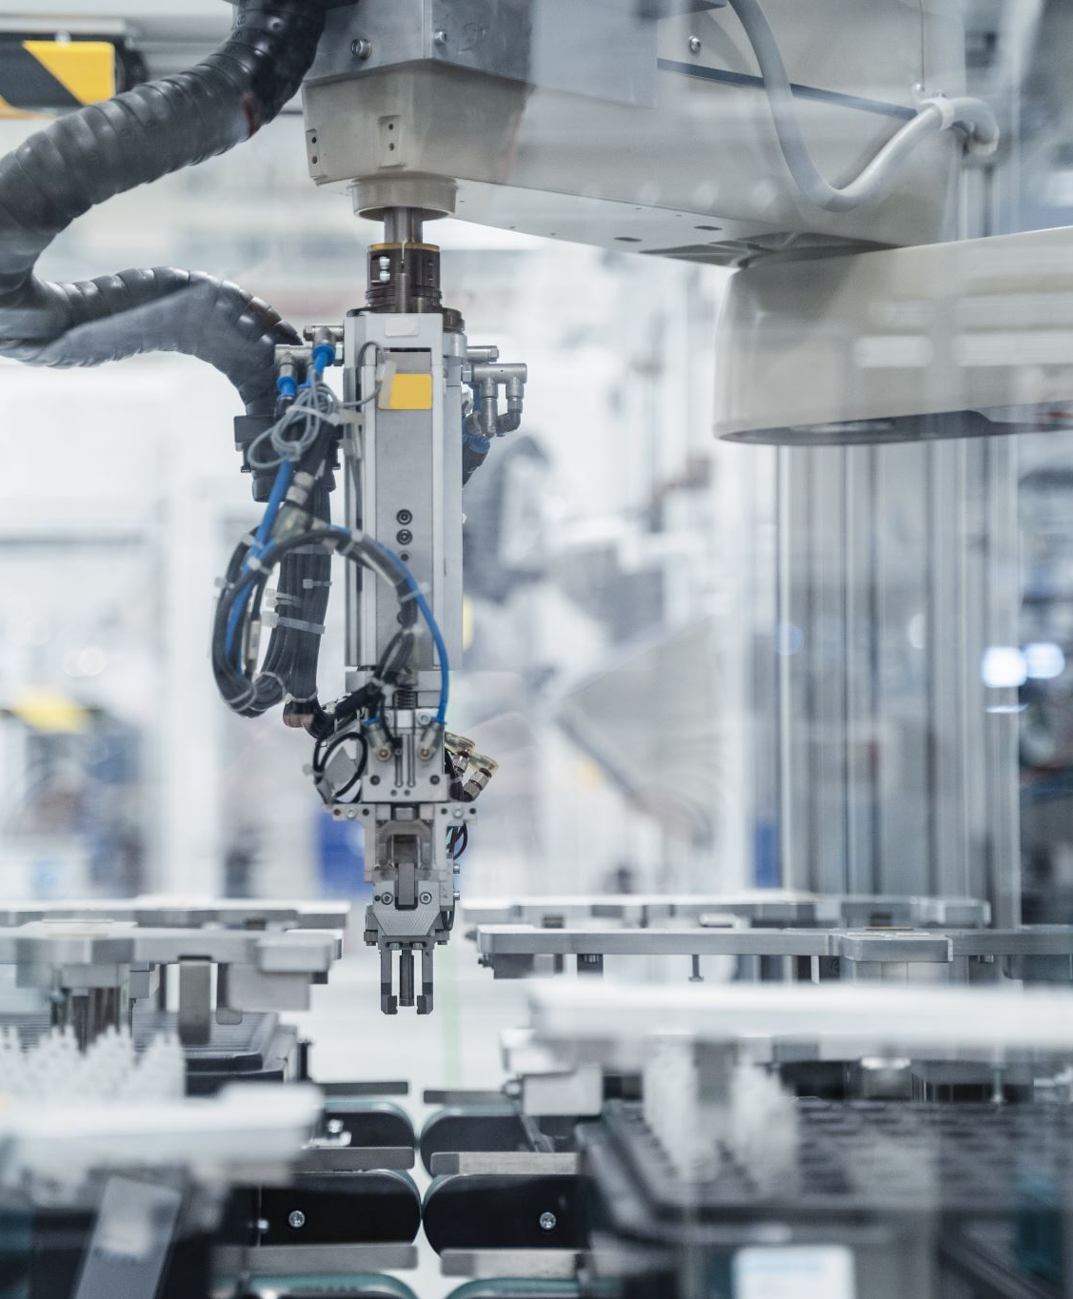
Use Case Motivation
AI
Automated defect detection
Language translation
Autonomous vehicles
EX: Factories use AI powered cameras to spot product defects- saving time and reducing waste
AGI
EX: A machine that not only spots defects but rethinks the entire production strategy on its own, adapting in real time

Slide 5
Techniques
AI
Machine Learning: Learn data patterns to make predictions or decisions
Deep Learning: Defect detection in manufacturing
Natural Language: Processing for chatbots
AGI
Symbolic reasoning: Logic-based decision making for abstract problem solving
Reinforcement Learning: Learning through trial and error
Transfer Learning: Applying knowledge from one domain to another

Slide 6

Key Applications
AI
Visual inspection systems that detect defects in manufacturing such as scratches on smart phones
Healthcare: Predictive systems that flag patients at risk of heart disease
AI models optimizing shelf restocking or personalized ads in retail
AGI
AI that can act as a researcher, therapist, teacher, all in one
Creative AGI could solve equations or generate art that reflects emotional depth

Slide 7
Benefits
AI
Speeds up decision making
Automates routine tasks
Improves safety and accuracy in domains such as engineering
AGI
Human level reasoning that is unbiased and emotionally aware
Brings true innovation by being able to work across various disciplines like economics, ethics, and creativity

Slide 8
Implementation Challenges
AI Challenges
Requires massive labeled datasets
Prone to bias
Difficulty explaining why decisions are made
AGI
Difficult to design systems that generalize and self-reflect
Ensuring AGI aligns with human values
Difficult to measure consciousness or understanding

Slide 9
Future Trends
AI Advances
Increase of multi-modal systems like GPT-4o
Improvement in explainability
AI models that run directly on devices like smartphones and smartwatches
AGI
Integreation of reasoning, learning, and memory would result in a more cognitive AI
Adaptive education like AGI tutors that personalize learning across subjects
Ethical reasoning that AGI systmes an weigh moral dilemmas and propose socially responsible solutions

Slide 10
Conclusion
AI is transforming industries now with task-specific intelligence
AGI represents a leap toward machines that think, learn, and adapt like humans
AGI holds immense promise but needs cautious development
AI is practical and powerful as of now but AGI is visionary and complex

Slide 11
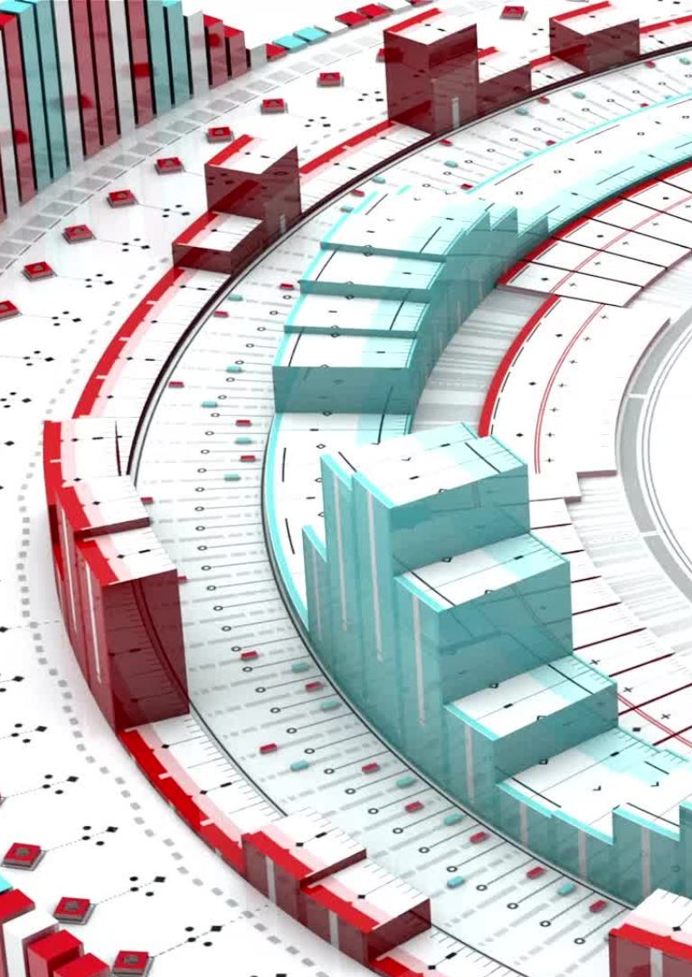
References
What is Artificial General Intelligence (AGI)? | IBM
Examples of Artificial General Intellgence (AGI) | IBM
Artificial General Intelligence: Use Cases, Market, Challenges, Opportunities & the Future - Orbiting Web
When Will AGI/Singularity Happen? 8,590 Predictions Analyzed
AGI explained | aijobs.net
What Is Artificial Intelligence (AI)? | IBM
Machine Learning in Manufacturing: 10 Use Cases and Examples

