Slide 1
AI in Healthcare
Miguel Mora
June 9th , 2025

Slide 2
Domain Overview & Importance
What is Healthcare? Healthcare is a system designed to maintain and improve health.
Why does it matter? It is a growing demand, aging population, cost inefficiencies, etc.
Key Challenges: Accuracy of diagnosis, personalized treatment, and overall accessibility.

Slide 3
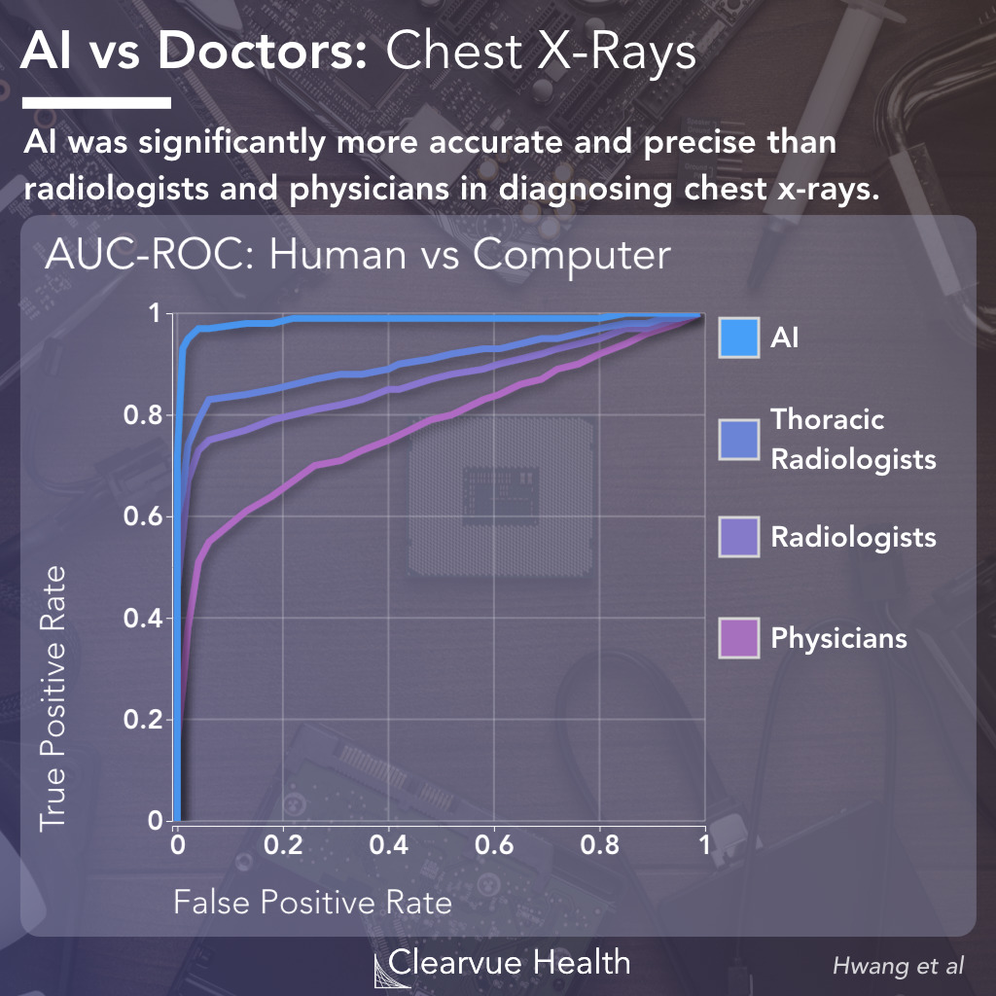
AI Use Case Motivation
The Problem being Solved: Better treatment due to early identification of diseases.
EX: Northwestern Medicine’s AI-powered radiology system helps radiologists read images faster and more accurately.

Slide 4
AI Techniques Used in Healthcare
Techniques: CNNs for medical imaging
NLP is used for processing health records
Generative AI for drug discovery

Slide 5

Key Applications (Case Studies)
IBM Watson assists doctors in treatment decisions
AI-powered wearable devices that track patients’ health.
AI-driven Medical Chatbots for interactions with patients.

Slide 6
Impact & Benefits
Healthcare Improvements: Better diagnostics and tailored treatments.
Economic Benefits: Cost savings and optimized hospital workflows.
Social Impact: Improved overall global health and increased patient trust.

Slide 7
Challenges & Risks
Data Privacy: Sensitive patient information
Fairness: Avoid bias in AI predictions
Transparency: Ensuring doctors understand the AI’s decision-making.

Slide 8
Future Decisions
Multimodal AI combining text with imaging analysis.
Federated learning for secure patient data sharing.
Responsible AI ensuring ethical healthcare solutions.

Slide 9
Conclusion
Recap: AI transforms healthcare with better diagnostics & efficiency.
Final Thought: Artificial Intelligence in Healthcare will better overall health in humanity.

Slide 10
References & Acknowledgments
What is healthcare - Google Search
10 real-world examples of AI in healthcare | Philips
New AI transforms radiology with speed, accuracy never seen before: For Journalists - Northwestern University
IBM Watson in Healthcare: The AI Doctor Who’s Always On Call
Challenges and risks for AI in healthcare – Search
Babylon health - Google Search

