Slide 1
Introduction
Miguel Mora
AI Expertise
Computer Vision and its usage in interpreting images and video.
Natural Language Processing and how it generates human language with context-aware precision.
Machine Learning and its capabilities to be scattered across domains such as computer vision.
Skilled in transforming raw data into actionable insights through cleaning, analysis, and visualization.

Slide 2

Project Highlight Part 1
Project: AI-Powered Predictive Maintenance System
Key Learnings:
Time-series forecasting with LSTM.
Failure classification with Random Forest.
Essemble modeling for balance accuracy and interpretability.
Tools mastered: TensorFlow, Scikit-Learn, SHAP, Streamlit.

Slide 3
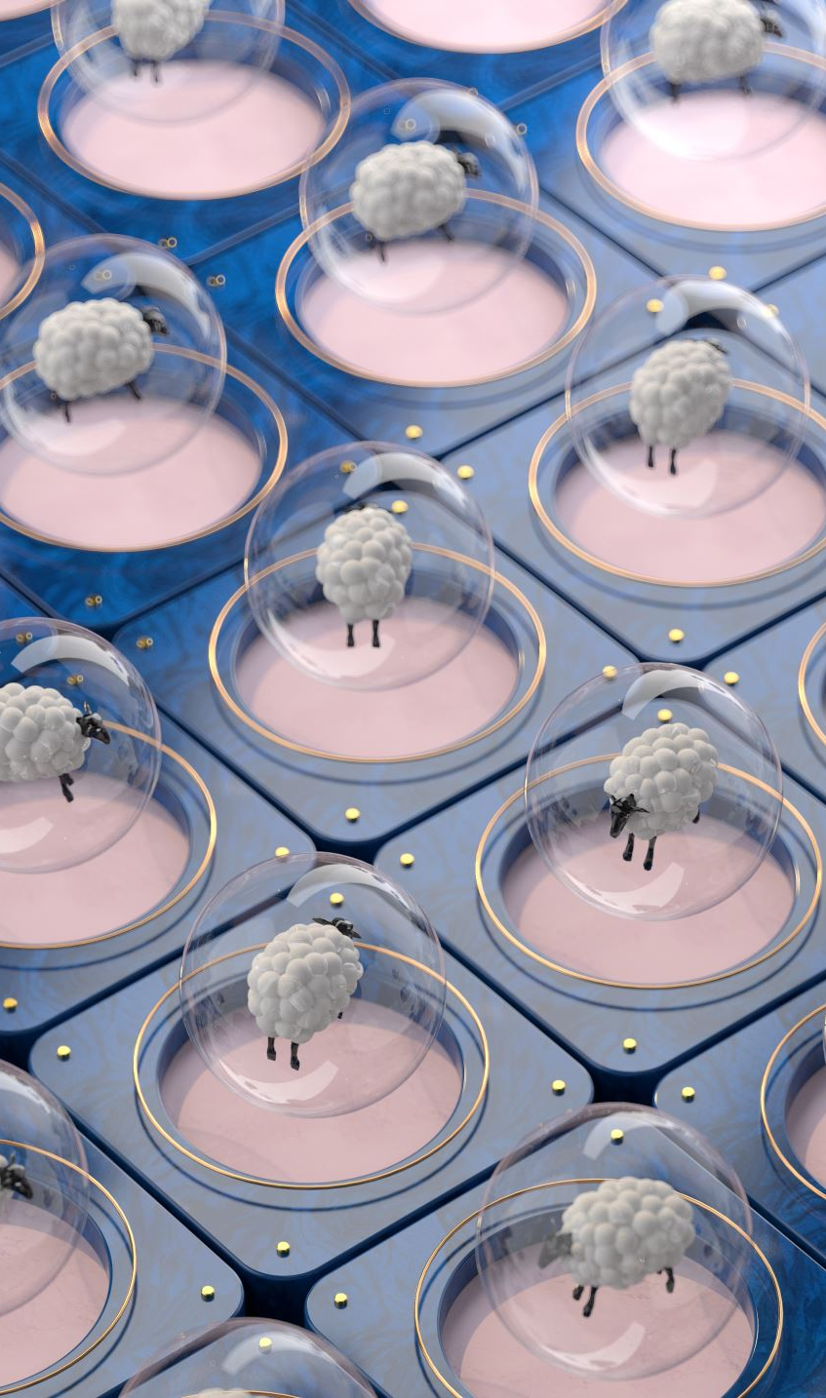
Project Highlights Part 2
Data Science Foundations
Preprocessing with Pandas/NumPY.
Visualization with Matplotlib/Seaborn.
Experiment tracking with Mlflow.

Slide 4
Real-World Applications
Industries: Manufacturing, Energy, Aviation, Renewable Energy.
Problems tackled:
Reduce downtime and costs.
Improve safety and sustainability.
Transparent AI for technician decision support.

Slide 5
Wrap Up
GitHub: https://github.com/211MM/AI-Powered-Predictive-Maintenance-System/blob/main/README.md
Contact: mmora.ai999@gmail.com

