Slide 1
中期报告 Association rules analysis with R arules package
2820150081 - LEESUJIN
2820150089 - KWONDAYEON

Slide 2
Content.
Installing arules package & loading library(arules)
Data Secure & exploration
Association rule analysis
Association rules evaluation & inquiry
arulesViz package

Slide 3
Association rules analysis
With R arules package
(Aporiori algorigthm)
Association Rule : {A} -> {B,C}
ISmeasure(Interest-Support)
Cross Support
support
confidence
Lift

Slide 4
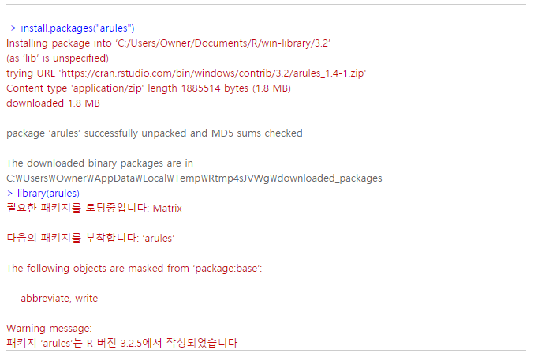
1.Installing arules package & loading library(arules)
aruels package is not base package so we need additional installing

Slide 5
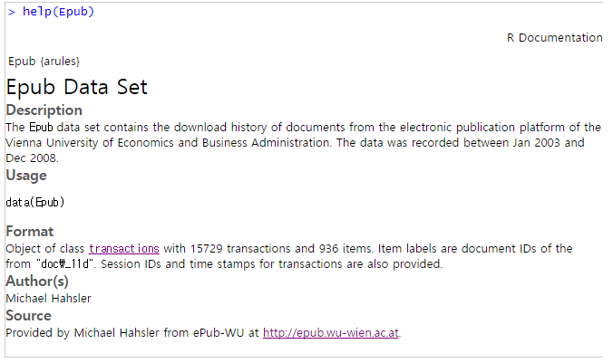
2.Data Secure & exploration
Data used in the analysis is the trading data of Epub data set. Epub data set contains the download history of documents from the electronic publication platform of the Vienna University of Economics and Business Administration.

Slide 6
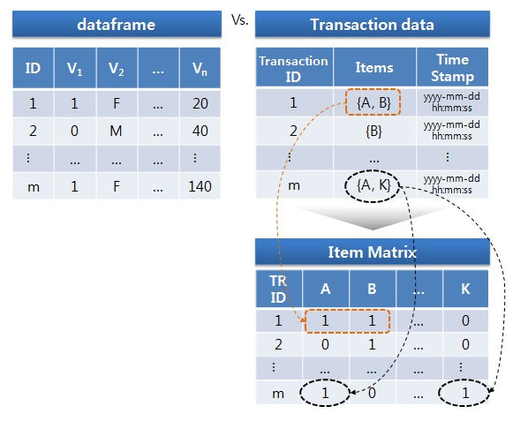
Dataframe vs Transaction data

Slide 7
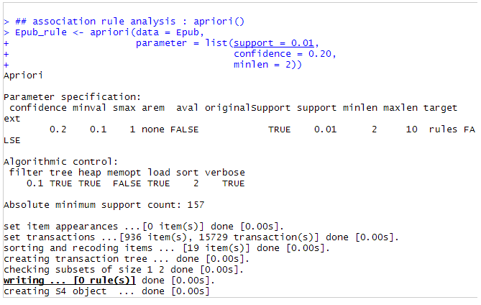
3.Association rule analysis
we will analysis using apriori() function of arules package
But I think first standards too high so association rule appeared ＇０＇，so I tried again by lowering the standards for analysis # re-setting minimum support from 0.01 to 0.001

Slide 8
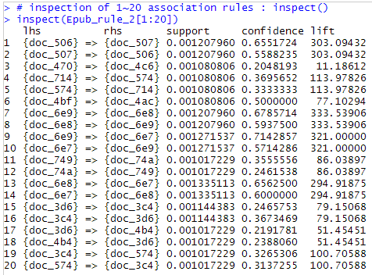
4. Association rules evaluation & inquiry
#inspection of 1~20 association rules : inspect()

Slide 9
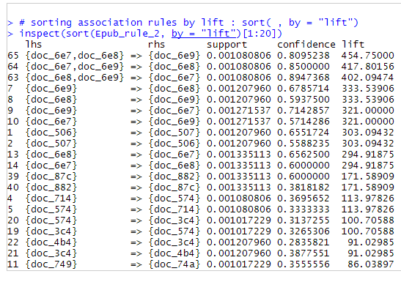
4. Association rules evaluation & inquiry
#sorting association rules by lift : sort( , by=“lift”)

Slide 10
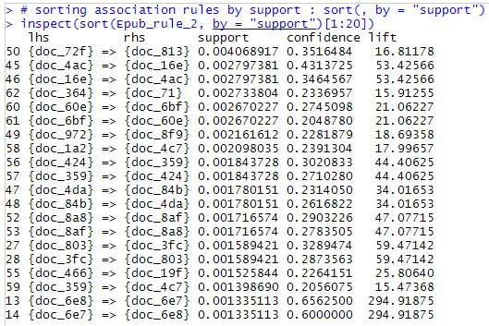
4. Association rules evaluation & inquiry
#sorting association rules by support : sort( , by = “support”)

Slide 11
我们现在到这儿做完 谢谢

