Slide 1
Systematic Review
Web Application Development Project
Alexander Irikov Borislav Hristov Panagiotis Antoniou Domantas Jurkus

Slide 2
What does the app do
The purpose of this application is to enable researchers to perform systematic reviews for various medical conditions. A systematic review is a method of gathering information about a specific topic of interest by collecting relevant documents from appropriate sources. Systematic reviews are usually quicker and cheaper than performing a whole new study.
A systematic review consists of a number of stages, which need to be recorded:
Query Construction,
Abstract Pool Evaluation and then
Document Pool Evaluation.

Slide 3
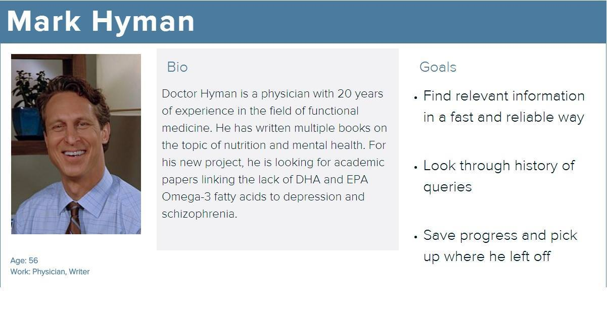

Slide 4
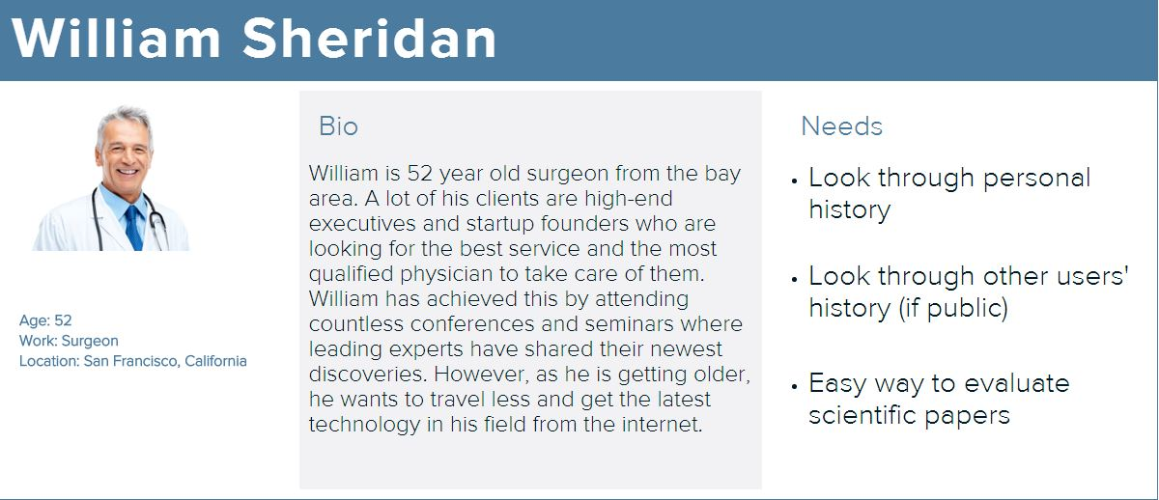

Slide 5
Main Features: Functional Requirements
The user of the application will be able to:
Register / Log in
Create a new review
Query the application with various keywords relevant for the review
Alter query parameters for existing reviews
Add another user(s) to a particular review
Approve / exclude suggested documents

Slide 6
List of specifications: Non-Functional Requirements
In order to function, the application will require:
A framework for building the application (Django)
A server for hosting the client, middleware and database (Python Anywhere)
Access to external medical records (PubMed API)

Slide 7
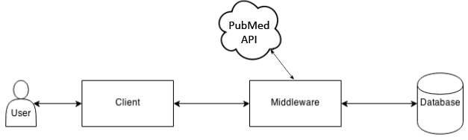
High-level system architecture
The user will interface with the application through a web browser (desktop, mobile, etc)
The client will send and receive information through the middleware (Django application)
The middleware will query the external PubMed API for retrieving relevant information.
This information, along with relevant user input, will be persisted into a database.

Slide 8
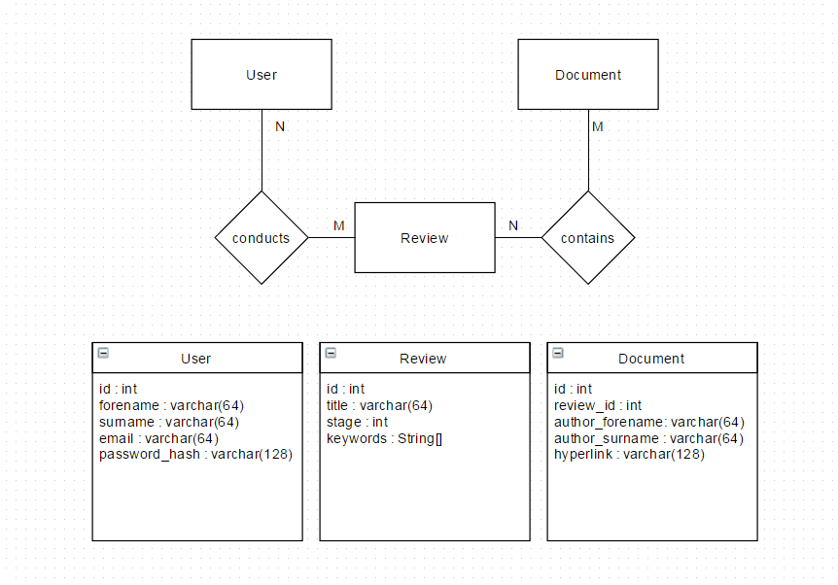
ER Diagram

Slide 9
Wireframes - Walkthrough of Features

Slide 10
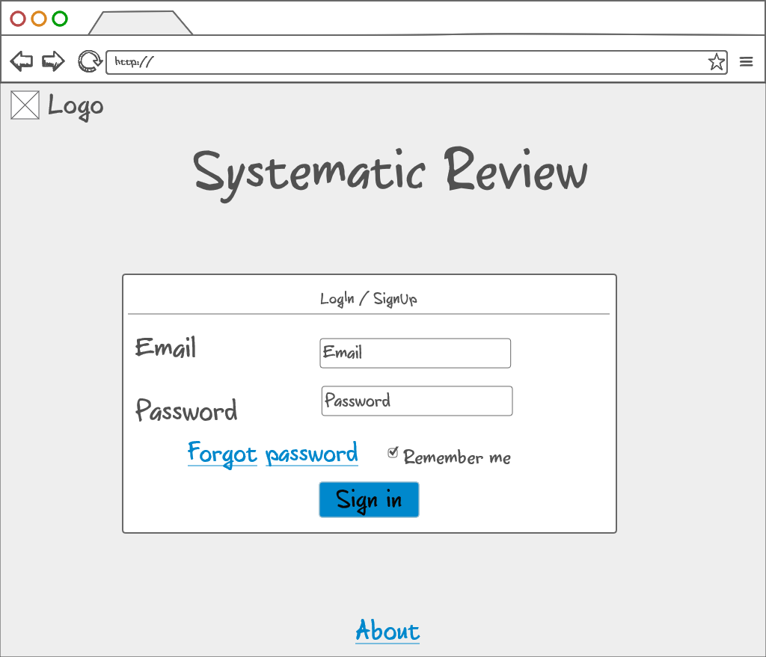

Slide 11
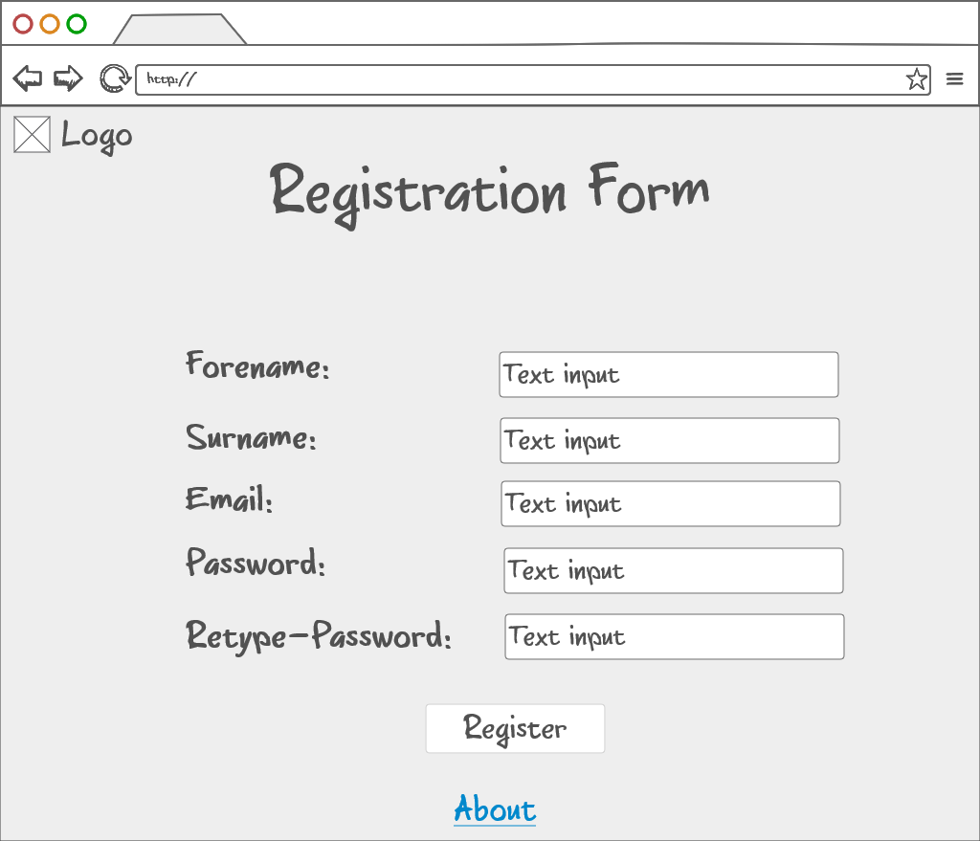

Slide 12
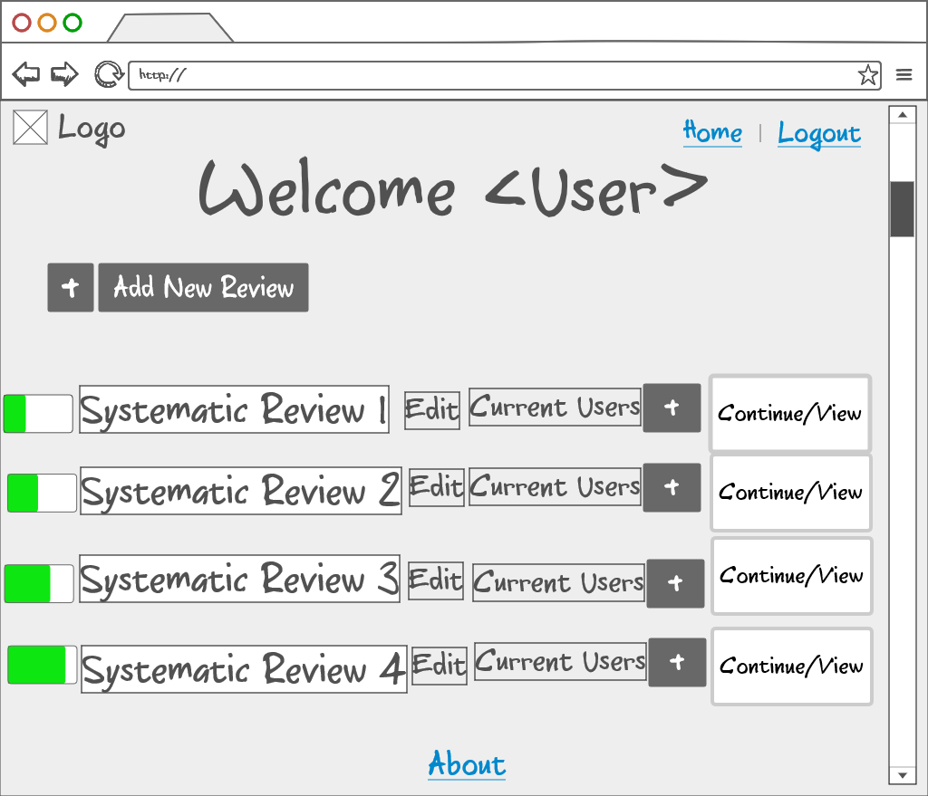

Slide 13
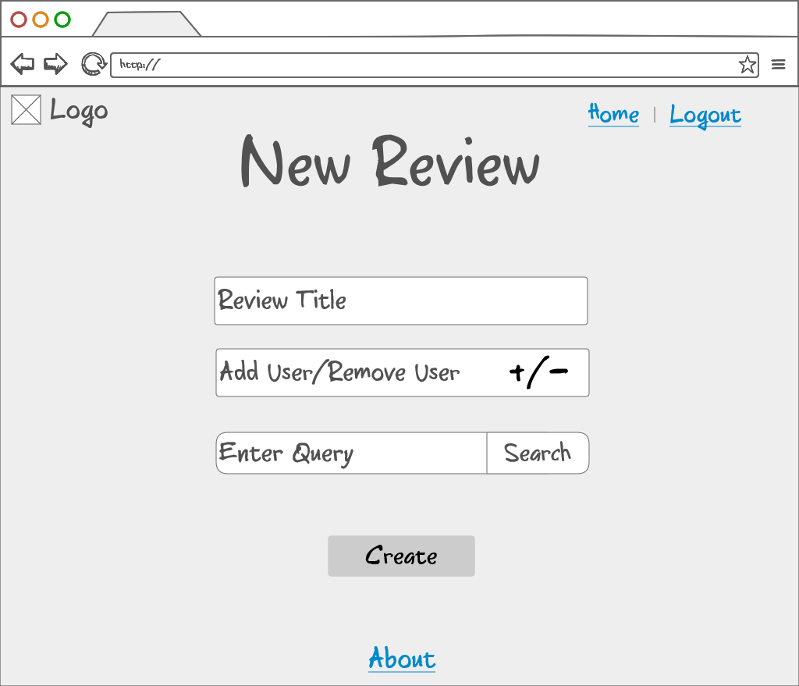

Slide 14
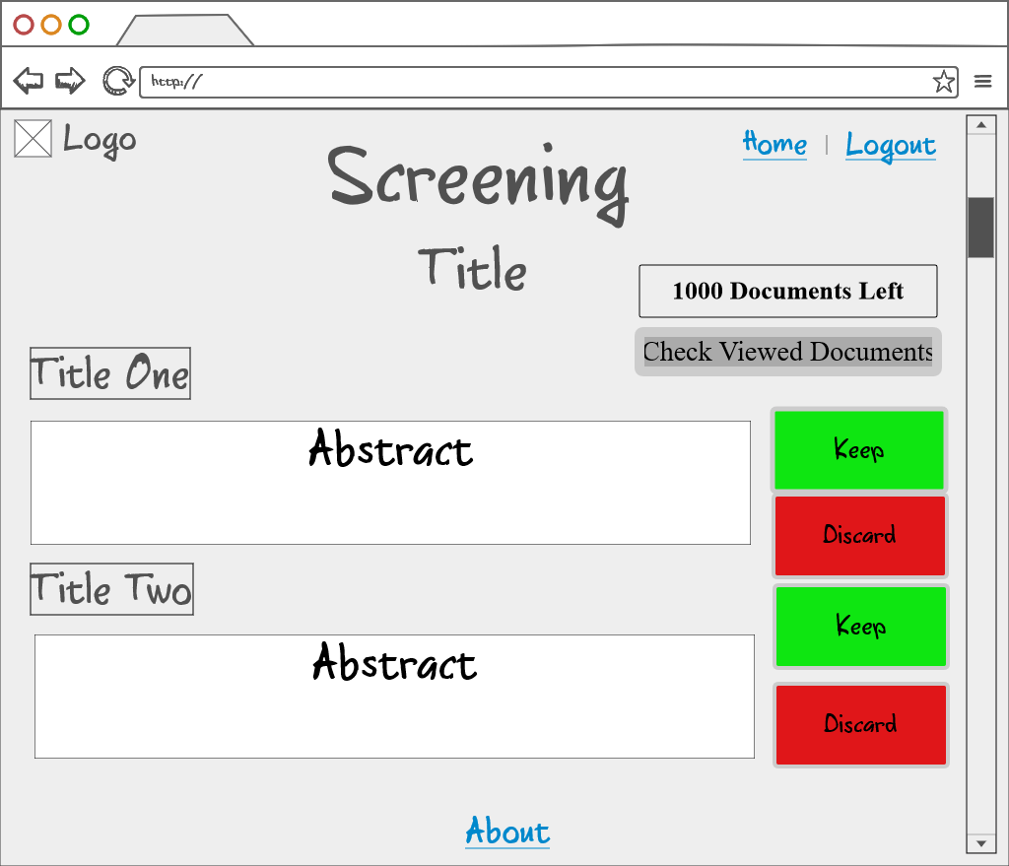

Slide 15
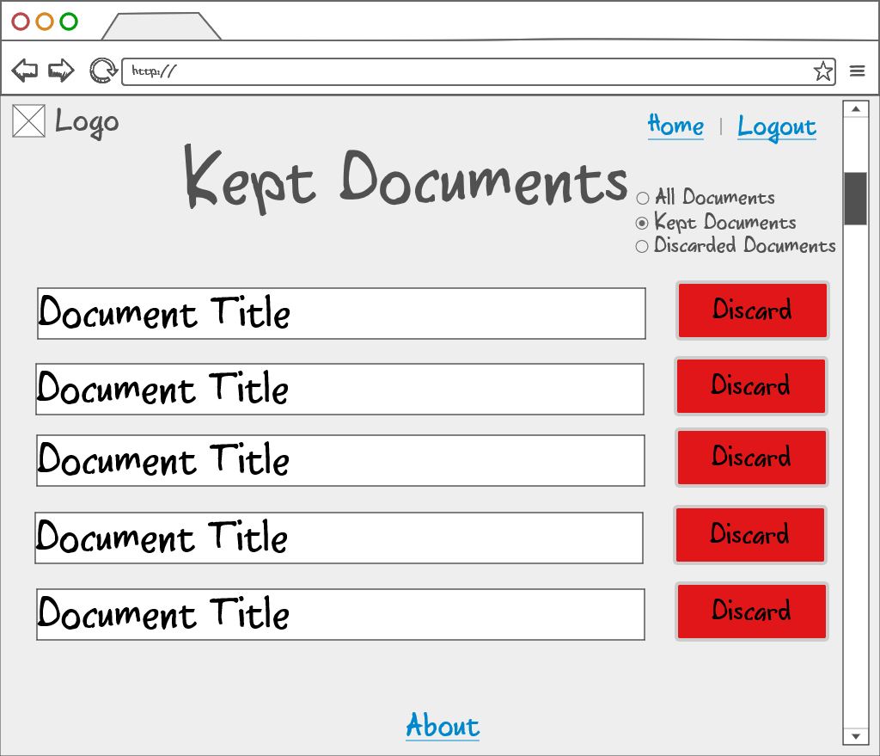
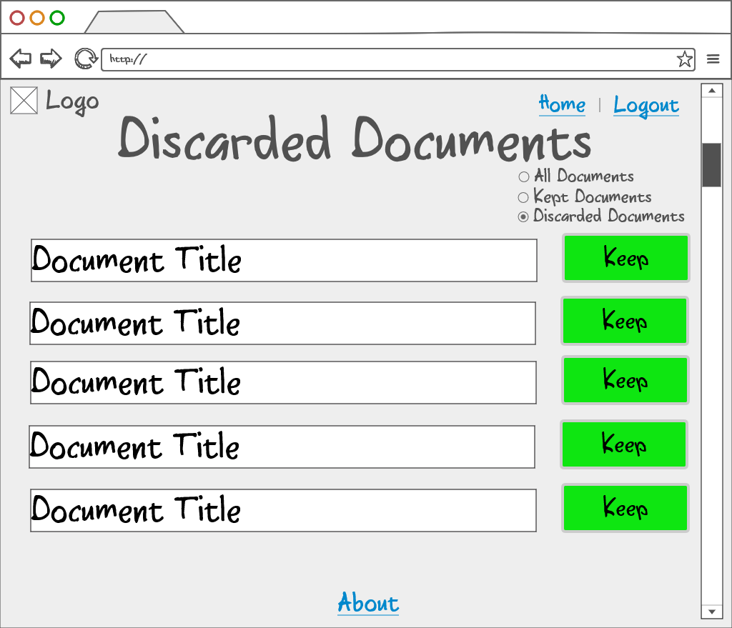

Slide 16
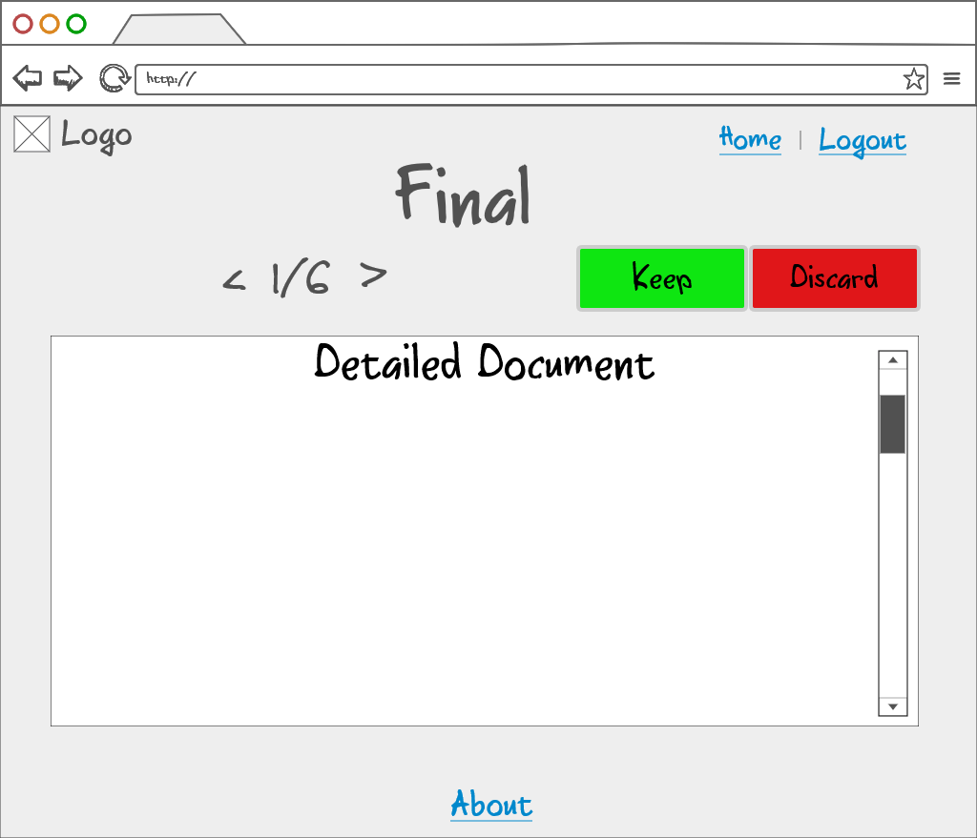

Slide 17
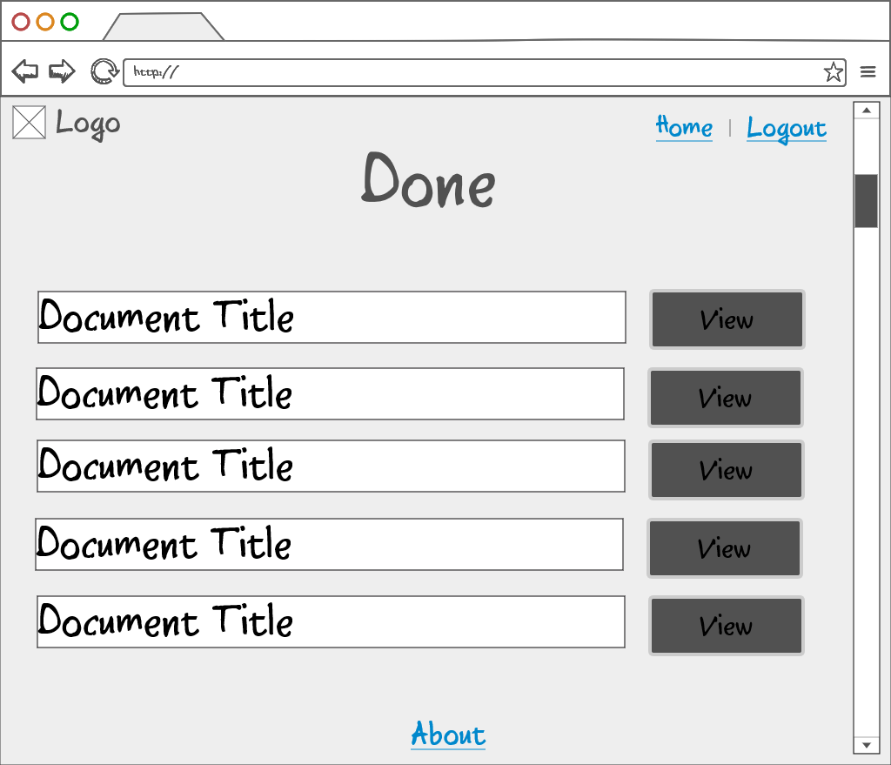

Slide 18
Walkthrough
Sign Up
Sign In
Home screen
New review
Screening
Kept
Final
Done

