Slide 1
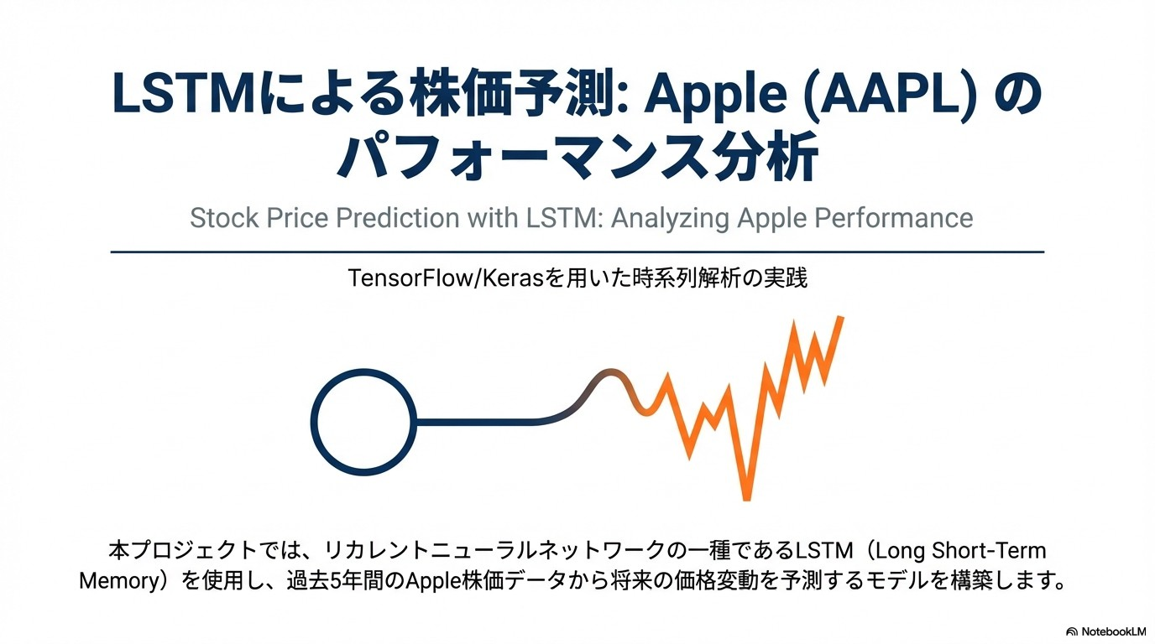

Slide 2
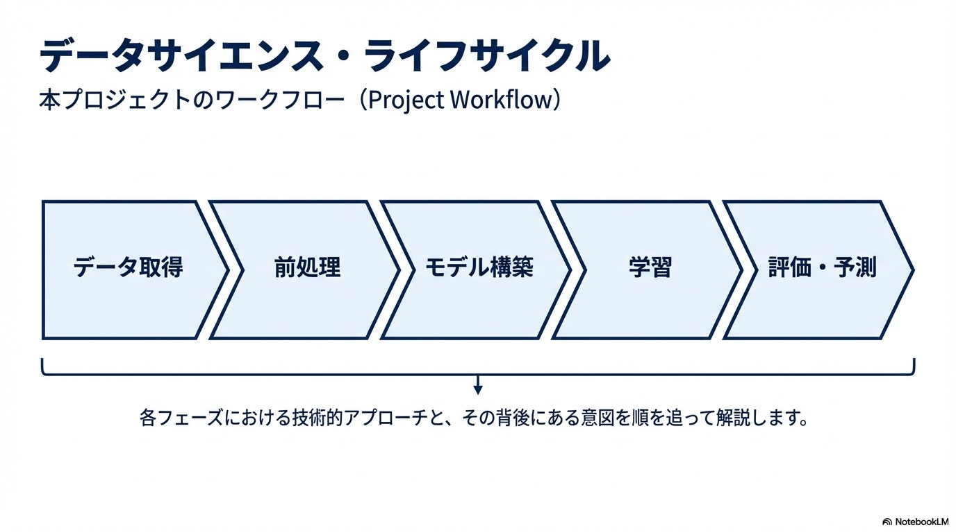

Slide 3
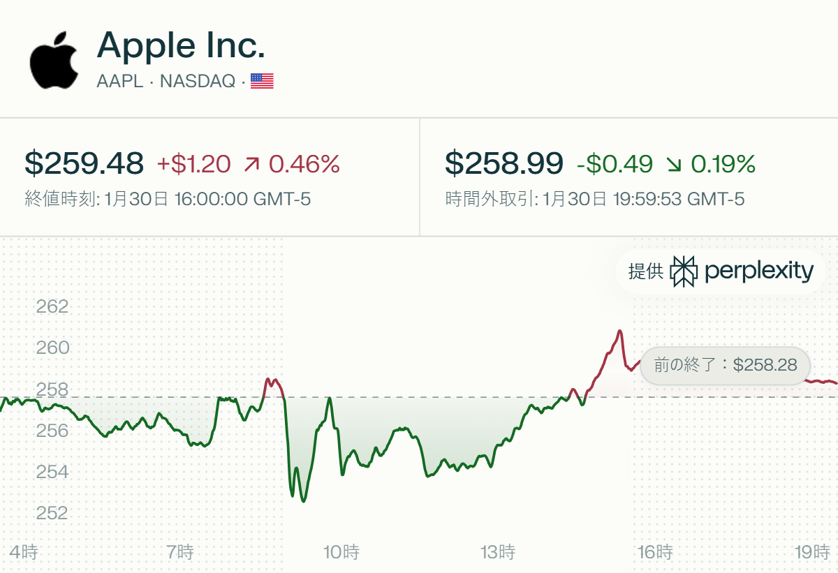
Introduction

Slide 4
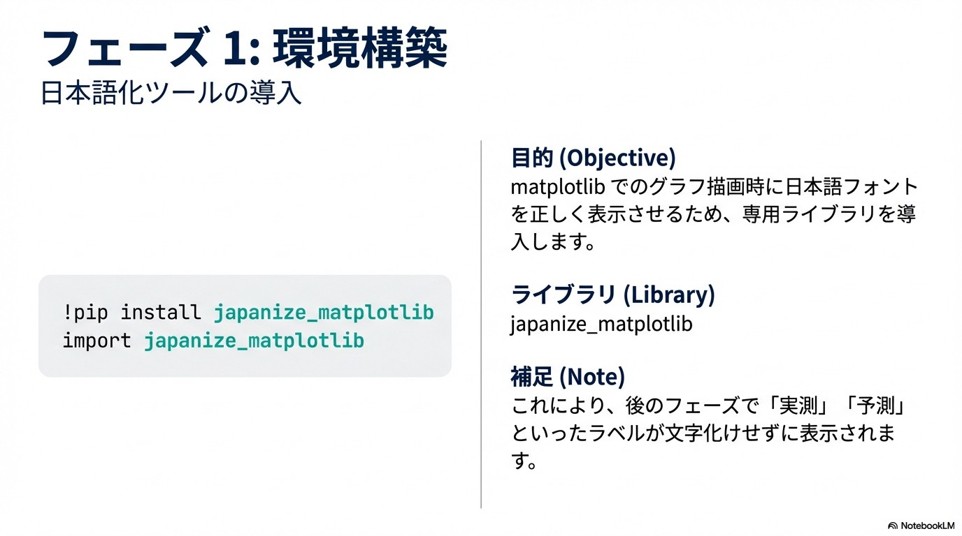

Slide 5
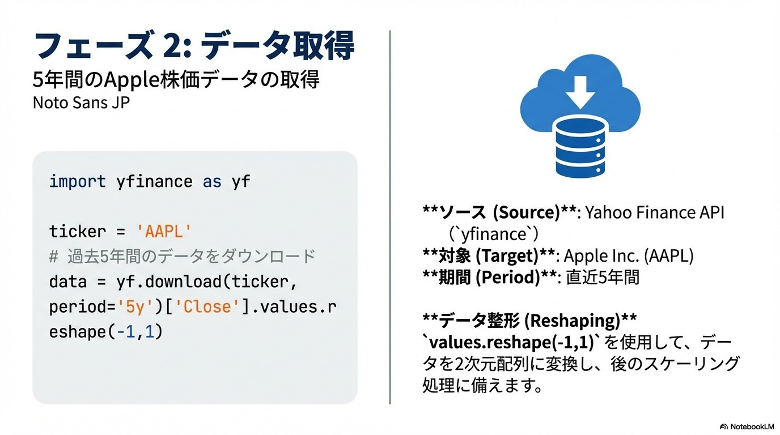

Slide 6
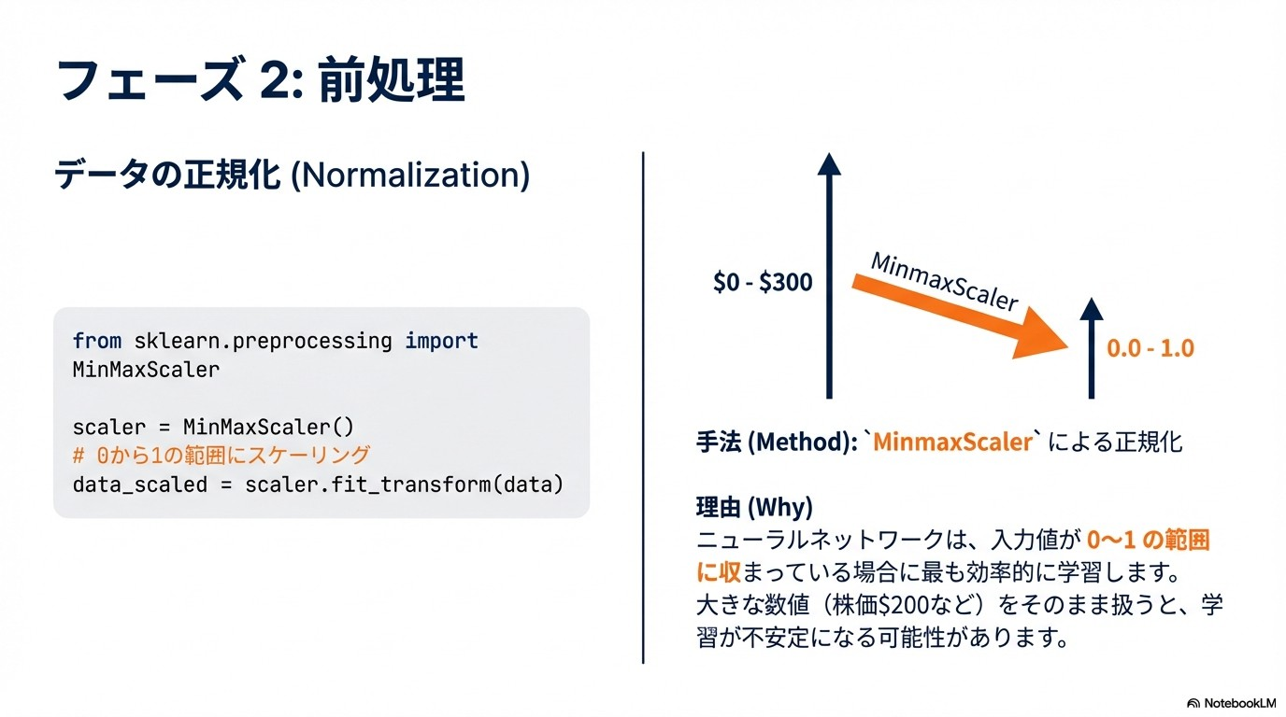

Slide 7
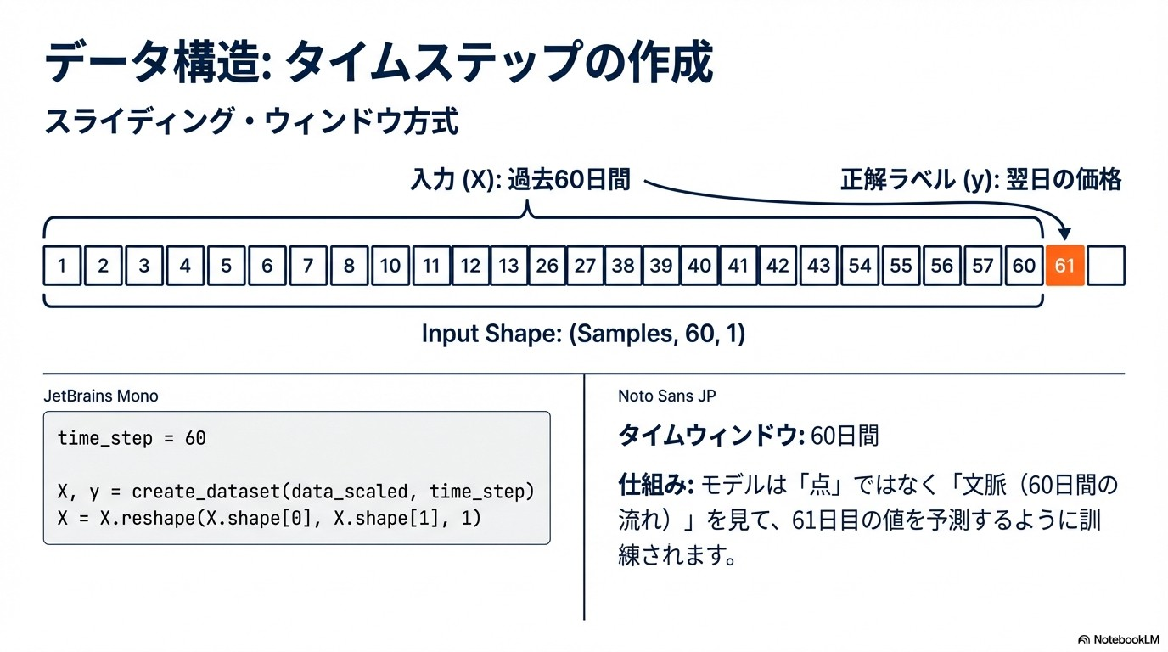

Slide 8
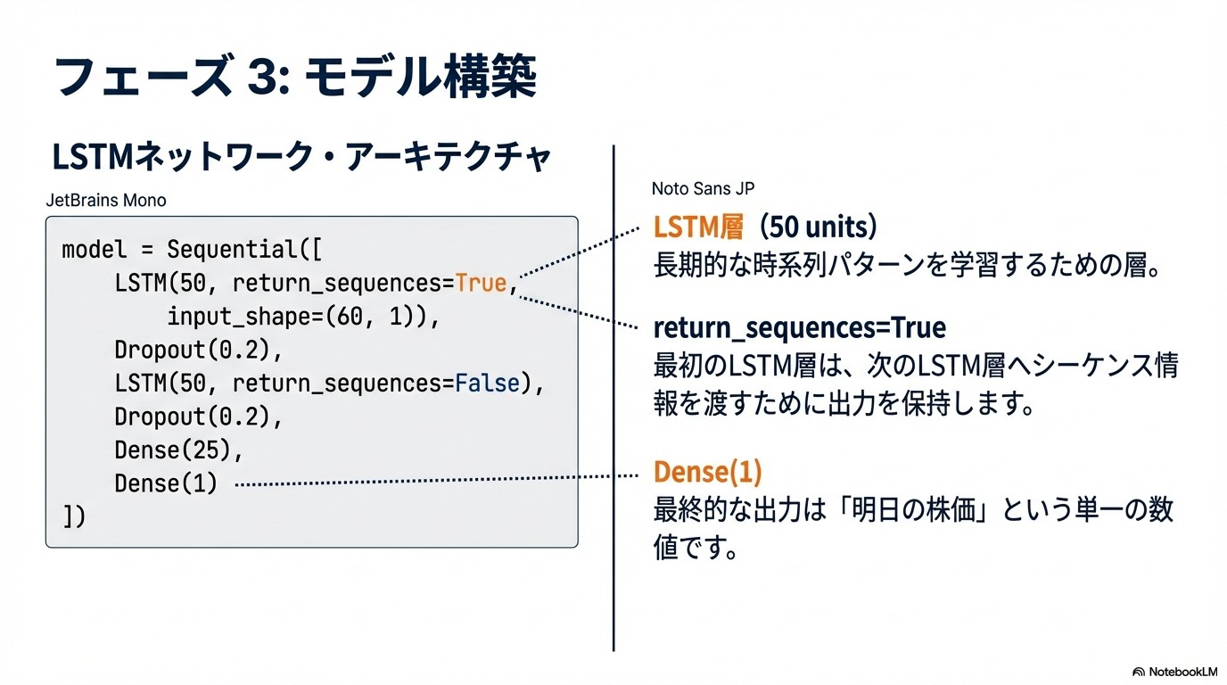

Slide 9
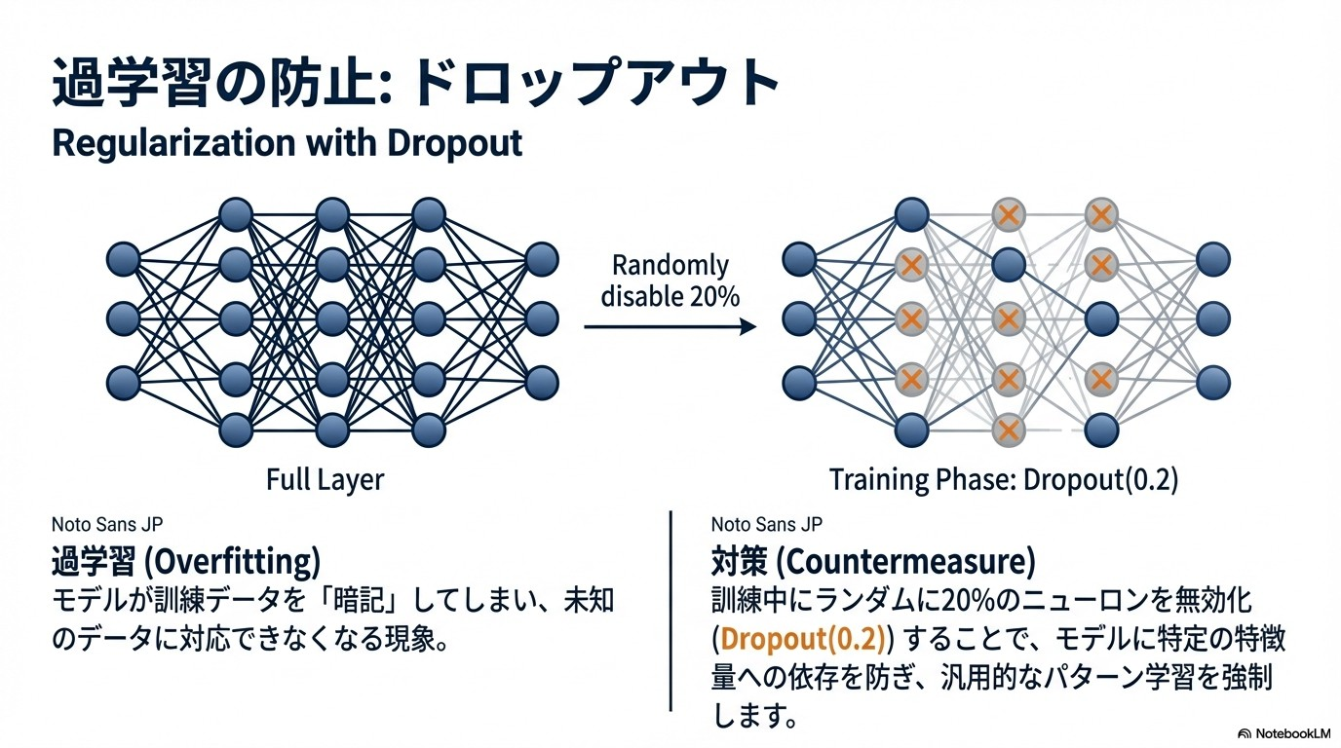

Slide 10
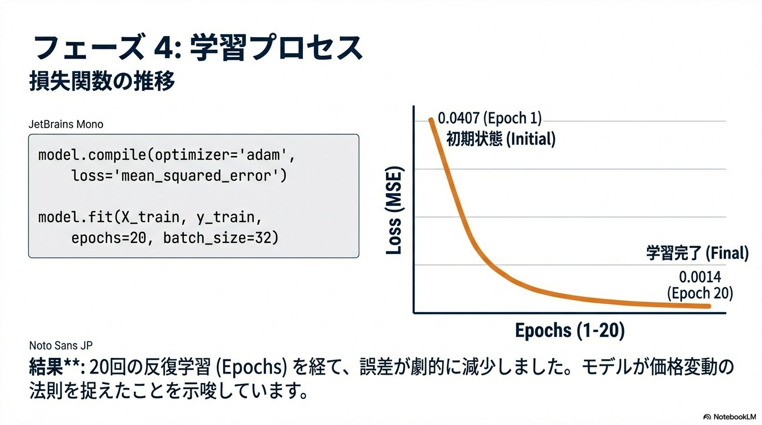

Slide 11
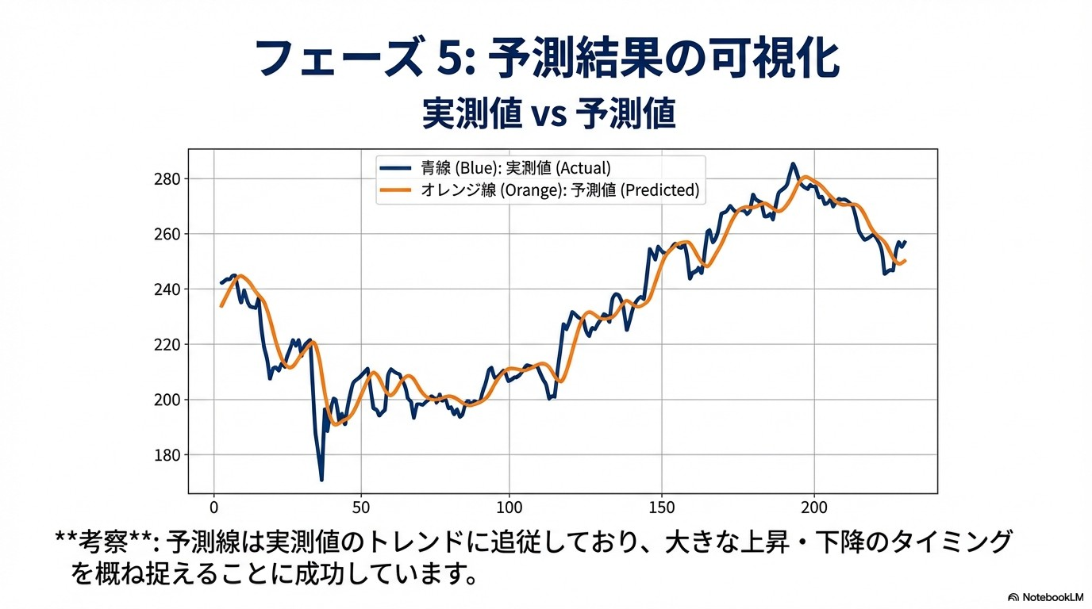

Slide 12
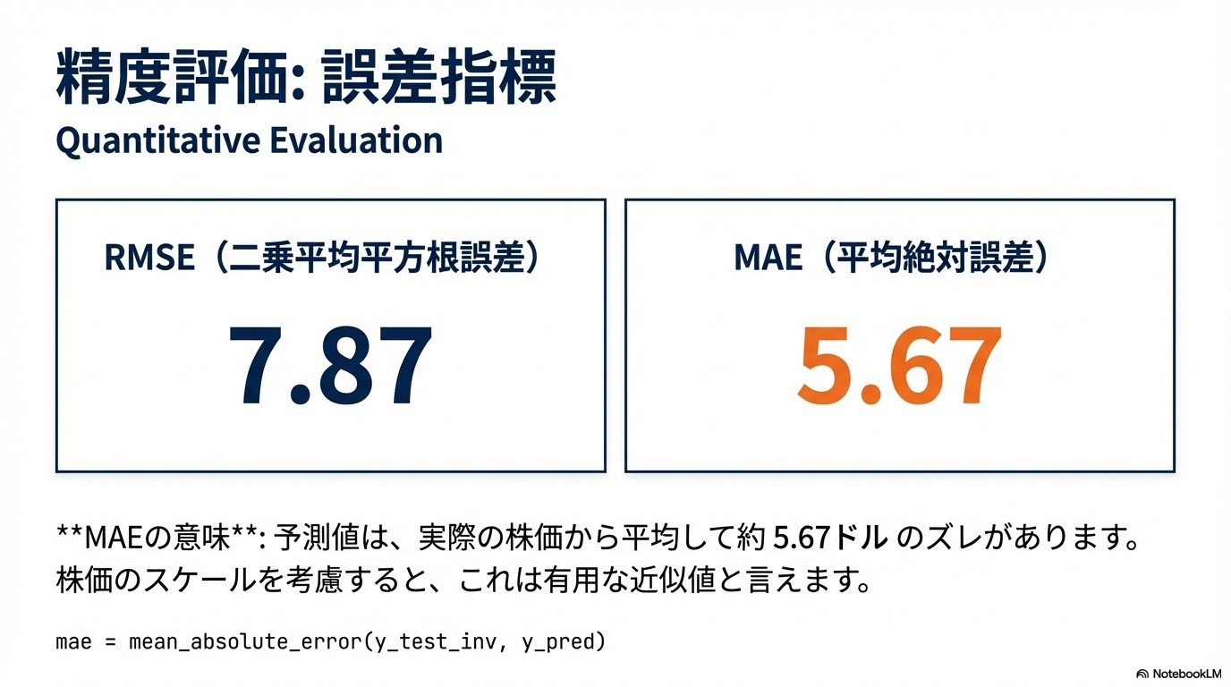

Slide 13
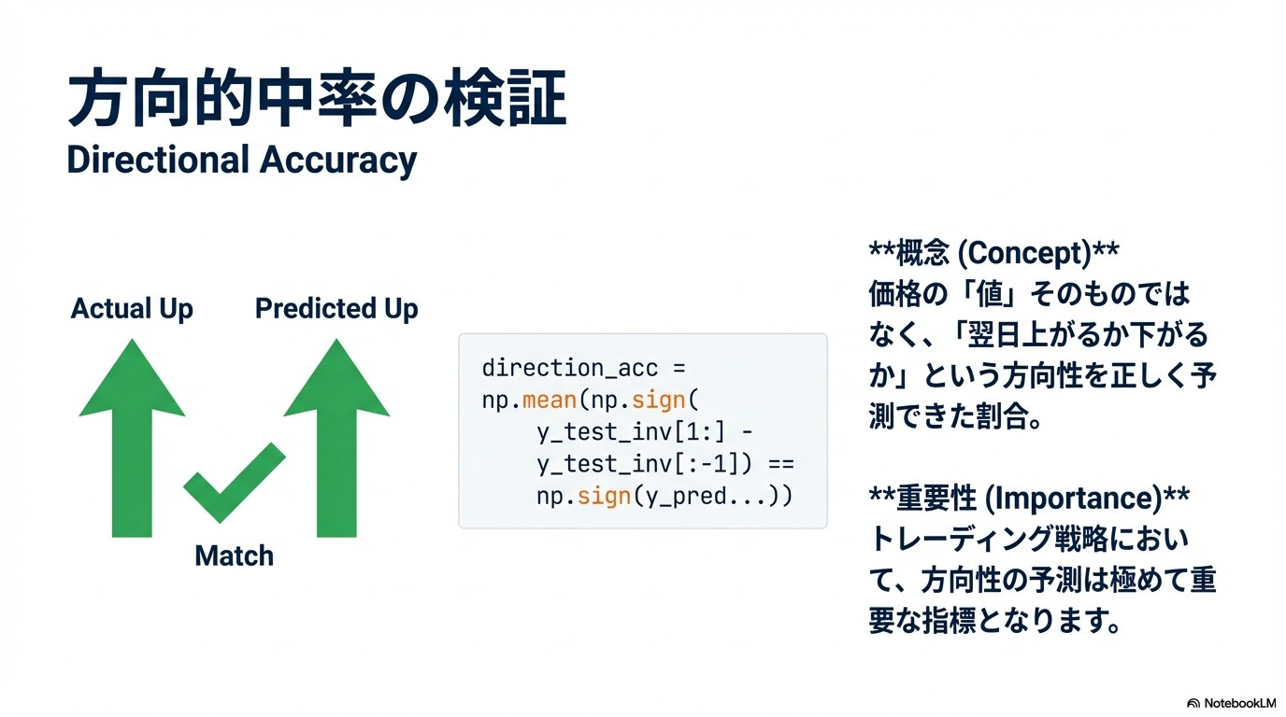

Slide 14
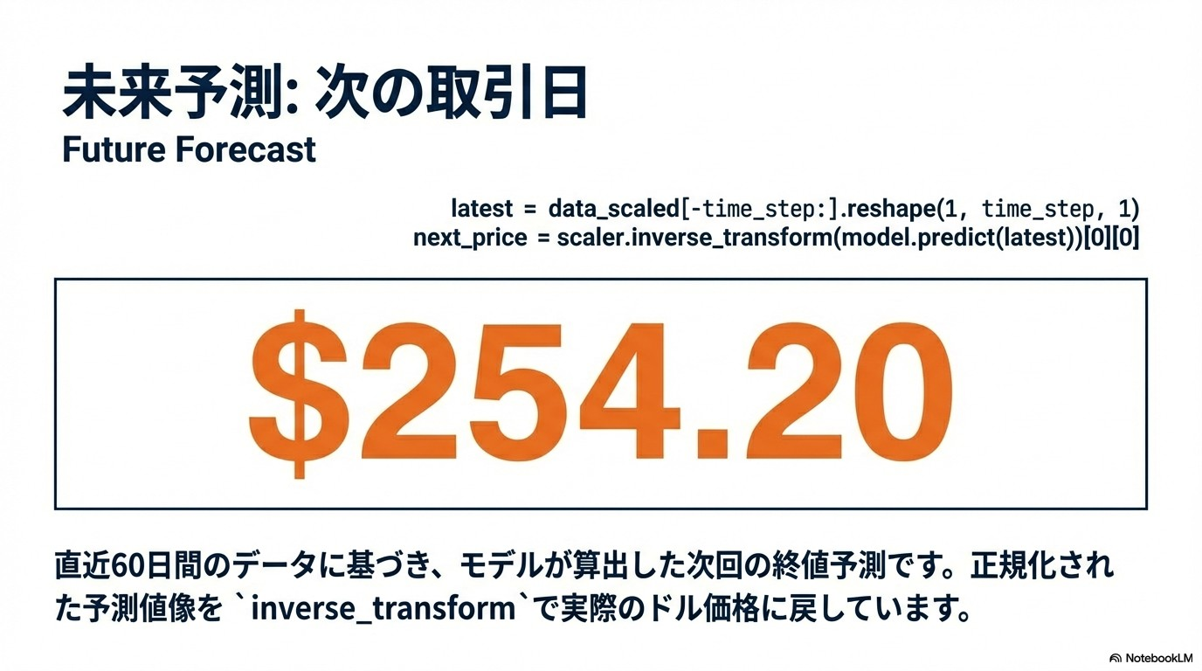

Slide 15
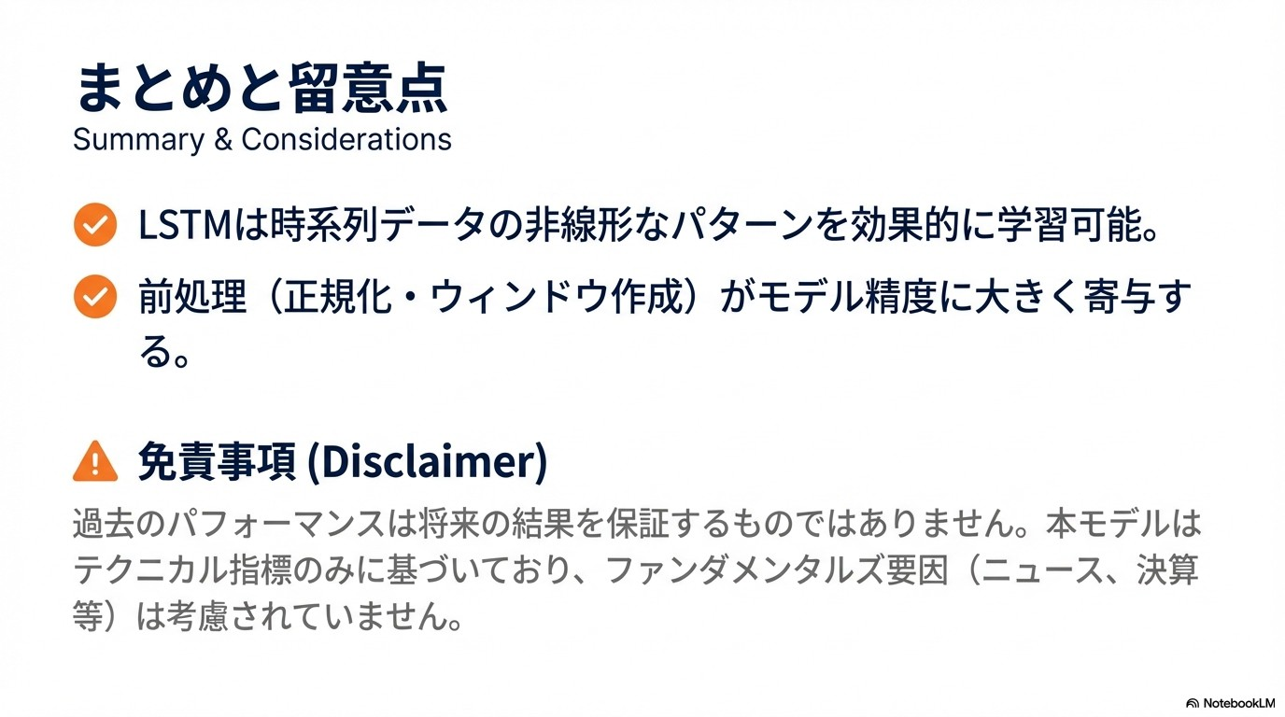

Slide 16
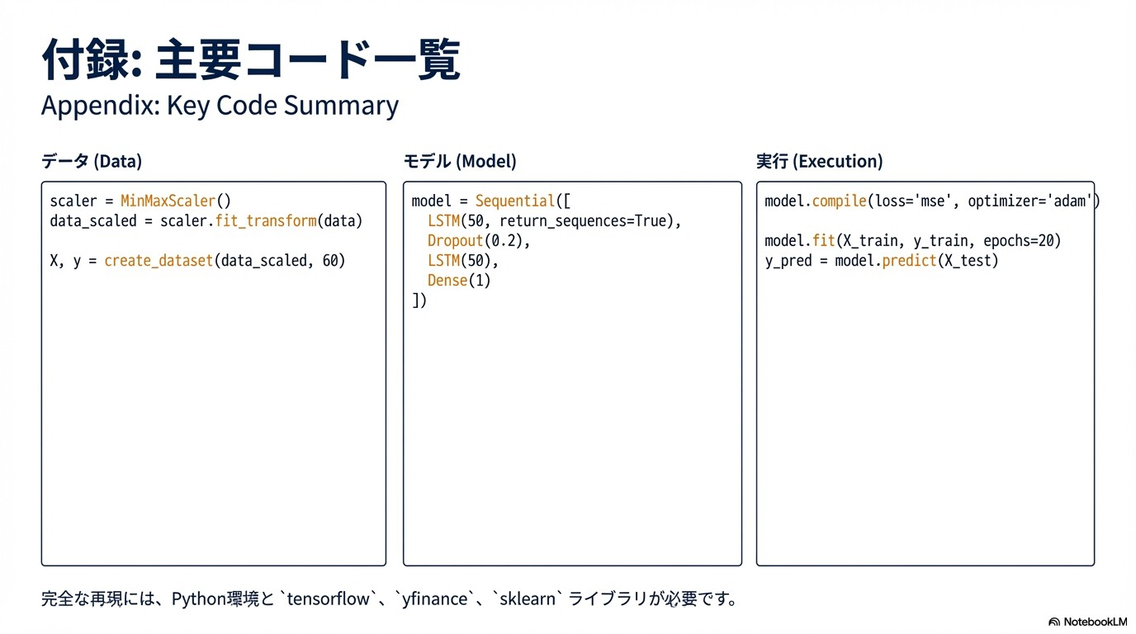

Slide 17
Code
# LSTMモデル（多層+Dropoutで過学習防止）
model = Sequential([
LSTM(50, return_sequences=True, input_shape=(time_step, 1)),
Dropout(0.2),
LSTM(50, return_sequences=False),
Dropout(0.2),
Dense(25),
Dense(1)
])
model.compile(optimizer='adam', loss='mean_squared_error')
model.fit(X_train, y_train, batch_size=32, epochs=20, validation_data=(X_test, y_test), verbose=1)
# 予測と逆正規化
y_pred = model.predict(X_test)
y_pred = scaler.inverse_transform(y_pred.reshape(-1,1))
y_test_inv = scaler.inverse_transform(y_test.reshape(-1,1))
# 可視化（実測vs予測）
plt.figure(figsize=(12,6))
plt.plot(y_test_inv, label='実測')
plt.plot(y_pred, label='予測')
plt.title(f'{ticker} Next day closing price forecast')
plt.legend()
plt.show()
# 方向的中率計算
direction_acc = np.mean(np.sign(y_test_inv[1:] - y_test_inv[:-1]) == np.sign(y_pred[1:] - y_pred[:-1]))
print(f"方向的中率: {direction_acc:.2%}")
import yfinance as yf
import numpy as np
import pandas as pd
from sklearn.preprocessing import MinMaxScaler
from tensorflow.keras.models import Sequential
from tensorflow.keras.layers import LSTM, Dense, Dropout
import matplotlib.pyplot as plt
# データ取得（Apple株、5年分）
ticker = 'AAPL'
data = yf.download(ticker, period='5y')['Close'].values.reshape(-1,1)
# 正規化とウィンドウ作成（過去60日→次日）
scaler = MinMaxScaler()
data_scaled = scaler.fit_transform(data)
def create_dataset(data, time_step=60):
X, y = [], []
for i in range(len(data)-time_step-1):
X.append(data[i:(i+time_step), 0])
y.append(data[i+time_step, 0])
return np.array(X), np.array(y)
time_step = 60
X, y = create_dataset(data_scaled, time_step)
X = X.reshape(X.shape[0], X.shape[1], 1)
# 訓練/テスト分割（80%）
split = int(0.8 * len(X))
X_train, X_test = X[:split], X[split:]
y_train, y_test = y[:split], y[split:]

Slide 18
Reference
Hochreiter, S. & Schmidhuber, J. (1997). Long Short-Term Memory. Neural Computation, 9(8), 1735–1780.
Chollet, F. Deep Learning with Python. Manning Publications, 2018.
Yahoo Finance API, yfinance Python library documentation.

