Slide 1
Your Life better!! ~Measure your stress levels~
5E No.22
Masahichi miyakoshi
Notes:
Now, I will give the presentation.
The title is ...

Slide 2
Do you have stress?
Notes:
I would like to ask everyone
...
Wouldn't you be happy if that stress could be reduced?

Slide 3
Purpose
・Analyze factors correlated with stress
・Quantify your current stress level to assess your physical condition objectively.
Notes:
So I will pursue two objectives.
First, analyze the causes of stress.
Secound, Quantify your current stress level to assess your physical condition objectively.

Slide 4
Data used for machine learning
Title: Sleep_health_and_lifestyle_dataset.csv
Data size: 374 (Training: 299, Validation: 75)
Features: 11+Stress level
(Gender, Age, Occupation, Sleep duration, Sleep quality, Physical activity level, Stress level, BMI category,
Blood pressure, Heart rate, Step count, Sleep disorder)
Notes:
Therefore, I used this data as input for machine learning.
...

Slide 5
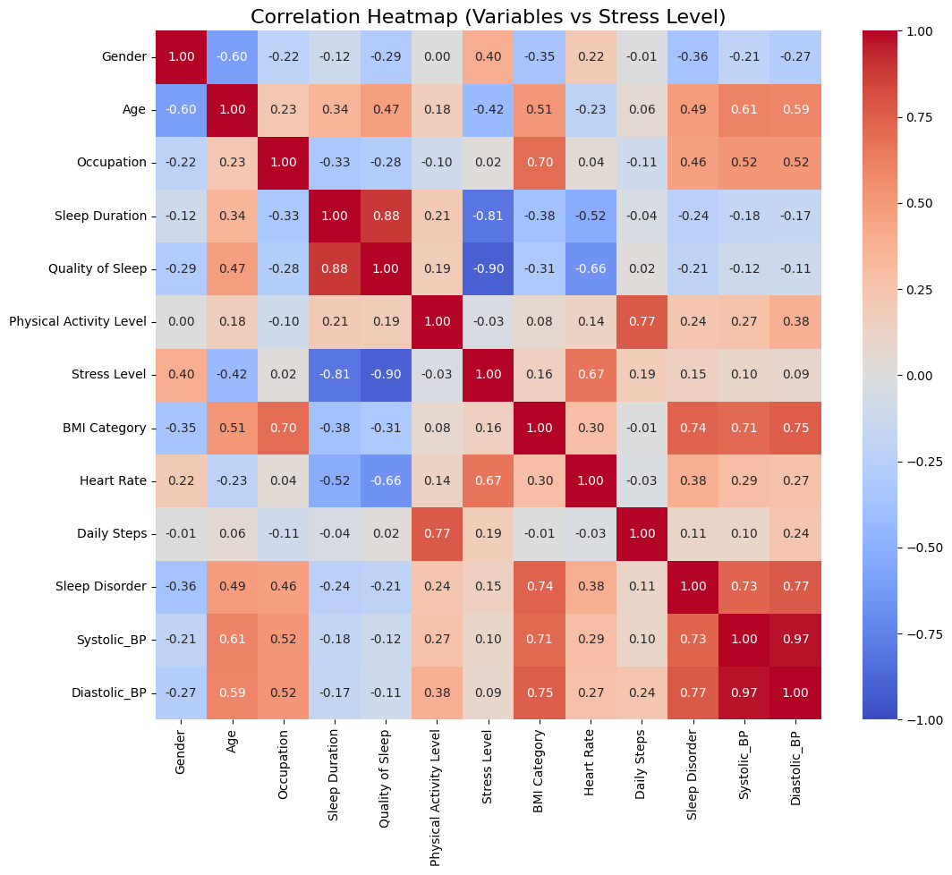
correlation heat map
Data with a correlation coefficient absolute value of 0.3 or higher was selected.
[‘Gender’, ‘Age’, ‘Sleep Duration’, ‘Quality of Sleep’, ‘Heart Rate’]
Notes:
I created a correlation heatmap of these features.
Then, we selected those with absolute correlation coefficients of 0.3 or higher for training.
...

Slide 6
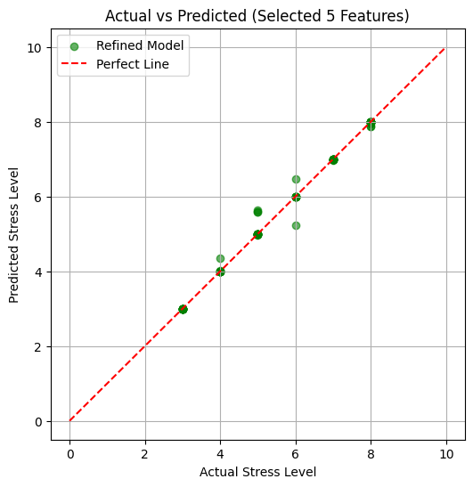
Model Evaluation
MAE : 0.051
R2 Score : 0.991
Notes:
We evaluate the model we actually trained.
The evaluation metrics are MAE and R2.
The MAE is 0.051, meaning the stress values, rated from 1 to 10, are on average 0.05 off.
Next, the R2 is 0.991, indicating extremely high accuracy.
This might be partly due to the small amount of data.

Slide 7
Let's actually using it!
Notes:
Now that we know the model's accuracy, let's actually try using it.

