Slide 1

Structural Bioinformatics Training Workshop & Hackathon 2017
Introduction to BioJava
Aleix Lafita
European Bioinformatics Institute
Structural Bioinformatics Laboratory
San Diego Supercomputer Center
UC San Diego

Slide 2
PART 1 BioJava Project
Mission
History
Organization
Documentation

Slide 3

BioJava mission
BioJava is an open-source project dedicated to providing a Java framework for processing biological data

Slide 4
BioJava history
Nov 7
Dec 20
6 days
Today
18 days
1992
Project starts
2012
BioJava 3
2015
BioJava 4
2017
BioJava 5
24 days
16 days
25 days

Slide 5
BioJava organization
Java
Programming language
Java 8
Maven
Project management
Git and Github
Code revision
Project hosting

Slide 6
Maven
Project Object Model (POM)
XML file that contains information about the project and configuration details used by Maven to build the project
Maven
Java source
pom.xml
https://maven.apache.org

Slide 7
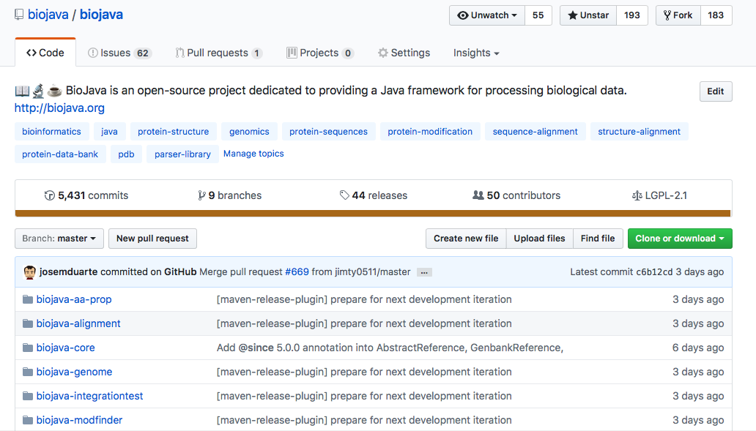
GitHub
https://github.com/biojava/biojava/

Slide 8
BioJava documentation
Tutorial
Educational introduction into some of the features that are provided by BioJava
https://github.com/biojava/biojava-tutorial
Cookbook
Collection of “How do I…?” and other common analysis
http://biojava.org/wiki/BioJava:CookBook

Slide 9
Demo 1
Create a new Maven respository in Eclipse

Slide 10
Exercise 1
Add the BioJava dependency to the new Maven repository

Slide 11
PART 2 BioJava Structures
Structure Class
Loading
Writing
Traversing

Slide 12
Structure Class
Structure
Model
Model
Chain
Chain
Chain
Chain
Group
Group
Atom
Atom

Slide 13
Loading
Environmental variables
PDB cache directory
AtomCache

Slide 14
Writting

Slide 15
Demo 2
Load a structure in the different formats

Slide 16
Exercise 2
Print the number of models, chains and residues of a structure

Slide 17
PART 3 Contribute to BioJava
Structure Class
Loading
Writing
Manipulation

