Slide 1

Structural Bioinformatics Training Workshop & Hackathon 2017
Introduction to BioJava
Aleix Lafita
European Bioinformatics Institute
Structural Bioinformatics Laboratory
San Diego Supercomputer Center
UC San Diego

Slide 2
PART 1 BioJava Project
History
Resources
Setup

Slide 3

BioJava
BioJava is an open-source project dedicated to
providing a Java framework for
processing biological data
File parsers
Algorithms
Data models
FASTA
PDB
MMTF
MMCIF
Resources
Protein structures
Biological sequences
Sequence and structure alignment
Protein domains: SCOP, CATH, ECOD
BLAST
Symmetry
DSSP

Slide 4
History of BioJava
2009
Port to SVN
2013
Port to Git (GitHub)
Java 4
Java 5
Java 6
Nov 7
Java 7
Java 8
Dec 20
6 days
Today
18 days
24 days
16 days
25 days
2000
Biojava born
Pocock et al
2008
BioJava legacy
Holland et al
2012
BioJava 3
Prlić et al
2015
BioJava 4
2017
BioJava 5

Slide 5
BioJava Resources
Website: https://biojava.org
Source code: https://github.com/biojava/biojava/
Wikipedia: https://en.wikipedia.org/wiki/BioJava
General information about the project
Tutorial: https://github.com/biojava/biojava-tutorial
Educational introduction into the tools provided by BioJava
Cookbook: http://biojava.org/wiki/BioJava:CookBook
Collection of “How do I…?” recipes for common tasks

Slide 6
Setting up BioJava
Project Object Model (POM): XML file that contains information about the project and configuration details
Maven
Java source
pom.xml

Slide 7
Demo 1
Create a new Maven repository in Eclipse

Slide 8
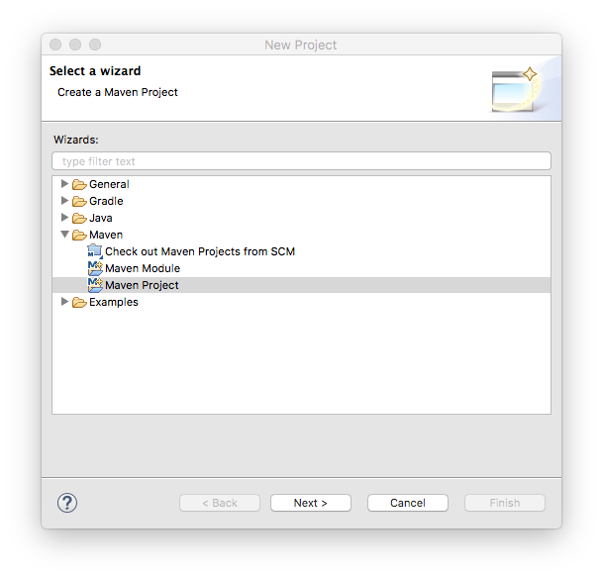
Demo 1
Create a new Maven repository in Eclipse
File > New > Project
Maven Project

Slide 9
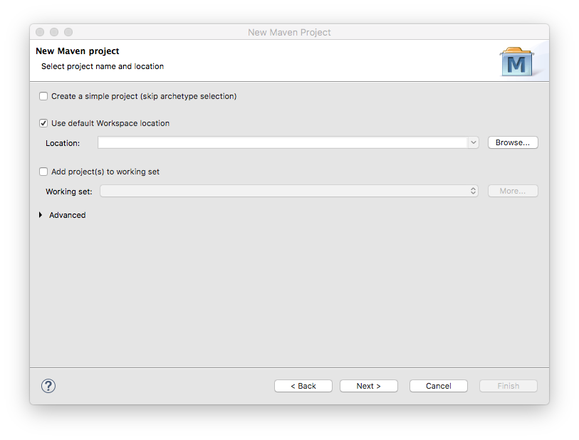
Demo 1
Create a new Maven repository in Eclipse
File > New > Project
Maven Project
Use defaults

Slide 10
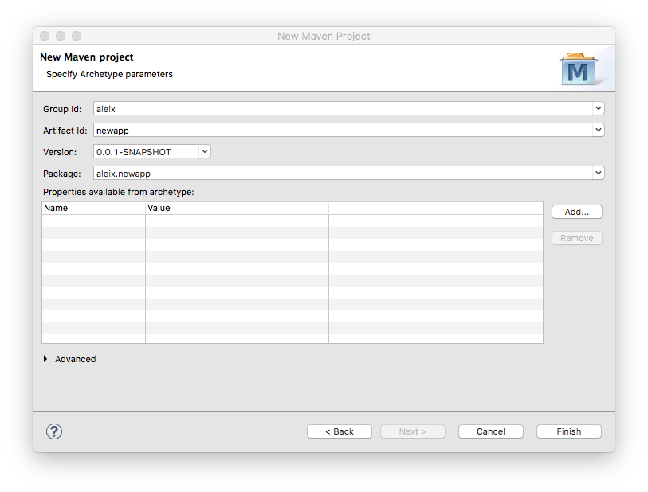
Demo 1
Create a new Maven repository in Eclipse
File > New > Project
Maven Project
Use defaults
Choose your group
and project id

Slide 11
Problem 1
Configure the new Maven repository and add the BioJava dependency
Task 1: fill in the URL field (replace the default URL)
Task 2: configure the Java 8 JDK. Insert these properties in the POM:
Task 3: insert the biojava-stucture dependency (hint: https://github.com/biojava/biojava-tutorial/blob/master/installation.md)
Task 4: ensure BioJava version is the latest (5.0.0-alpha8)
<jdk.version>1.8</jdk.version>
<maven.enforcer.jdk-version>1.8</maven.enforcer.jdk-version>
<maven.compiler.source>1.8</maven.compiler.source>
<maven.compiler.target>1.8</maven.compiler.target>

Slide 12
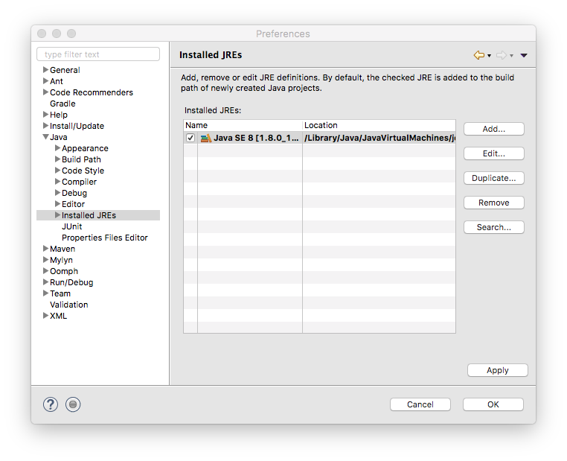
Setting up BioJava
Configure the BioJava environment
Eclipse > Preferences > Java > Installed JREs
Edit…

Slide 13
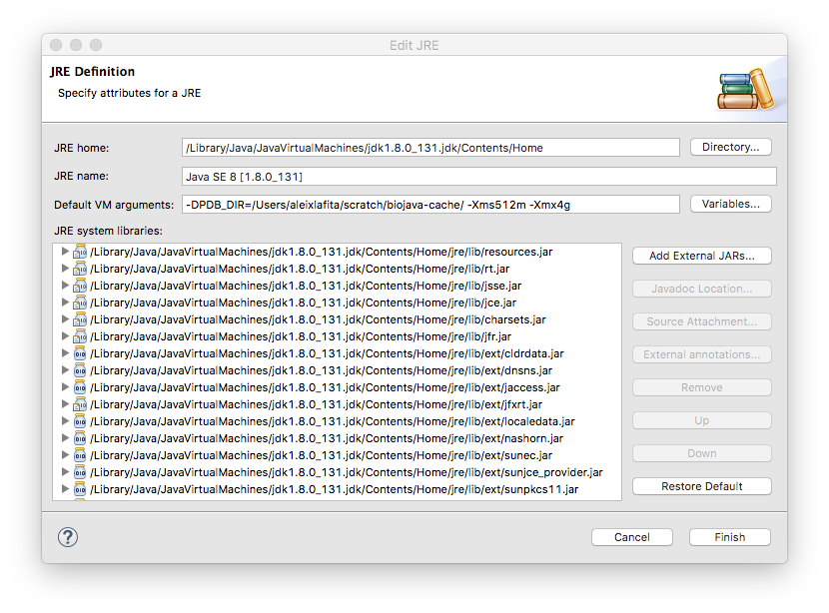
Setting up BioJava
Configure the BioJava environment
Eclipse > Preferences > Java > Installed JREs
Edit…
Add -DPDB_DIR=
directory

Slide 14
PART 2 BioJava Structures
Structure Objects
Loading and writing
Operations

Slide 15
Structure Objects
Structure
Model
Model
Chain
Chain
Chain
Chain
Structure = List<Model>
Model = List<Chain>
Chain = List<Group>
Group = List<Atom>
Atom = coordinates (X,Y,Z)
Group
Group
Atom
Atom

Slide 16
Group Types
BioJava uses the Chemical Component Dictionary to assign group types
Amino Acid (L-peptides)
Nucleotide (DNA or RNA)
Waters
Hetatoms
https://github.com/biojava/biojava-tutorial/blob/master/structure/chemcomp.md

Slide 17
Loading Structure Objects
AtomCache
PDB ids (2HHB)
Structural ranges (2HHB.A:1-20)
SCOP, CATH & ECOD ids (d2hhba_)
Many configuration options

Slide 18
Demo 2
Load a structure in different formats
Write a structure from BioJava to a file

Slide 19
Problem 2
Traverse BioJava structures
Task 1: number of models. Hint: nrModels
Task 2: number of polymer chains. Hint: PolyChains
Task 3: number of amino acids in a chain.
Take a look at the GroupType class first
Hint: use one method from the Chain object
Task 4: number of oxygens in the amino acids of a chain.
Take a look at the Element class
Hint: use a double loop iteration over List of Groups and Atoms

Slide 20
PART 3 BioJava Applications
Biological assemblies
Structure alignments
Solvent accessible surface

