Slide 1
2026 FLTRP·ETIC Cup — Understanding Contemporary China
Four New Disciplines Special Track
ENGLISH PRESENTATION · 3-MIN VIDEO
One Health in Action
HUMAN
ANIMAL
An AI-Powered Early-Warning System for Brucellosis Prevention
AI EARLY-WARNING
Risk Fusion Engine
A Low-Cost, Grassroots-Adaptable China Solution
One Health
AI Early Warning
Brucellosis
Low-Cost
Grassroots-Adaptable
ENVIRONMENT
From fragmented control to One Health early warning.
One Health in Action · AI-Powered Brucellosis Early Warning
2026

Slide 2





PART 1 · IDENTIFYING THE PROBLEM
02
Background and Significance
High-burden zoonosis — spreads mainly from cattle and sheep to humans; insidious, chronic and recurrent.
One Health
Integrated prevention across humans, animals and the environment.
Neglected yet severe — the WHO lists it among the most overlooked threats to public health.
One Health required — control must integrate human, animal and environmental health.
A real global gap — affordable, grassroots-adaptable early warning is still missing.
Brucellosis is among the most neglected diseases, yet it poses a major threat to public health.
— World Health Organization, Brucellosis in Humans and Animals, 2006 (paraphrased)
Significance: closing this gap protects pastoral livelihoods and offers a model other zoonoses can copy.
One Health in Action · 2026 FLTRP·ETIC Cup
02 / 12

Slide 3

PART 1 · IDENTIFYING THE PROBLEM
03
The Problem: A Neglected Global Zoonosis
How severe is the global brucellosis burden — and is it really under control?
China stays high
Five years at 47.4k–70.4k; 62.1k in 2024, no decline.
EU and EEA rising
Confirmed cases climbed yearly, reaching 273 in 2024.
So what?
The burden is not receding; control lags behind.
Sources: official surveillance reports — China notifiable cases 2020–2024; EU/EEA confirmed cases 273 (2024).
A persistent, high-level global burden — prevention and control clearly lag behind.
One Health in Action · 2026 FLTRP·ETIC Cup
03 / 12

Slide 4

PART 1 · IDENTIFYING THE PROBLEM
04
Problems to Solve
Governance Fragmentation
CORE RESEARCH QUESTION
P1
Animal, human and environmental data sit in separate silos, with no routine digital link.
How can low-resource regions achieve early, accurate and affordable early warning?
Weak Grassroots Surveillance
P2
Manual patrols and quarterly quarantine leave long lags; latent infections go unseen.
Unaffordable Technology
P3
High-cost, lab-based systems cannot scale to low-resource, livestock-based regions.
The single question this project sets out to answer.
One Health in Action · 2026 FLTRP·ETIC Cup
04 / 12

Slide 5




PART 2 · ANALYZING THE PROBLEM
05
Research Design: Methods and Steps
STEPS
Define the transmission chain and data gaps
Collect and clean multi-source data, 2020–2024
Map current control bottlenecks
Derive root causes and design the solution
1
2
3
4
METHODS
Literature Review
Multi-Source Data Analysis
Case Study
One Health governance, brucellosis surveillance and AI early-warning studies.
Animal quarantine, livestock density, environment and human case data.
Grassroots counties and pastoral areas: workflow, staffing, capacity.
Evidence base
Data foundation
Field grounding
Evidence-driven: every conclusion in this study traces back to these three sources.
One Health in Action · 2026 FLTRP·ETIC Cup
05 / 12

Slide 6
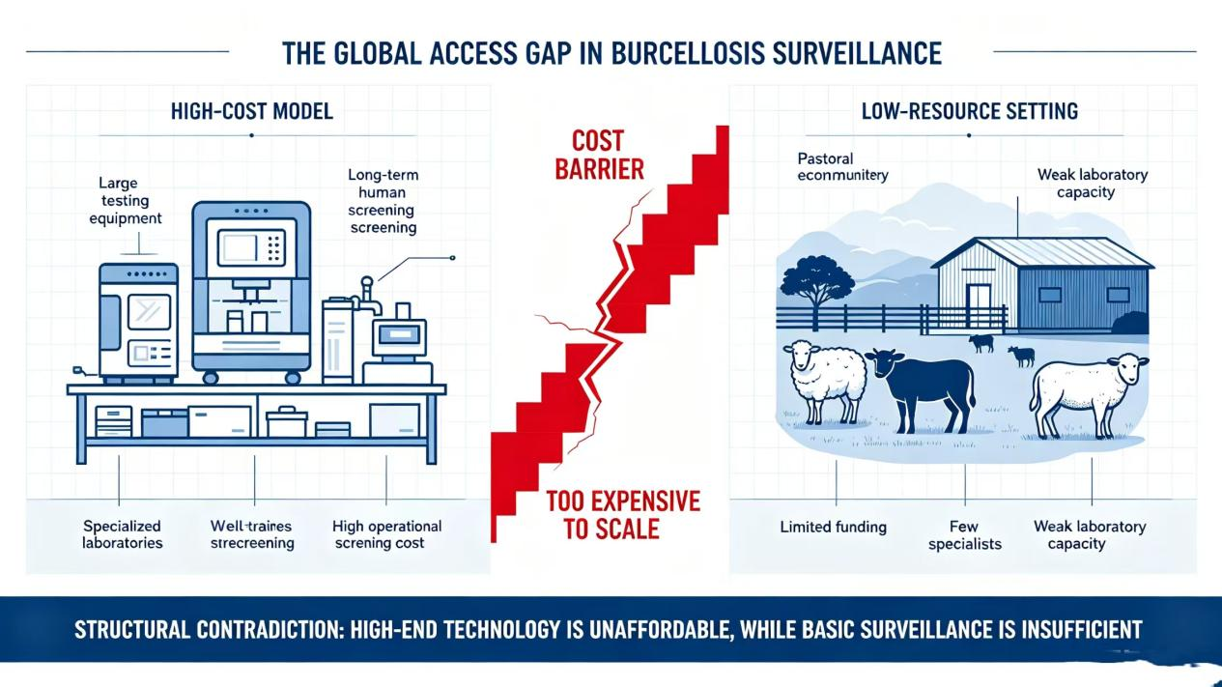
PART 2 · ANALYZING THE PROBLEM
06
Major Findings from the Survey
F1
Control lags at the clinic — early symptoms mimic flu; misdiagnosis and under-reporting are common.
F2
Sectoral data never meet — no shared platform links animal and human records at county level.
F3
Detection trails infection — reporting still follows clinic visits, not early risk signals.
F4
Cost is the binding constraint — the counties reviewed could not sustain lab-based screening.
Fig. The global access gap in brucellosis surveillance (entry document).
Together, these findings point to one missing piece: affordable early warning.
High-end technology is unaffordable, while basic surveillance is insufficient — a structural contradiction.
One Health in Action · 2026 FLTRP·ETIC Cup
06 / 12

Slide 7
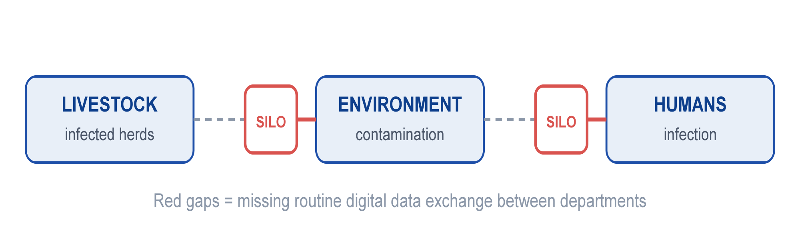
PART 2 · ANALYZING THE PROBLEM
07
Root-Cause Analysis
The transmission loop is intact — but the data loop is broken
R1 · Fragmented Governance
R2 · Weak Grassroots Surveillance
R3 · High-Cost Tech Cannot Scale
Mechanism: animal, health and environment agencies each keep their own records.
Mechanism: manual patrols and quarterly quarantine, with few trained staff.
Mechanism: mainstream systems rely on labs, devices and long-term screening.
Consequence: no one sees the full transmission chain; risk is judged late and in pieces.
Consequence: latent infections accumulate unseen; response stays reactive.
Consequence: unaffordable where livestock is the backbone of the economy.
Together:
the three causes compound each other — high-end systems are unaffordable, low-end control cannot hold the line.
One Health in Action · 2026 FLTRP·ETIC Cup
07 / 12

Slide 8
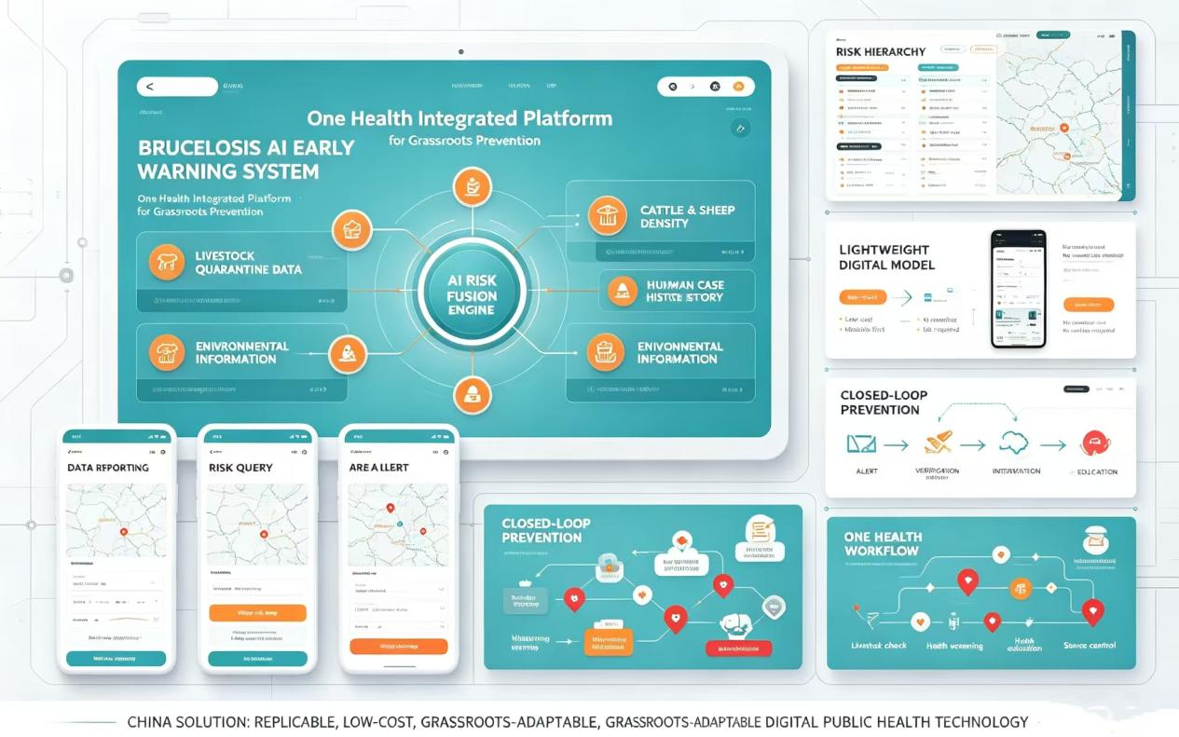
PART 3 · SOLVING THE PROBLEM
08
The China Solution
AI + One Health + Low-Cost Digital Tools
Goal: a grassroots-adaptable, replicable, low-cost early-warning system that makes One Health coordination real.
1
Fusion of four multi-source data streams
2
Lightweight mini-program — no extra hardware at the grassroots
3
Closed loop: warning → verification → intervention → education
4
Grassroots-first deployment, not lab-first design
Existing research largely stops at algorithms; this project delivers a complete, field-ready operational loop.
Prototype platform: an AI risk-fusion engine linking four data sources
One Health in Action · 2026 FLTRP·ETIC Cup
08 / 12

Slide 9

PART 3 · SOLVING THE PROBLEM
09
How It Works
From passive case intake to active early warning
Data Collection
AI Fusion
Risk Mapping
Early Warning
Verification
Intervention
Education
Multi-source fusion, closed-loop response
CURRENT PROGRESS
· Four streams in: livestock quarantine, herd density, environmental data, past human cases.
Prototype system built
Pilot planned next
· AI pinpoints high-risk townships, farms and exposed groups.
To validate accuracy and grassroots usability
· Dual-line verification by animal-husbandry and health teams, then disinfection, isolation, screening and health education.
One Health in Action · 2026 FLTRP·ETIC Cup
09 / 12

Slide 10
PART 3 · SOLVING THE PROBLEM
10
Why This Solution Stands
Academic Grounding
Innovation
Built on the One Health framework and epidemiological modelling — risk is inferred from transmission chains, not guesswork.
A lightweight early-warning loop built for the grassroots rather than the lab — a step existing studies rarely take.
Interdisciplinarity · Four New Disciplines
Operability
New Medicine
New Agriculture
New Engineering
New Liberal Arts
No new hardware, reuses existing data streams, deployable at county level — designed to run where resources are scarcest.
Public health, animal disease control, AI and data fusion, and global governance — joined in one working data-to-action pipeline.
Grounded in theory, new in form, cross-disciplinary in method, and ready to deploy.
One Health in Action · 2026 FLTRP·ETIC Cup
10 / 12

Slide 11
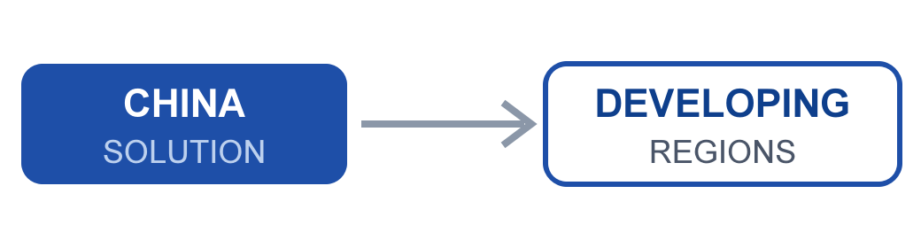
PART 3 · SOLVING THE PROBLEM
11
Expected Outcomes and Global Implications
Expected Outcomes
01
A working prototype platform
02
A pilot-validated warning model
03
A county-level deployment guide
Global Implications: A Replicable China Paradigm
· A low-cost digital path instead of expensive equipment stacks — within reach of developing countries.
· From a single medical lens to One Health cross-sector coordination.
Adapting abroad means localising data interfaces, delivery channels and mandates — not copying.
· Big data and AI close the grassroots public-health gap at low cost.
One Health in Action · 2026 FLTRP·ETIC Cup
11 / 12

Slide 12
CONCLUSION
Earlier. More accurate. More inclusive.
Thank you. Questions and comments are welcome.
AI + One Health can bring brucellosis early warning within reach of the grassroots — in China and beyond.
REFERENCES
[1]
World Health Organization. Brucellosis in Humans and Animals. Geneva: WHO Press, 2006.
[2]
Franc KA, Krecek RC, Hasler BN, Arenas-Gamboa AM. Brucellosis remains a neglected disease in the developing world. BMC Public Health, 2018, 18(1): 125.
[3]
Wang W, et al. Epidemiological characteristics of human brucellosis in China. Chinese Journal of Preventive Medicine, 2023, 57(10): 1477-1483.
[4]
National Health Commission of the PRC. National Action Plan for Brucellosis Prevention and Control (2021-2025). Beijing, 2021.
12
One Health in Action · 2026 FLTRP·ETIC Cup
12 / 12

