Slide 1
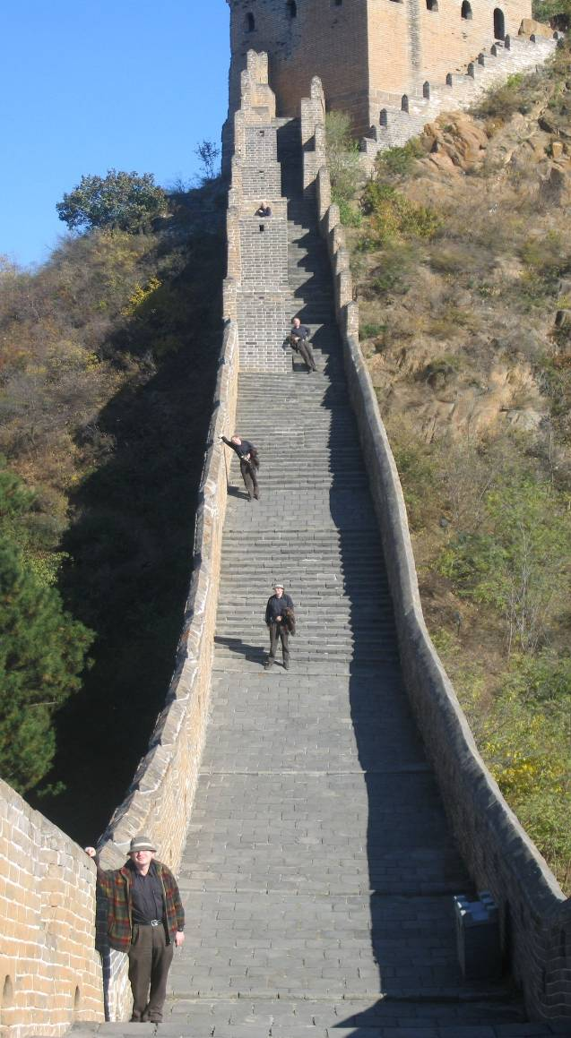
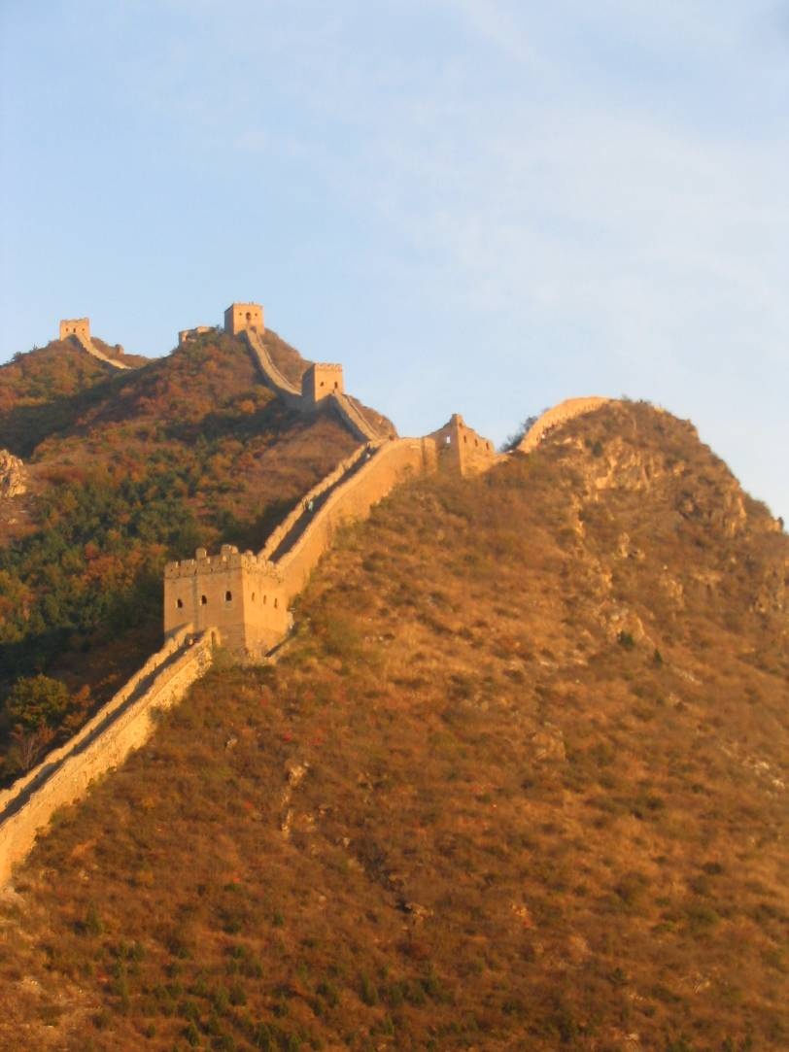
Automatic Image Alignment (direct)
15-463: Computational Photography
Alexei Efros, CMU, Fall 2006
with a lot of slides stolen from
Steve Seitz and Rick Szeliski

Slide 2
Image Alignment
How do we align two images automatically?
Two broad approaches:
  Feature-based alignment
    Find a few matching features in both images
    compute alignment
  Direct (pixel-based) alignment
    Search for alignment where most pixels agree

Slide 3
Direct Alignment
The simplest approach is a brute force search (hw1)
  Need to define image matching function
    SSD, Normalized Correlation, edge matching, etc.
  Search over all parameters within a reasonable range:
e.g. for translation:
for tx=x0:step:x1,
for ty=y0:step:y1,
compare image1(x,y) to image2(x+tx,y+ty)
end;
end;
Need to pick correct x0,x1 and step
  What happens if step is too large?

Slide 4
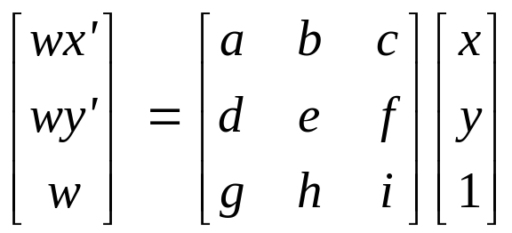
Direct Alignment (brute force)
What if we want to search for more complicated transformation, e.g. homography?
for a=a0:astep:a1,
for b=b0:bstep:b1,
for c=c0:cstep:c1,
for d=d0:dstep:d1,
for e=e0:estep:e1,
for f=f0:fstep:f1,
for g=g0:gstep:g1,
for h=h0:hstep:h1,
compare image1 to H(image2)
end; end; end; end; end; end; end; end;

Slide 5
Problems with brute force
Not realistic
  Search in O(N⁸) is problematic
  Not clear how to set starting/stopping value and step
What can we do?
  Use pyramid search to limit starting/stopping/step values
  For special cases (rotational panoramas), can reduce search slightly to O(N⁴):
    H = K₁R₁R₂⁻¹K₂⁻¹ (4 DOF: f and rotation)
Alternative: gradient decent on the error function
  i.e. how do I tweak my current estimate to make the SSD error go down?
  Can do sub-pixel accuracy
  BIG assumption?
    Images are already almost aligned (<2 pixels difference!)
    Can improve with pyramid
  Same tool as in motion estimation

Slide 6
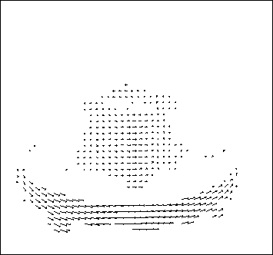
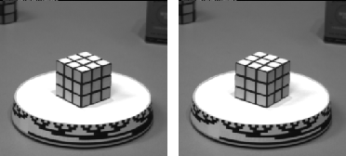
Motion estimation: Optical flow
Will start by estimating motion of each pixel separately
Then will consider motion of entire image

Slide 7
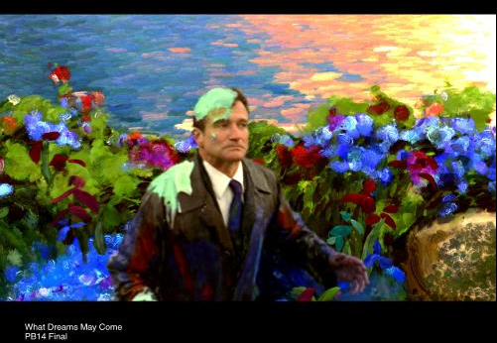
Why estimate motion?
Lots of uses
  Track object behavior
  Correct for camera jitter (stabilization)
  Align images (mosaics)
  3D shape reconstruction
  Special effects

Slide 8


Problem definition: optical flow
How to estimate pixel motion from image H to image I?
  Solve pixel correspondence problem
    given a pixel in H, look for nearby pixels of the same color in I
Key assumptions
  color constancy: a point in H looks the same in I
    For grayscale images, this is brightness constancy
  small motion: points do not move very far
This is called the optical flow problem

Slide 9


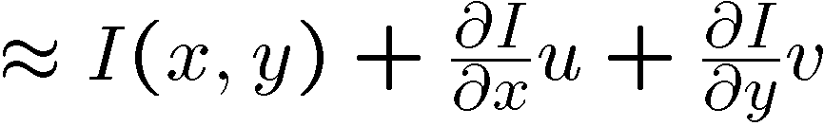
Optical flow constraints (grayscale images)
Let’s look at these constraints more closely
  brightness constancy: Q: what’s the equation?
  small motion: (u and v are less than 1 pixel)
    suppose we take the Taylor series expansion of I:
Notes:
A: H(x,y) = I(x+u, y+v)

Slide 10
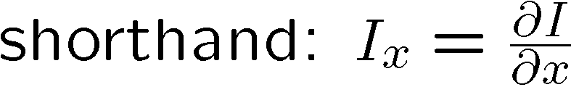


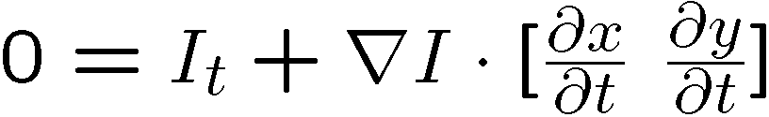
Optical flow equation
Combining these two equations
In the limit as u and v go to zero, this becomes exact

Slide 11

Optical flow equation
Q: how many unknowns and equations per pixel?
Intuitively, what does this constraint mean?
  The component of the flow in the gradient direction is determined
  The component of the flow parallel to an edge is unknown
This explains the Barber Pole illusion
  http://www.sandlotscience.com/Ambiguous/barberpole.htm
Notes:
A: u and v are unknown, 1 equation

Slide 12
Aperture problem

Slide 13
Aperture problem

Slide 14
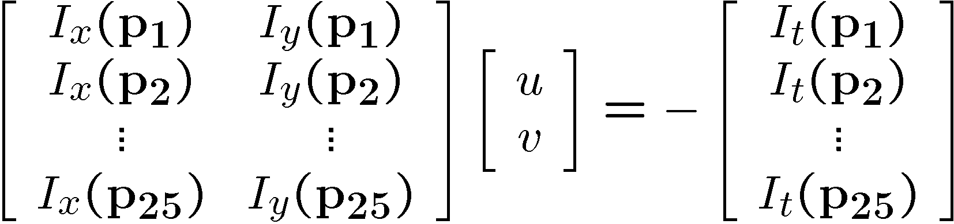




Solving the aperture problem
How to get more equations for a pixel?
  Basic idea: impose additional constraints
    most common is to assume that the flow field is smooth locally
    one method: pretend the pixel’s neighbors have the same (u,v)
      If we use a 5x5 window, that gives us 25 equations per pixel!

Slide 15
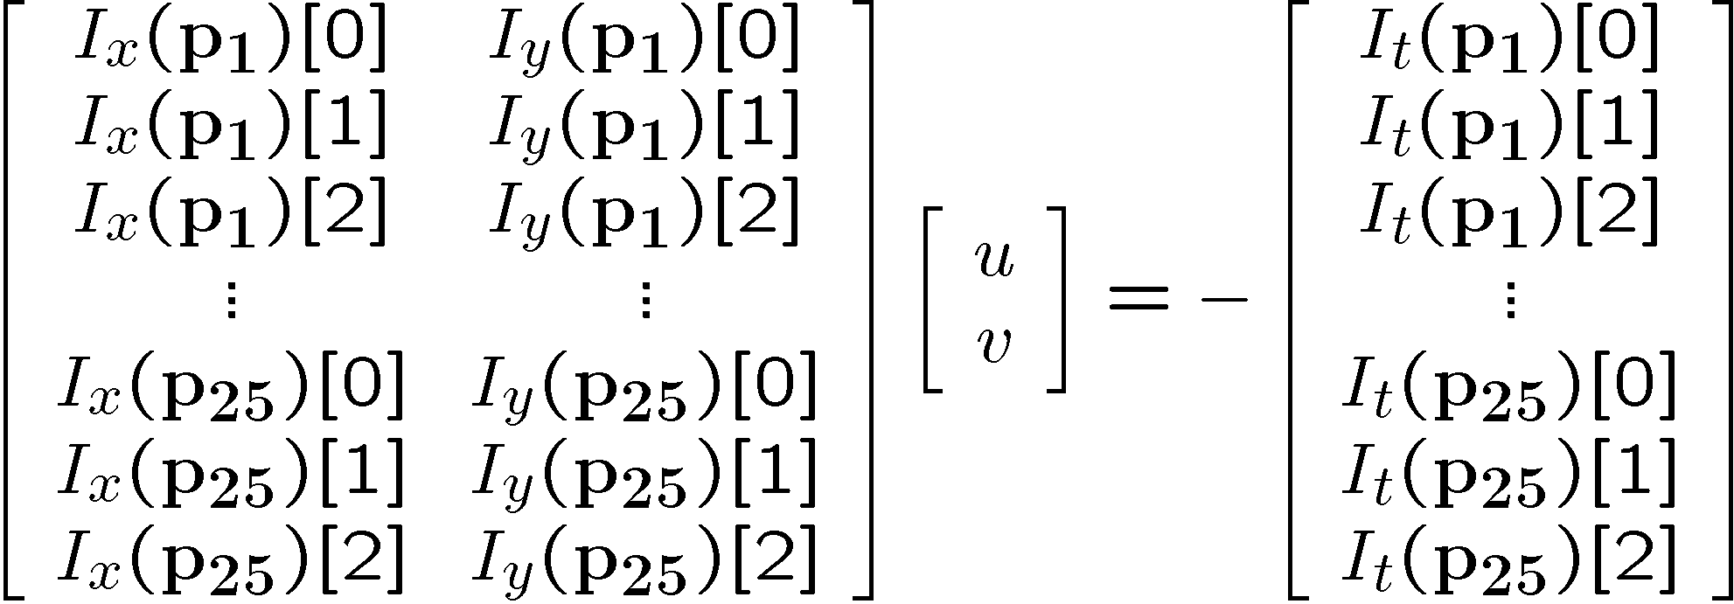


RGB version
How to get more equations for a pixel?
  Basic idea: impose additional constraints
    most common is to assume that the flow field is smooth locally
    one method: pretend the pixel’s neighbors have the same (u,v)
      If we use a 5x5 window, that gives us 25*3 equations per pixel!

Slide 16





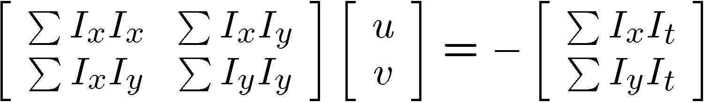


Lukas-Kanade flow
Prob: we have more equations than unknowns
Solution: solve least squares problem
  minimum least squares solution given by solution (in d) of:
  The summations are over all pixels in the K x K window
  This technique was first proposed by Lukas & Kanade (1981)

Slide 17
Conditions for solvability
  Optimal (u, v) satisfies Lucas-Kanade equation
When is This Solvable?
  A^{T}A should be invertible
  A^{T}A should not be too small due to noise
    eigenvalues λ₁ and λ₂ of A^{T}A should not be too small
  A^{T}A should be well-conditioned
    λ₁/ λ₂ should not be too large (λ₁ = larger eigenvalue)
A^{T}A is solvable when there is no aperture problem

Slide 18
Local Patch Analysis

Slide 19
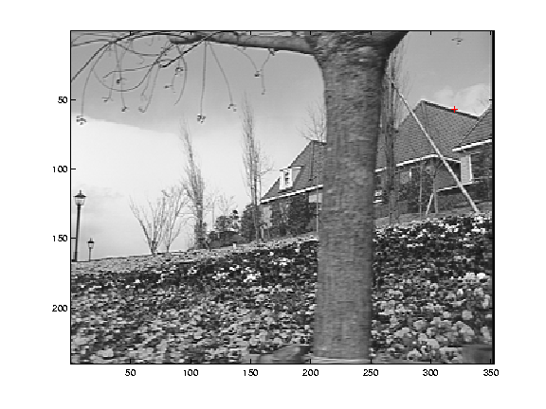
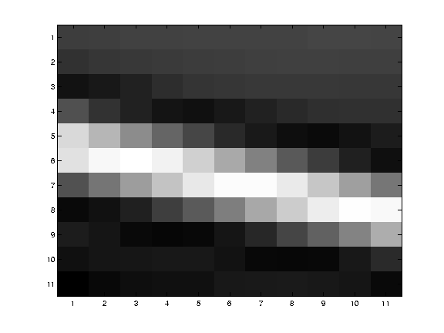
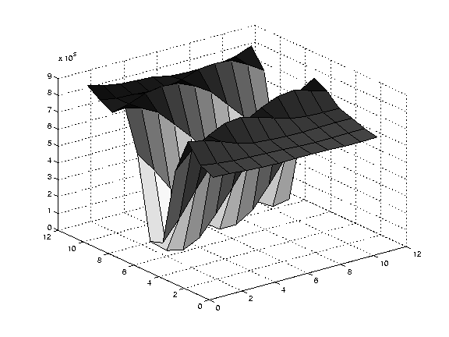
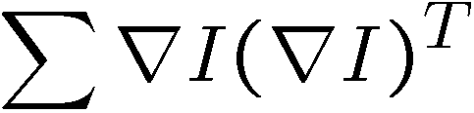
Edge
large gradients, all the same
large λ₁, small λ₂

Slide 20
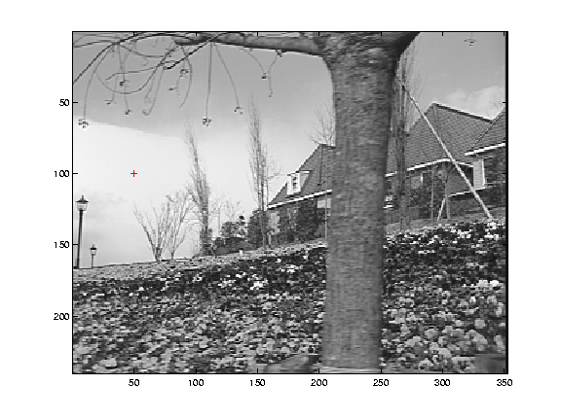
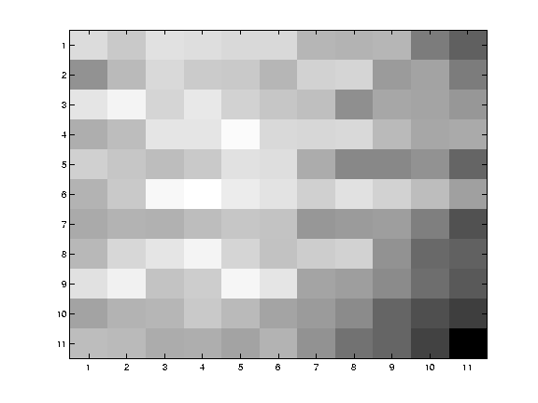
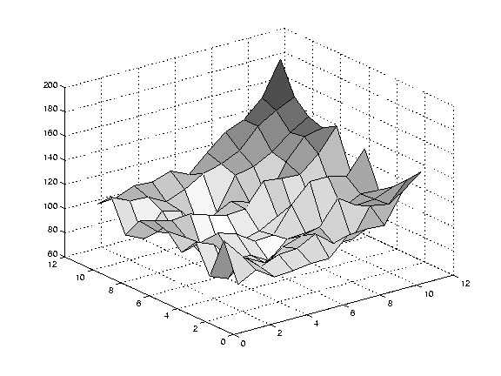
Low texture region
gradients have small magnitude
small λ₁, small λ₂

Slide 21
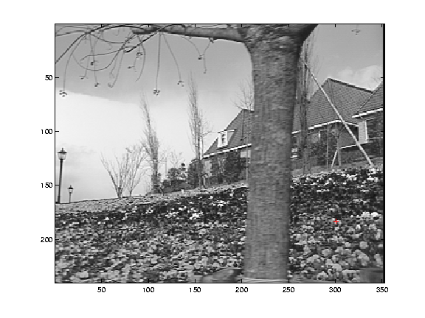
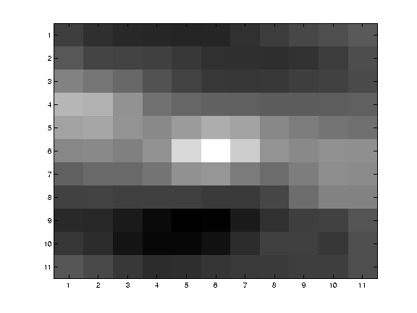
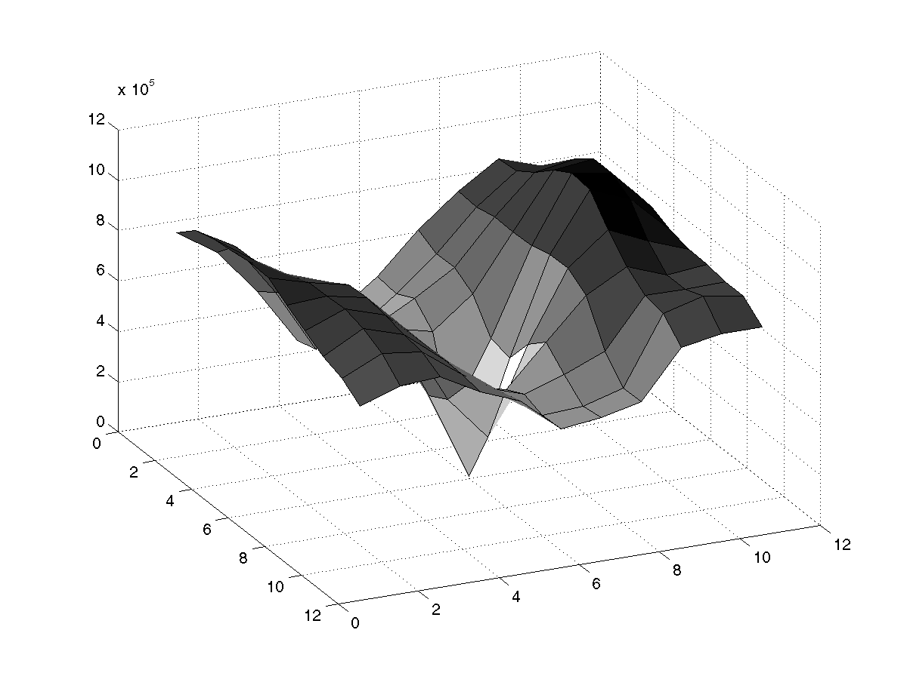
High textured region
gradients are different, large magnitudes
large λ₁, large λ₂

Slide 22
Observation
This is a two image problem BUT
  Can measure sensitivity by just looking at one of the images!
  This tells us which pixels are easy to track, which are hard
    very useful later on when we do feature tracking...

Slide 23
Errors in Lukas-Kanade
What are the potential causes of errors in this procedure?
  Suppose A^{T}A is easily invertible
  Suppose there is not much noise in the image
When our assumptions are violated
  Brightness constancy is not satisfied
  The motion is not small
  A point does not move like its neighbors
    window size is too large
    what is the ideal window size?

Slide 24
Iterative Refinement
Iterative Lukas-Kanade Algorithm
  Estimate velocity at each pixel by solving Lucas-Kanade equations
  Warp H towards I using the estimated flow field
    - use image warping techniques
  Repeat until convergence

Slide 25
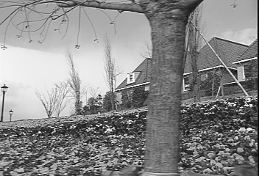
Revisiting the small motion assumption
Is this motion small enough?
  Probably not—it’s much larger than one pixel (2nd order terms dominate)
  How might we solve this problem?

Slide 26
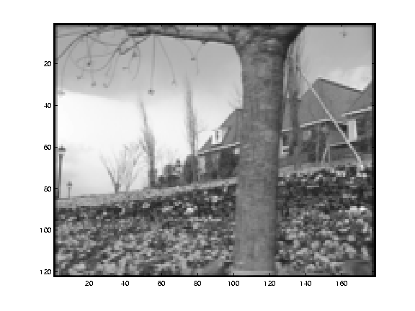
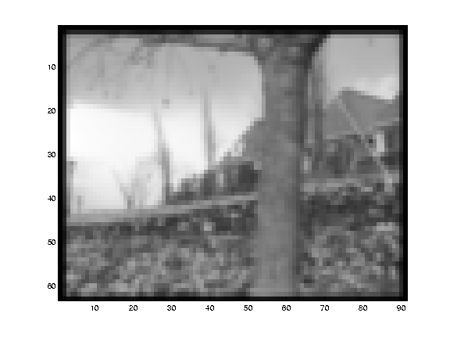
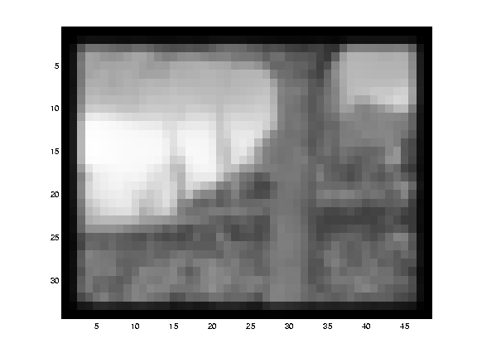
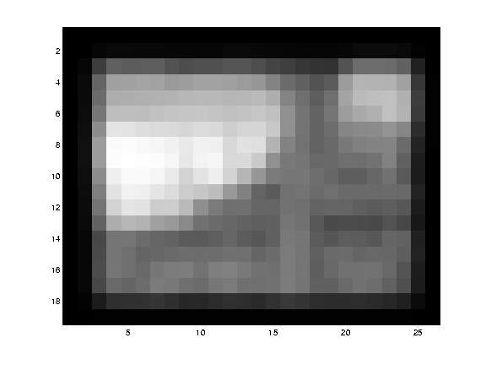
Reduce the resolution!

Slide 27
Coarse-to-fine optical flow estimation
u=1.25 pixels
u=2.5 pixels
u=5 pixels
image H
u=10 pixels
image I
image H
image I
Gaussian pyramid of image H
Gaussian pyramid of image I

Slide 28
Coarse-to-fine optical flow estimation
run iterative L-K
warp & upsample
run iterative L-K
.
.
.
image J
image I
image H
image I
Gaussian pyramid of image H
Gaussian pyramid of image I

Slide 29
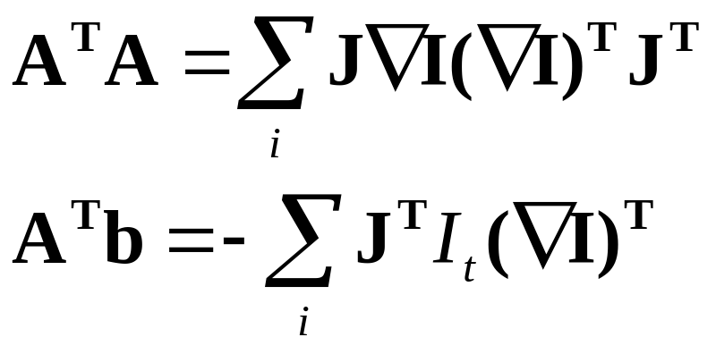
Beyond Translation
So far, our patch can only translate in (u,v)
What about other motion models?
  rotation, affine, perspective
Same thing but need to add an appropriate Jacobian (see Table 2 in Szeliski handout):

Slide 30
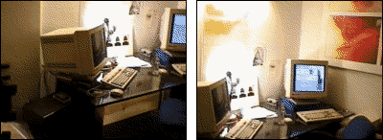
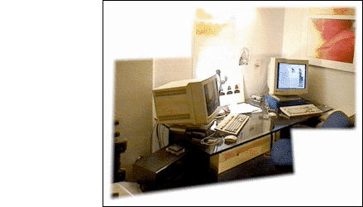
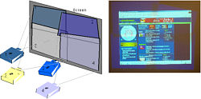
Image alignment
Goal: estimate single (u,v) translation for entire image
  Easier subcase: solvable by pyramid-based Lukas-Kanade

Slide 31
Lucas-Kanade for image alignment
Pros:
  All pixels get used in matching
  Can get sub-pixel accuracy (important for good mosaicing!)
  Relatively fast and simple
Cons:
  Prone to local minima
  Images need to be already well-aligned ☺
What if, instead, we extract important “features” from the image and just align these?

Slide 32
Feature-based alignment
Find a few important features (aka Interest Points)
Match them across two images
Compute image transformation as per Project #3
How do we choose good features?
  They must prominent in both images
  Easy to localize
  Think how you did that by hand in Project #3
  Corners!

Slide 33
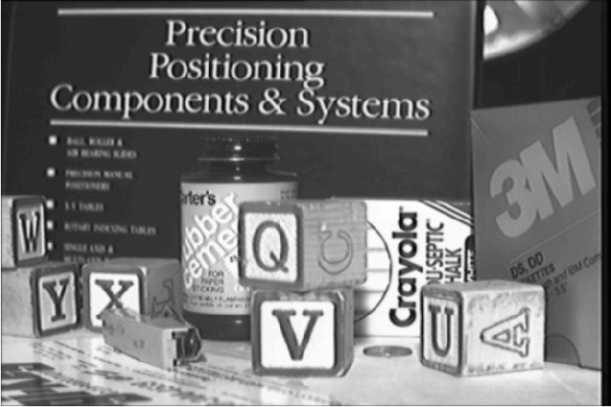
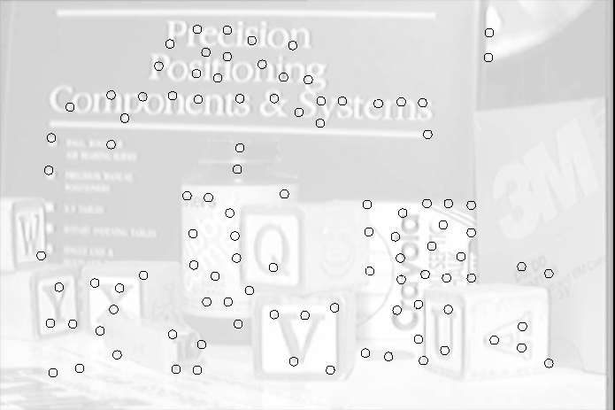
Feature Detection

Slide 34
Feature Matching
How do we match the features between the images?
  Need a way to describe a region around each feature
    e.g. image patch around each feature
  Use successful matches to estimate homography
    Need to do something to get rid of outliers
Issues:
  What if the image patches for several interest points look similar?
    Make patch size bigger
  What if the image patches for the same feature look different due to scale, rotation, etc.
    Need an invariant descriptor

Slide 35
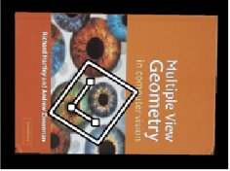

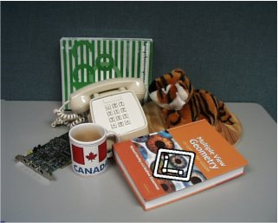

Invariant Feature Descriptors
Schmid & Mohr 1997, Lowe 1999, Baumberg 2000, Tuytelaars & Van Gool 2000, Mikolajczyk & Schmid 2001, Brown & Lowe 2002, Matas et. al. 2002, Schaffalitzky & Zisserman 2002

