Slide 1


Slide 2
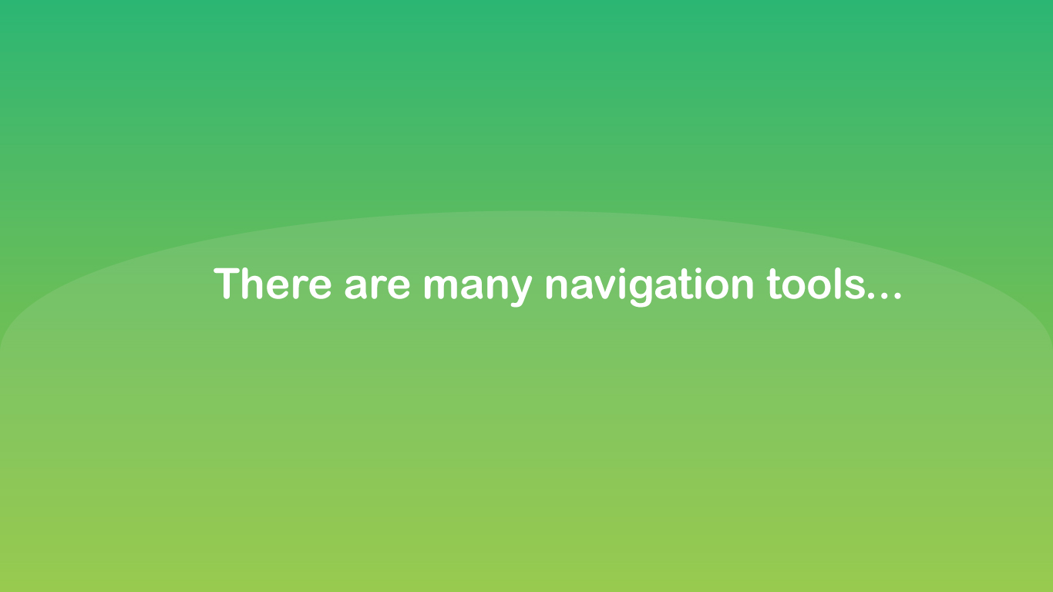





Slide 3


Slide 4


Slide 5


Slide 6
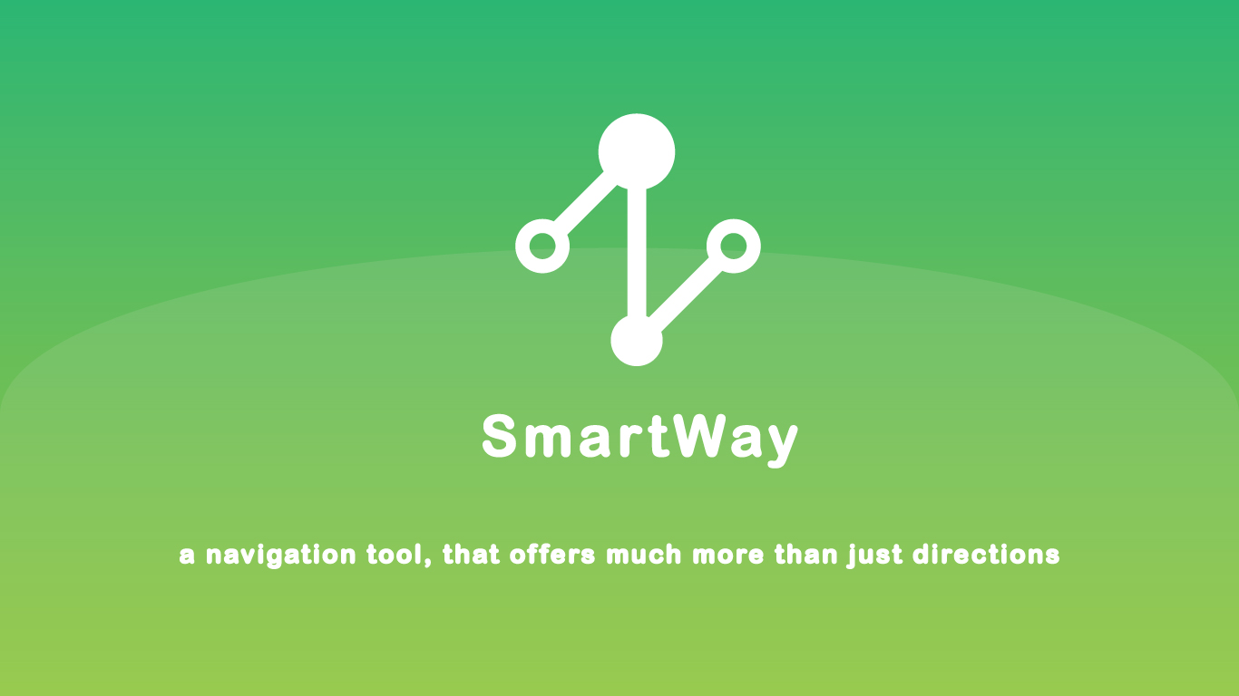

Slide 7


Slide 8


Slide 9
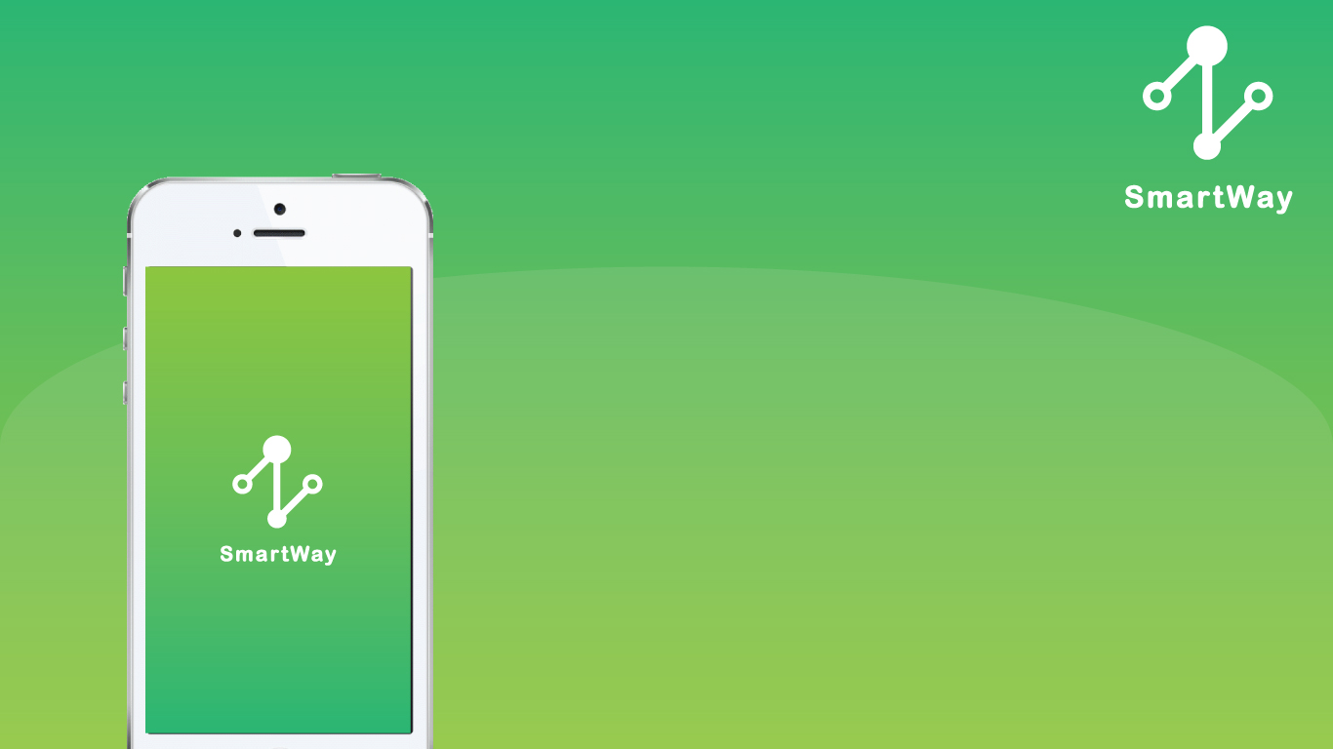
Simple design, simple use

Slide 10
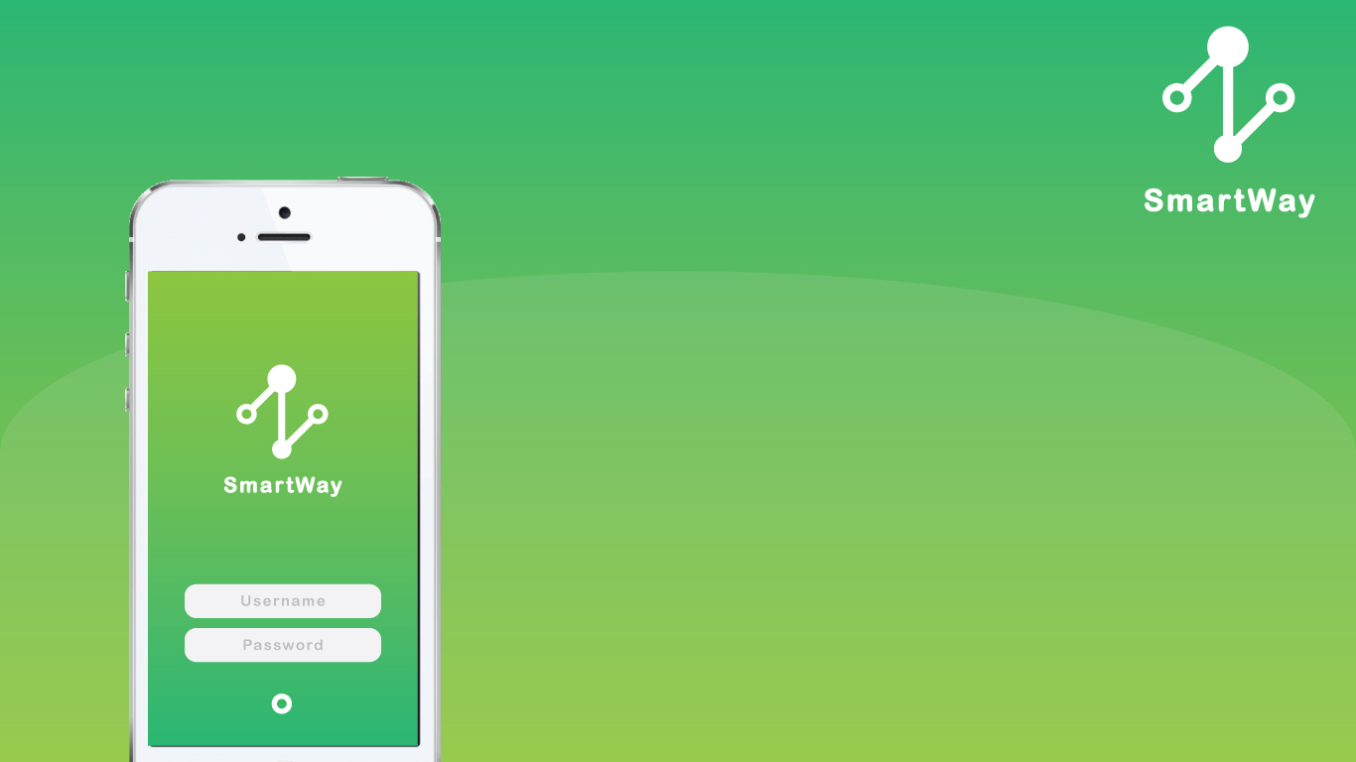
Simple design, simple use
Easy access (connect through FB)
Purpose

Slide 11
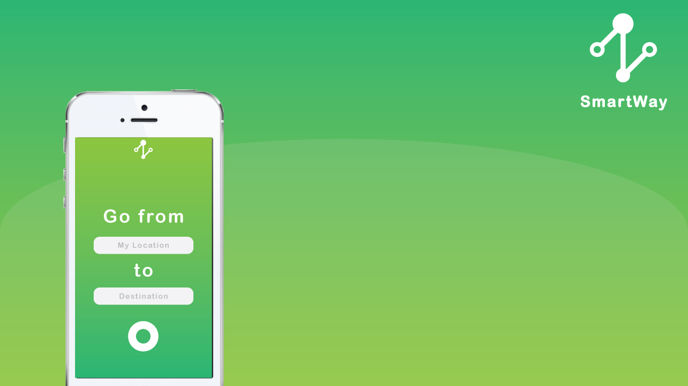
Simple design, simple use
Easy access (connect through FB)
Purpose
Get best directions from A to B

Slide 12
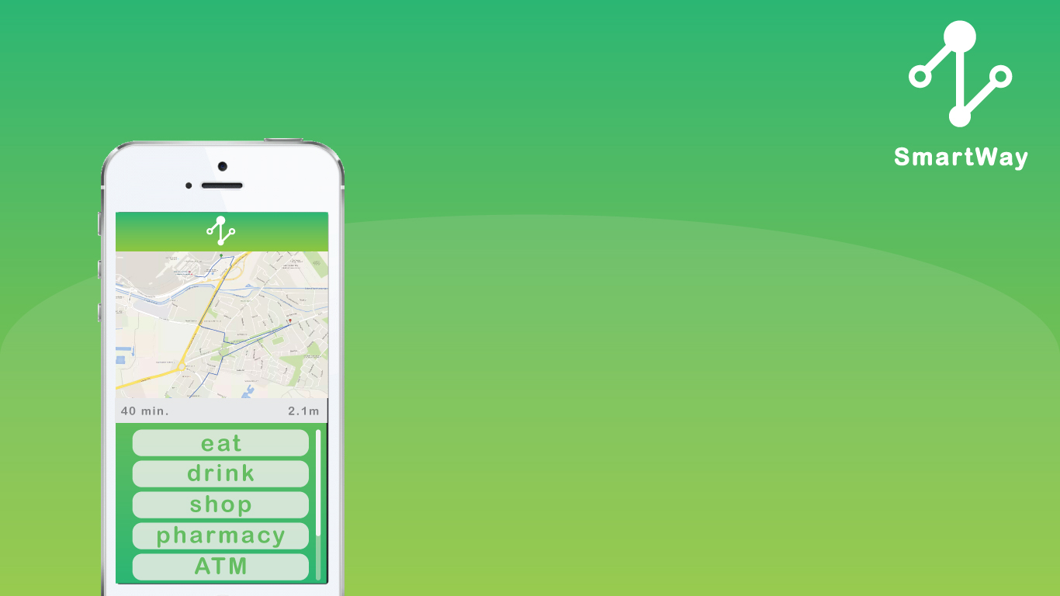
Simple design, simple use
Easy access (connect through FB)
Purpose
Get best directions from A to B

Slide 13
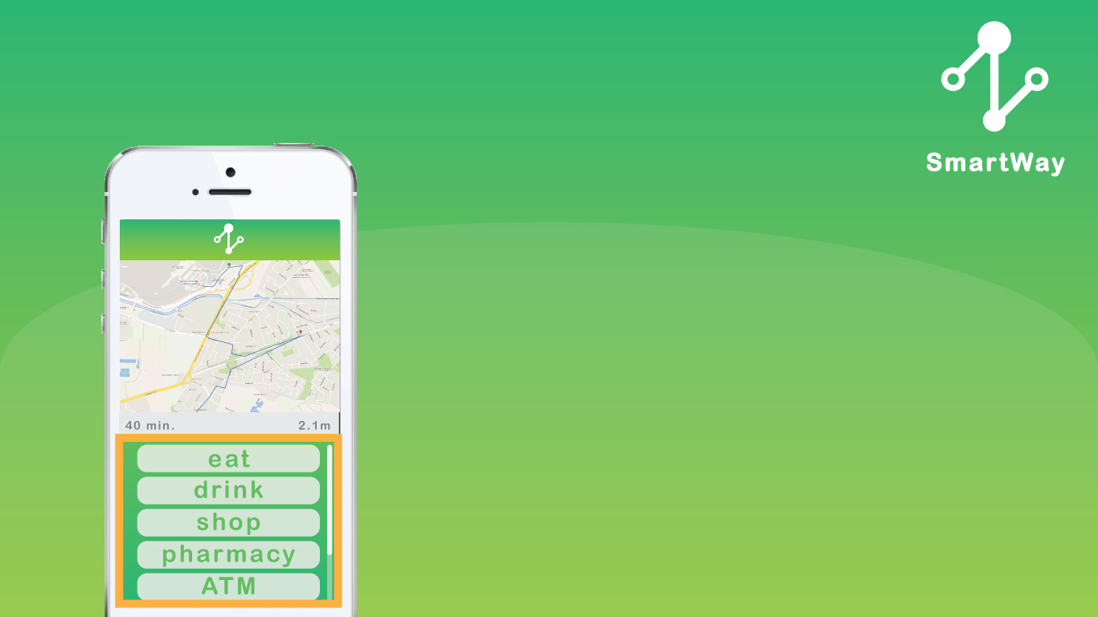
Simple design, simple use
Easy access (connect through FB)
Purpose
Get best directions from A to B

Slide 14
Simple design, simple use
Easy access (connect through FB)
Purpose
Get best directions from A to B
Select service you want to use before you reach your final destination

Slide 15

Simple design, simple use
Easy access (connect through FB)
Purpose
Get best directions from A to B
Select service you want to use before you reach your final destination

Slide 16
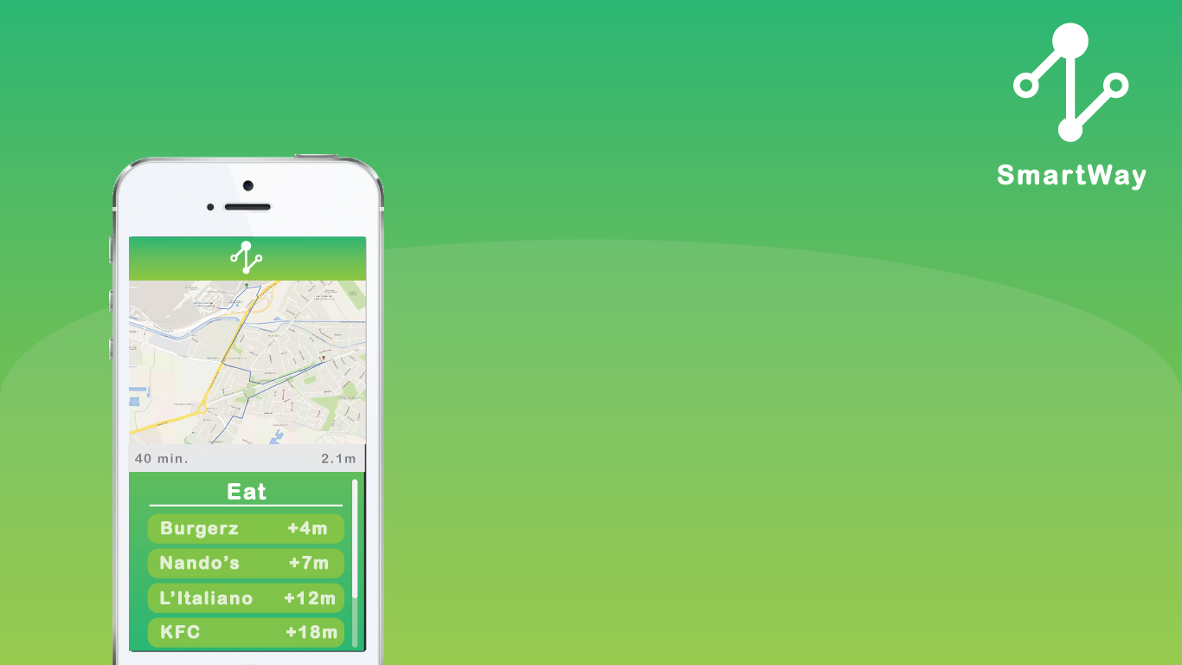
Simple design, simple use
Easy access (connect through FB)
Purpose
Get best directions from A to B
Select service you want to use before you reach your final destination

Slide 17
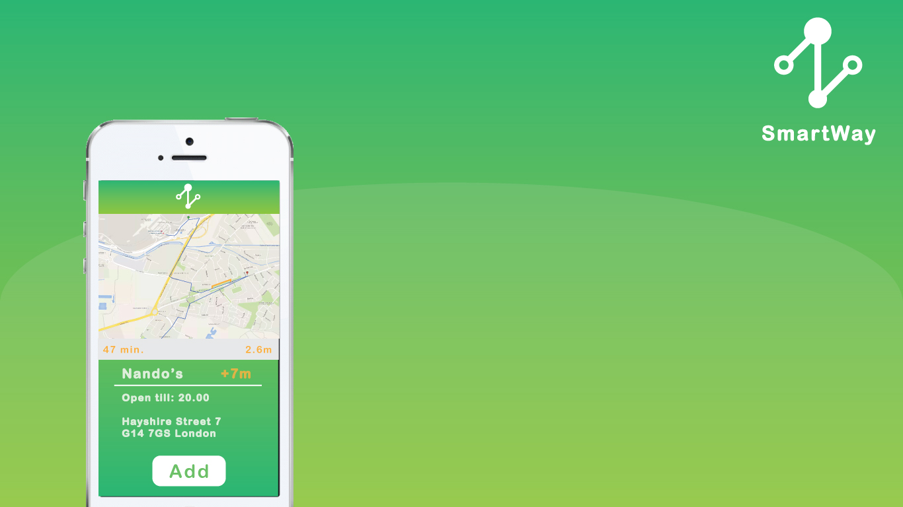
Simple design, simple use
Easy access (connect through FB)
Purpose
Get best directions from A to B
Select service you want to use before you reach your final destination

Slide 18
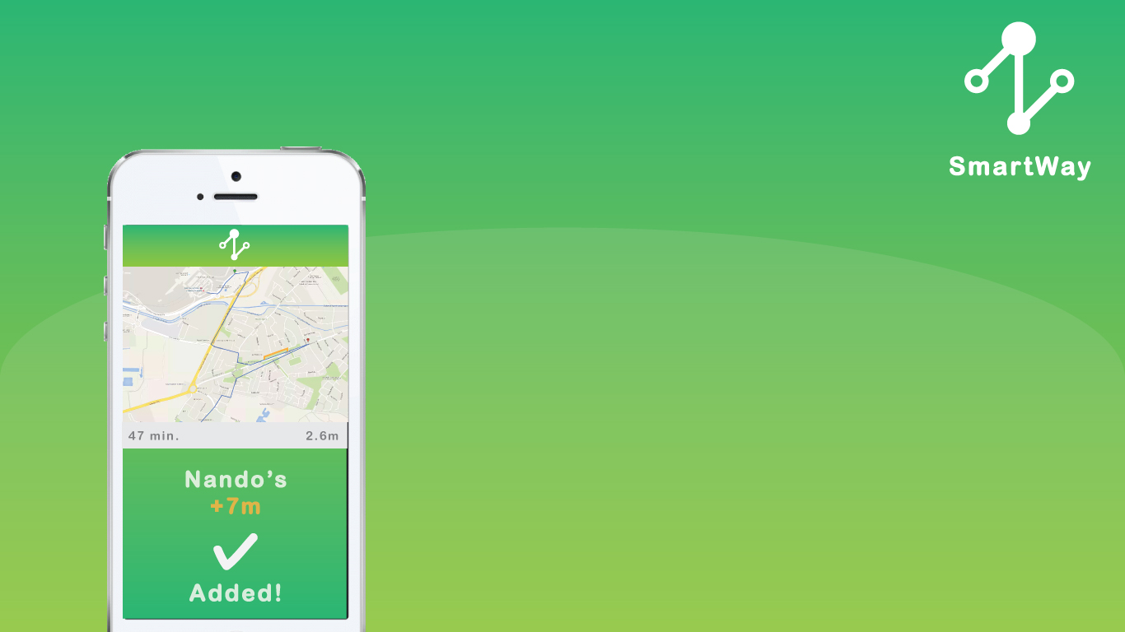
Simple design, simple use
Easy access (connect through FB)
Purpose
Get best directions from A to B
Select service you want to use before you reach your final destination

Slide 19
Simple design, simple use
Easy access (connect through FB)
Purpose
Get best directions from A to B
Select service you want to use before you reach your final destination
Suggestions to sort out your calendar tasks

Slide 20
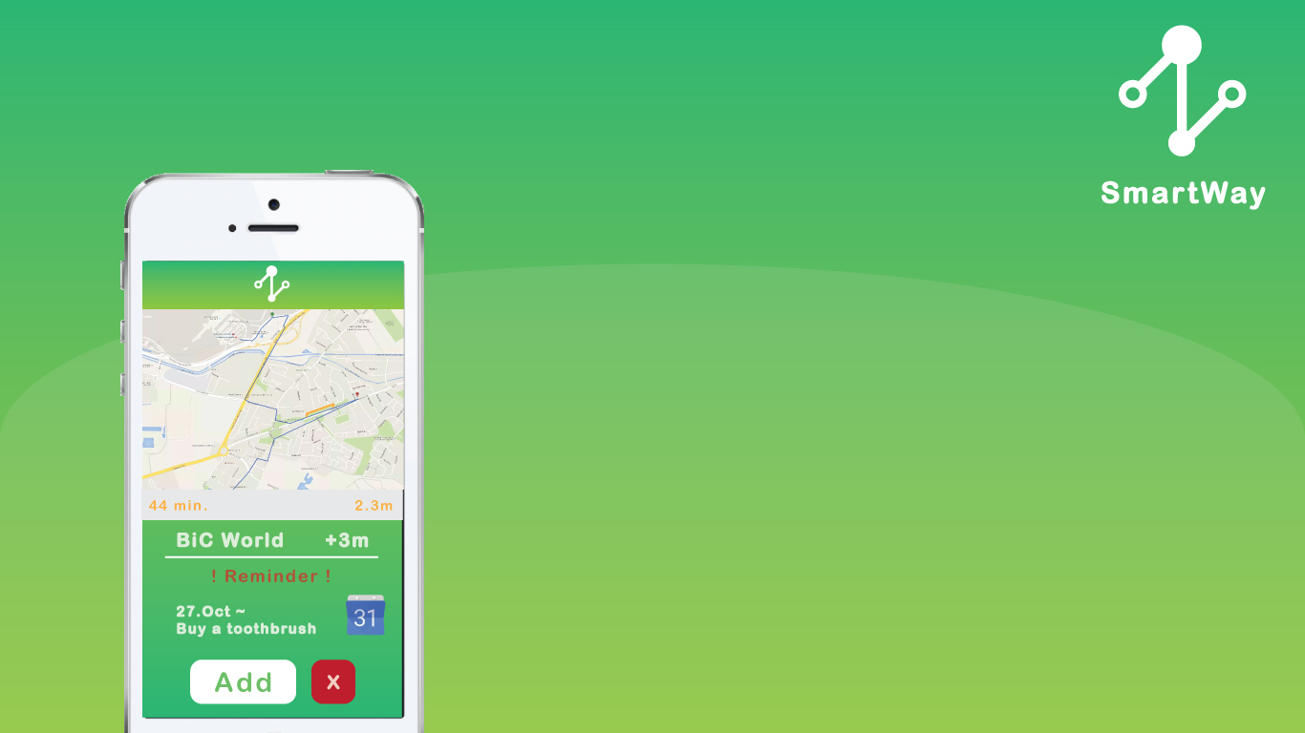
Simple design, simple use
Easy access (connect through FB)
Purpose
Get best directions from A to B
Select service you want to use before you reach your final destination
Suggestions to sort out your calendar tasks

Slide 21
Simple design, simple use
Easy access (connect through FB)
Purpose
Get best directions from A to B
Select service you want to use before you reach your final destination
Suggestions to sort out your calendar tasks
Combine as much destination as you need

Slide 22
Simple design, simple use
Easy access (connect through FB)
Purpose
Get best directions from A to B
Select service you want to use before you reach your final destination
Suggestions to sort out your calendar tasks
Combine as much destinations as you need

Slide 23

Target Audience
Business travellers
Tourists
Citizens of big towns
Teenagers
Companies

Slide 24



Road to Market
Website domain, FB page
Building user-base Revenue
Kickstarter, presentations at StartUp Weekends
Investor Advertising Campaign
Reaching 100,000 downloads
Negotiating contracts with companies

Slide 25
Market Value
Potential 300,000,000 customers (users of navigation apps)
Example of revenue generation
getting a commision from stores for highlighting them in an app
ad fee : £200/month/store)
(Average ad fee of competitors : £230/month/store)
London : 914 stores × £200 = £182,800/month
UK: 2,708 stores × £200 = £541,600/month

Slide 26

University of Glasgow
Team 2

