Slide 1

CampusHub
An College Management System
Project Synopsis Presentation
Shikhar Sharma
250820520005
PGDAC - Aug 2025

Slide 2
Introduction
Building a secure, scalable web-based College Management System to manage students, faculty, courses, attendance, examinations, results, fees, library, timetable, and reporting.
Problem Statement - CampusHub solves the real-world problem of inefficient and disconnected college administration by centralizing student, faculty, academic, and administrative activities into a single digital platform.

Slide 3
Scope
User (role based access, secure login and authentication), Student & Faculty Management (admissions, registrations, profile management, etc.), Academic (curriculum and course planning), Attendance, Examinations & Assessment, Fee, Timetable, Library management, etc.
Out of Scope: Online classes, biometrics, online exams, mobile app development, etc.

Slide 4
Feasibility
Technical Feasibility - Technically feasible with current tools, resources, and expertise.
Economic Feasibility - Economically feasible with potential for substantial ROI (Return of Investment).
Operational Feasibility - Operationally feasible with user-friendly design and scalable deployment.
Legal & Ethical Feasibility - Feasible with adherence to ethical AI practices and data protection laws.

Slide 5
Methodology
Requirement & Planning - Gather functional and non-functional requirements for college management. Identify user roles, modules, workflows, and system expectations.
System Design - Create ER diagrams, class diagram, data flow diagram. Technologies, tools, and frameworks for frontend, backend, database, and deployment are finalized.
Frontend Development - Build a responsive UI in React using component-based architecture. Integrate APIs, implement role-based dashboards, forms, reports, and visualizations
Backend Development - Develop REST APIs using Spring Boot. Implement modules for auth., students, faculty, attendance, exams, and payments. Use layered architecture and integrate MySQL.
Database Creation - Design normalized MySQL database schemas, define relationships, constraints, and prepare migration scripts. Ensure data integrity, security, and optimization.
Deployment - Containerized Deployment (Docker + CI/CD).
Hosting - 2 options: i) render ii) college servers.

Slide 6
Modules
12 Modules
User & Role Management Module
Attendance Management Module
Result/Grade Management Module
Courses & Subjects Management Module
Announcements Management Module
Document Management Module
Timetable Management Module
Exam Management Module
Library Management Module
Placement Management Module
Hostel Management Module
Fee & Finance Management Module

Slide 7
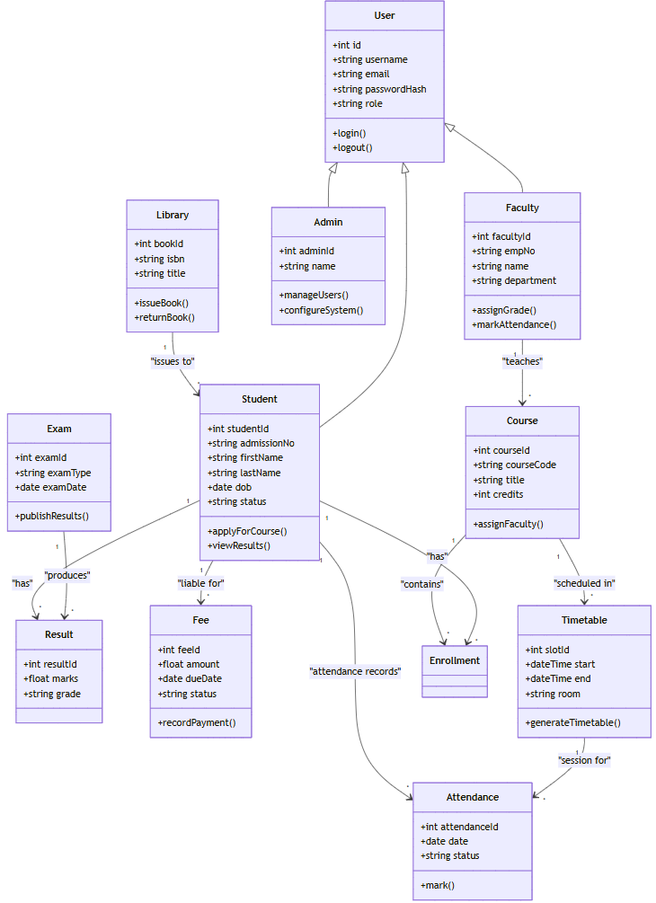
Class Diagram

Slide 8
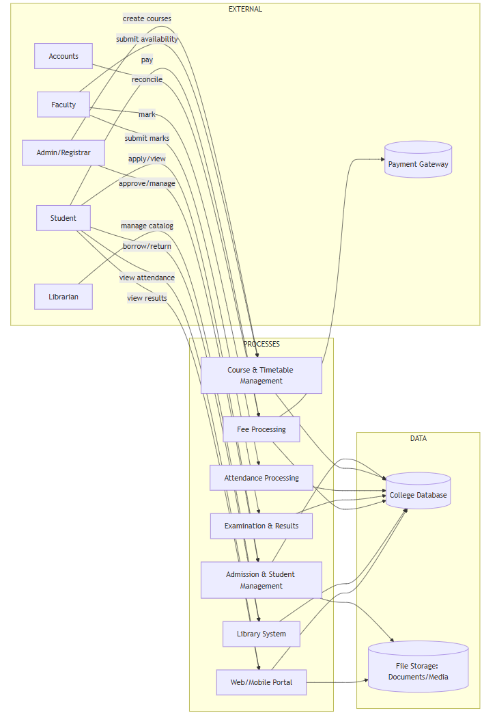
Data Flow Diagram

Slide 9
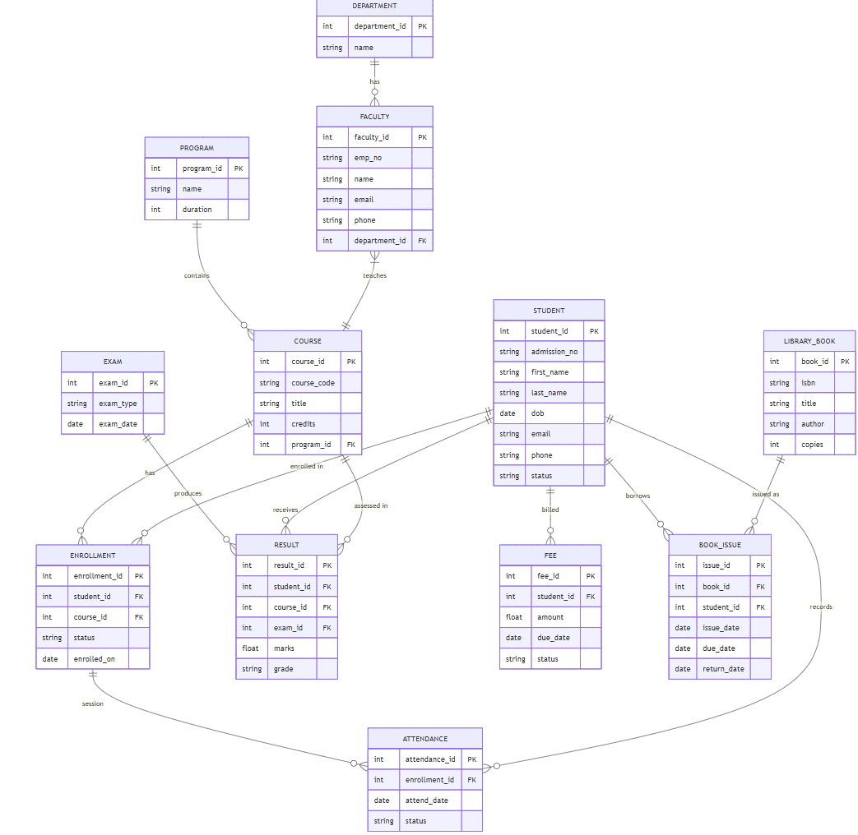
ER Diagram

Slide 10
Requirements
Hardware
Processor: Intel i3 or higher
RAM: 8 GB minimum
Storage: 20 GB free space
Display: 1024x768 resolution minimum
Software
Operating System - Windows
Frontend - React.js, HTML, CSS, JavaScript
Backend - Java Spring Boot
Database - MySQL
Tools - VS Code, Eclipse IDE, Postman, Docker
Version Control - Git, GitHub

Slide 11
Security Issues
Authentication & Authorization Risks
Data Security & Privacy
API Security Issues
Database & Server Risks
Deployment & DevOps Issues
Payment Gateway Issues

Slide 12
Conclusion/Expected Outcome
A fully functional web-based system for managing college where several users (students, faculties, etc.) can perform different tasks.
Role-based dashboards for admin, faculty, students, and parents.
Secure and optimized backend with REST APIs.
Responsive and user-friendly frontend interface.
Centralized database with accurate and reliable records.
Dockerized deployment ready for hosting.

Slide 13
Thank You
a presentation by :- Shikhar Sharma

