Slide 1

Title & introduction
Project Title : “AI-Based Early Depression Risk Detection Using Passive Signals”
Problem Statement : “Early Disease Risk Detection Using Passive Signals”
Team Details :
  Team Name : Luminex
  Domain : Health Tech
  Team Members : Ramya. M.M (Leader) Avvamma
  Shashidhar. H.M. Aishwarya. G.
Collage Name : Bapuji Institute of engineering and technology Davanagere
Overview : The AI Depression Risk Detection System predicts early signs of depression using behavioral data like sleep, screen time, and activity levels. It uses a Machine Learning model to classify risk levels and provide personalized mental health support.
The system also includes interactive features like therapy suggestions, games, and voice emotion detection to improve well-being.

Slide 2
PROBLEM STATEMENT
  The real-world problem : Prolonged stress gradually affects everyday routines, leading to irregular sleep habits, decreased movement, limited social interaction, and unusual late-night mobile usage. Despite these noticeable lifestyle shifts, they are rarely interpreted as early signs of mental health decline.
  Why it matters : Chronic stress and untreated depression impact students and professionals by reducing focus, productivity, and emotional stability. When early warning signs are ignored, the condition can worsen and affect relationships and overall well-being. Early detection is essential to prevent serious long-term consequences.
  Quick data to support the need : Globally over 280 million people live with depression, and in India nearly 15 % of adults need active mental health intervention. However, more than 75 % of those affected in low- and middle-income countries do not receive proper treatment, highlighting a major gap in early detection and care.

Slide 3
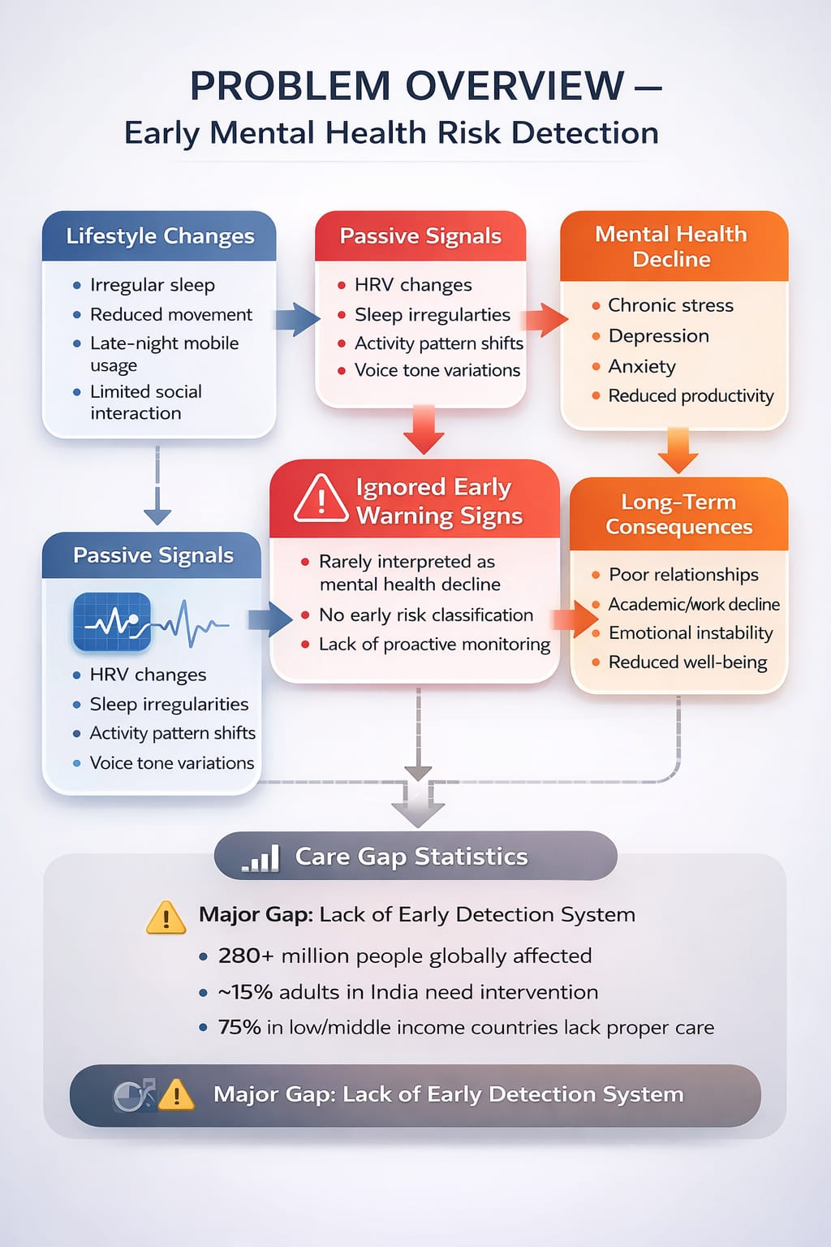
PROBLEM STATEMENT
Current Limitations / Gaps in Existing Solutions :
Most existing mental health solutions rely on self-assessments or clinical consultations, which usually identify issues only after they become serious. People often overlook early warning signs or avoid seeking help due to stigma. Many apps require manual input instead of passively tracking behavioral changes like sleep, activity, or phone usage. Limited access to professionals, especially in developing regions, further delays early detection and timely support.

Slide 4
PROPOSED SOLUTION
  Idea : We propose an AI-based system that analyzes passive behavioral data such as sleep patterns, activity levels, social interaction, and phone usage to identify early signs of stress-related depression. The model generates a risk score and provides timely alerts and guidance, enabling early support before the condition becomes severe.
  Solution to the problem : We propose an AI-based system that passively monitors sleep, HRV, activity, and phone usage to detect early signs of stress and depression. It uses machine learning to assess risk levels and provides personalized wellness guidance for timely intervention.
  Key features : 1. Passive Data Monitoring 5. Personalized Wellness Guidance
  2. Personalized Baseline Modeling 6. Early Intervention Alerts
  3. AI-Based Prediction Engine 7. AI Insights Panel
  4. Risk Classification System

Slide 5
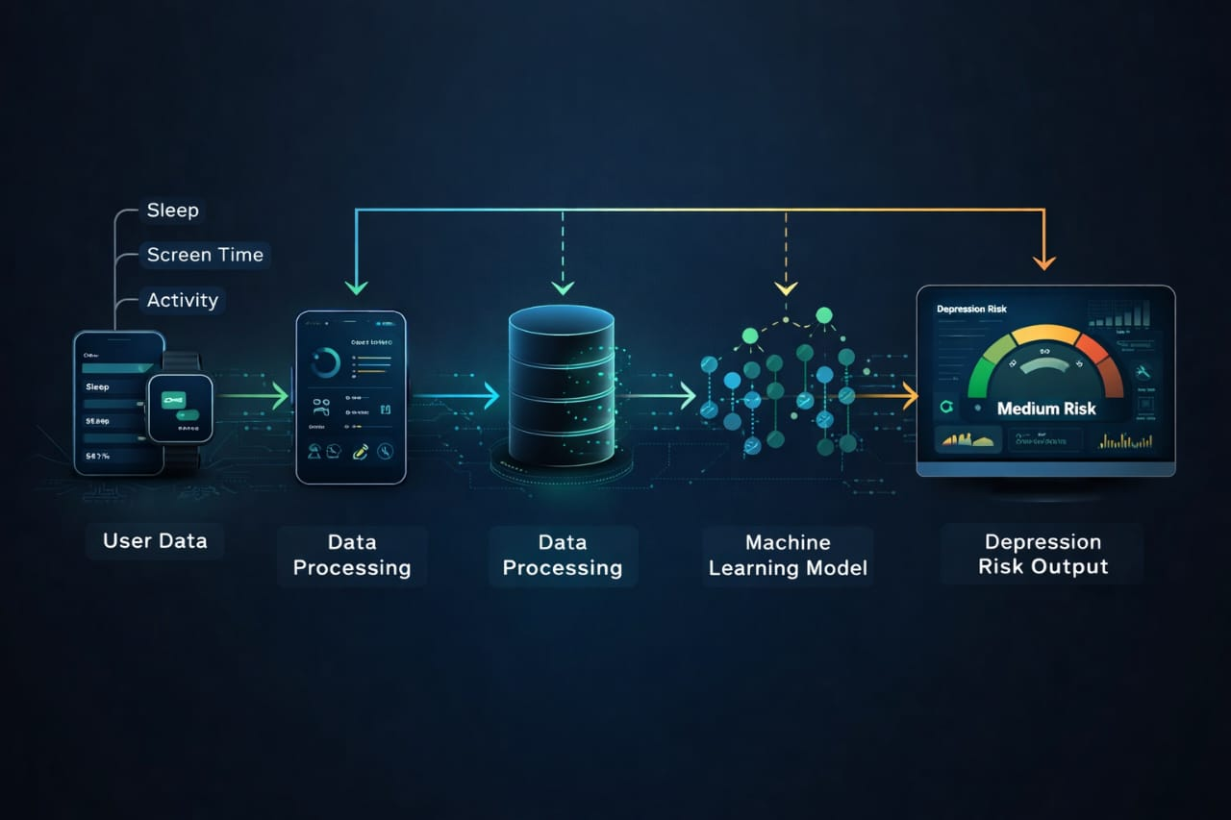
PROPOSED SOLUTION
Data Collection
Passive data like sleep, screen time, and activity is collected from users.
Data Processing
Raw data is cleaned and prepared for analysis.
Feature Analysis
Important patterns are identified from the processed data.
Machine Learning Model
Random Forest algorithm predicts the depression risk level.
Result Display
Output is shown as Low, Medium, or High risk on a dashboard.

Slide 6
TECHNICAL IMPLEMENTATION
  PROGRAMMING LANGUAGES USED
  Python → Backend & Machine Learning CSS → Styling and UI design
  JavaScript → Frontend logic & interaction HTML → Structure of web pages
  2. FRAMEWORKS / LIBRARIES
  BackendFlask → Web framework to create API
  Machine LearningScikit-learn → Model training (Random Forest)
  Pandas → Data handlingNumPy → Numerical operations
  FrontendChart.js → Dashboard graphs
  3. DATABASE USED : CSV file used as dataset
  4. APIs : APIsFlask REST API (/predict) for communication
  ToolsVS Code → DevelopmentPython → Execution
  PlatformsWeb browser (Chrome/Edge)

Slide 7
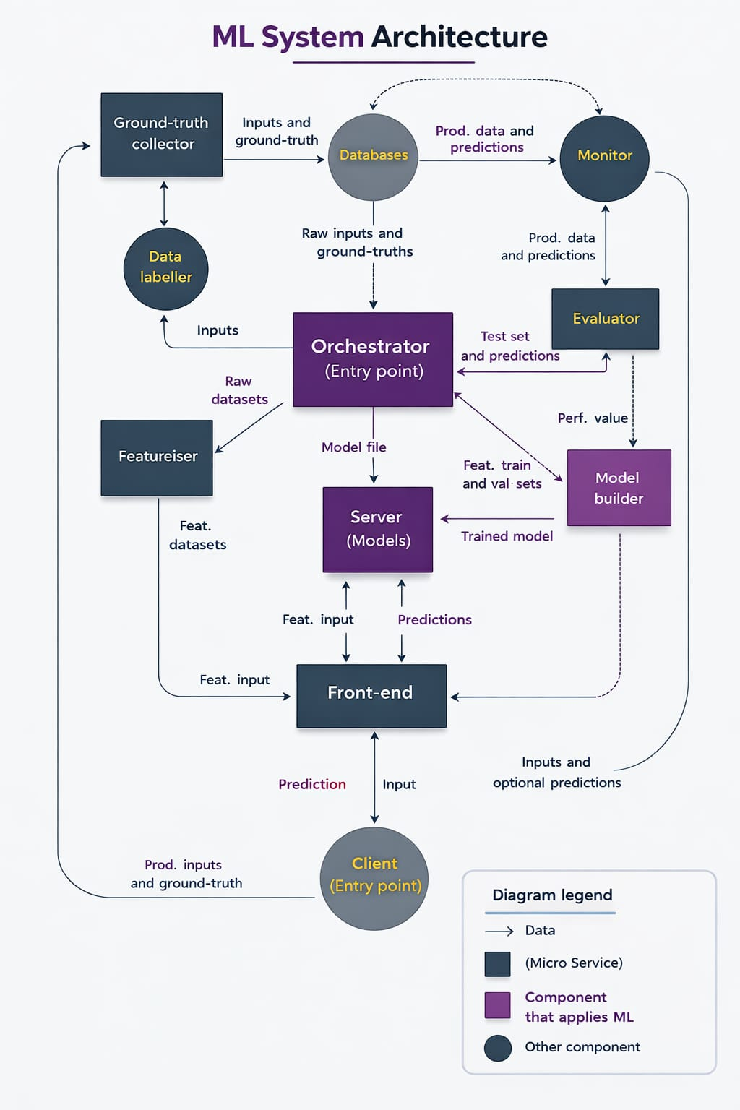
System Architecture
Client (Entry Point)
Sends input data
Receives predictions
Front-End
Collects input
Displays results
Orchestrator
Controls workflow
Manages data flow
Databases
Stores data
Maintains records
Ground-Truth Collector
Collects actual outcomes
Improves accuracy
Data Labeller
Labels raw data
Featuriser
Features extraction
Model Builder
Trains model
Optimizes performance
Evaluator
Tests model
Server (Models)
Hosts model
Gives predictions
Monitor
Tracks performance
Detects issues

Slide 8
Innovation & Uniqueness
Detection + Intervention (Not Just Prediction)Most systems only:
Detect depression risk
Show result
Our system:
Detects risk
Provides therapy suggestions
Includes stress-relief games
Offers motivational support
Novel Approach / Creative Thinking
Uses passive behavioral signals
(Screen time, sleep, activity, social interaction)
No complex medical equipment required
Easy-to-use web interface
Interactive engagement through games
[ Passive Behavioral Signals ]
(Sleep | Screen Time | Activity | Social Interaction) ↓
[ AI Risk Detection Engine ]
(Baseline Learning + ML Model)
↓
[ Depression Risk Level ]
(Low / Medium / High)
↓ ┌───────────────┬───────────────┬──────────────
│ Therapy │ Stress Relief │ Motivational │
│ Suggestions │ Games │ Support │ └───────────────┴───────────────┴──────────────

Slide 9
Innovation & Uniqueness
Technical Innovation
Machine Learning model (Random Forest)
Real-time API communication (Flask)
Interactive dashboard visualization (Chart.js)
Our system dynamically adapts:
High Risk → Intensive support
Moderate → Preventive advice
Low → Positive reinforcement
Scalability & Adaptability
Voice emotion detection
Wearable integration (heart rate, sleep tracking)
Mobile app deployment
Cloud-based real-time monitoring
Hospital / school deployment

Slide 10
Conclusion
Summary of Our Solution
Analyzes passive behavioral signals
Uses Machine Learning for risk classification
Provides real-time dashboard visualization
Offers preventive therapy suggestionsIncludes interactive mental wellness games
Expected Impact
Enables early detection of depression risk
Encourages preventive mental health care
Reduces stigma through simple, accessible interface
Promotes self-awareness and healthy habits
Supports emotional well-being through engagement
This solution can help
Students Working , professionals Educational , institutions Healthcare support systems

Slide 11

Conclusion
• Developed an AI-based system for early depression risk detection
• Combines machine learning with interactive mental wellness features
• Provides personalized support like therapy, games, and voice analysis
• Promotes preventive mental healthcare and user engagement
• Can be extended for real-world healthcare applications

Slide 12
THANK YOU!
Notes:
Project: AI-Based Early Depression Risk Detection Using Passive Signals Project: AI-Based Early Depression Risk Detection Using Passive Signals

