Slide 1


Paper No: 4621
Resident Carbon Credit Incentive Decision-Making Method to Promote Valley Filling
Tianao Zheng
Nanjing University of Posts and Telecommunications
b20041418@njupt,edu.cn

Slide 2
01
Background
02
Method
CONTENT
03
Model
04
Results
05
Conclusions

Slide 3
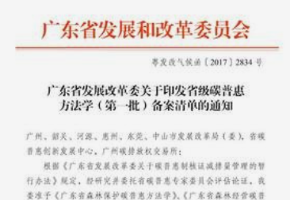

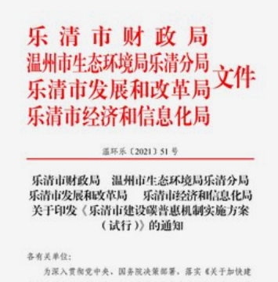
Background
The carbon market, as a crucial policy to combat climate change, can contribute to achieving peak carbon and carbon-neutral strategic goals.
The carbon credit, as a carbon emission measurement unit used for carbon trading, can promote the carbon saving behavior of each user.
Considering the large base of residents, its potential to reduce total carbon emissions cannot be ignored.

Slide 4
Method
An incentive decision-making method to promote valley filling is proposed for residential carbon credits. Firstly, a residential carbon credits-oriented incentive model is introduced for "peak load shaving" behavior. Then, residents are classified according to the carbon valley electricity consumption ratio to achieve targeted incentives. Lastly, the performance of the proposed method is verified by numerical examples.
Residential carbon credits-oriented incentive model
Classify residents to achieve targeted incentives
The performance of the proposed method is verified
Population
Electricity consumption
Incentive carbon credits
K-means clustering method
Numerical examples

Slide 5
Resident Carbon Credit-Oriented Incentive Model for Promoting Carbon Valley Response
The existing monthly carbon credits of residents involves such elements as carbon quotas, dynamic carbon emission factor, and electricity consumption of residents at different periods.
In this paper, the incentive carbon credits is considered for "peak load shaving" behavior.
Monthly initial carbon quotas
m=1,2,3 represent the population of the resident are four and below four, five and above, seven and above respectively.
Fig. 1. Schematic diagram for carbon emission valley period
Existing monthly carbon credits of residents
Monthly carbon credits of residents proposed
Incentive carbon credits

Slide 6
Resident Carbon Credits Decision-making Model
Based on the residential daily load curve, the carbon valley electricity consumption ratio is used to characterize the residential carbon valley electricity consumption characteristics. K-means clustering method is used to classify residents according to the ratio.
Distance between the resident and the cluster center
Center value of cluster j
From the first cluster to the final, the cluster center decline.
Fig. 2. Solution process based on K-means cluster

Slide 7
Resident Carbon Credits Decision-making Model
Incentive coefficients
Fig. 1. Schematic diagram for carbon emission valley period

Slide 8
Model Construction
Optimization goal
Residents with a higher carbon valley electricity consumption ratio should get more incentive credits.
Constraints
1) Average monthly carbon credits constraints
2) Proportion of residents with zero credit constraints
3) Difference of mean carbon credits between clusters

Slide 9
Results
Data source: The simulation analysis is carried out with 2000 residents in August 2020. Residential electricity consumption is measured per hour.
Fig. 3. Average electricity consumption curves
Fig. 4. Monthly carbon credits and number of residents
Carbon valley electricity consumption ratio gradually increases
Total electricity consumption and peak-valley difference increased
Most of residents fall into the range between 0-20 kg CO₂ and 20-40 kg CO₂

Slide 10
Results
Fig. 5. The distribution of residents' carbon credits of 3 clusters
Fig. 6. Distribution and share of below-zero carbon credits
Cluster 1 distributed with most carbon credits
With the increase of clustering level, residents gather fewer carbon credits
Number of users with carbon credits between 0-20 kg CO₂ are the largest
Residents in all clusters with below-zero carbon credits are in this interval

Slide 11
Conclusions
Firstly, the monthly carbon quotas, basic carbon emission and incentive carbon credits are fully considered for resident carbon credit-oriented incentive model.
Secondly, by using the clustering method, different clusters of residents are set up to set different incentive threshold and incentive coefficients.
Moreover, through case study, it is found that the monthly carbon credits of residents are mostly in the interval of 0-40 kg CO₂. It can not only reduce government investment, but also increase the residents' satisfaction.
Besides, more carbon credits can be obtained for residents with higher carbon valley electricity consumption ratio. Therefore, effective targeted incentives are met.
Lastly, it is concluded that there is some potential for further incentive.

Slide 12
Paper No: 4621
Thank you!
Tianao Zheng
Nanjing University of Posts and Telecommunications
b20041418@njupt,edu.cn

