Slide 1
BDF
BDF

Slide 2
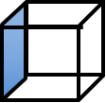
Ruler

Slide 3
Animation

Slide 4

Fix
Show Nodes

