Slide 1
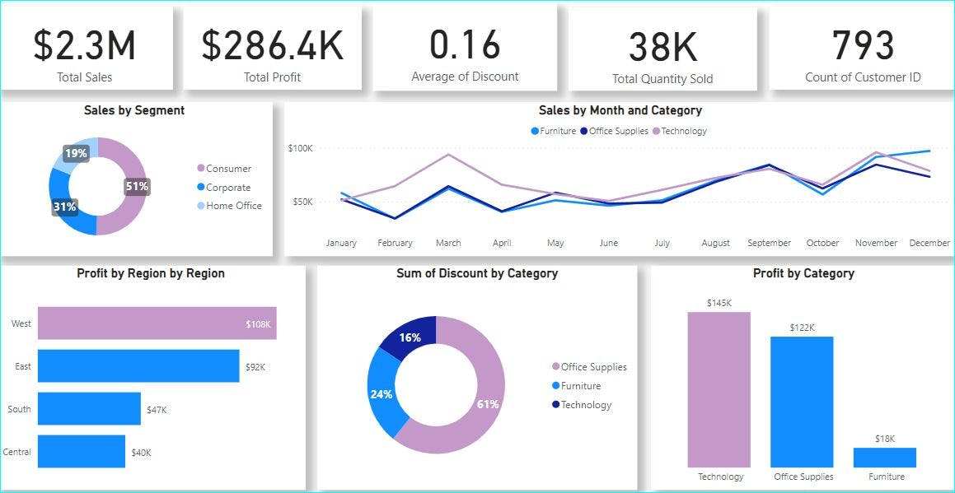



Anulekha Sai A

Slide 2
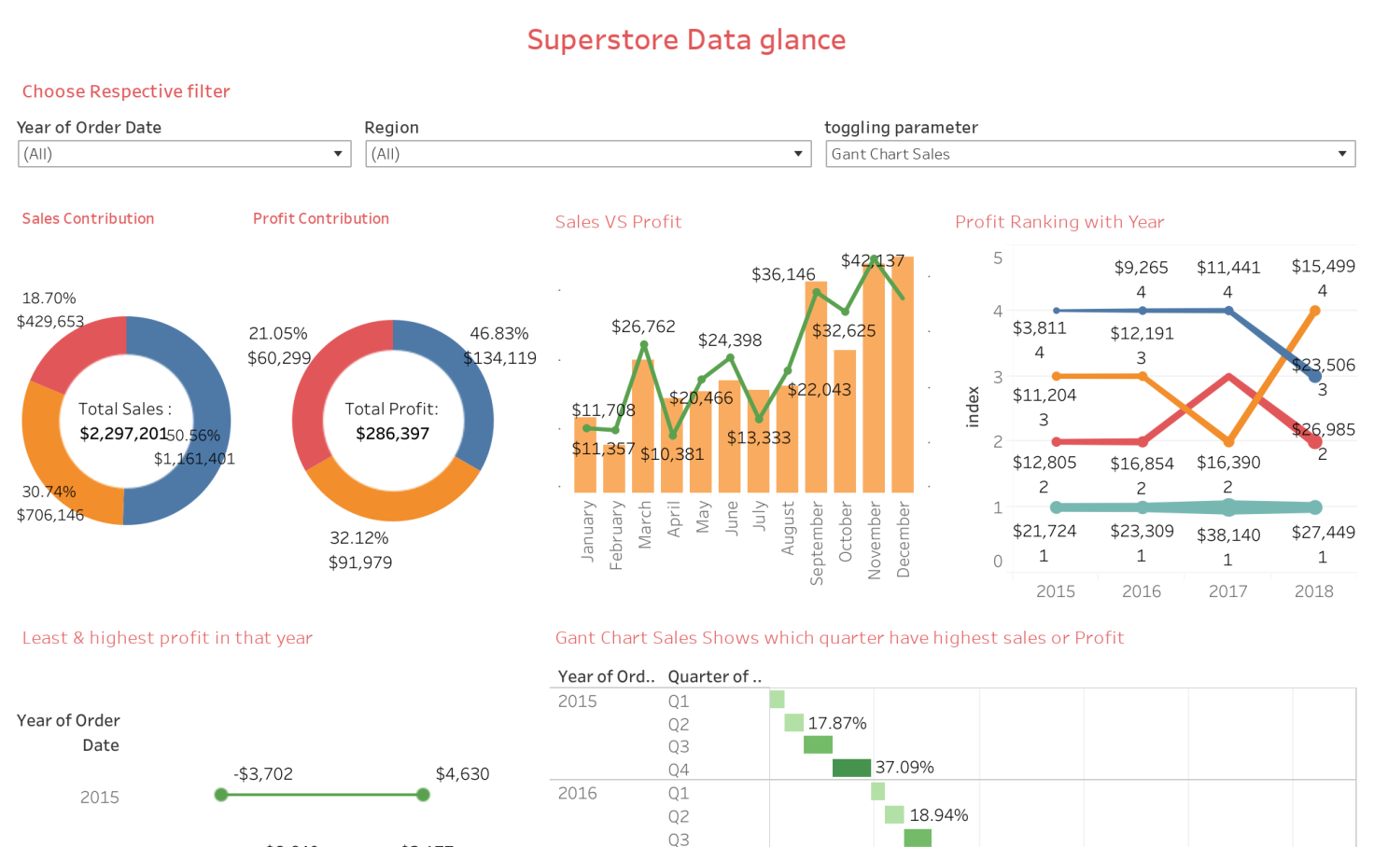
Sample Superstore Dataset Analysis

Slide 3
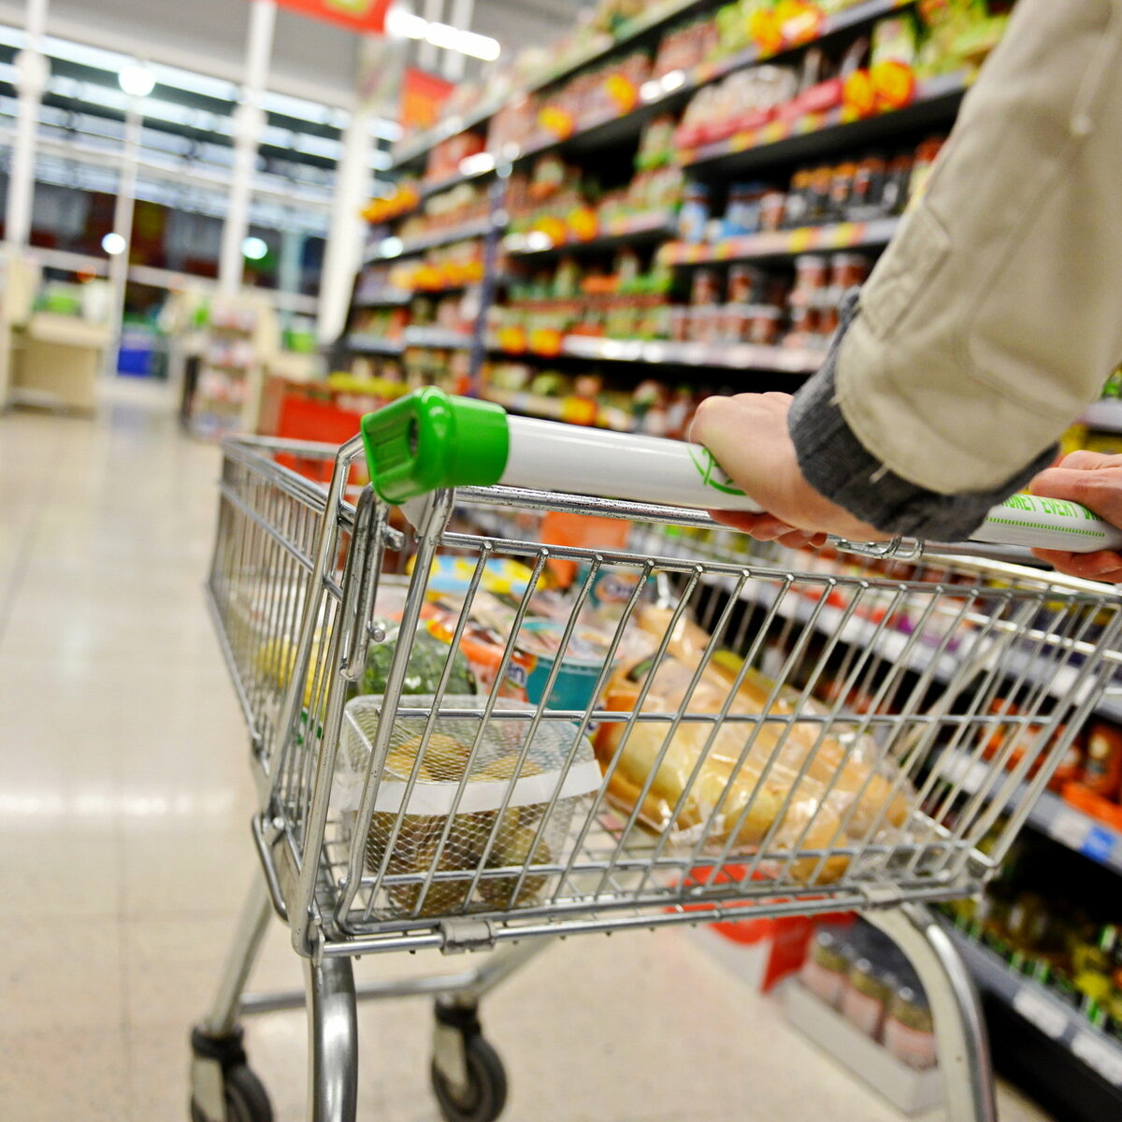
Sample superstore to customer
At Sample Superstore, we redefine the shopping experience by offering an extensive range of products to meet all your needs under one roof. Whether you're looking for the latest in electronics, home appliances, fashion, or groceries, we have it all.
Customer satisfaction is our top priority at Sample Superstore. Our friendly and knowledgeable staff are always ready to assist you, ensuring that your queries are promptly addressed and your shopping experience is smooth. We believe in building lasting relationships with our customers, which is why we offer personalized services, including product recommendations and special orders.
Sample Superstore is at the forefront of retail innovation, offering convenient shopping options to suit your lifestyle. With our user-friendly online store, you can browse and purchase your favorite products from the comfort of your home.

Slide 4
The Superstore marketto ConsumerSales process involves the following steps:
1. Market Research and Product Selection
Conduct Market Research: Gather data on consumer preferences, trends, and demand through surveys, focus groups, and industry reports.
Analyze Data: Identify key trends, customer needs, and gaps in the market.
Select Products: Choose a range of products that align with consumer demand and market trends.
Negotiate with Suppliers: Establish relationships with suppliers to secure quality products at competitive prices.
2. Procurement and Inventory Management
Place Orders: Order selected products from suppliers based on projected demand.
Receive Shipments: Inspect and verify the quality and quantity of received products.
Stock Inventory: Organize products in the warehouse for efficient retrieval and restocking.
Inventory Tracking: Utilize inventory management systems to monitor stock levels, sales, and reorder points.
3. Pricing and Merchandising
Set Pricing: Determine competitive pricing strategies based on market analysis, cost, and desired profit margins.
Create Displays: Design visually appealing product displays to attract customers and promote sales.
Categorize Products: Organize products logically within the store to ensure ease of navigation for customers.
Promotional Strategies: Plan and execute promotions, discounts, and special offers to drive sales.

Slide 5
4. Marketing and Customer Outreach
Develop Marketing Campaigns: Use various channels (social media, email, advertisements) to promote products and store events.
Engage with Customers: Interact with customers through in-store events, online platforms, and customer service.
Loyalty Programs: Implement and manage loyalty programs to reward repeat customers and encourage retention.
5. Sales and Customer Service
Train Staff: Ensure sales associates are knowledgeable about products and trained in customer service.
Assist Customers: Provide assistance, answer questions, and offer product recommendations to shoppers.
Facilitate Transactions: Ensure a smooth checkout process with multiple payment options.
Customer Support: Offer post-purchase support, including handling returns, exchanges, and addressing customer inquiries.
6. Post-Sale Analysis and Feedback
Analyze Sales Data: Review sales performance to identify trends, successful products, and areas for improvement.
Gather Customer Feedback: Collect feedback through surveys, reviews, and direct customer interactions.
Adjust Strategies: Make necessary adjustments to product selection, pricing, marketing, and customer service based on analysis and feedback.
Plan for Future: Continuously improve processes and plan future strategies to enhance customer satisfaction and drive growth.

Slide 6

Why My SQL is important for Supertore sample store analytics
1. Efficient Data Storage and Management:
MySQL stores and organizes large volumes of sales, inventory, and customer data efficiently.
2. Powerful Query Capabilities:
It allows complex queries to retrieve specific data sets and generate detailed reports.
3. Data Integrity and Security:
MySQL ensures data integrity with ACID compliance and offers robust security features.
4. Integration with Analytical Tools:
It integrates seamlessly with tools like Tableau, Power BI, and Python for advanced data analysis.
5. Real-time Data Analysis:
MySQL supports real-time processing, enabling timely analysis of sales and inventory data.
6. Cost-Effective Solution:
Being open-source, MySQL provides powerful features without high licensing costs, making it budget-friendly.

Slide 7
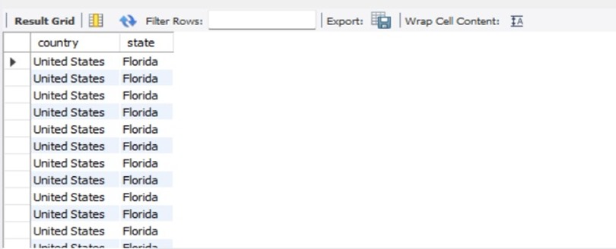
selection: It is used to retrive or fetch the data from the table by selecting rows and columns. syntax: select col_name from tablename where<condition>; 1. WAQTD country and state are listed in the samplesuperstore table for the state 'Florida'?"
select country ,state from samplesuperstorewhere state ='Florida';
Result:

Slide 8
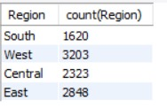
count(): It is use to obtain number of values in the column. It is only multi row function can accept as arguments. 2. WAQTD the total number of entries for each region in the 'samplesuperstore' dataset?“
select Region ,count(Region) from samplesuperstore group by Region;
Result:

Slide 9

Having clause: Having clause is used to filter the group. Having clause Execute after the execuction of group by clause. Having clause execute group by group. Having clause can accept multi row functions. Syntax: Select group function/expression From Tname Where <filter the records> Group By Col_name/expression Having <filter grouped by condition> 3. Find the total number of entries for the 'Central' region in the 'samplesuperstore’ dataset?
select count(Region) from samplesuperstore group by Region having Region = "central";
Result:

Slide 10
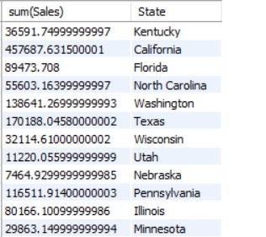
sum(): It is used to get the total value present in the column. 4. WAQTD the total sales amount for each state in the 'samplesuperstore' dataset?“
Select sum(Sales),State from samplesuperstore group by State;
Result:

Slide 11

avg(): It is used to obtain Average of value present in the column. 5. What is the average discount given for each product category in the samplesuperstore table?
select avg(discount),category from samplesuperstore group by category;
Result:

Slide 12
Order By clause: Order by clause is used to arrange the records in ascending and descending order. Compiler will arrange the records in ascending default. If want to arrange the records in descending order means 'dese' keyword. Syntax: select function group/expression from Tablename where <filter the records> group By Col_name/expression having <filter the group > order by col_name; 6. How can you retrieve the list of regions and cities from the samplesuperstore table, ordered by region?
select region,city from samplesuperstore order by region;

Slide 13
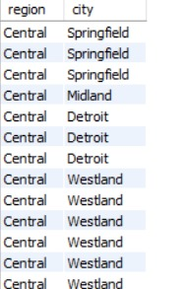
Result:

Slide 14
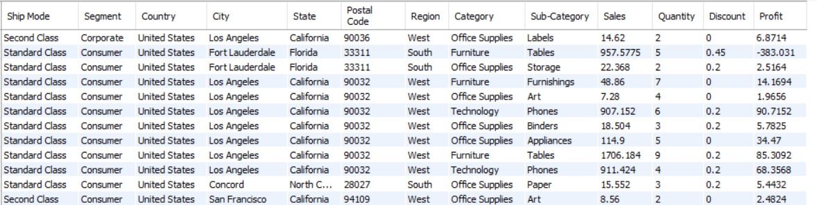
Like operator: Like operator is used to Pattern matching. Syntax: col_name/expression Like 'Pattern to match'; 7. WAQTD state from samplesuperstore where the state name ends with the letter 'a'.
select * from samplesuperstore where state like '%a';
Result:

Slide 15
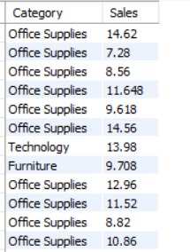
Between operator: Between operator used whenever we are having range of values. Syntax: col_name/expression between/lower range AND higher range; 8. WAQTD categories of items have sales in the range of 7.28 to 14.62?
select Category ,sales from samplesuperstore where sales between 7.28 and 14.62 ;
Result:

Slide 16
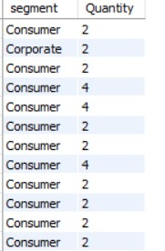
In operator: In operator is multiple value operator. It can accept one value of LHS. It can accept multiple value of RHS* We can use In operator instead of using '=' operator. Syntax: col_name/expression In(v1,v2.......vn); 9. WAQTD the segment and Quantity from the samplesuperstore table, where the Quantity is 2 ,4.
select segment ,Quantity from samplesuperstore where Quantity in(2,4);
Result:

Slide 17
Group by: It is used to group the records. Group By Clause execute row by row. After execution group by clause we can get group. Any clause execute after execution group by clause will execute group by group. Syntax: Select group function/expression From Tname Where <filter the records> Group By Col_name/expression 10. Find the unique sales values in the samplesuperstore table where the discount is 20%?
select sales from samplesuperstore where discount=0.2 group by sales;

Slide 18
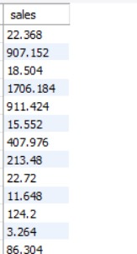
Result:

Slide 19
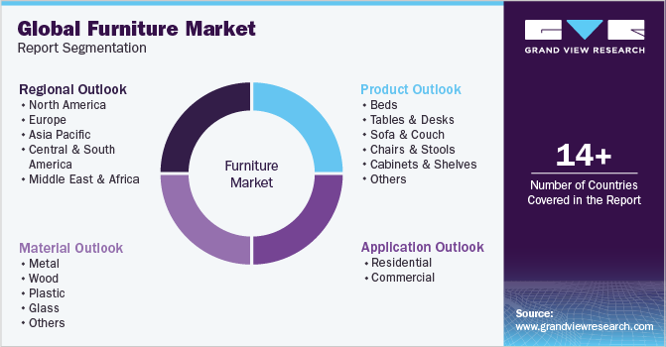

The Trends And Consumer Behaviour In Furniture Analysis
Thank you for listening

