Slide 1

Hash Algorithm
Notes:
Image Resource: https://slack.com/brand-guidelines

Slide 2

History
Whitfield Diffie Martin Hellman
1976
Diffie and Hellman
identified the need for a one-way hash function as a building block of a digital signature scheme.
Notes:
Image Resource: https://news.bitcoin.com/diffie-hellman-2015-turing-award/

Slide 3
History (cont.)
1976 (cont.)
The first definitions, analysis and constructions for cryptographic hash functions can be found in the work of Rabin, Yuval , and Merkle of the late 1970s.
1987
Damg˚ard formalized the definition of collision resistance

Slide 4
History (cont.)
1989
Naor and Yung defined a variant of seoncd preimage resistant functions called Universal One Way Hash Functions.
2004
perfected differential cryptanalysis
2007
NIST announced that it would organize the SHA-3 competition, with as goal to select a new hash function family by 2012.
2008

Slide 5
What
Hashing algorithm is another type of encryption which focuses on applying math.
Going through the process produces “message digest” or “message fingerprint”
Mostly used by cryptographers for securing passwords as well as crypto-currencies like Bitcoin.

Slide 6
What (cont.)
Common Features of Hash Functions:
Hash Value – fixed length
Hashing the data – converting data with no specific length to a fixed length
Represents large data as smaller and compressed version of it i.e. “compression features”
N-bit Hash Function – n-bit output of hash function

Slide 7
What (cont.)
Examples of Hash Functions:
Message Digest (MD) – for keeping files from being modified. It is a 128-bit hash function
Secure Hash Function (SHA) – subdivided into four algorithms: SHA-0, SHA-1, SHA-2, SHA-3
Whirlpool – 512-bit hash function
Notes:
A message digest is a fixed size numeric representation of the contents of a message, computed by a hash function. A message digest can be encrypted, forming a digital signature.

Slide 8
How
Two Steps of Hashing:
Converting an element into an integer thru hash function. Element == index → hash table
Element in the hash table may be retrieved thru hashed keys
- hash = hashFunction(key)
- index = hash MOD arraySize

Slide 9
Hash Table

Slide 10
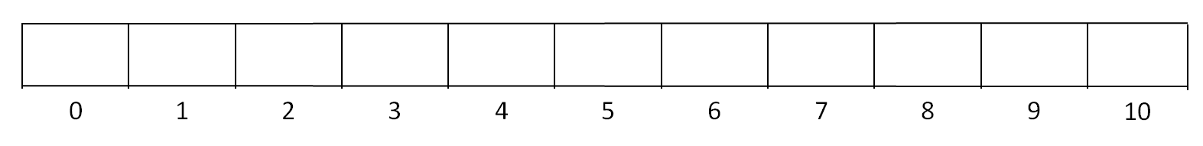













Placing a value on an array using hashing algorithm.

Slide 11
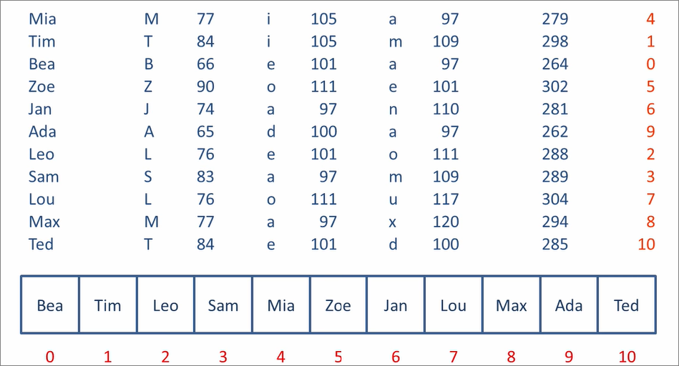

Hashing Algorithm

Slide 12
Collision

Slide 13
Bea
Tim
Len
Moe
Mia
Zoe
Sue
Lou
Rae
Max
Tod
0
1
2
3
4
5
6
7
8
9
10
Mia M 77 i 105 a 97 = 279 4
Tim T 84 i 105 m 109 = 298 1
Bea B 66 e 101 a 97 = 264 0
Zoe Z 90 o 111 e 101 = 302 5
Sue S 83 u 117 e 101 = 301 4
Len L 76 e 101 n 110 = 287 1
Moe M 77 o 111 e 101 = 289 3
Lou L 76 o 111 u 117 = 304 7
Rae R 82 a 97 e 101 = 280 5
Max M 77 a 97 x 120 = 294 8
Tod T 84 o 111 d 100 = 295 9

Slide 14
Open Addressing
- resolving a collision by placing an item somewhere other than its calculated address.
Linear Probing
- open addressing technique that utilizes linear search when the calculated address is already occupied.

Slide 15
Bea
Tim
Len
Moe
Mia
Zoe
Sue
Lou
Rae
Max
Tod
0
1
2
3
4
5
6
7
8
9
10
Find Rae
Rae = (82 + 97 + 101) = 280
280 Mod 11 = 5
theData = Array(5)

Slide 16
Real-Life Application
Digital Signature - hashing algorithms are used to scramble digital signatures.
Files Downloaded - the hash provides additional assurance that the data we received is correct
Notes:
Digital Signatures - These are first transformed with the algorithm to give a message-digest, then sent to the recipient of a coded transmission along with the associated hash value or key using separate transmissions.
Files Downloaded - Finally, hashes are used to authenticate messages. In this case, we are trying to protect the original input from tampering, and we select a hash that is strong enough to make malicious attack infeasible or unprofitable.

Slide 17
Real-Life Application (cont.)
Authentication
Search
Programming languages
Construct a message authentication code (MAC)
Timestamping
Key updating
Notes:
Authentication - Cryptographic hash functions let you log in to a system without storing your password anywhere vulnerable.
Search - Hashing is useful for indexing large storage spaces, so that you can look things up in them without reading their entire contents every time.
Programming Languages - Hash tables are a convenient way to implement the mechanism that connects a variable's name to its memory location.
Key Updating- key is hashed at specific intervals resulting in new key

Slide 18
Conclusion
Notes:
Resources:
http://etutorials.org/Programming/Programming+.net+security/Part+III+.NET+Cryptography/Chapter+13.+Hashing+Algorithms/13.1+Hashing+Algorithms+Explained/
http://www.cs.uregina.ca/Links/class-info/210/Hash/
http://interactivepython.org/runestone/static/pythonds/SortSearch/Hashing.html
https://www.hackerearth.com/practice/data-structures/hash-tables/basics-of-hash-tables/tutorial/
https://www.ibm.com/support/knowledgecenter/en/SSFKSJ_7.1.0/.../sy10510_.htm

