Slide 1
Spring Framework Overview – Pre-work
Rod Tumbaga
Ryan Lamaroza

Slide 2

Need To Knows
OOP Concept
Java Classes
Java Methods and Variables
Java Interfaces
Java Annotations
Jquery
XML
MyBatis
Tomcat Web Server
Maven

Slide 3



OOP Concept
OOP (Object Oriented Programming) is is a programming language model organized around objects rather than "actions" and data rather than logic. Historically, a program has been viewed as a logical procedure that takes input data, processes it, and produces output data.
http://searchsoa.techtarget.com/definition/object-oriented-programming .

Slide 4
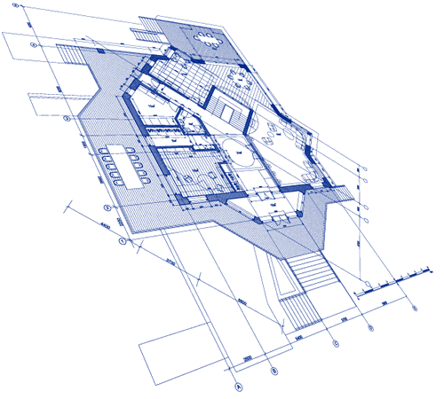
Java Classes
A class is nothing but a blueprint or a template for creating different objects which defines its properties and behaviors. Java class objects exhibit the properties and behaviors defined by its class. A class can contain fields and methods to describe the behavior of an object.
http://www.wideskills.com/java-tutorial/java-classes-and-objects

Slide 5
Java Methods and Variables
Methods are nothing but members of a class that provide a service for an object or perform some business logic. Java field and member function names are case sensitive. Current states of a class’s corresponding object are stored in the object’s instance variables. Methods define the operations that can be performed in java programming.
Sub is to Perl
Method is to Java
Sub
Perl
Method
Java
http://www.wideskills.com/java-tutorial/java-classes-and-objects

Slide 6
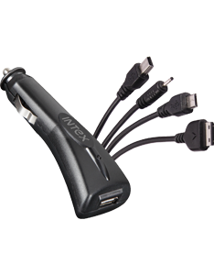
Java Interface
Interface looks like class but it is not a class. An interface can have methods and variables just like the class but the methods declared in interface are by default abstract (only method signature, no body). Also, the variables declared in an interface are public, static & final by default.
Interface is to Java
Requires and is-a to PERL
http://beginnersbook.com/2013/05/java-interface/

Slide 7

Java Annotation
Java annotations are used to provide meta data for your Java code. Being meta data, Java annotations do not directly affect the execution of your code, although some types of annotations can actually be used for that purpose.
http://tutorials.jenkov.com/java/annotations.html

Slide 8

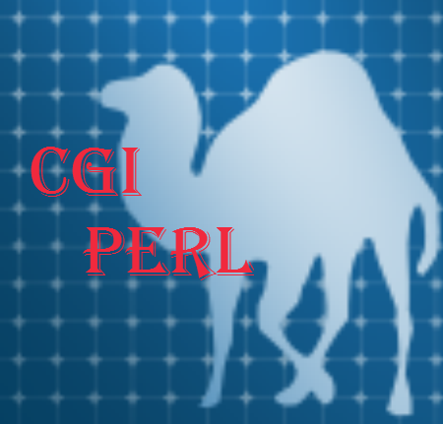
JSP
JavaServer Pages (JSP) is a technology for developing web pages that support dynamic content which helps developers insert java code in HTML pages by making use of special JSP tags, most of which start with <% and end with %>.
CGI is to Perl
JSP is to Java
https://www.tutorialspoint.com/jsp/jsp_overview.htm

Slide 9

JQuery
jQuery is a fast, small, and feature-rich JavaScript library. It makes things like HTML document traversal and manipulation, event handling, animation, and Ajax much simpler with an easy-to-use API that works across a multitude of browsers. With a combination of versatility and extensibility, jQuery has changed the way that millions of people write JavaScript.
https://jquery.com/

Slide 10
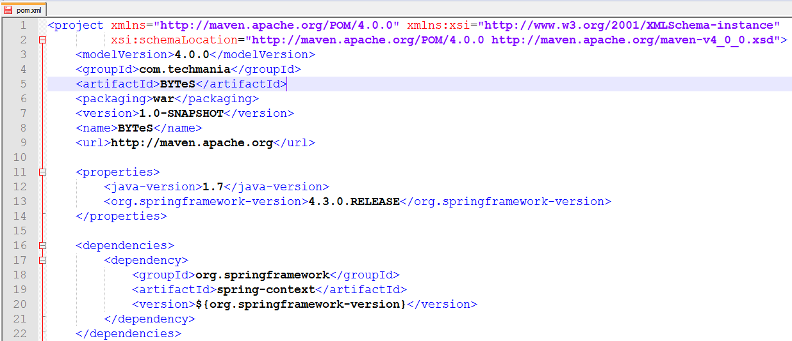

XML
XML stands for EXtensible Markup Language
XML is a markup language much like HTML
XML was designed to store and transport data
XML was designed to be self-descriptive
XML is a W3C Recommendation
http://www.w3schools.com/xml/xml_whatis.asp

Slide 11
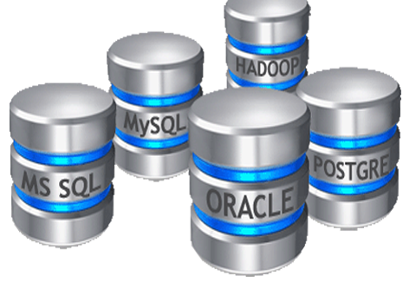


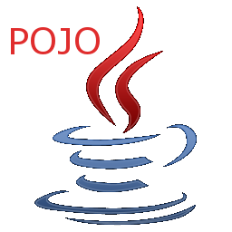
MyBatis
MyBatis is a first class persistence framework with support for custom SQL, stored procedures and advanced mappings. MyBatis eliminates almost all of the JDBC code and manual setting of parameters and retrieval of results. MyBatis can use simple XML or Annotations for configuration and map primitives, Map interfaces and Java POJOs (Plain Old Java Objects) to database records.
http://www.mybatis.org/mybatis-3/

Slide 12




Tomcat
Apache Tomcat, often referred to as Tomcat, is an open-source web server developed by the Apache Software Foundation (ASF). Tomcat implements several Java EE specifications including Java Servlet, JavaServer Pages (JSP),Java EL, and WebSocket, and provides a "pure Java" HTTP web server environment in which Java code can run.
https://en.wikipedia.org/wiki/Apache_Tomcat

Slide 13

Maven
Apache Maven is a software project management and comprehension tool. Based on the concept of a project object model (POM), Maven can manage a project's build, reporting and documentation from a central piece of information.
https://en.wikipedia.org/wiki/Apache_Tomcat

