Slide 1
Debugging and Deploying on Azure
[Speaker]
[Company]
Email: [Email]
Twitter: [Twitter]

Slide 2
Agenda
Azure Web Apps Overview
Introduction to the Azure Dashboard
Deploying to Azure with Visual Studio
Deploying to Azure with GitHub
Debugging Remote Node Applications with Visual Studio

Slide 3
Azure Web Apps Overview

Slide 4

Develop apps with…
.NET
Python
Node.js
Java
PHP
Web App

Slide 5
Azure Apps
Easy to deploy a variety of different web sites : node, python, php, asp.net, etc.
Can install some software from the gallery like WordPress or preconfigured stacks ( MEAN stack )
Has a few limitations such as cannot configure ports, compile native modules for Node

Slide 6
Azure Apps
Can configure custom domains
Can add FTP users
Can run multiple web sites
Ideal for a production / staging environment

Slide 7
Deploying to Azure with Visual Studio

Slide 8
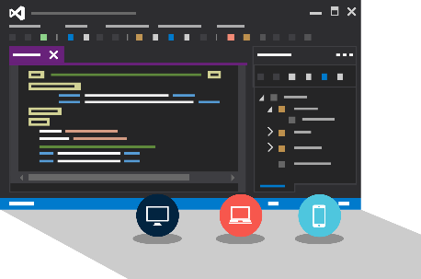
Visual Studio + App Service Web Apps
Create Azure Resources during File / New
Create Web App during deploy
Manage with Server Explorer

Slide 9
Deploying to Azure with Visual Studio

Slide 10
Deploying to Azure with Github

Slide 11

Continuous Deployment
Production Slot
Agility through Continuous Deployment
Auto-Swap
Hooks
Git pull
Commits
Changes
Staging Slot
Source Control / Code Repo
Developer

Slide 12

Source Control
Git
Visual Studio
Online
CodePlex
GitHub
BitBucket
DropBox
FTP
Choose your own adventure!
Notes:
Slide Objectives:
Objective #1
Transition:
Transition statement(s) to setup the slide
Speaking Points:
Speaking Point #1
Speaking Point #2
Notes:
Any notes go here

Slide 13
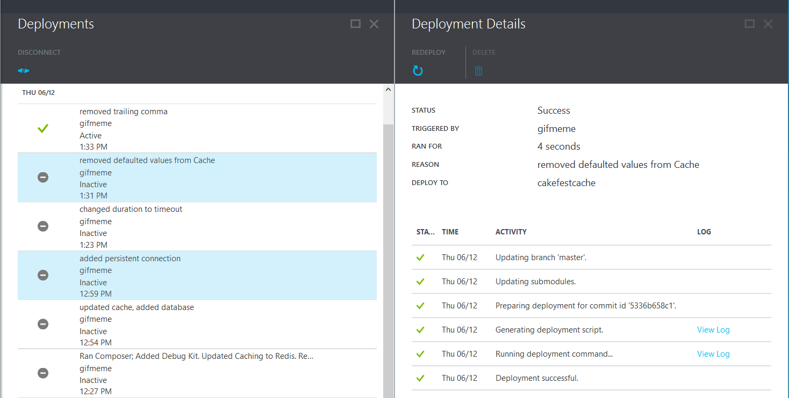
Deployments

Slide 14
Deploying to Azure with Github

Slide 15
Remote debugging with Visual Studio

Slide 16
Remote Debugging a Node.js application with Visual Studio and Azure

Slide 17

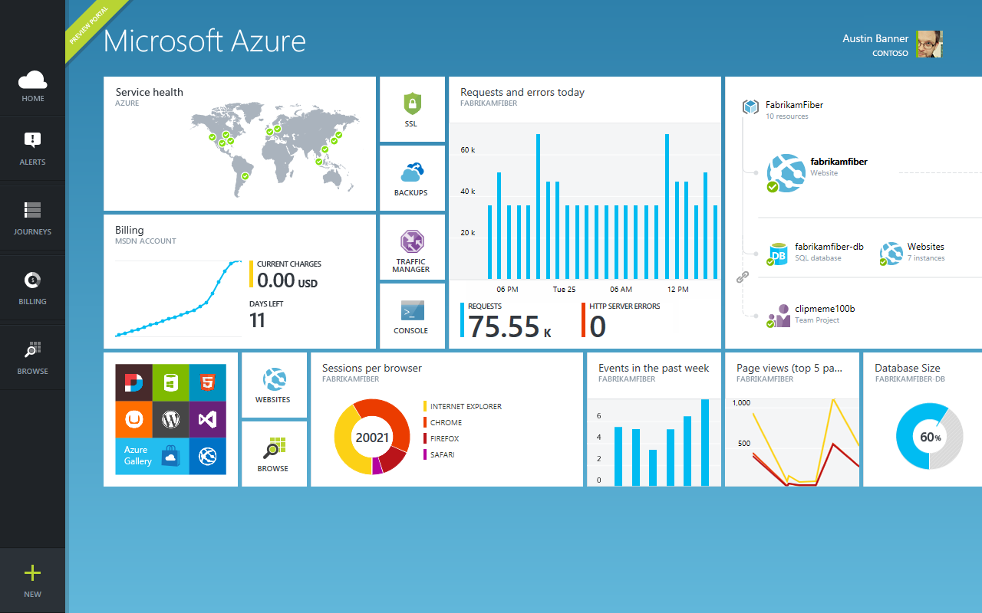
Get started
Visit azure.microsoft.com

