Slide 1
Creating the User Interface
[Speaker]
[Company]
Email: [Email]
Twitter: [Twitter]

Slide 2
Agenda
Introduction to Jade
Jade Templates
Implementing Bootstrap
Creating the chat UI

Slide 3
Introduction to Jade

Slide 4
Templating with Jade
Jade is a templating language to simplify writing HTML.
Jade syntax and keywords map directly to HTML.
Jade adds the ability to separate and extend your HTML.
Helps prevent code repeat
Ensures clean HTML is generated.
Allows you to insert values into HTML through templates.

Slide 5
Templating with Jade
Simple Tags
Output
div
address
i
strong
<div>
<address></address><i></i><strong></strong>
</div>

Slide 6
Templating with Jade
Tags with Attributes
Output
h1(id="title") Welcome to Jade
button(class="btn", data-action="bea").
Be Awesome
<h1 id="title">Welcome to Jade</h1>
<button data-action="bea" class="btn">Be Awesome</button>

Slide 7
Templating with Jade
The extends keyword allows a template to extend a layout or parent template. It can then override certain pre-defined blocks of content.
The block keyword allows you to establish a block or replace the content of pre-defined blocks.

Slide 8
Bootstrap

Slide 9
Bootstrap – Why use it?
CSS is can be tricky
Cross browser support can be a challenge
Solves basic tasks (e.g. page layout without tables)
Bootstrap 3 makes it easier

Slide 10
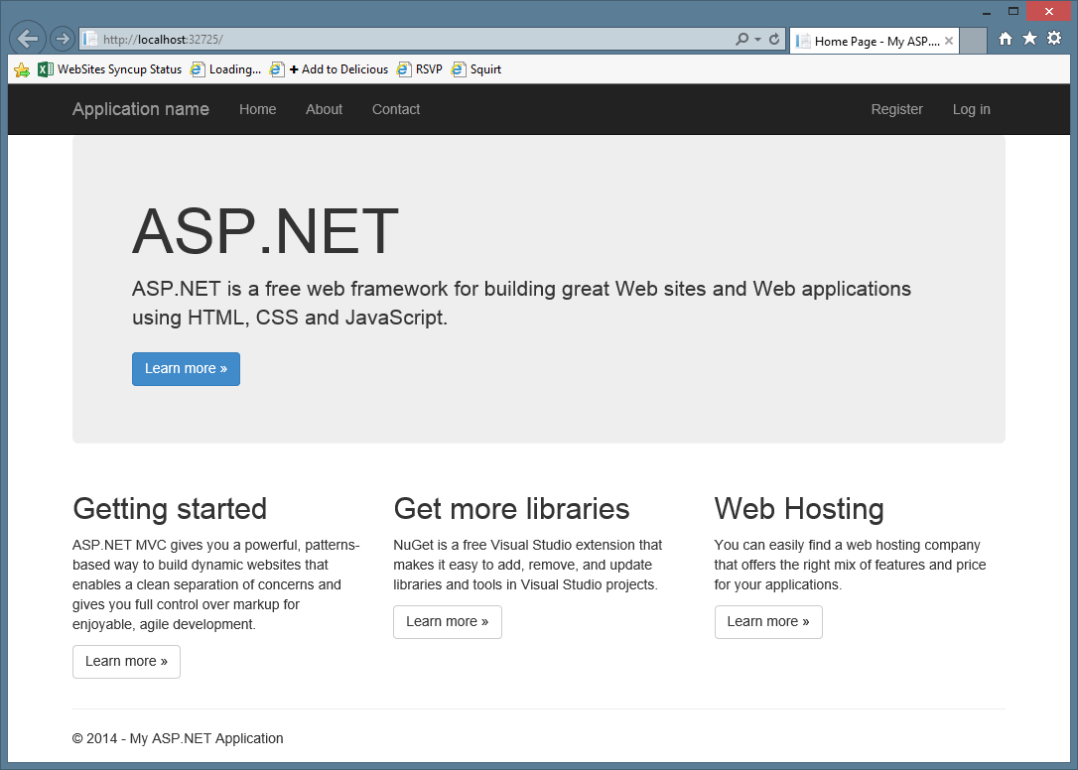
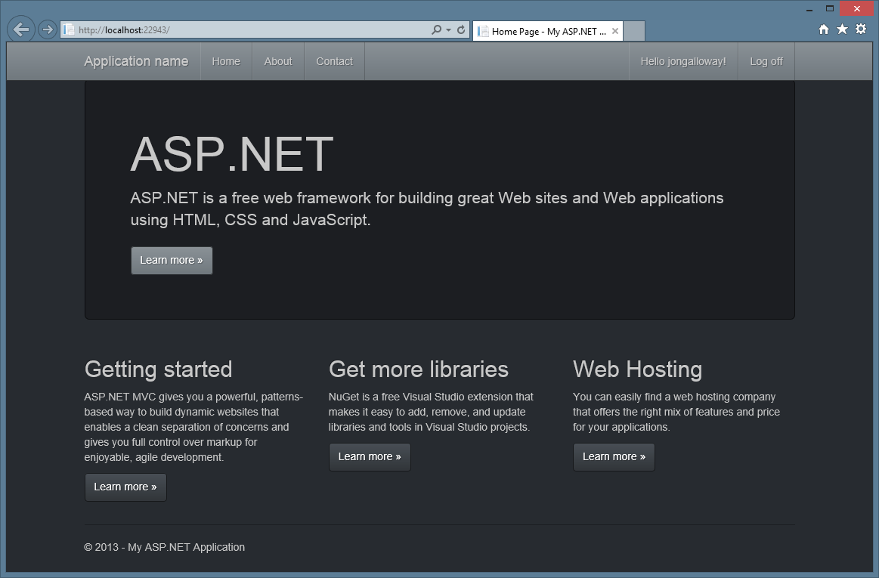
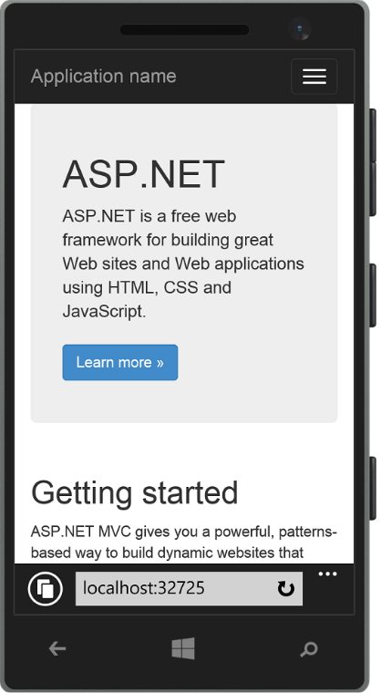
Bootstrap Features
Theme Support
Responsive
Grid system
Components
Pagination
Buttons
Modal
Great Visual Studio support

Slide 11
Bootstrap Grid system
Bootstrap works on a grid
The grid has 12 columns
There are four grids
One grid for each screen size
Large (1200px and higher)
Medium (992px-1200px)
Small (768px-991px)
Extra small (less than 768px)

Slide 12
Bootstrap Grid system
 | Extra small devices Phones (<768px) | Small devices Tablets (≥768px) | Medium devices Desktops (≥992px) |  | Large devices Desktops (≥1200px)
Grid behavior | Horizontal at all times | Collapsed to start, horizontal above breakpoints
Container width | None (auto) | 750px |  | 970px |  | 1170px
Class prefix | .col-xs- | .col-sm- |  | .col-md- |  | .col-lg-
# of columns | 12
Column width | Auto | 60px |  | 78px |  | 95px
Gutter width | 30px (15px on each side of a column)
Always 12 columns

Slide 13





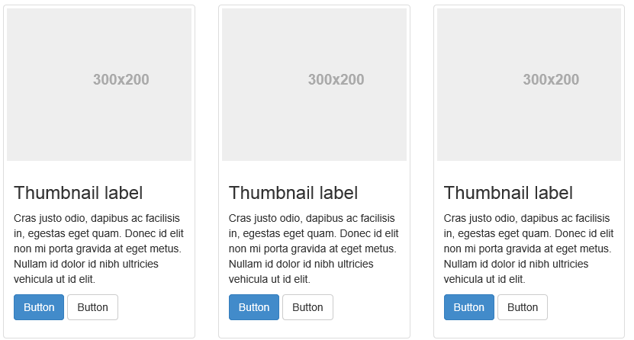
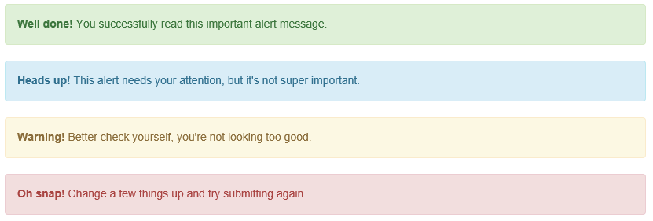
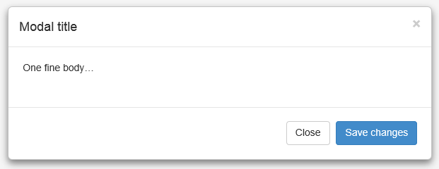
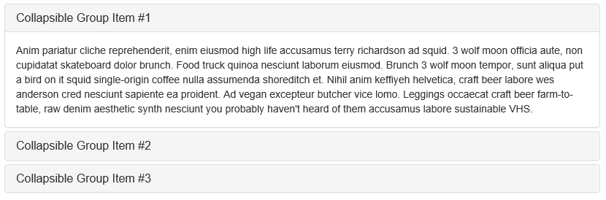
Bootstrap components

Slide 14
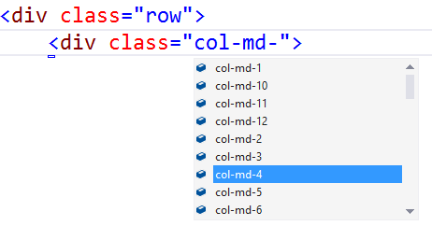
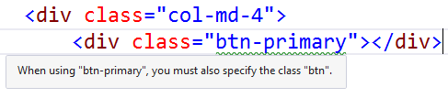
Bootstrap - Visual Studio support
CSS Class IntelliSense
Updated templates and MVC scaffolding to use Bootstrap classes
Web Essentials - Missing class detection

Slide 15
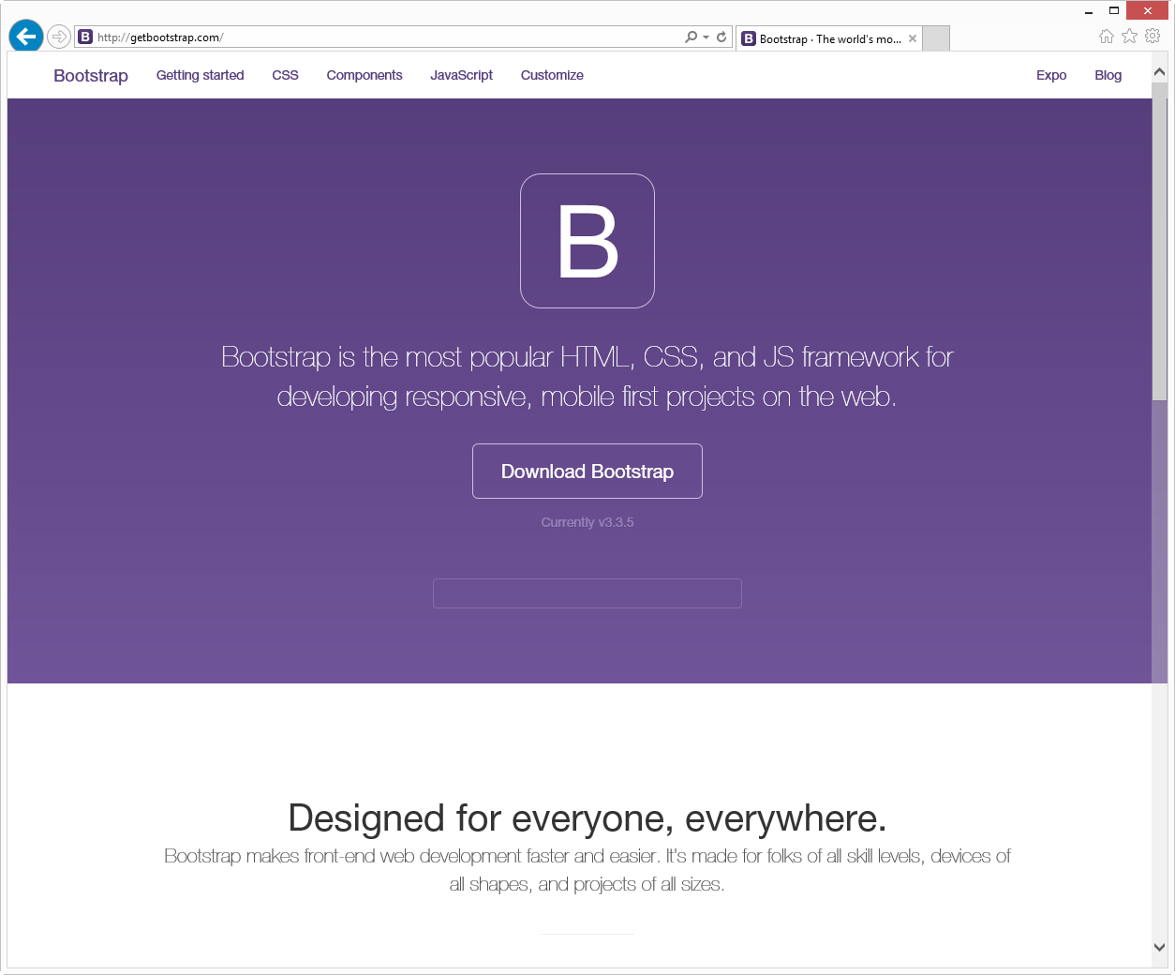
http://getbootstrap.com/

Slide 16
Using Jade Templates with Bootstrap

Slide 17
Creating the chat UI

