Slide 1
Provisioning, Deploying and Debugging on Azure
[Speaker]
[Company]
Email: [Email]
Twitter: [Twitter]

Slide 2
Agenda
Azure Web Apps Overview
Provisioning Azure Resources using Azure CLI
Deploying to Azure with Visual Studio
Deploying to Azure with GitHub
Remote debugging with Visual Studio

Slide 3
Azure Web Apps Overview

Slide 4

Develop apps with…
.NET
Python
Node.js
Java
PHP
Web App

Slide 5
Azure Apps
Easy to deploy a variety of different web sites: node, python, php, asp.net, etc.
Can install some software from the gallery like WordPress or preconfigured stacks (MEAN stack)
Has a few limitations such as cannot configure ports, compile native modules for Node

Slide 6
Azure Apps
Can configure custom domains
Can add FTP users
Can run multiple web sites
Ideal for a production / staging environment

Slide 7
Provisioning Azure Resources using Azure CLI

Slide 8
Azure CLI
Cross-platform command line interface to develop, deploy and manage Microsoft Azure applications
Runs on Node.js. It's installed using npm package
manager npm install -g azure-cli
Works in one of two modes
Service management: Azure service management API
Resource manager: Azure Resource Manager API

Slide 9
Azure CLI with Azure Resource Manager
Deploy, manage, and monitor the solution resources as a group, rather than handling them individually
Use declarative templates to define the solution deployment
Define the dependencies between resources so they are deployed in the correct order

Slide 10
Using Azure CLI
Get authenticated with Microsoft Azure
azure login
Switch to Azure Resource Manager
azure config mode arm
Create a Resource Group
azure group create -n "chatroomRG" -l "East US"
Create the Azure resources using a json template
azure group deployment create -f azuredeploy.json –e azuredeploy.parameters.json chatroomRG chatroomDeploy

Slide 11
Provisioning Azure Resources using Azure CLI

Slide 12
Deploying to Azure with Visual Studio

Slide 13
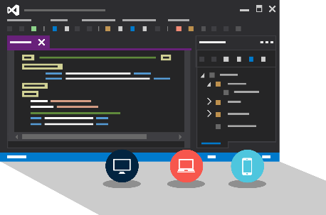
Visual Studio + App Service Web Apps
Create Azure Resources during File / New
Create Web App during deploy
Manage with Server Explorer

Slide 14
Deploying to Azure with Visual Studio

Slide 15
Deploying to Azure with GitHub

Slide 16

Continuous Deployment
Production Slot
Agility through Continuous Deployment
Auto-Swap
Hooks
Git pull
Commits
Changes
Staging Slot
Source Control / Code Repo
Developer

Slide 17

Source Control
Git
Visual Studio
Online
CodePlex
GitHub
BitBucket
DropBox
FTP
Choose your own adventure!
Notes:
Slide Objectives:
Objective #1
Transition:
Transition statement(s) to setup the slide
Speaking Points:
Speaking Point #1
Speaking Point #2
Notes:
Any notes go here

Slide 18
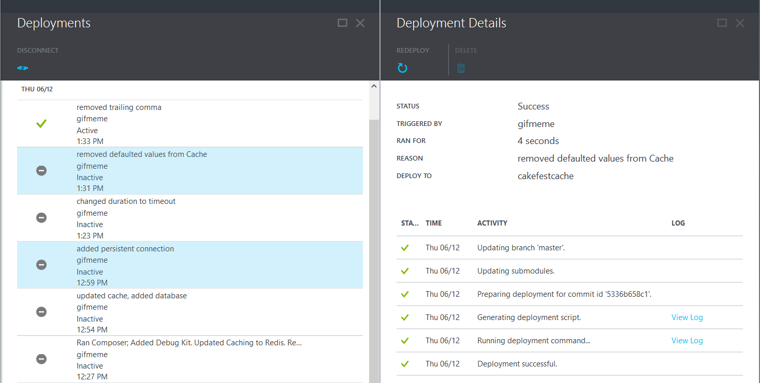
Deployments

Slide 19
Deploying to Azure with GitHub

Slide 20
Remote debugging with Visual Studio

Slide 21
Remote Debugging a Node.js application with Visual Studio and Azure

Slide 22

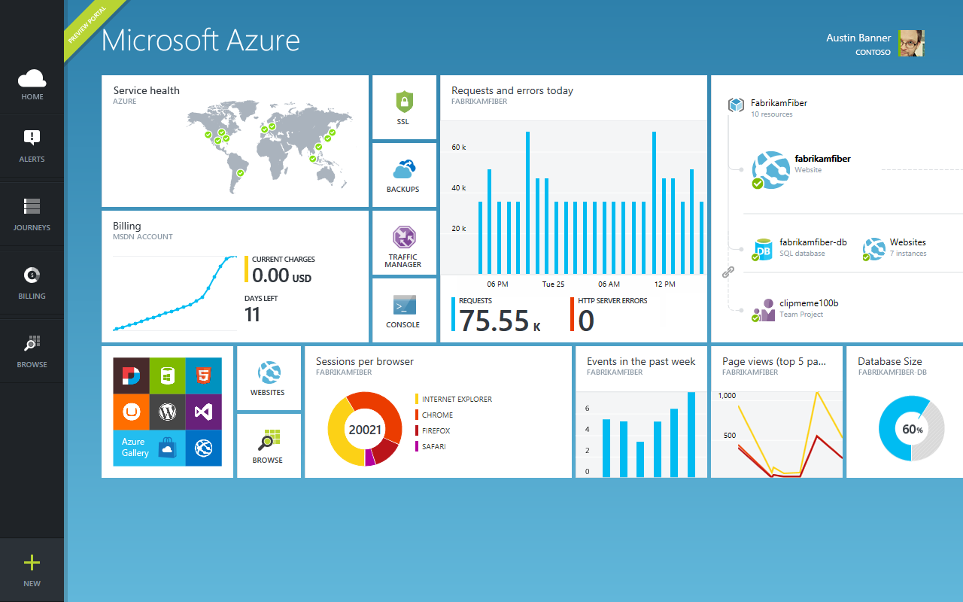
Get started
Visit azure.microsoft.com

