Slide 1
Introduction to Node.js
[Speaker]
[Company]
Email: [Email]
Twitter: [Twitter]

Slide 2
Agenda
About Node
Setting up your environment
First Node application
Node Package Manager (NPM)

Slide 3
About Node

Slide 4
What is Node?
Node.js is a runtime environment and library for running JavaScript applications outside the browser.
Node.js is mostly used to run real-time server applications and shines through its performance using non-blocking I/O and asynchronous events.

Slide 5
About Node
Leverage skills with JavaScript now on the server side
Unified development environment/language
High Performance JavaScript Engines – V8
Open source, created in 2009 by Ryan Dahl
Windows, Linux, Mac OSX

Slide 6
When to use Node
Node is great for streaming or event-based real-time applications like:
Chat Applications
Real time applications and collaborative environments
Game Servers
Ad Servers
Streaming Servers
Node is great for when you need high levels of concurrency but little dedicated CPU time.
Great for writing JavaScript code everywhere!

Slide 7
Node in the Wild
Microsoft
Yahoo!
LinkedIn
eBay
Dow Jones
Cloud9
The New York Times, etc

Slide 8
Node Release & Release Model
Following a forked release model, similar to Ubuntu.
Long-Term Support vs. Current
Current LTS Version: v4.6.0 (NPM: 2.15.9)
Current Version: v6.7.0 (NPM 3.10.3)
On Windows, use the Current version as there are less issues with long-paths and NPM since >v3.0

Slide 9
Setting up your environment

Slide 10
Installing Node on Windows
http://nodejs.org/ - pre-complied Node.js binaries to install
https://github.com/joyent/node/wiki/Installation - building it yourself
Via Chocolatey – package manager for Windows:
choco install nodejs.install

Slide 11
Path Variable
Double check that the node executable has been added to your PATH system environment variable.
https://www.youtube.com/watch?v=W9pg2FHeoq8 To see how to change your environment variables on Windows 8 and Windows 8.1.
You will want to make sure the following folder has been added to the PATH variable: C:\Program Files (x86)\nodejs\

Slide 12
Installing Node with Bash for Windows
Install Bash for Windows: https://msdn.microsoft.com/en-us/commandline/wsl/install_guide
sudo apt-get update
sudo apt-get install nodejs nodejs-legacy npm

Slide 13
Installing Visual Studio Code
Visual Studio Code is a lightweight but powerful source code editor which runs on your desktop and is available for Windows, Mac and Linux. https://code.visualstudio.com
It comes with built-in support for JavaScript, TypeScript and Node.js and has a rich ecosystem of extensions for other languages (such as C++, C#, Python, PHP) and runtimes.
Built-in support for Node.js Debugging, Git, Intellisense, Linting, Chrome Debugging Protocol, etc.

Slide 14
Installing Node.js Tools for Visual Studio
NTVS is a free, open source plugin that turns Visual Studio into a Node.js IDE.
It supports Editing, Intellisense, Profiling, npm, TypeScript, Debugging locally and remotely (Windows / MacOS / Linux), as well Azure Web App and Cloud Service.
Designed, developed, and supported by Microsoft and the community.
https://nodejstools.codeplex.com/

Slide 15
First Node Application

Slide 16
Hello World Application

Slide 17
Basic HTTP Server

Slide 18
Basic TCP server

Slide 19
Event Driven Programming
“A programming paradigm in which the flow of the program is determined by events such as user actions (mouse clicks, key presses) or messages from other programs.” – Wikipedia

Slide 20
Node Event Loop
Node provides the event loop as part of the language.
With Node, there is no call to start the loop.
The loop starts and doesn’t end until the last callback is complete.
Event loop is run under a single thread therefore sleep() makes everything halt.

Slide 21
Blocking I/O
var fs = require('fs');
var contents = fs.readFileSync('package.json').toString();
console.log(contents);

Slide 22
Non Blocking I/O
var fs = require('fs');
fs.readFile('package.json', function (err, buf) {
console.log(buf.toString());
});

Slide 23
Reading file content sync vs async

Slide 24
Callback Style Programming
Event loops result in callback-style programming where you break apart a program into its underlying data flow.
In other words, you end up splitting your program into smaller and smaller chunks until each chuck is mapped to operation with data.
Why? So that you don’t freeze the event loop on long-running operations (such as disk or network I/O).

Slide 25
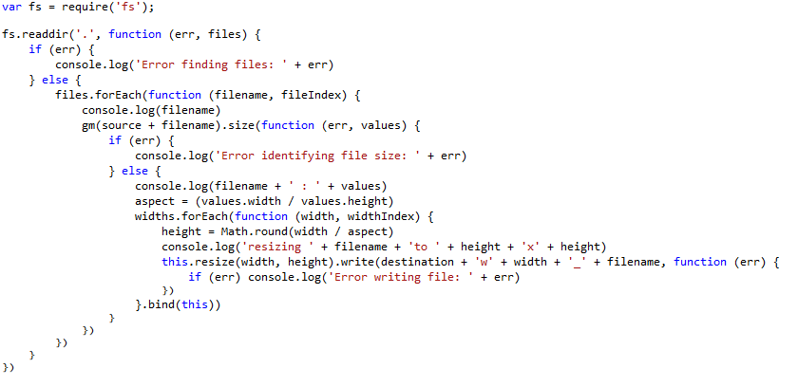
Callback Insanity

Slide 26
Promises
A function will return a promise for an object in the future.
Promises can be chained together.
Simplify programming of async systems.
Read More: http://spin.atomicobject.com/2012/03/14/nodejs-and-asynchronous-programming-with-promises/

Slide 27
Event Emitters
Allows you to listen for “events” and assign functions to run when events occur.
Each emitter can emit different types of events.
The “error” event is special.
Read More: http://code.tutsplus.com/tutorials/using-nodes-event-module--net-35941

Slide 28
Streams
Streams represent data streams such as I/O.
Streams can be piped together like in Unix.
var fs = require("fs");
// Read File
fs.createReadStream("package.json")
// Write File
.pipe(fs.createWriteStream("out.json"));

Slide 29
Modules and Exports
Node.js has a simple module and dependencies loading system.
Unix philosophy -> Node philosophy
Write programs that do one thing and do it well -> Write modules that do one thing and do it well.

Slide 30
Require() Module Loading System
Call the function “require” with the path of the file or directory containing the module you would like to load.
Returns a variable containing all the exported functions.
var fs = require("fs");

Slide 31
Node Package Manager (NPM)

Slide 32
What is NPM?
Official package manager for Node.
Bundled and installed automatically with the environment.
Frequent Usage:
npm install package_name --save
npm update

Slide 33
What is a package.json?
{
"name": "Node101",
"version": "0.1.0",
"description": “MVA Presentation Code",
"main": "1_hello_world.js",
"author": {
"name": "Rami Sayar",
"email": ""
}
}

Slide 34
Popular NPM Modules
Most Depended Upon
underscore
async
request
lodash
commander
express
bluebird
chalk
debug

Slide 35
How does it work?
Reads package.json
Installs the dependencies in the local node_modules folder
In global mode, it makes a node module accessible to all.
Can install from a folder, tarball, web, etc…
Can specify dev or optional dependencies.

Slide 36
Async Module
async.map(
['file1','file2','file3'],
fs.stat,
function (err, results) {
// results is now an array of stats for each file
});
async.filter(
['file1','file2','file3'],
fs.exists,
function (results) {
// results now equals an array of the existing files
});
async.parallel([
function () { },
function () { }
], callback);
async.series([
function () { },
function () { }
]);
Async is a utility module which provides straight-forward, powerful functions for working with asynchronous JavaScript.

Slide 37
Request Module
Request is designed to be the simplest way possible to make http calls. It supports HTTPS, streaming and follows redirects by default.
var request = require('request'); request('http://www.microsoft.com', function (error, response, body) {
if (!error && response.statusCode == 200) {
console.log(body);
}
});

Slide 38
Install and update Node packages through the Node Package Manager

Slide 39
Resources
https://blog.jcoglan.com/2013/03/30/callbacks-are-imperative-promises-are-functional-nodes-biggest-missed-opportunity/
http://code.tutsplus.com/tutorials/using-nodes-event-module--net-35941
http://spin.atomicobject.com/2012/03/14/nodejs-and-asynchronous-programming-with-promises/

