Slide 1
Debugging and Deploying on Azure
[Speaker]
[Company]
Email: [Email]
Twitter: [Twitter]

Slide 2
Agenda
Azure Websites Overview
Introduction to the Azure Dashboard
Deploying to Azure with Visual Studio
Deploying to Azure with Github
Debugging Remote Node Applications with Visual Studio

Slide 3
Azure WebSites Overview

Slide 4
Azure Websites
Easy to deploy a variety of different web sites : node, python, php, asp.net etc..
Can install some software from the gallery like WordPress or preconfigured stacks ( MEAN stack )
Has a few limitations such as cannot configure ports, compile native modules for Node

Slide 5
Azure Websites
Can configure custom domains
Can add FTP users
Can run multiple web sites
Ideal for a production / staging environment

Slide 6
Introduction to the Azure Dashboard

Slide 7
Introduction to the Azure Dashboard

Slide 8
Deploying to Azure with Visual Studio

Slide 9
Deploying to Azure with Visual Studio

Slide 10
Deploying to Azure with Github

Slide 11
Deploying to Azure with Github

Slide 12
Remote debugging with Visual Studio

Slide 13
Remote Debugging a node application with Visual Studio and Azure

Slide 14
Configuration Overview

Slide 15
Setting environment variables and connection strings

Slide 16
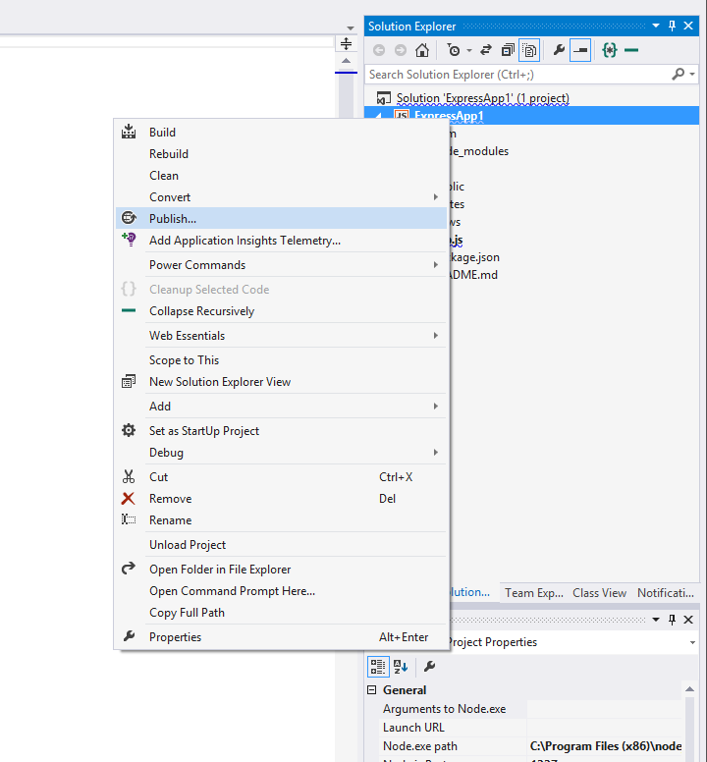
Azure Publishing

Slide 17
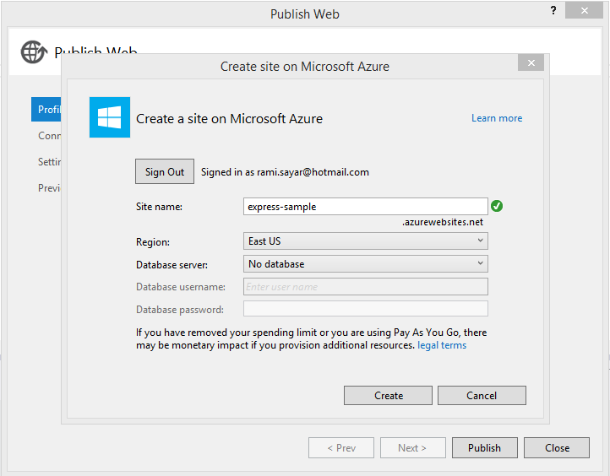
Why use Express?

Slide 18
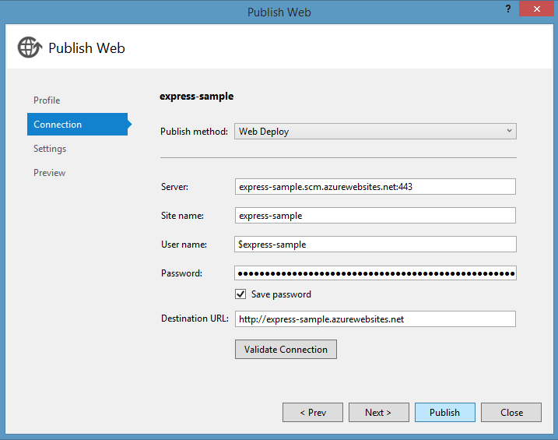
Why use Express?

Slide 19
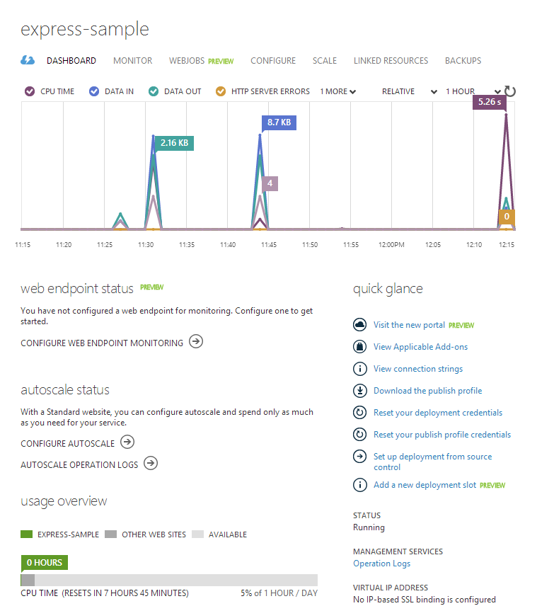
Why use Express?

