Slide 1
Building the Backend
[Speaker]
[Company]
Email: [Email]
Twitter: [Twitter]

Slide 2
Agenda
What are Web Sockets?
Using Socket.IO to connect users, broadcast and receive messages
Using a NoSQL Database

Slide 3
What are Web Sockets?

Slide 4
What are Web Sockets
A Websocket is a protocol designed to allow web applications to create a full-duplex channel over TCP (i.e. to have bi-directional communication) between the web browser and a web server
It is fully compatible with HTTP and uses TCP port number 80
WebSockets allowed web applications to become real-time and support advanced interactions between the client and the server
It is supposed by several browsers including Microsoft Edge, Internet Explorer, Google Chrome, Firefox, Safari and Opera

Slide 5
What is Socket.IO
Socket.IO is a simple JavaScript library and node.js module that allows you to create real-time bidirectional event-based communication apps simply and quickly
It simplifies the process of using WebSockets significantly. We will be using Socket.IO v1.0 to make our chatroom app

Slide 6
Using Socket.IO to connect users, broadcast and receive messages

Slide 7
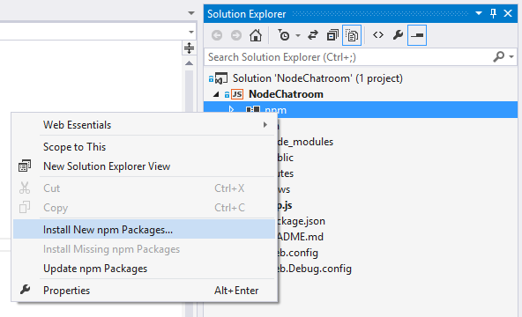
Implementing Socket.IO
Add it to the package.json
In Visual Studio > right click NPM to add module
Or from the command prompt :
npm install --save socket.io

Slide 8
Using Socket I.O to connect users, send and receive messages

Slide 9
Using a NoSQL Database

Slide 10
About NoSQL databases
Not only SQL
Different types: document based, graph databases, key-value stores, etc.
DocumentDB, MongoDB, Couchbase, HBase, Cassandra
Object oriented APIs
Good for large amounts of data, can be scaled

Slide 11
DocumentDB is particularly suited for web and mobile applications
Schema-less, NoSQL document database
Fully managed, with provisioned capacity
Stored entities are JSON documents
Tunable consistency
Designed to scale
Notes:
So speaking of customers, let’s move on to some of the scenarios that we’ve seen DocDB used for. DocDB is particularly suited for web and mobile application development of all types, but a few scenarios seem to be great fit for the service and we’ve seen these scenarios in the private preview.
Catalog Data
Store, query and process entities – people, places, things
Evolve item schema and attributes based on application needs
Tune indexing to match query and performance needs
Examples include product catalogs, user profiles, device information i.e. IoT systems
Preferences and State
Store user preference data for application experiences and UI customization
Store application information including game state or device configuration information
Support cross document transactions i.e. item transfer or concurrent add/remove operations
Event Store
Process store and query device and application events in near real time i.e. IoT systems
Partition data as time-series or by source ID
Expose web APIs and application experiences over event data with diverse structure
Archive or delete data as it ages out
User Generated Content
Store user generated content such as blogs, comments, annotations.
Support varying properties based on consumption platform (web, mobile)
Rapidly evolve schema based on application needs
Data Exchange
Consume, aggregate and serve data from a variety of sources
Adapt to evolving schemas
Offer queries over heterogeneous document structures
Scale data consumption or delivery from disparate sources

Slide 12
DocumentDB
NoSQL document database-as-a-service
First of its kind database service to offer native support for JavaScript, SQL query and transactions over JSON documents
Rich Query and Transactions
over JSON Data
Reliable &
Predictable Performance
Rapid Development
Query JSON data with no secondary indices
Native JavaScript transactional processing
Familiar SQL-based query language
Fast, predictable performance
Tunable consistency
Elastic scale
Build with familiar tools – REST, JSON, JavaScript
Easy to start and fully-managed
Enterprise-grade Azure platform
Notes:
So what is DocumentDB?
DocumentDB is a NoSQL document database-as-a-service, fully managed by Microsoft Azure.
It is for cloud-designed apps when query over schema-free data; reliable and predictable performance; and rapid development are key. It’s the first of its kind database service to offer native support for JavaScript, SQL query and transactions over JSON documents.
The key benefits of DocDB can be broken down into three pillars. We'll go into a bit more detail into how DocDB is differentiated in the market based on these pillars.
Rich query and transaction over JSON data – which includes the concepts of query, automatic indexing, transactions, sql-like query language
Reliable and Predictable Performance – built for the cloud, tunable consistency, elastic
Rapid Development – benefits of being part of Azure, build with familiar tools (so you can bring your JSON data and take it away)
Together, you have a service that is perfect for cloud architects and developers who need an enterprise-ready NoSQL document database.

Slide 13
DocumentDB: A Document Store
DocumentDB
Collections
Document 1
Document 2
{
"name": "John",
"country": "Canada",
"age": 43,
"lastUse": "March 4, 2014"
}
{
"name": "Eva",
"country": "Germany",
"age": 25
}
SQL query
Document 3
Document 4
JSON
Application
{
"name": "Lou",
"country": "Australia",
"age": 51,
"firstUse": "May 8, 2013"
}
{
"docCount": 3,
"last": "May 1, 2014"
}
Notes:
Source: https://msdn.microsoft.com/en-us/library/azure/dn781482.aspx
Microsoft Azure DocumentDB is a document-oriented, NoSQL database service designed for modern mobile and web applications. DocumentDB delivers consistently fast reads and writes, schema flexibility, and the ability to easily scale a database up and down on demand. DocumentDB enables complex ad hoc queries using a dialect of SQL, supports well defined consistency levels, and offers JavaScript language integrated, multi-document transaction processing using the familiar programming model of stored procedures, triggers and UDFs.

Slide 14
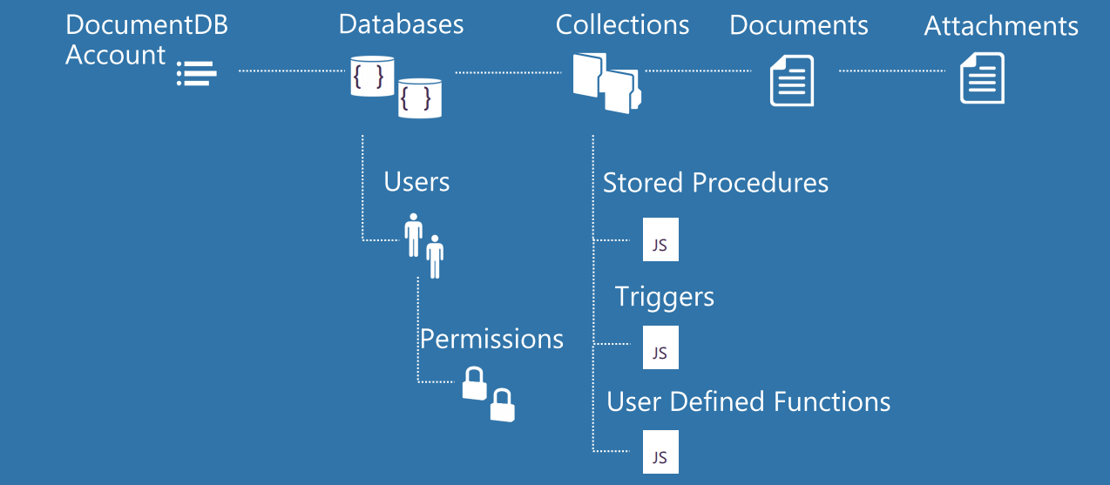
DocumentDB: The Basics

Slide 15
Saving messages to Azure DocumentDB

Slide 16
Setting environment variables

Slide 17
Using MongoDB
Many developers build Node apps with MongoDB
DocumentDB databases can now be used as the data store for apps written for MongoDB using the existing drivers by simply changing a connection string
Alternatively, you can connect to 3rd party services like MongoHQ or MongoLab or run MongoDB in a VM

Slide 18
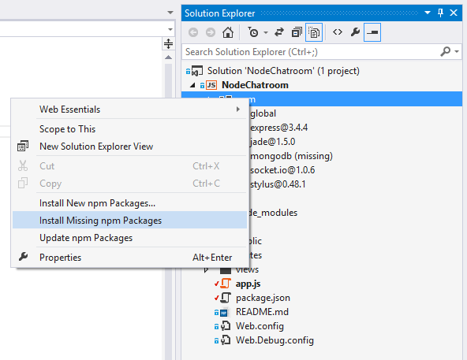
Add Support for MongoDB
Add it to the package.json
In Visual Studio > right click NPM to add module
Or from the command prompt :
npm install --save mongodb

