Slide 1
Web Camps
[Speaker]
[Company]
Email: [Email]
Twitter: [Twitter]

Slide 2
Today’s Agenda
Session | Start | End
Keynote | 8:30 | 9:00
Introduction to ASP.NET and Visual Studio 2013 Web Tools | 9:00 | 10:00
Building Web Applications using the latest ASP.NET technologies | 10:00 | 11:00
Break | 11:00 | 11:15
Building web front ends for both desktop and mobile using the latest web standards | 11:15 | 12:15
Lunch | 12:15 | 1:15
API Services for both web and devices | 1:15 | 2:15
Running, improving and maintaining a site in the real world | 2:15 | 3:15
Break | 3:15 | 3:30
Real-time Communications with SignalR | 3:30 | 4:30
Wrap Up | 4:30 | 5:00

Slide 3
The foundation: tools & frameworks
Visual Studio
NuGet
ASP.NET
Microsoft Azure

Slide 4


Visual Studio 2013: The editor for serious web dev
HTML5 / CSS3 standards and smarts
JavaScript language features
Page Inspector + Browser Link
One code editor for client and server
Web Essentials extension

Slide 5

NuGet: The smart, easy way to manage dependencies
Find the latest release
Install and configure in your project
Handle dependencies and versions
Updates with dependency checking
Common list of installed packages
Simplified uninstalls
Streamlined deployment with Package Restore

Slide 6
One ASP.NET: A Framework for us all
Sites
Services
Web
Forms
Web
Pages
Single Page Apps
SignalR
MVC
Web API
ASP.NET

Slide 7

Deploying ASP.NET Apps to the Cloud
Microsoft Azure Web Apps (10 free!)
Fast site creation and deployment
Nothing new to learn
Easy to scale

Slide 8
Microsoft Azure signup
demo…
http://aka.ms/webcamps-azure
Notes:
http://aka.ms/webcamps-azure

Slide 9
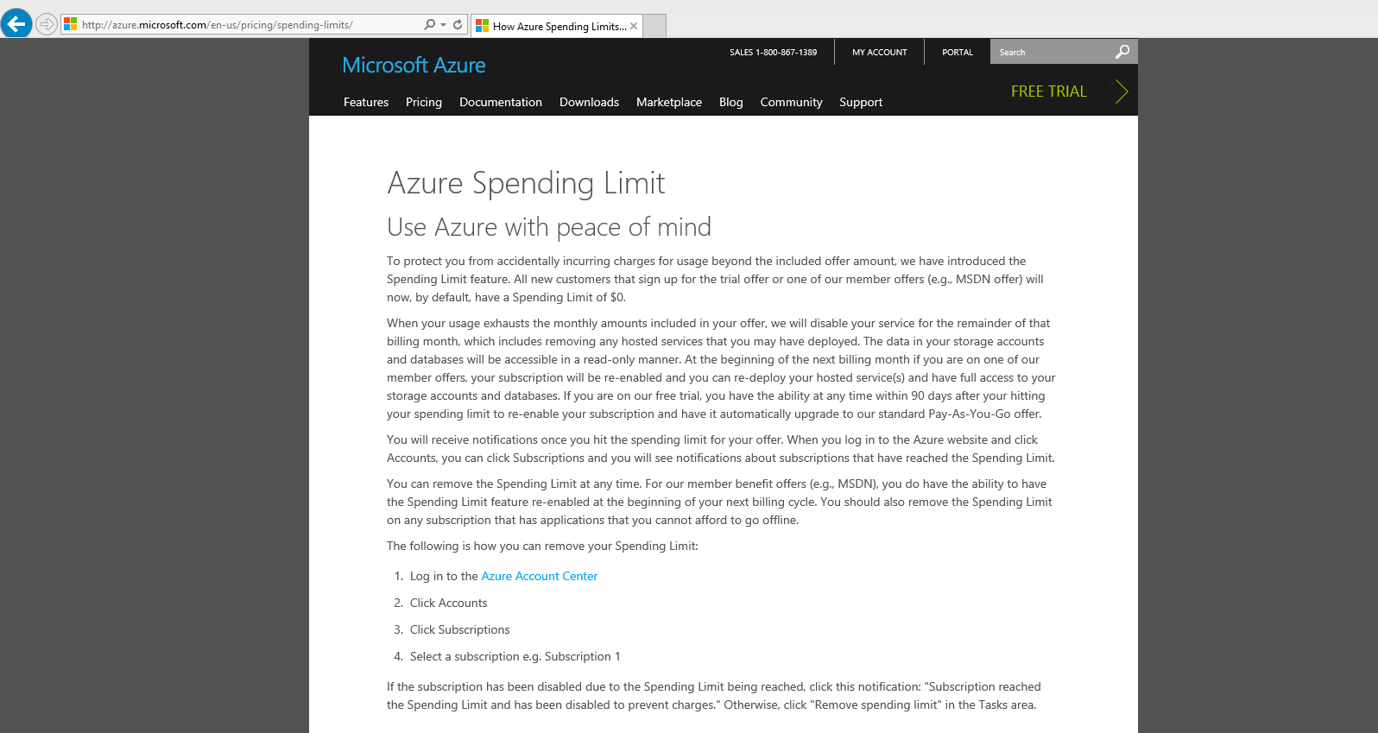

Slide 10
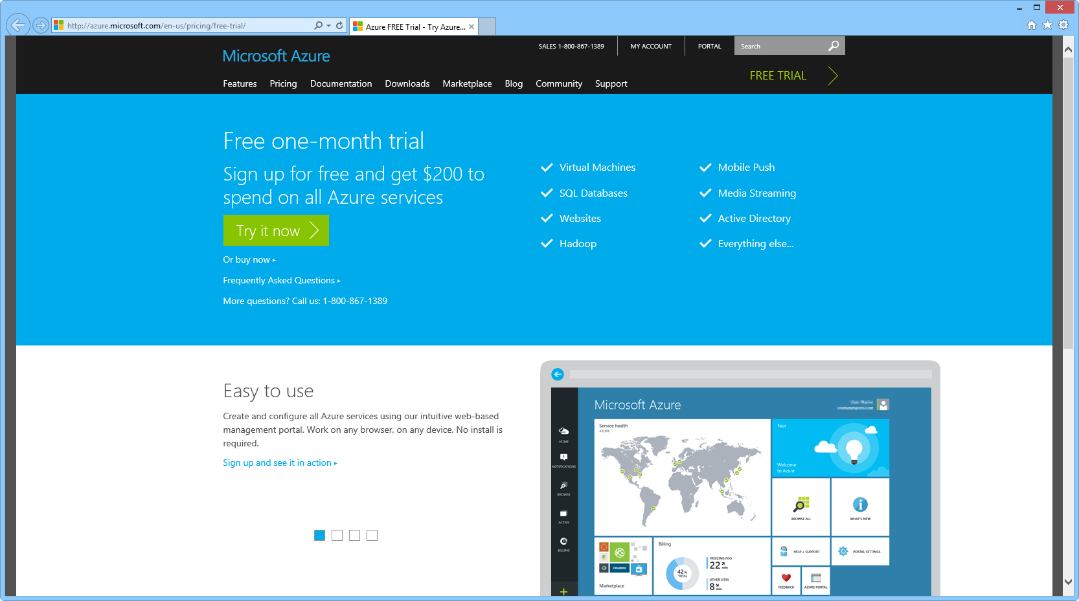

Slide 11
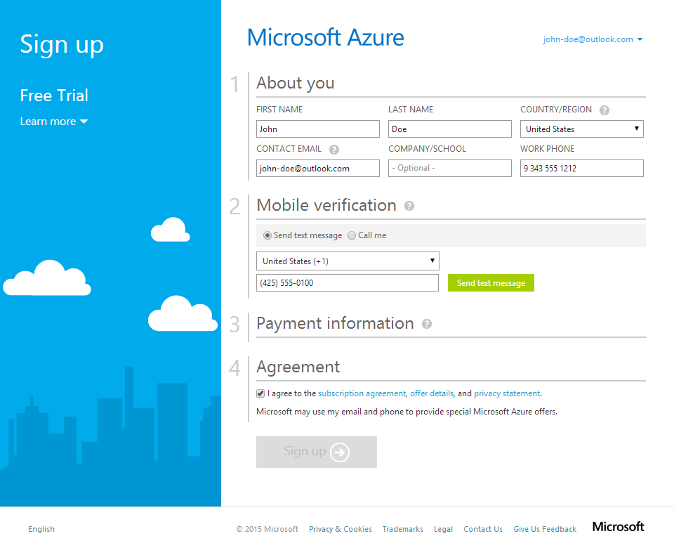

Slide 12
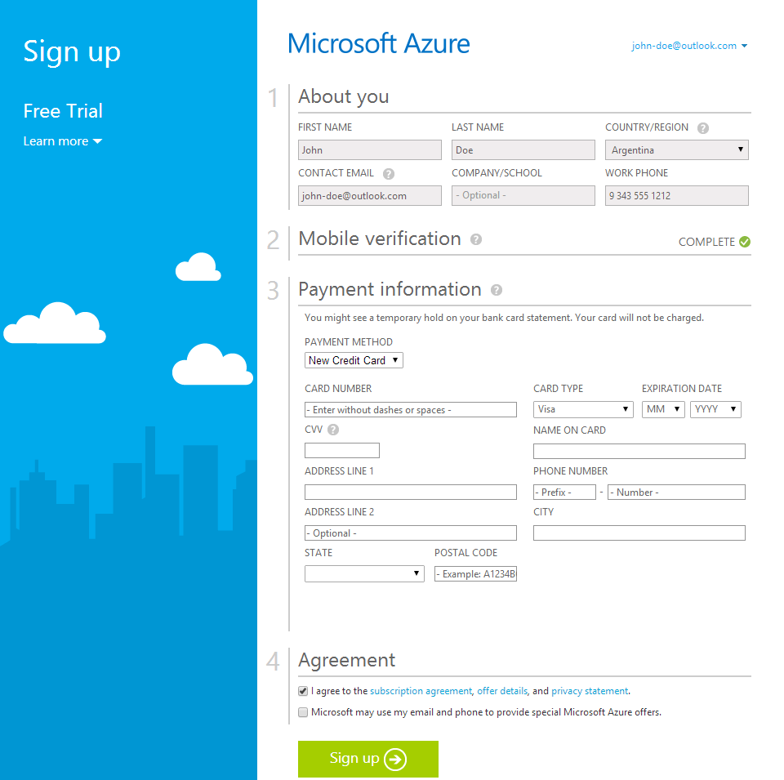

Slide 13
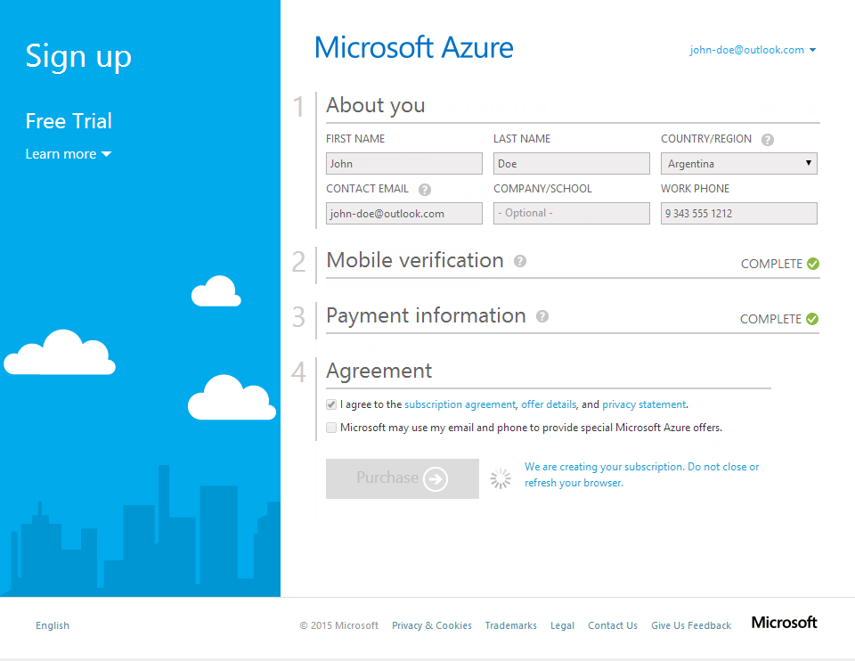

Slide 14
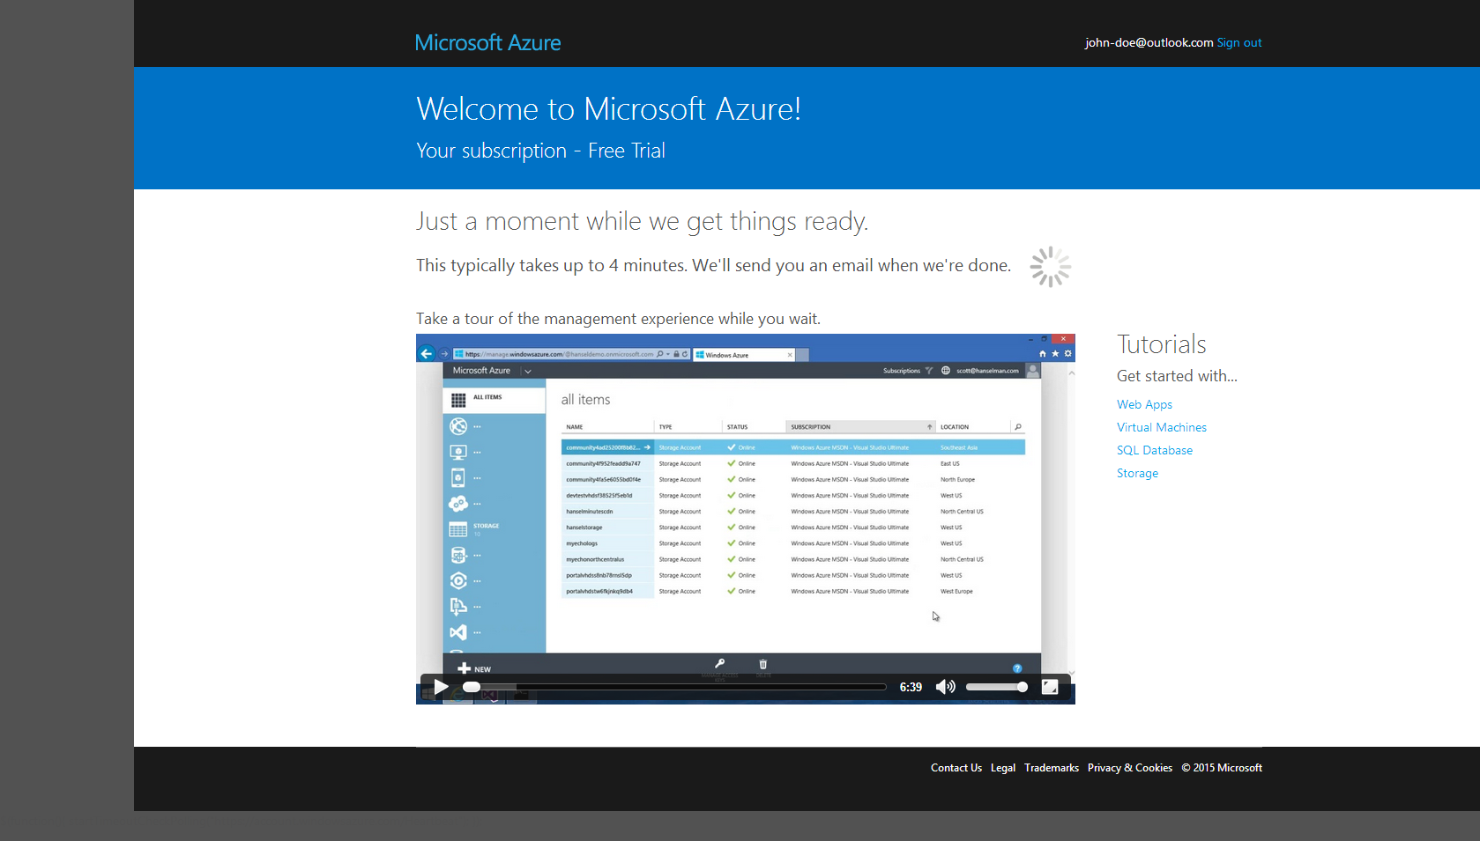

Slide 15
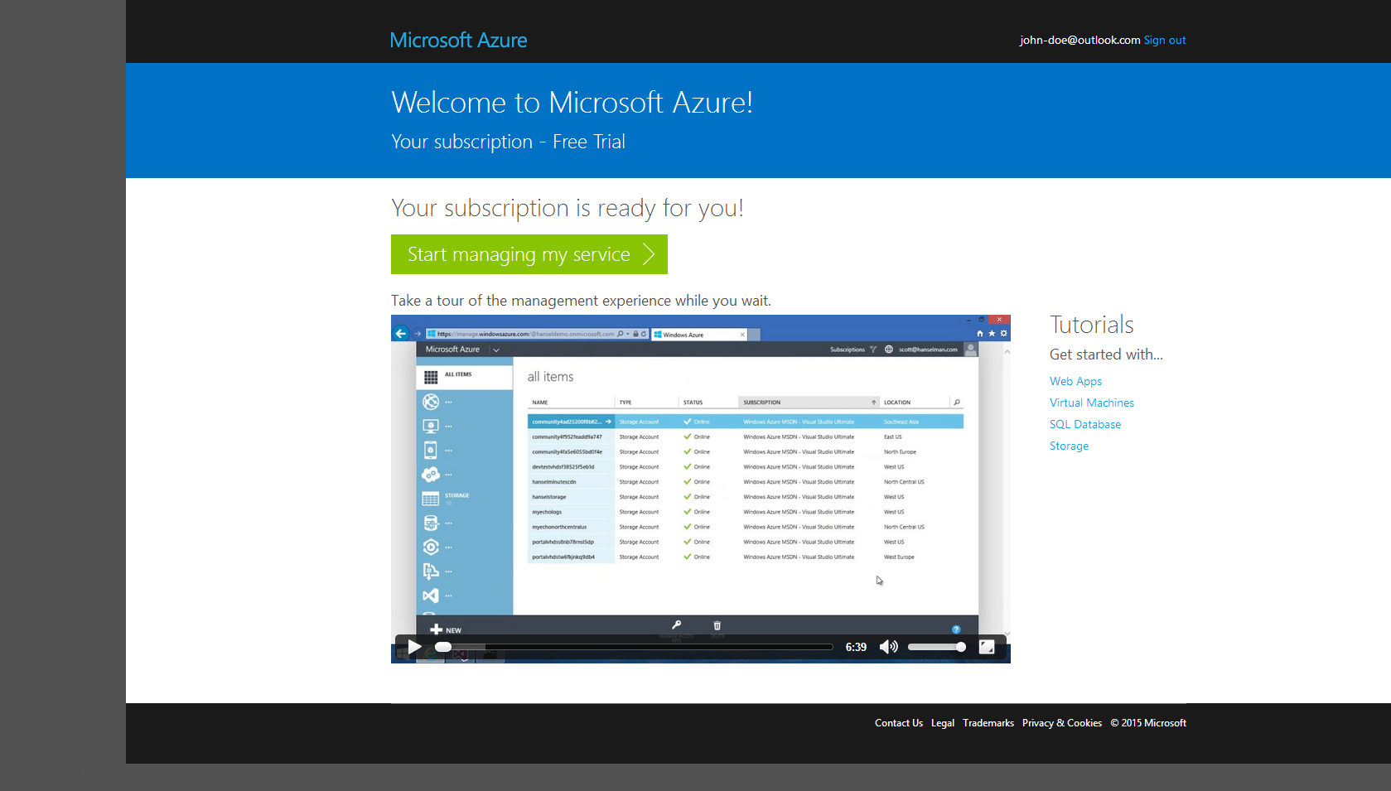

Slide 16
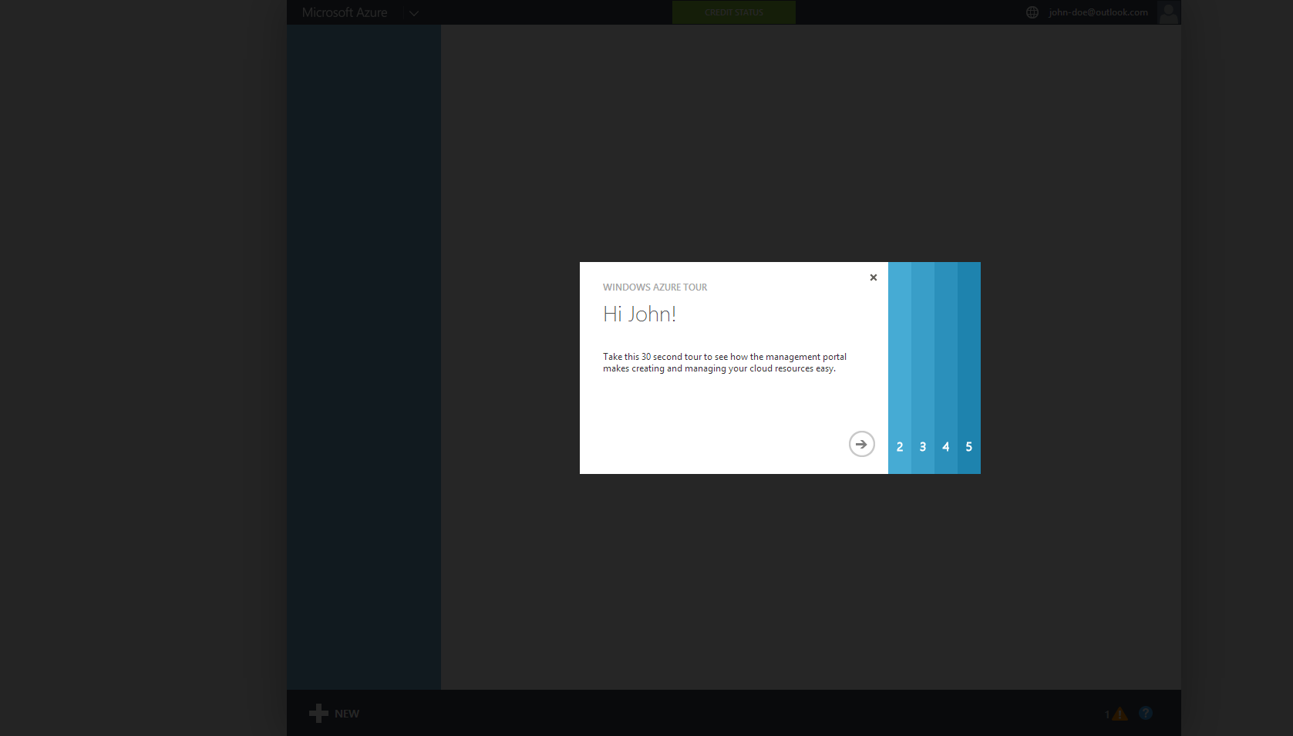

Slide 17
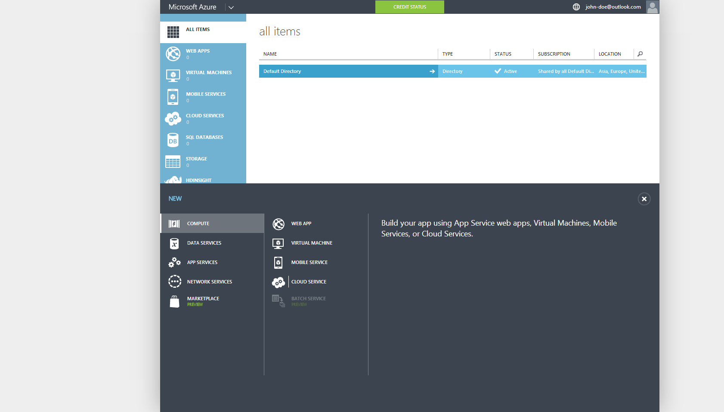

Slide 18
33%
25%
NO
DISCOUNT RESERVED WEB APPS CLOUD SERVICES, HDINSIGHT
CREDIT CARD REQUIRED
DISCOUNT VIRTUAL MACHINES
$150
$100
$50
MONTHLY CREDIT
VISUAL STUDIO ULTIMATE WITH MSDN
MONTHLY CREDIT
VISUAL STUDIO PREMIUM
WITH MSDN
MONTHLY CREDIT
VISUAL STUDIO PROFESSIONAL WITH MSDN
Notes:
Fastest Growing Hypervisor, taking share from VMWare”
2 releases of Hyper-V since ESX 5.1 (WS2012 and WS2012 R2)
Hyper-V share is growing 3x that of VMW over the past 2 years
Hyper-V steadily taking over a point of share per quarter
Microsoft in the Gartner Virtualization Magic Quadrant for the 3rd straight year and is the only vendor moving up and to the right
Over 50 new services released this year
Compute & Storage Capacity doubling every 6 – 9 months

Slide 19
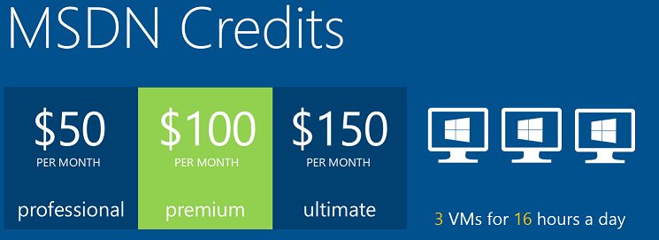
Microsoft Azure

Slide 20

Microsoft Azure

Slide 21

Microsoft Azure

Slide 22

Microsoft Azure

Slide 23
The foundation: tools & frameworks
Visual Studio
NuGet
ASP.NET
Microsoft Azure

Slide 24
Resources
Feedback and questions http://asp.net
http://asp.net/vnext
http://azure.microsoft.com
http://www.devcamps.ms/web
http://aka.ms/webcamps-training-kit
http://aka.ms/webcamps-azure (free trial)

