Slide 1
Introduction to ASP.NET & Visual Studio 2013 Web Tools
[Speaker]
[Company]
Email: [Email]
Twitter: [Twitter]
Notes:
Description
We'll start out by explaining the One ASP.NET experience in Visual Studio 2013, showing how to create hybrid web applications. Next, we'll introduce new features for web developers in Visual Studio 2013 and Web Essentials, explaining how Visual Studio is the best editor for HTML, CSS and JavaScript as well as your back end code. We'll also look at some new features across the ASP.NET platform including new Bootstrap templates, the new scaffolding system, and the new membership and identity system.

Slide 2
Session | Start | End
Keynote | 8:30 | 9:00
Introduction to ASP.NET and Visual Studio 2013 Web Tooling | 9:00 | 10:00
Building Web Applications using the latest ASP.NET technologies | 10:00 | 11:00
Break | 11:00 | 11:15
Building web front ends for both desktop and mobile using the latest web standards | 11:15 | 12:15
Lunch | 12:15 | 1:15
API Services for both web and devices | 1:15 | 2:15
Running, improving and maintaining a site in the real world | 2:15 | 3:15
Break | 3:15 | 3:30
Real-time Communications with SignalR | 3:30 | 4:30
Wrap Up | 4:30 | 5:00

Slide 3
Agenda
Release Recap
One ASP.NET
Visual Studio 2013 + Web Essentials
What’s new in ASP.NET

Slide 4
ASP.NET and Web Tools Cadence
Release every ~6 months
Sept 2012
ASP.NET 4.5 VS2012
Feb 2013
ASP.NET and Web Tools 2012.2
Oct 2013
Visual Studio 2013

Slide 5
Visual Studio 2012.2 Release (Feb 2013)
Templates
Web Tooling
Web Forms
Page Inspector
SignalR
IntelliSense
Web API
Publishing
MVC
Editor
Facebook
SPA

Slide 6
One ASP.NET
Sites
Services
Web
Forms
Web
Pages
Single
Page
Apps
MVC
Web
API
SignalR
ASP.NET

Slide 7
One ASP.NET
Sites
Services
YOU!
Web
Forms
Web
Pages
Single
Page
Apps
MVC
Web
API
SignalR
YOU!
ASP.NET

Slide 8
One ASP.NET
Sites
Services
YOU!
Web
Forms
Web
Pages
Single
Page
Apps
MVC
Web
API
SignalR
YOU!
ASP.NET

Slide 9
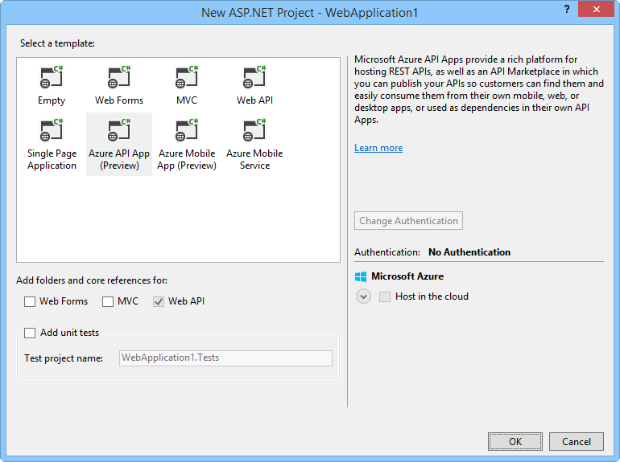
One ASP.NET
Visual Studio 2013 – New ASP.NET Project

Slide 10
Demo
One ASP.NET
Notes:
DEMO-One-ASP-NET
## Overview ## In this demo you will walk through the process of creating a new site using the new One ASP.NET tooling in Visual Sudio. You will start with a Web Forms application, create a simple model "Person" and use the new tooling to scaffold an MVC and a Web Api controller for it.
### Goals ###
In this demo, you will see how to:
1. Create a new site using the new One ASP.NET tooling
2. Create a simple model "Person" 3. Scaffold an MVC controller for Person
4. Scaffold a Web API controller for Person

Slide 11

New ASP.NET Core Features

Slide 12
ASP.NET Core Features
Bootstrap templates
Identity
Scaffolding
Owin
Notes:
This slide introduces these features at a high level. The demo for these features is included in the next section.

Slide 13
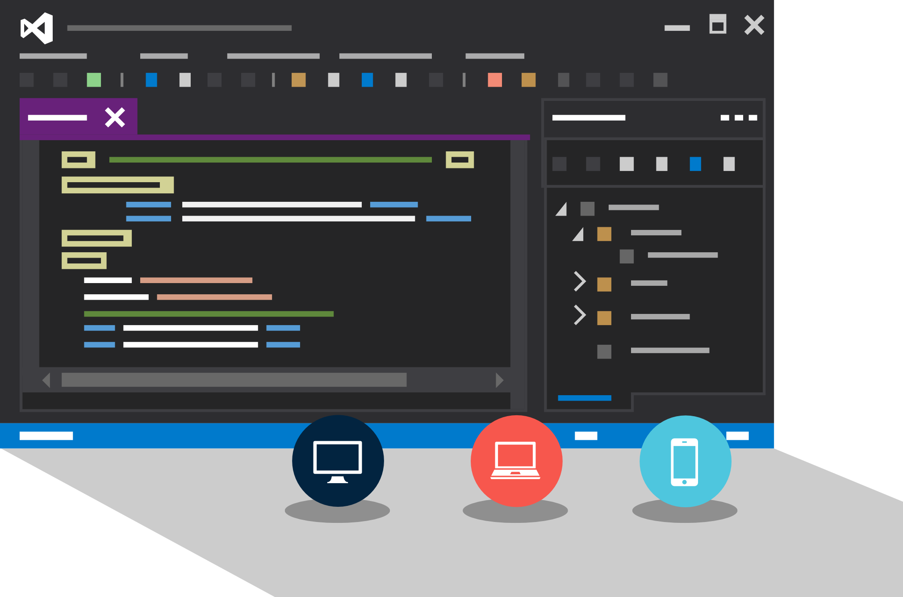
Visual Studio Web Tools

Slide 14
Visual Studio 2013 – Web Tools
Browser Link
HTML Editor
Web Essentials
Side Waffle

Slide 15
Demo
Visual Studio Web Tools

Slide 16
Recap

Slide 17
One ASP.NET
Sites
Services
YOU!
Web
Forms
Web
Pages
Single
Page
Apps
MVC
Web
API
SignalR
YOU!
ASP.NET

Slide 18
ASP.NET Core Features
Bootstrap templates
Identity
Scaffolding
Owin
Notes:
This slide introduces these features at a high level. The demo for these features is included in the next section.

Slide 19
Visual Studio 2013 – Web Tools
Browser Link
HTML Editor
Web Essentials
Side Waffle

Slide 20
Only the highlights…
General
New ASP.NET Identity System
Templates based on Bootstrap.js
One ASP.NET
One Project: Web Forms, MVC, Web API
Add any framework to any project
New Scaffolding
Configurable Authentication
Azure SDK
Azure Server Explorer: SSO, Remote Debugging, Web Apps, Mobile Apps, Mgmt APIs, Log DL
Web API
CORs, Attribute Routing
MVC
Attribute Routing
Entity Framework
Async, Stored Procs, Resiliency
Visual Studio
New HTML Editor
Live Browser Link + Extensibility
JavaScript AngularJS Intellisense

