Slide 1
ASP.NET 5 Preview
[Speaker]
[Company]
Email: [Email]
Twitter: [Twitter]

Slide 2
Today’s Agenda
Session | Start | End
Keynote | 8:30 | 9:00
Introduction to ASP.NET and Visual Studio 2015 Web Tools | 9:00 | 10:00
Building Web Applications using the latest ASP.NET technologies | 10:00 | 11:00
Break | 11:00 | 11:15
Building web front ends for both desktop and mobile using the latest web standards | 11:15 | 12:15
Lunch | 12:15 | 1:15
API Services for both web and devices | 1:15 | 2:15
Running, improving and maintaining a site in the real world | 2:15 | 3:15
Break | 3:15 | 3:30
Real-time Communications with SignalR | 3:30 | 4:00
ASP.NET 5 Preview | 4:00 | 4:45
Wrap Up | 4:45 | 5:00

Slide 3
Agenda
.NET Core Overview
Intro to ASP.NET 5
ASP.NET MVC 6
Resources

Slide 4
.NET Core Overview

Slide 5




.NET 2015
.NET Framework 4.6
.NET Core 5
Common
Runtime
Compilers
NuGet packages
Next gen JIT
SIMD
.NET Compiler Platform
Languages innovation
.NET Core 5 Libraries
.NET Framework 4.6 Libraries

Slide 6



What is .NET Core
ASP.NET 5
App Model
Universal Windows Apps Model
Any other
app model
.NET Core
Unified BCL
(Base Class Library)
Runtime Adaption Layer
Core CLR
.NET Native
and Runtime
Other Runtime

Slide 7

NuGet is mainstream in .NET Core
.NET Core

Slide 8
.NET 2015 – 10K foot view
WPF
Windows Forms
ASP.NET (4 & 5)
ASP.NET 5
Universal Windows Apps
Core CLR
.Net Native
.NET Framework 4.6
.NET Core 5
Full .NET Framework for any scenario and
library support on Windows
Modular libraries & runtime optimized for server and cloud workloads
Common
Runtime Components
Compilers
NuGet packages
Next gen JIT (RyuJIT)
SIMD
.NET Compiler Platform (Roslyn)
Languages innovation
.NET Core 5 Libraries
.NET Framework 4.6 Libraries

Slide 9
.NET Compiler Platform (“Roslyn”)
Scenarios/usage cases
C#
VB
Language and IDE
FROM
Isolated/closed compilers
Hard to extend dev experience
API
VS dev experience extensibility
TO
API: open platform
Rich IDE experiences/refactoring
Code analysis
Custom diagnostics
Open Source compilers
OSS
Open Source

Slide 10


Open Sourcing .NET
Platforms
General purpose .NET Core runtime, compilers and libraries
ASP.NET 5 web server stack
Fully Supported cross-platform
Windows, Linux and OS X
Visual Studio tooling support (e.g. debugging and deploying to Docker in Linux)
Omnisharp extensions to cross-plat IDEs (Sublime, Emacs…)
Open Source
.NET Core and ASP.NET 5 source being developed on GitHub
Contributions accepted, tested and fully supported
Close collaboration with Mono community
What is Microsoft Open Sourcing?
.NET 2015
.NET
Framework 4.6
.NET
Core 5
Common
Runtime components
Compilers
Libraries
.NET Compiler Platform
(“Roslyn”)
Languages
.NET Core 5 Libraries
.NET Framework 4.6 Libraries
RyuJIT, SIMD
Core-CLR
Get started from:
github.com/microsoft/dotnet

Slide 11
Intro to ASP.NET 5

Slide 12
ASP.NET 5
Unified framework for MVC, Web API and SignalR*
.NET Framework 4.6 stack and libs
.NET Core 5 stack and libs
Full .NET Framework for any scenario and library support
Small runtime optimized for server and cloud workloads
* SignalR will ship after ASP.NET 5 RTM

Slide 13
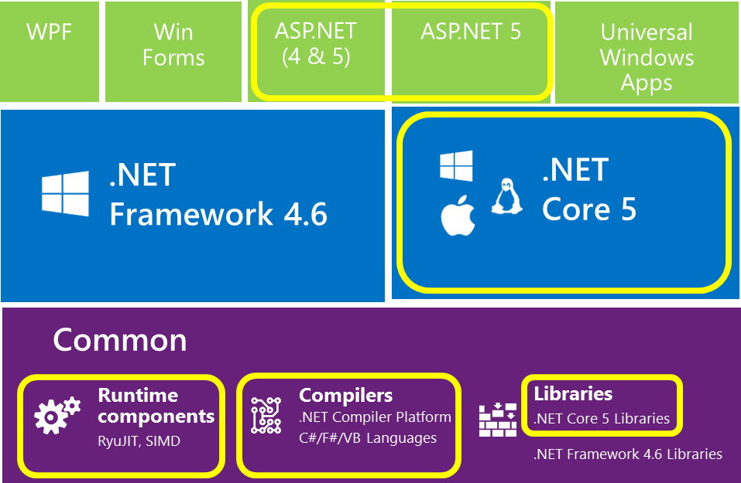
What is Open Source?

Slide 14
MSBuild -> csc.exe
CodeDOM -> csc.exe
Application
DNX (Roslyn)
Loose, GAC, NuGet
Libraries
NuGet
Open Source
FCL, GAC, NuGet
Application Frameworks
NuGet
IIS
Web Server
IIS, HTTP.SYS
Kestrel
System.Web
Application Host
DNX
.NET BCL & FCL
Platform Libraries
.NET BCL & FCL
.NET on NuGet
.NET CLR
Runtime
.NET CLR
.NET Core CLR
IIS: WebEngine4.dll
Exe: OS
Runtime Loader
DNX
Windows
Operating System
Windows, OSX, Linux

Slide 15
History of ASP (18+ years)
1996 – Active Server Pages (ASP)
2002 – ASP.NET
2008 – ASP.NET MVC
2010 – ASP.NET Web Pages
2012 – ASP.NET Web API, SignalR
2014 – ASP.NET 5 (and the Core CLR)

Slide 16


ASP.NET and the Modern Web
Totally Modular
Faster Development Cycle
Seamless transition from on-premises to cloud
Choose your Editors
and Tools
Open Source with Contributions
OSS
Cross-Platform
Fast

Slide 17
Modern Web - Agility
Faster Development Cycle
Features are shipped as packages
Framework ships as part of the application
More Control
Zero day security bugs patched by Microsoft
Same code runs in development and production
Developer opts into new versions, allowing breaking changes

Slide 18
Modern Web - Fast
Runtime Performance
Faster startup times
Lower memory / higher density (> 90% reduction)
Modular, opt into just features needed
Use a raw socket, framework or both
Development productivity and low friction
Edit code and refresh browser
Flexibility of dynamic environment with the power of .NET
Develop with Visual Studio, third party and cloud editors

Slide 19
Modern Web - Cloud
Seamless transition from on-premises to cloud
Cloud ready
Configuration
Session
Cache
Diagnostics
Run/Debug in Cloud
Tracing/Logging without re-deploy

Slide 20


Modern Web – Cross Platform
Runtime
Windows, Mac, Linux
Editors
Visual Studio, Text, Cloud editors
No editors (command line)
OSS
Open Source with Contributions

Slide 21
Demo
ASP.NET 5

Slide 22
ASP.NET 2015 in a Nutshell
Visual Basic 14
Visual Basic 14 (coming soon)
C#
Web
Forms
MVC 5.x
Web API 2.2
MVC / Web API 6
ASP.NET 4.6 System.Web
ASP.NET 5
Core CLR
.Net Native
.NET Framework 4.6
.NET Core 5
Full .NET Framework for any scenario and
library support on Windows
Modular libraries & runtime optimized for server and cloud workloads

Slide 23
ASP.NET 5 - Compatibility
Web Forms, MVC 5, Web API 2, Web Pages 3, EF 6
Fully supported on .NET 4.6
MVC, Web API, EF 7
Breaking changes:
New Project System
New Configuration System
MVC / Web API / Web Pages merge
No System.Web, new Lightweight HttpContext (not System.Net.Http)
.NET 5 on Core CLR
Subset of the .NET Full Framework
Things you depend on might not be available yet

Slide 24
ASP.NET 5 - Summary
Feature | Running on .NET 4.6 | Running on .NET Core 5
Cloud Ready | * | *
Modular Design | * | *
Dependency Injection | * | *
Consistent Tracing / Debugging | * | *
Faster Development (No Build Step) | * | *
Open Source | * | *
Full Side by Side (framework deployed inside application) |  | *
Fast startup, Low memory / High throughput (best of class) |  | *

Slide 25
ASP.NET 5 - Schedule
Milestone | Release Week
Beta6 | 27 Jul 2015
Beta7 | 2 Sep 2015
Beta8 | 12 Oct 2015
RC1 | Nov 2015
1.0.0 | Q1* 2016
https://github.com/aspnet/Home/wiki/Roadmap

Slide 26
ASP.NET MVC 6

Slide 27
The world today – similar, but different
Web Pages
MVC
Web API
Razor
HTML Helpers
HTML Helpers
Controllers
Controllers
Actions
Actions
Filters
Filters
Model binding
Model binding
DI
DI

Slide 28
MVC + Web API + Web Pages = ASP.NET MVC 6

Slide 29
MVC 6: MVC, Web API, Web Pages
One set of concepts – remove duplication
Web UI and Web APIs
Smooth transition from Web Pages to MVC (future)
Built DI first
Built on ASP.NET 5
Runs on IIS or self-hosted
Supports .NET Core

Slide 30
What’s stayed the same
File / New experience
Model / View / Controller code and interactions

Slide 31
What’s changed
Controller invocation (e.g. POCO Controllers)
Katana to ASP.NET 5 middleware
DI
Views
Config
Namespace
System.Web

Slide 32
Getting Started with ASP.NET MVC 6
Add the MVC package: Microsoft.AspNet.Mvc
Add the MVC services
Configure MVC options
Setup your MVC routes
Or just create a new ASP.NET 5 Starter Web App
Samples and source at https://github.com/aspnet/mvc

Slide 33
Routing
Based on the ASP.NET 5 routing middleware
Routes fall through by default
Fewer problems with route ordering due to a greedy route
Compact route template syntax for default values, route constraints, optional values
Ex. {controller=Home}/{action=Index}/{id?}
Attribute routing enabled by default
Keep it DRY with area/controller/action route tokens
Ex. [Route(“api/[controller]”)]
Notes:
These slides are hidden by default due to time constraints – feel free to show them if you can get through them

Slide 34
Areas
Add route with {area:exists} route value
Mark controllers with [Area(<area>)] attribute
Put area specific views in areas/<area>/Views folder
Notes:
These slides are hidden by default due to time constraints – feel free to show them if you can get through them

Slide 35
Model binding and formatting
Use [From*] attributes control how data is bound
[FromBody] - Bind formatted data using available formatters
[FromForm] – Bind from form data in the body
[FromQuery] – Bind from query parameters
[FromRoute] – Bind from route data
[FromHeader] – Bind from request header value
Use [Produces]/[Consumes] to control which formats are supported
Ex [Produces(“application/json”)] – Action only produces JSON formatted data
Formats: JSON, XML (separate package)
Notes:
These slides are hidden by default due to time constraints – feel free to show them if you can get through them

Slide 36
Demo
ASP.NET MVC 6

Slide 37
TagHelpers
HTML helpers expressed as tags
Ex. Instead of:
@Html.LabelFor(m => m.UserName, new { @class = "col-md-2 control-label" })
Write this:
<label asp-for="UserName" class="col-md-2 control-label"></label>
Easier to customize with additional attributes
Work seamlessly with the HTML editor

Slide 38
TagHelpers
@using (Html.BeginForm(new { ReturnUrl = ViewBag.ReturnUrl })) {
@Html.AntiForgeryToken()
@Html.ValidationSummary(true)
<fieldset>
<legend>Log in Form</legend>
<ol>
<li>
@Html.LabelFor(m => m.UserName)
@Html.TextBoxFor(m => m.UserName)
@Html.ValidationMessageFor(m => m.UserName)
</li>

Slide 39
TagHelpers
<form anti-forgery=“true“ validation-summary=“true” action="Create“>
<fieldset>
<legend>Log in Form</legend>
<ol>
<li>
<label for=“UserName”>
<input for=“UserName”>
<span validation-for="Name" style="color:blue" />
</li>

Slide 40
TagHelpers: Create Your Own
public interface ITagHelper
{
int Order { get; }
Task ProcessAsync(TagHelperContext context, TagHelperOutput output);
}
Examples: https://github.com/aspnet/Mvc/tree/dev/src/Microsoft.AspNet.Mvc.TagHelpers

Slide 41
Demo
Tag Helpers

Slide 42
Resources (your homework)

Slide 43
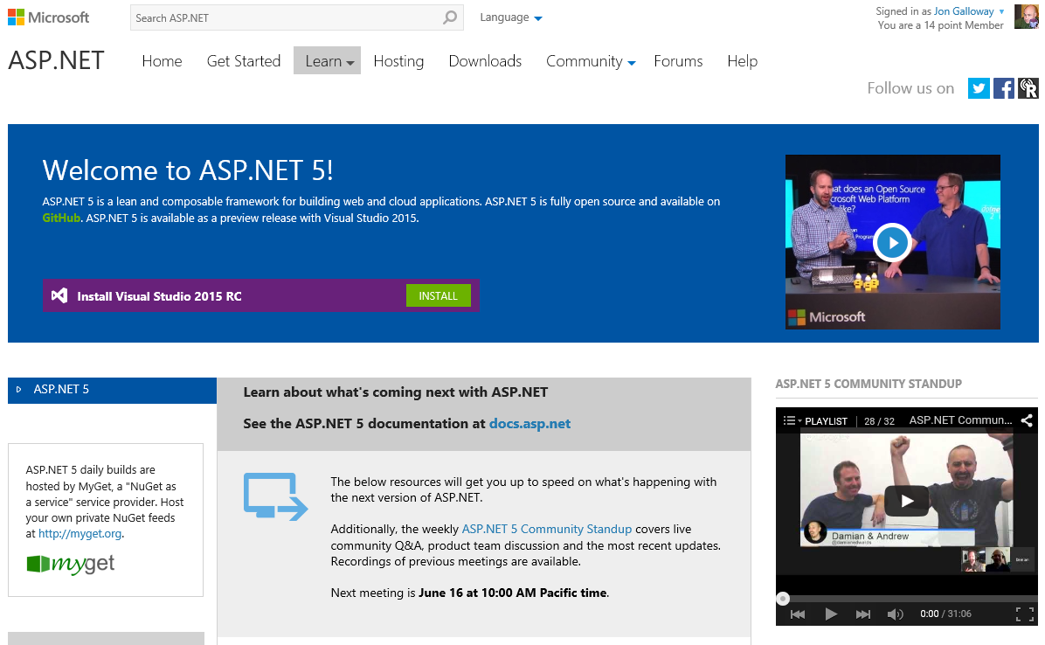
http://www.asp.net/vnext

Slide 44
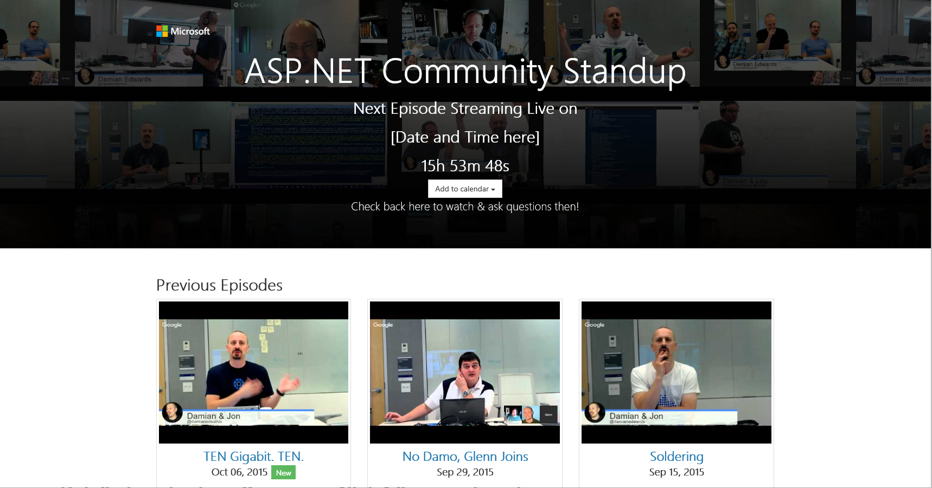
http://live.asp.net

Slide 45
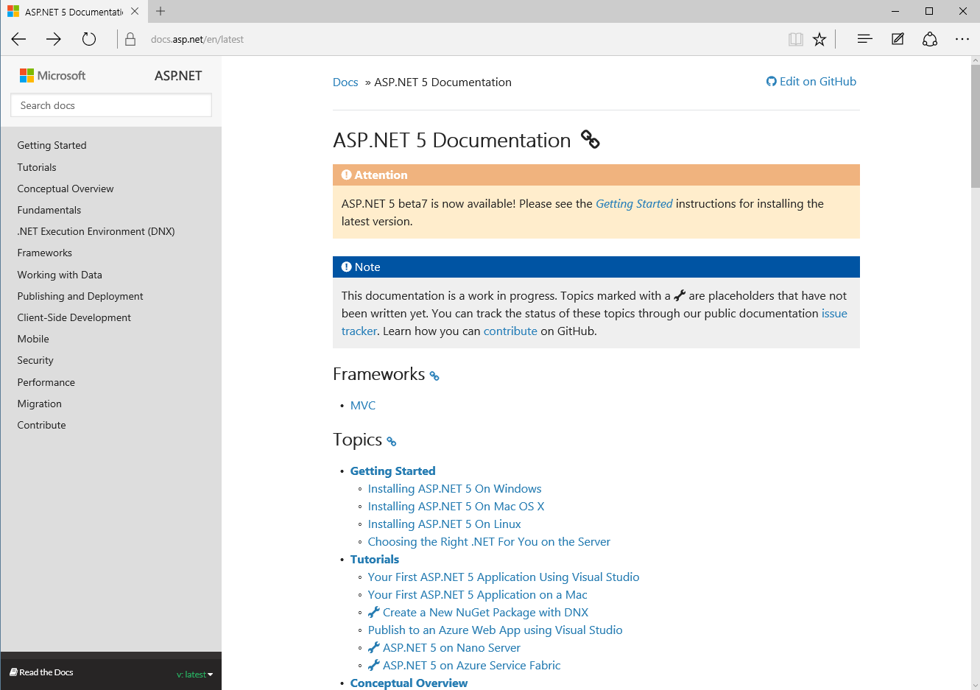
http://docs.asp.net

Slide 46
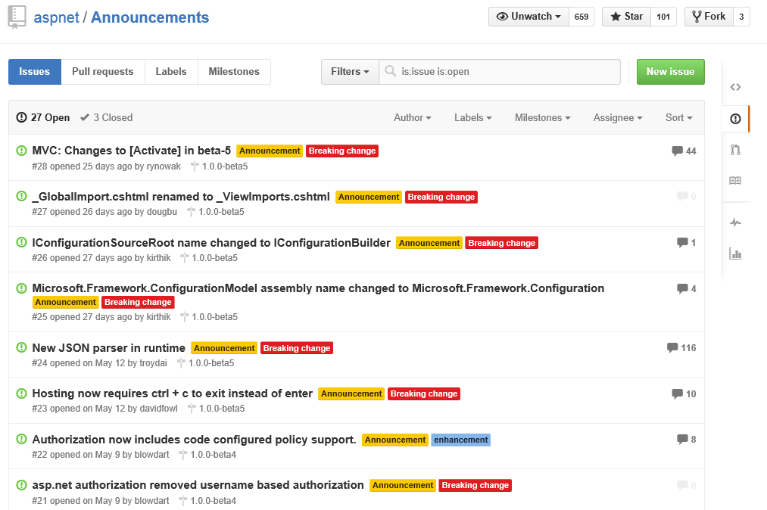
https://github.com/aspnet/announcements/issues

Slide 47
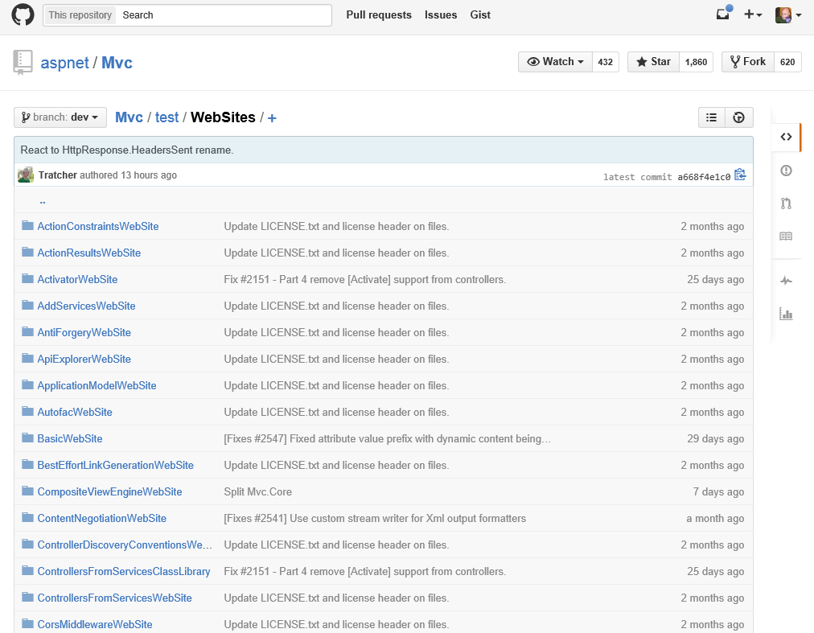
https://github.com/aspnet/Mvc/tree/dev/test/WebSites

