Slide 1
Web Camps
[Speaker]
[Company]
Email: [Email]
Twitter: [Twitter]

Slide 2
Today’s Agenda
Session | Start | End
Keynote | 8:30 | 9:00
Introduction to ASP.NET and Visual Studio 2015 Web Tools | 9:00 | 10:45
Break | 10:45 | 11:00
Building Web Applications using the latest ASP.NET technologies | 11:00 | 12:15
Lunch | 12:15 | 1:15
Building web front ends for both desktop and mobile using the latest web standards | 1:15 | 2:15
API Services for both web and devices | 2:15 | 3:15
Break | 3:15 | 3:30
Running, improving and maintaining a site in the real world | 3:30 | 4:30
Wrap Up | 4:30 | 5:00

Slide 3
The foundation: tools & frameworks
Visual Studio
NuGet
ASP.NET
Microsoft Azure

Slide 4


Visual Studio 2015: The editor for serious web dev
HTML5 / CSS3 standards and smarts
JavaScript language features
Page Inspector + Browser Link
One code editor for client and server
Web Essentials extension

Slide 5

NuGet: The smart, easy way to manage dependencies
Find the latest release
Install and configure in your project
Handle dependencies and versions
Updates with dependency checking
Common list of installed packages
Simplified uninstalls
Streamlined deployment with Package Restore

Slide 6
One ASP.NET: A Framework for us all
Sites
Services
Web
Forms
Web
Pages
Single Page Apps
SignalR
MVC
Web API
ASP.NET

Slide 7



.NET 2015 – 10K foot view
WPF
Windows Forms
ASP.NET (4 & 5)
ASP.NET Core 1.0
Universal Windows Apps
Core CLR
.Net Native
.NET Framework 4.6
.NET Core 1.0
Full .NET Framework for any scenario and
library support on Windows
Modular libraries & runtime optimized for server and cloud workloads
Common
Runtime Components
Compilers
NuGet packages
Next gen JIT (RyuJIT)
SIMD
.NET Compiler Platform (Roslyn)
Languages innovation
.NET Core 1.0 Libraries
.NET Framework 4.6 Libraries

Slide 8
ASP.NET 2015 in a Nutshell
Visual Basic 14
Visual Basic 14 (coming soon)
C#
Web
Forms
MVC 5.x
Web API 2.2
MVC / Web API 6
ASP.NET 4.6 System.Web
ASP.NET Core 1.0
Core CLR
.Net Native
.NET Framework 4.6
.NET Core 1.0
Full .NET Framework for any scenario and
library support on Windows
Modular libraries & runtime optimized for server and cloud workloads

Slide 9
MVC + Web API + Web Pages = ASP.NET MVC 6

Slide 10
MVC 6: MVC, Web API, Web Pages
One set of concepts – remove duplication
Web UI and Web APIs
Smooth transition from Web Pages to MVC (future)
Built DI first
Built on ASP.NET Core 1.0
Runs on IIS or self-hosted
Supports .NET Core

Slide 11

Deploying ASP.NET Apps to the Cloud
Microsoft Azure Web Sites (10 free!)
Fast site creation and deployment
Nothing new to learn
Easy to scale

Slide 12
Microsoft Azure signup
demo…
http://aka.ms/webcamps-azure
Notes:
http://aka.ms/webcamps-azure

Slide 13
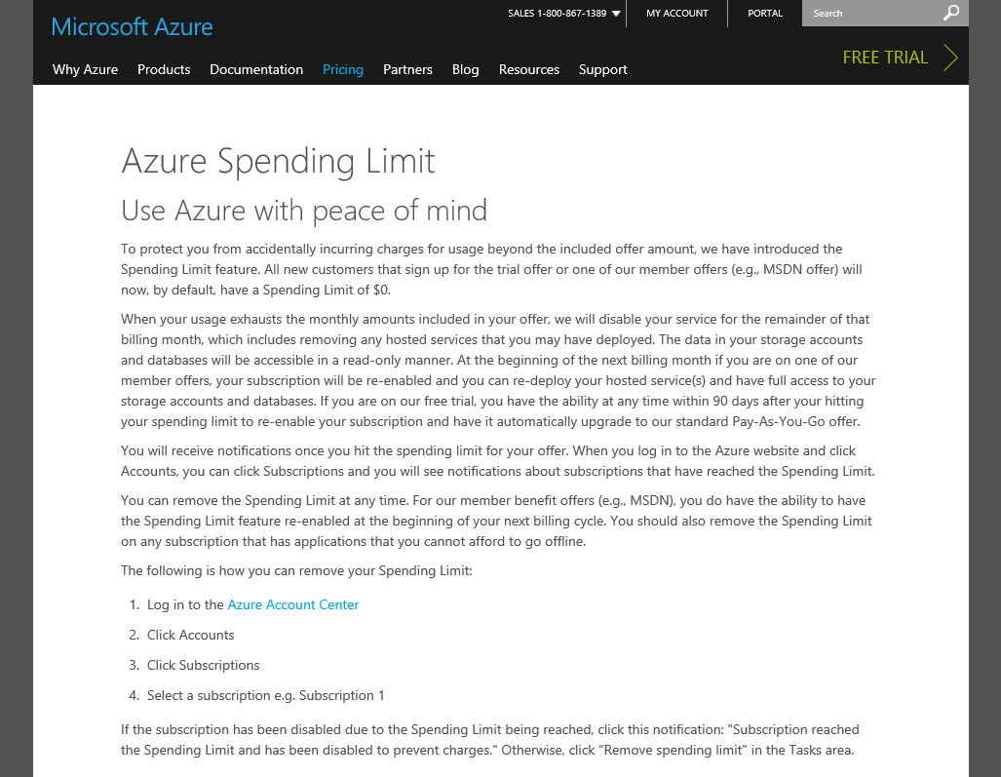
https://azure.microsoft.com/pricing/spending-limits/

Slide 14
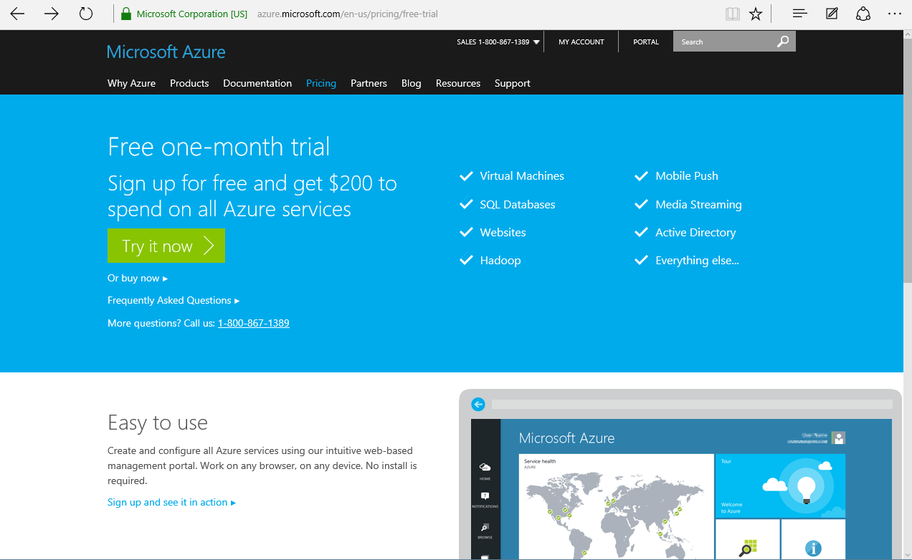

Slide 15
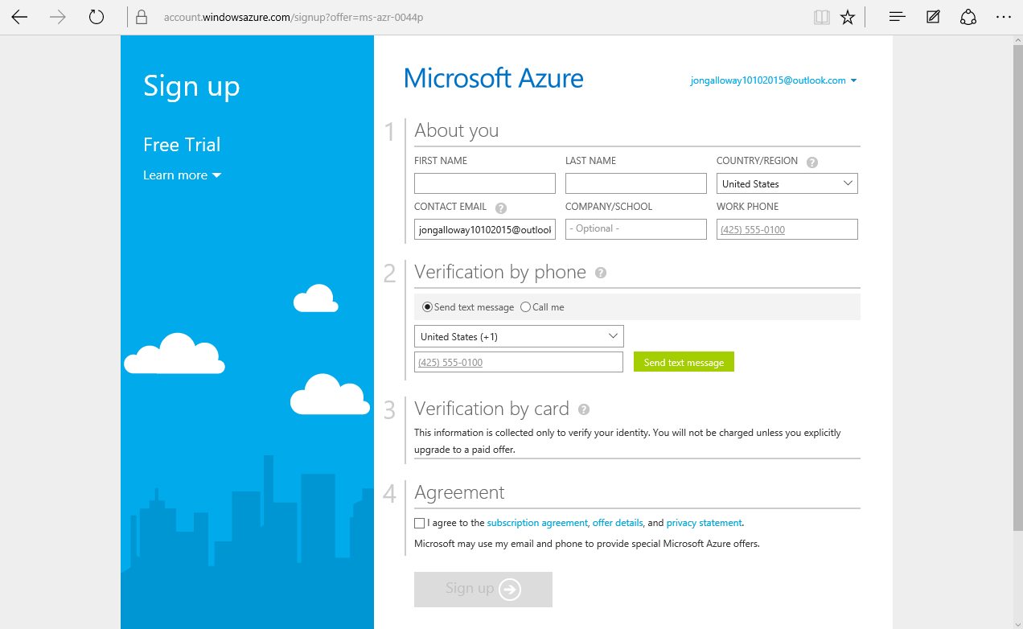

Slide 16
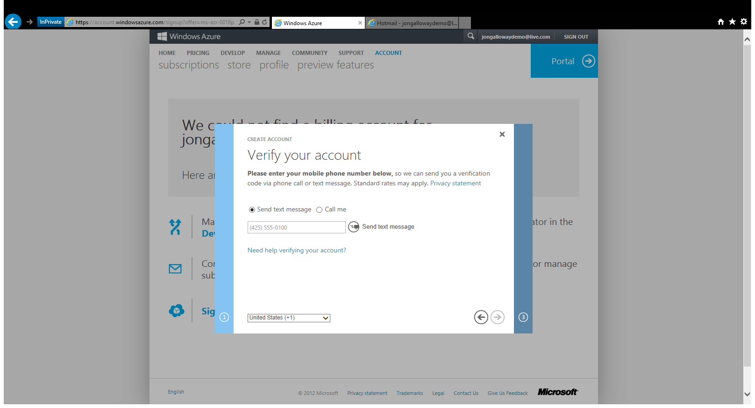

Slide 17
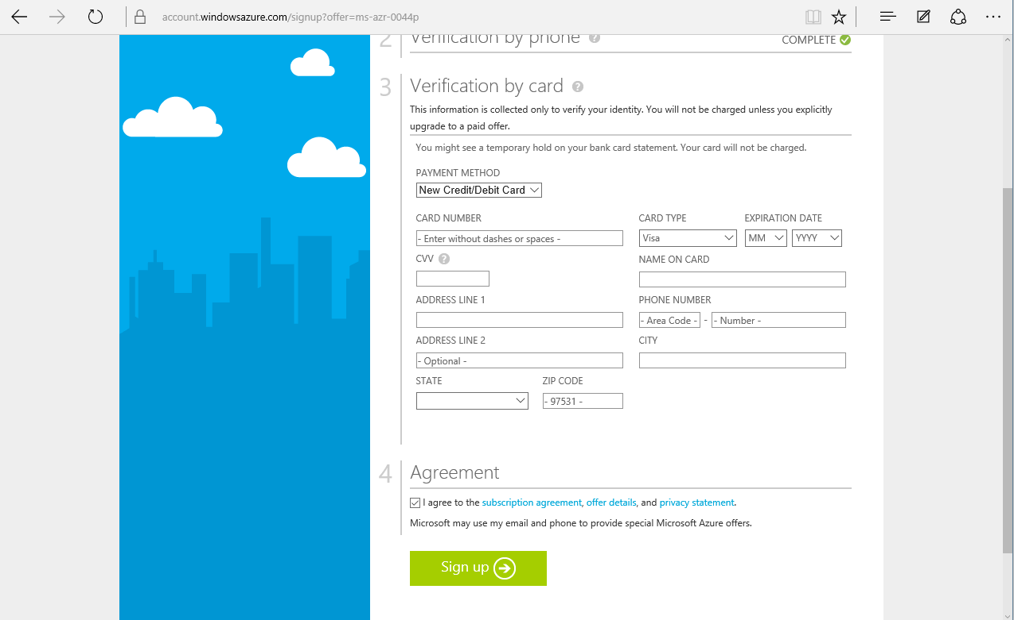

Slide 18
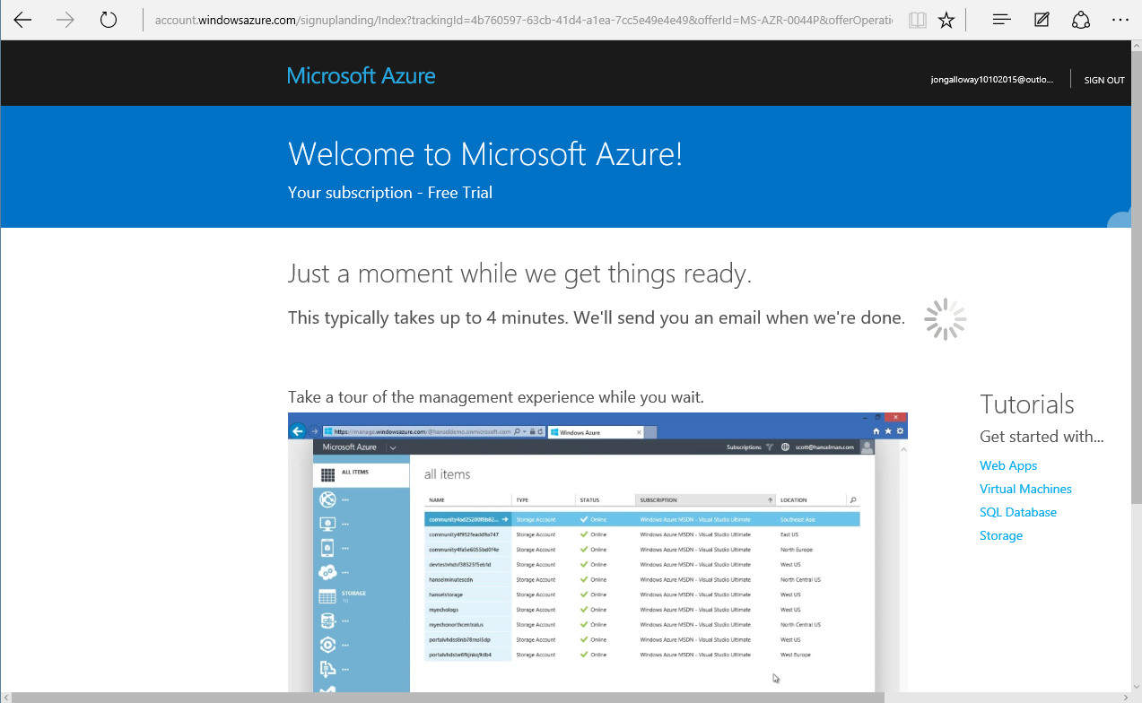

Slide 19
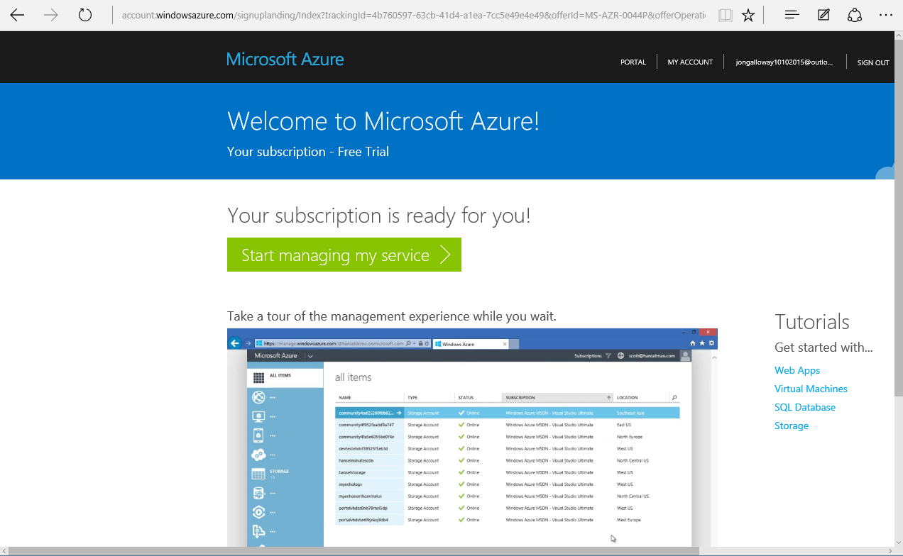

Slide 20
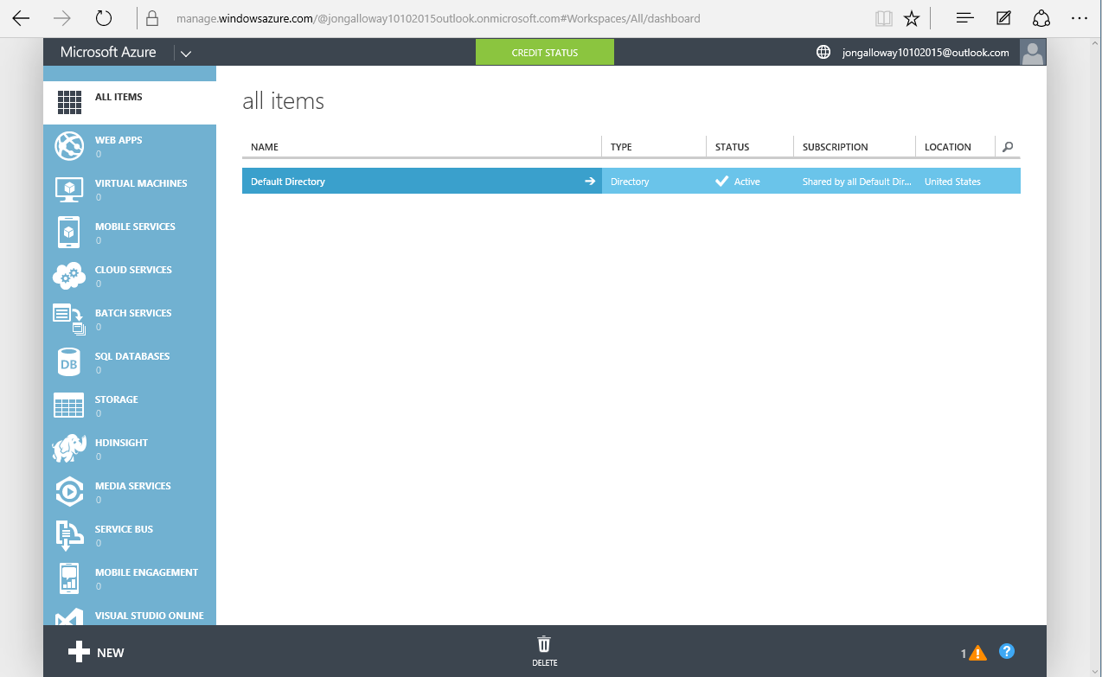
yournamehere@outlook.com

Slide 21
33%
25%
NO
DISCOUNT RESERVED WEB SITES CLOUD SERVICES, HDINSIGHT
CREDIT CARD REQUIRED
DISCOUNT VIRTUAL MACHINES
$150
$100
$50
MONTHLY CREDIT
VISUAL STUDIO ULTIMATE WITH MSDN
MONTHLY CREDIT
VISUAL STUDIO PREMIUM
WITH MSDN
MONTHLY CREDIT
VISUAL STUDIO PROFESSIONAL WITH MSDN
Notes:
https://azure.microsoft.com/en-us/pricing/member-offers/msdn-benefits-details/

Slide 22
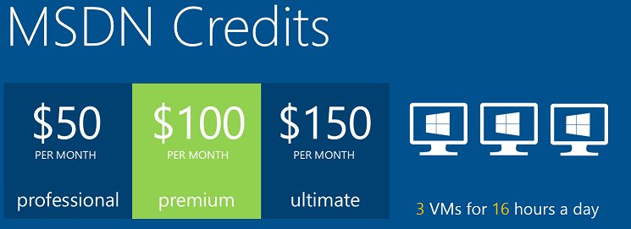
Microsoft Azure

Slide 23

Microsoft Azure

Slide 24

Microsoft Azure

Slide 25

Microsoft Azure

Slide 26
The foundation: tools & frameworks
Visual Studio
NuGet
ASP.NET
Microsoft Azure

Slide 27
Resources
Feedback and questions http://asp.net
http://asp.net/vnext
http://azure.microsoft.com
http://aka.ms/webcamps-training-kit
http://aka.ms/webcamps-azure (free trial)

