Slide 1
Running, improving and maintaining a site in the real world
[Speaker]
[Company]
Email: [Email]
Twitter: [Twitter]

Slide 2
Today’s Agenda
Session | Start | End
Keynote | 8:30 | 9:00
Introduction to ASP.NET and Visual Studio 2015 Web Tools | 9:00 | 10:00
Building Web Applications using the latest ASP.NET technologies | 10:00 | 11:00
Break | 11:00 | 11:15
Building web front ends for both desktop and mobile using the latest web standards | 11:15 | 12:15
Lunch | 12:15 | 1:15
API Services for both web and devices | 1:15 | 2:15
Running, improving and maintaining a site in the real world | 2:15 | 3:15
Break | 3:15 | 3:30
Real-time Communications with SignalR | 3:30 | 4:00
ASP.NET 5 Preview | 4:00 | 4:45
Wrap Up | 4:45 | 5:00

Slide 3
Agenda
Scenario: Scale
Scenario: Adapt to Change
Scenario: Environments

Slide 4
Let’s get Real

Slide 5
Scenario: Scale

Slide 6
Scenario description
Your site load varies over time.
You need to adapt.
Smoothly.

Slide 7
Load profiles
BATCH
PREDICTABLE
No
load
Load
Load
INCREASING
UNPREDICTABLE
Load
Load

Slide 8
Step 1: Preserve server bandwidth
PROBLEM:
Your servers are wasting bandwidth serving static files.

Slide 9
Step 1: Preserve server bandwidth
SOLUTION:
Serve static files from blob storage.
This is a step towards to delivering content from a content delivery network (CDN).

Slide 10
Step 2: Caching
PROBLEM:
Your servers have finite resources.
You don’t want to repeat work you don’t have to.

Slide 11
Step 2: Caching
SOLUTION:
Store ASP.NET page output cache in Microsoft Azure Caching Service.

Slide 12
Step 3: Manual scale
PROBLEM:
You need more server resources.

Slide 13
Step 2: Manual Scale
SOLUTION:
Add more servers (horizontal scaling).
Use more powerful servers (vertical scaling).

Slide 14
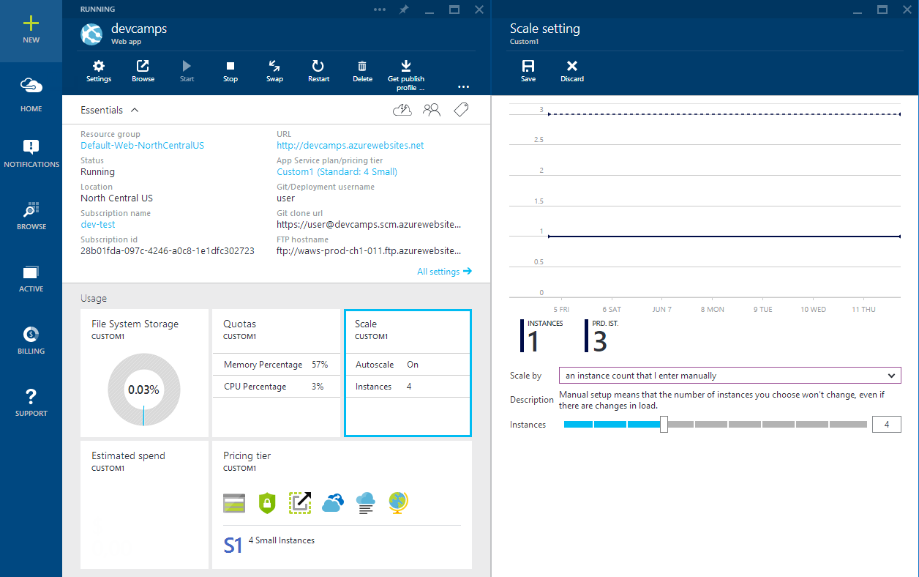

Slide 15
Step 3: Auto-scale
PROBLEM:
Manual scaling reaction time means outages.
Manual scaling is busy work.

Slide 16
Step 2: Auto-scale
SOLUTION:
Use auto-scale.

Slide 17
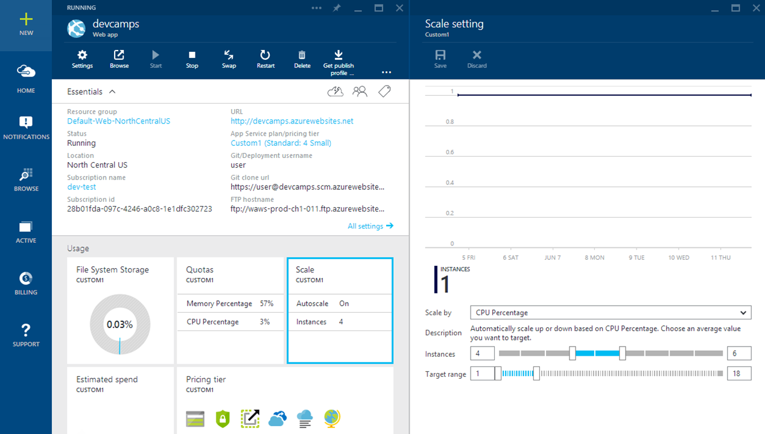

Slide 18
Demo
Scenario: Scale

Slide 19
Scenario: Change

Slide 20
Scenario description
Your site isn’t done when you deploy to production.
You need to add new features.
Change adds risk.

Slide 21
Step 1: Manage database schema
PROBLEM:
Your database and application code need to stay in sync.

Slide 22
Step 1: Manage database schema
SOLUTION:
Use Entity Framework Data Migrations.

Slide 23
Demo
Scenario: Data migrations

Slide 24
Step 2: Manage deployments
PROBLEM:
People sometimes make misteaks.

Slide 25
Step 2: Manage deployments
SOLUTION:
Use deployment rollback.

Slide 26
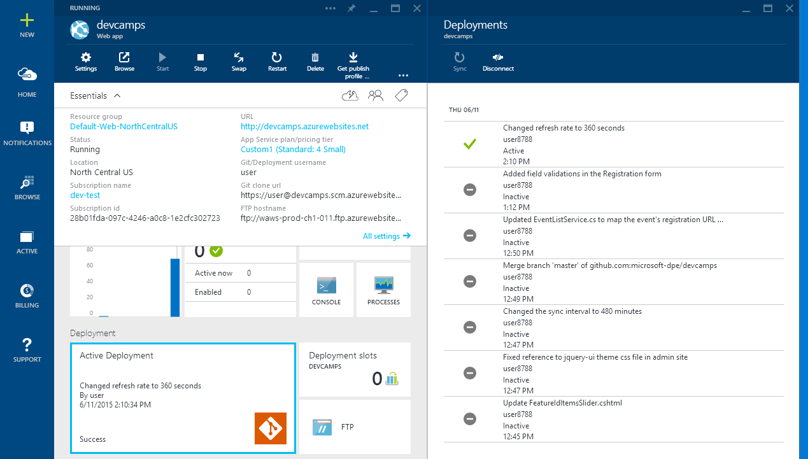

Slide 27
Demo
Scenario: Deployment rollback

Slide 28
Step 3: Leverage services
PROBLEM:
Large changes often require you to add new features quickly.

Slide 29
Step 3: Leverage services
SOLUTION:
Take advantage of available Microsoft Azure services.

Slide 30
Demo
Scenario: Azure Active Directory

Slide 31
Scenario: Multiple Environments

Slide 32
Scenario description
Running a real site requires multiple internal environments.
Global availability requires multiple worldwide deployments.

Slide 33
Step 1: Dev / Test environments
PROBLEM:
Setting up development web server environments is time consuming.
You need to see your code running somewhere other than deployment before deploying.

Slide 34
Step 1: Dev / Test environments
SOLUTION:
Environment consistency via deployment setup in Microsoft Azure Web Apps or VM images.
Cost savings by paying only for what you need.

Slide 35
33%
25%
NO
DISCOUNT RESERVED WEB APPS CLOUD SERVICES, HDINSIGHT
CREDIT CARD REQUIRED
DISCOUNT VIRTUAL MACHINES
$150
$100
$50
MONTHLY CREDIT
VISUAL STUDIO ULTIMATE WITH MSDN
MONTHLY CREDIT
VISUAL STUDIO PREMIUM
WITH MSDN
MONTHLY CREDIT
VISUAL STUDIO PROFESSIONAL WITH MSDN
Notes:
Fastest Growing Hypervisor, taking share from VMWare”
2 releases of Hyper-V since ESX 5.1 (WS2012 and WS2012 R2)
Hyper-V share is growing 3x that of VMW over the past 2 years
Hyper-V steadily taking over a point of share per quarter
Microsoft in the Gartner Virtualization Magic Quadrant for the 3rd straight year and is the only vendor moving up and to the right
Over 50 new services released this year
Compute & Storage Capacity doubling every 6 – 9 months

Slide 36
Step 2: Global Reach
PROBLEM:
It’s hard to deploy a consistent environment in multiple datacenters.

Slide 37
Step 2: Global Reach
SOLUTION:
Use automated deployment workflow to ensure consistency in deployment process.

Slide 38
Step 3: Continuous Delivery
PROBLEM:
Bugs and issues in your code get harder to fix the longer it takes to find out about them.
Deployment is a risky, error-prone operation.

Slide 39
Step 3: Continuous Delivery
SOLUTION:
Use continuous integration to automate build, unit & integration testing.
Use automated deployment workflow to ensure consistency in deployment process.

Slide 40
Demo
Scenario: Multiple environment

