Slide 1
API Services for both web and devices
[Speaker]
[Company]
Email: [Email]
Twitter: [Twitter]

Slide 2
Today’s Agenda
Session | Start | End
Keynote | 8:30 | 9:00
Introduction to ASP.NET and Visual Studio 2015 Web Tools | 9:00 | 10:00
Building Web Applications using the latest ASP.NET technologies | 10:00 | 11:00
Break | 11:00 | 11:15
Building web front ends for both desktop and mobile using the latest web standards | 11:15 | 12:15
Lunch | 12:15 | 1:15
API Services for both web and devices | 1:15 | 2:15
Running, improving and maintaining a site in the real world | 2:15 | 3:15
Break | 3:15 | 3:30
Real-time Communications with SignalR | 3:30 | 4:00
ASP.NET 5 Preview | 4:00 | 4:45
Wrap Up | 4:45 | 5:00

Slide 3
Agenda
How does ASP.NET Web API fit in?
Understanding HTTP APIs
Introduction to Web API
Consuming Web APIs in web apps
Consuming Web APIs in client apps

Slide 4
How ASP.NET Web API Fits In



HTML
JSON
XML
Web Forms
Web Pages
MVC
Web API
ASP.NET Core
Notes:
1. We’ve seen how ASP.NET provides a common core which supports several different toolsets.
2. [click for first animation] On the left side, we have tools which produce HTML, which will be viewed in browsers by people.
3. [click for second animation] On the right, we have Web API, which produces other formats which are consumed by machines (represented by this happy robot) – JSON, XML, and other custom formats which are read by JavaScript code, other programs, other servers, etc.

Slide 5
Understanding HTTP APIs
REST / HTTP
Hypermedia
API design
HTTP Status Codes
Notes:
This slide is hidden by default – up to you if you want to talk about some of these things.

Slide 6
Introduction to ASP.NET Web API

Slide 7
Sample Read-only Model and Controller
Step 1:
Create a Model
public class Person
{
public int Id { get; set; }
public string Name { get; set; }
}
Step 2:
Make an API Controller
public class PersonController : ApiController
{
List<Person> _people;
public PersonController()
{
_people = new List<Person>();
_people.AddRange(new Person[]
{
new Person { Id = 1, Name = "Chuck Norris" },
new Person { Id = 2, Name = "David Carradine" },
new Person { Id = 3, Name = "Bruce Lee" }
});
}
}

Slide 8
Read-only Controller Actions to return data
Step 3:
Return everything
// GET /api/person
public IEnumerable<Person> Get()
{
return _people;
}
Step 4:
Return one item
// GET /api/person/5
public Person Get(int id)
{
return _people.First(x => x.Id == id);
}

Slide 9
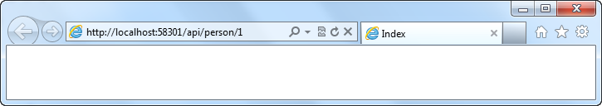
Routing a Web API
Routing:
Familiar syntax, conventional approach
public static void RegisterRoutes(RouteCollection routes)
{
routes.MapHttpRoute(
name: "DefaultApi",
routeTemplate: "api/{controller}/{id}",
defaults: new { id = RouteParameter.Optional }
);
}

Slide 10
Manipulating HTTP Responses
Return HttpResponseMessage<T> to modify response headers
Example
Find a person and return it, but what happens if we don’t find a match?
// GET /api/person/5
public HttpResponseMessage<Person> Get(int id)
{
try
{
var person = _people.First(x => x.Id == id);
return new HttpResponseMessage<Person>(
person,
HttpStatusCode.OK
);
}
catch
{
return new HttpResponseMessage<Person>(HttpStatusCode.NotFound);
}
}

Slide 11
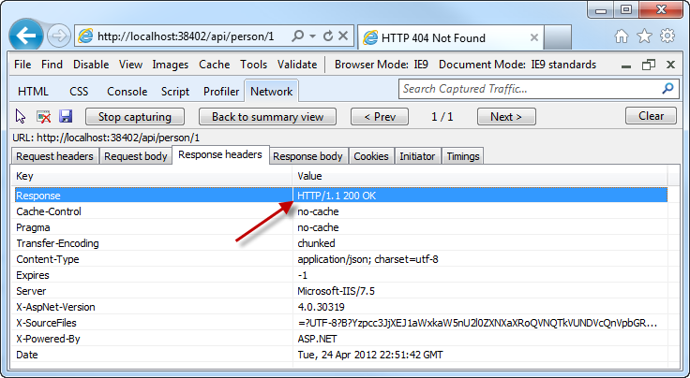
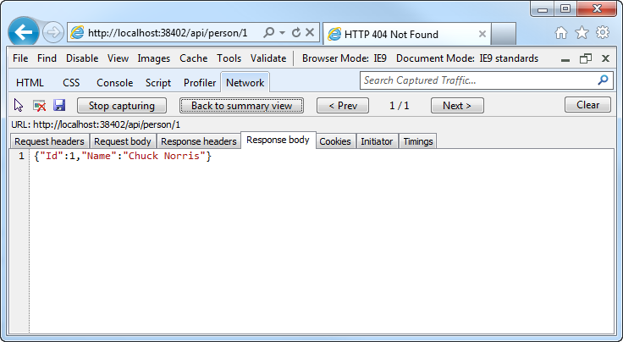
Manipulating HTTP Responses
A successful API call returns an HTTP OK and the JSON data

Slide 12
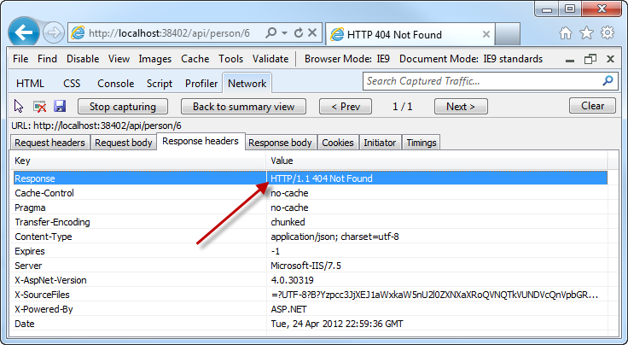
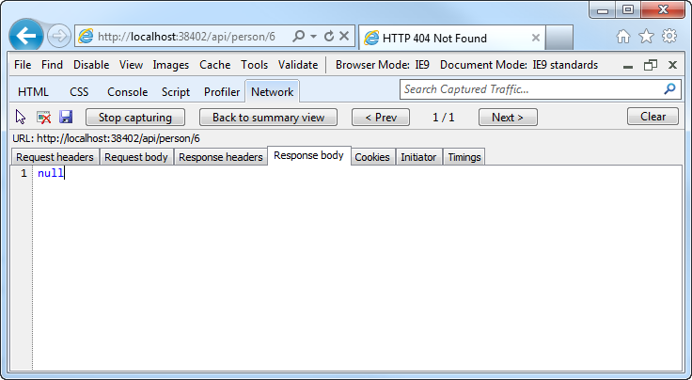
Manipulating HTTP Responses
An unsuccessful API call returns an HTTP 404 (and no JSON)

Slide 13
Posting Data to a Web API
Use HTTP Post:
Pass a Model
public HttpResponseMessage Post(Person person)
{
person.Id = _people.Count + 1;
if (_people.Any(x => x.Id == person.Id))
return new HttpResponseMessage(HttpStatusCode.BadRequest);
try
{
_people.Add(person);
}
catch
{
return new HttpResponseMessage(HttpStatusCode.BadRequest);
}
return new HttpResponseMessage(HttpStatusCode.OK);
}

Slide 14
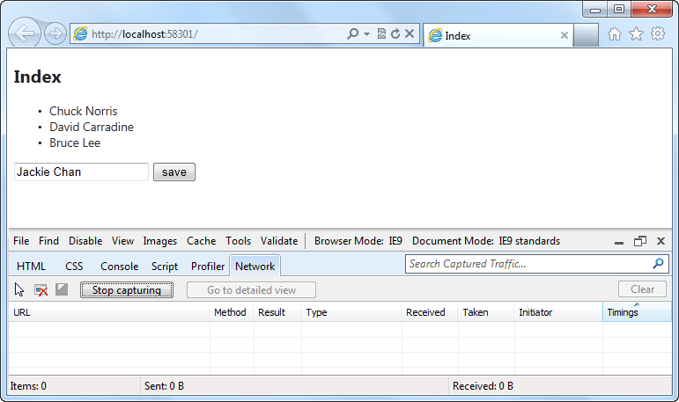
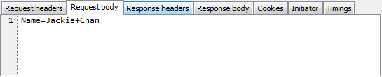
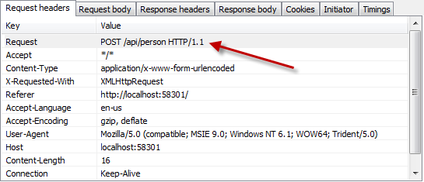
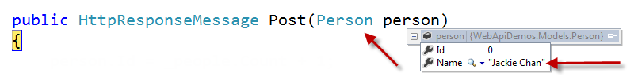
Posting Data to a Web API

Slide 15
Demo
File / New Project / Web API

Slide 16
Demo
Building the GeekQuiz services

Slide 17
Demo
Consuming Web APIs in client apps

Slide 18
Recap
How does ASP.NET Web API fit in?
Understanding HTTP APIs
Introduction to Web API
Consuming Web APIs in web apps
Consuming Web APIs in client apps

