Slide 1
What’s next
[Speaker]
[Company]
Email: [Email]
Twitter: [Twitter]

Slide 2
Today’s Agenda
Session | Start | End
Keynote | 8:30 | 9:00
Introduction to ASP.NET and Visual Studio 2015 Web Tools | 9:00 | 10:45
Break | 10:45 | 11:00
Building Web Applications using the latest ASP.NET technologies | 11:00 | 12:15
Lunch | 12:15 | 1:15
Building web front ends for both desktop and mobile using the latest web standards | 1:15 | 2:15
API Services for both web and devices | 2:15 | 3:15
Break | 3:15 | 3:30
Running, improving and maintaining a site in the real world | 3:30 | 4:30
Wrap Up | 4:30 | 5:00

Slide 3
Agenda
What we covered today
Top resources for more info
Your homework assignments

Slide 4
What we covered

Slide 5
What we learned today
Visual Studio
Microsoft Azure
NuGet
ASP.NET

Slide 6
What we learned today
Sites
Services
Web
Forms
Web
Pages
Single Page Apps
SignalR
MVC
Web API
ASP.NET
Notes:
Estimated Time: 2 minutes
No matter which type of developer you are, you get the benefit of the ASP.NET Core runtime, which provides many useful modules that provide functionality that you are likely to need when creating web applications. For example: Profile, Roles and Membership is important if you want to build in users and security around different parts of your website.
[Build x 3]
ASP.NET Web Forms, ASP.NET MVC and ASP.NET Web Pages are three different approaches to building web applications on the server side with ASP.NET. They all build on top of the same core runtime that provides them with the same powerful set of modules that web developers can leverage from within their web applications.
ASP.NET Web Forms is great for developers coming from desktop application development where they are accustomed to controls, event-driven development and code-behind. Despite not being concepts that are native to the web, Web Forms achieves this by abstracting away things like maintaining state, form posting and much more. This ease of development means that developers relinquish a certain amount of control as Web Forms manages communication between the server and client on your behalf.
ASP.NET MVC, in contrast, is for developers that like to be in full control of the interactions between client and server and provides a more “raw” approach to what happens in the web application. Due to its loosely coupled architecture, MVC is also very extensible with many places for developers to customize and plugin components as well write test code easily.
Developing in ASP.NET Web Pages is centered around inline code and is similar to PHP or classic ASP in that compilation of your application isn’t required (it is in WebForms and MVC). It is designed to provide the simplest approach to building websites with the fewest number of concepts to learn.
[Build x 2]
When it comes to controlling the markup that is rendered to the client there are two view engines you may use. The Web Forms view engine is shared by both Web Forms and MVC and uses the familiar <% %> syntax. With ASP.NET MVC 3 and ASP.NET Web Pages Microsoft introduced the Razor View Engine which uses a different syntax centered around the @ symbol. The Razor syntax uses fewer characters to achieve the same things in Web Forms and allows the developer to mix markup and code really easily.

Slide 7



.NET 2015 – 10K foot view
WPF
Windows Forms
ASP.NET (4 & 5)
ASP.NET Core 1.0
Universal Windows Apps
Core CLR
.Net Native
.NET Framework 4.6
.NET Core 1.0
Full .NET Framework for any scenario and
library support on Windows
Modular libraries & runtime optimized for server and cloud workloads
Common
Runtime Components
Compilers
NuGet packages
Next gen JIT (RyuJIT)
SIMD
.NET Compiler Platform (Roslyn)
Languages innovation
.NET Core 1.0 Libraries
.NET Framework 4.6 Libraries

Slide 8
ASP.NET 2015 in a Nutshell
Visual Basic 14
Visual Basic 14 (coming soon)
C#
Web
Forms
MVC 5.x
Web API 2.2
MVC / Web API 6
ASP.NET 4.6 System.Web
ASP.NET Core 1.0
Core CLR
.Net Native
.NET Framework 4.6
.NET Core 1.0
Full .NET Framework for any scenario and
library support on Windows
Modular libraries & runtime optimized for server and cloud workloads

Slide 9
What we learned today
Introduction to ASP.NET and Visual Studio 2013 Web Tooling
Building Web Applications using the latest ASP.NET technologies
Building web front ends for both desktop and mobile using the latest web standards
API Services for both web and devices
Running, improving and maintaining a site in the real world
Real-time Communications with SignalR
Notes:
Note: Should add other key scenarios we won’t be covering in depth

Slide 10




What you can do next
Build
Contribute
Grow

Slide 11
Top resources for more info

Slide 12
ASP.NET Questions
http://www.asp.net/feedback
Twitter - @aspnet
Facebook - /ASPNET
G+ - ASP.NET

Slide 13
Web Camps
http://www.devcamps.ms
http://aka.ms/webcamps-training-kit

Slide 14
Microsoft Azure
http://azure.microsoft.com

Slide 15
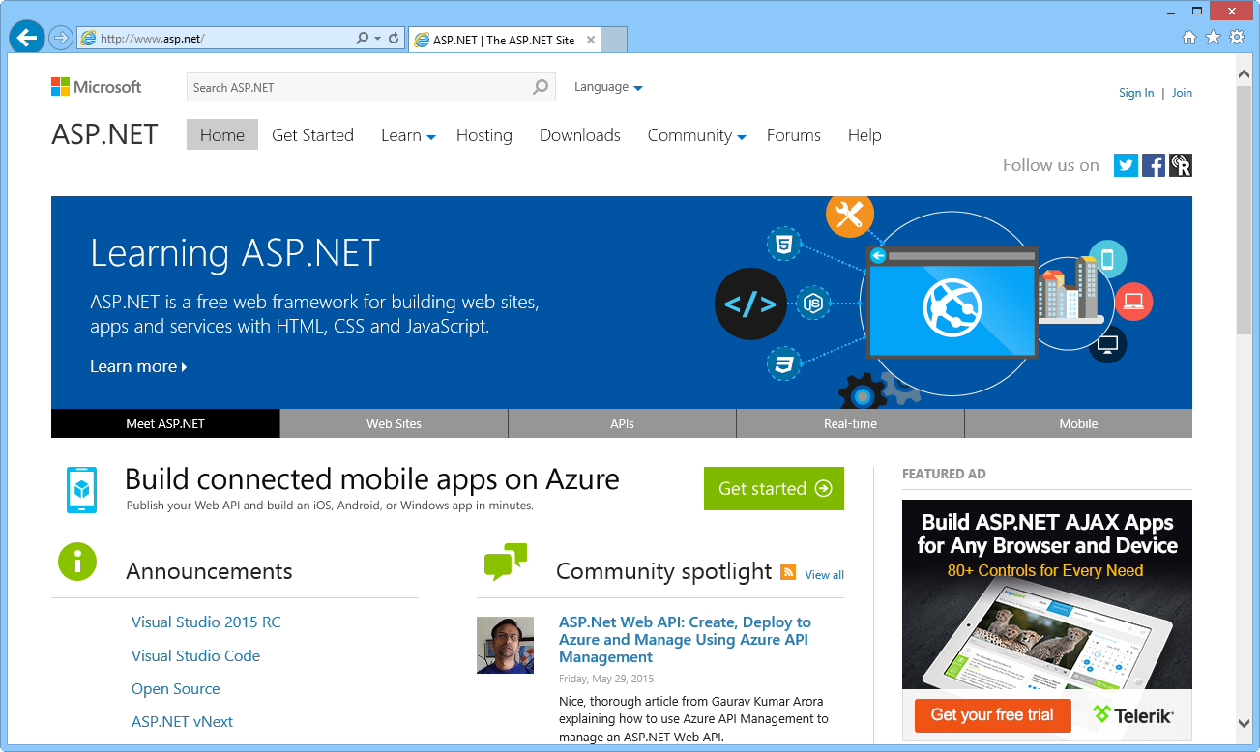
ASP.NET site

Slide 16
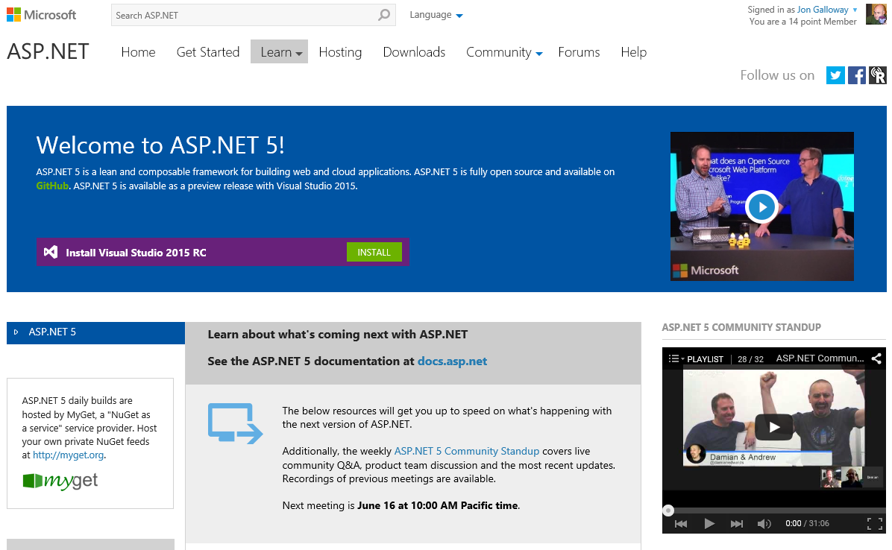
http://www.asp.net/vnext

Slide 17
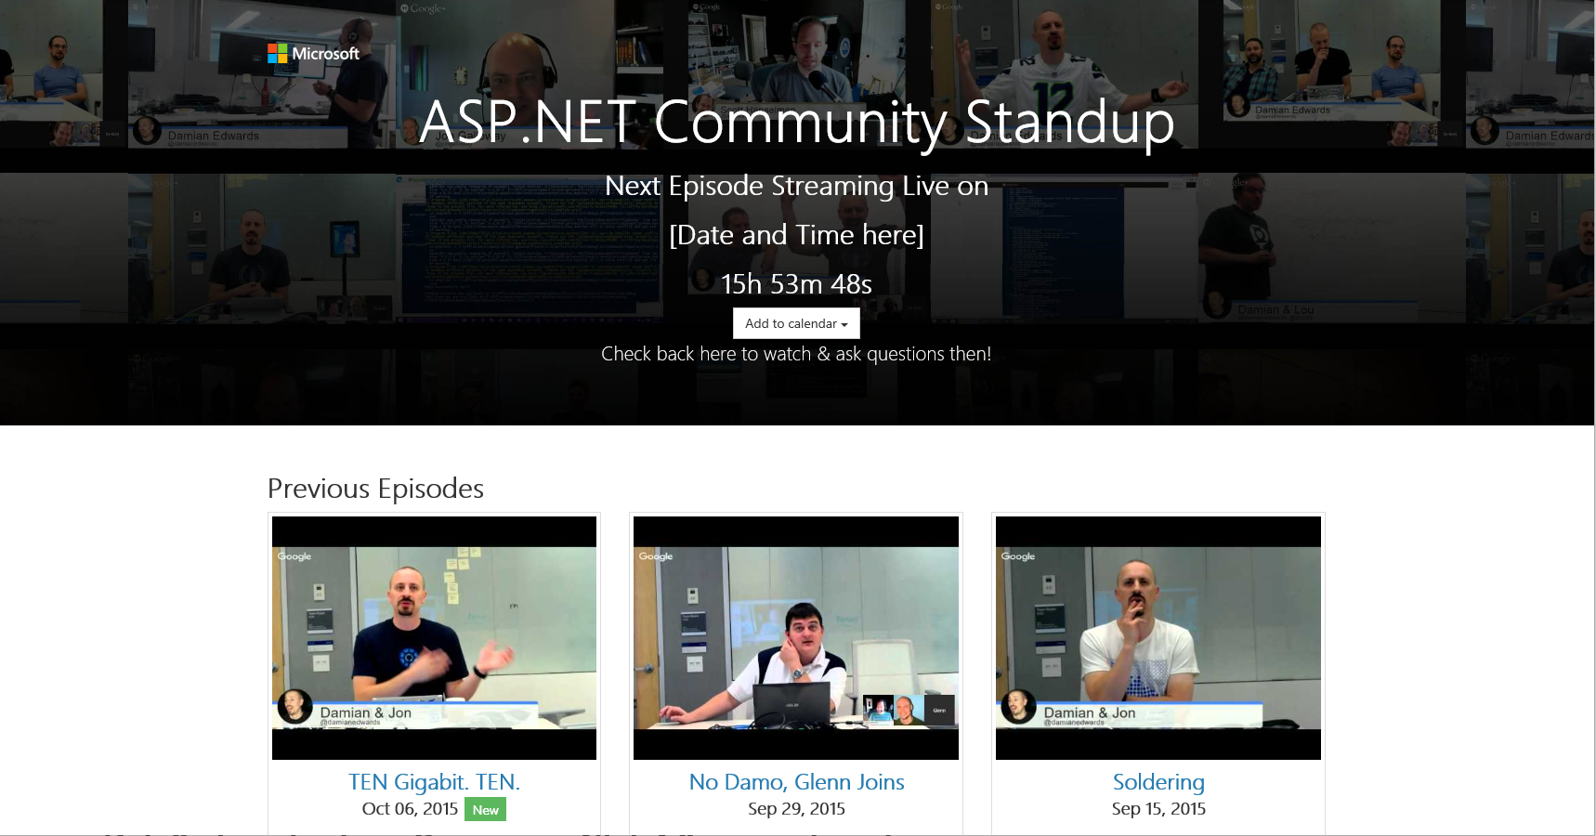
http://live.asp.net

Slide 18
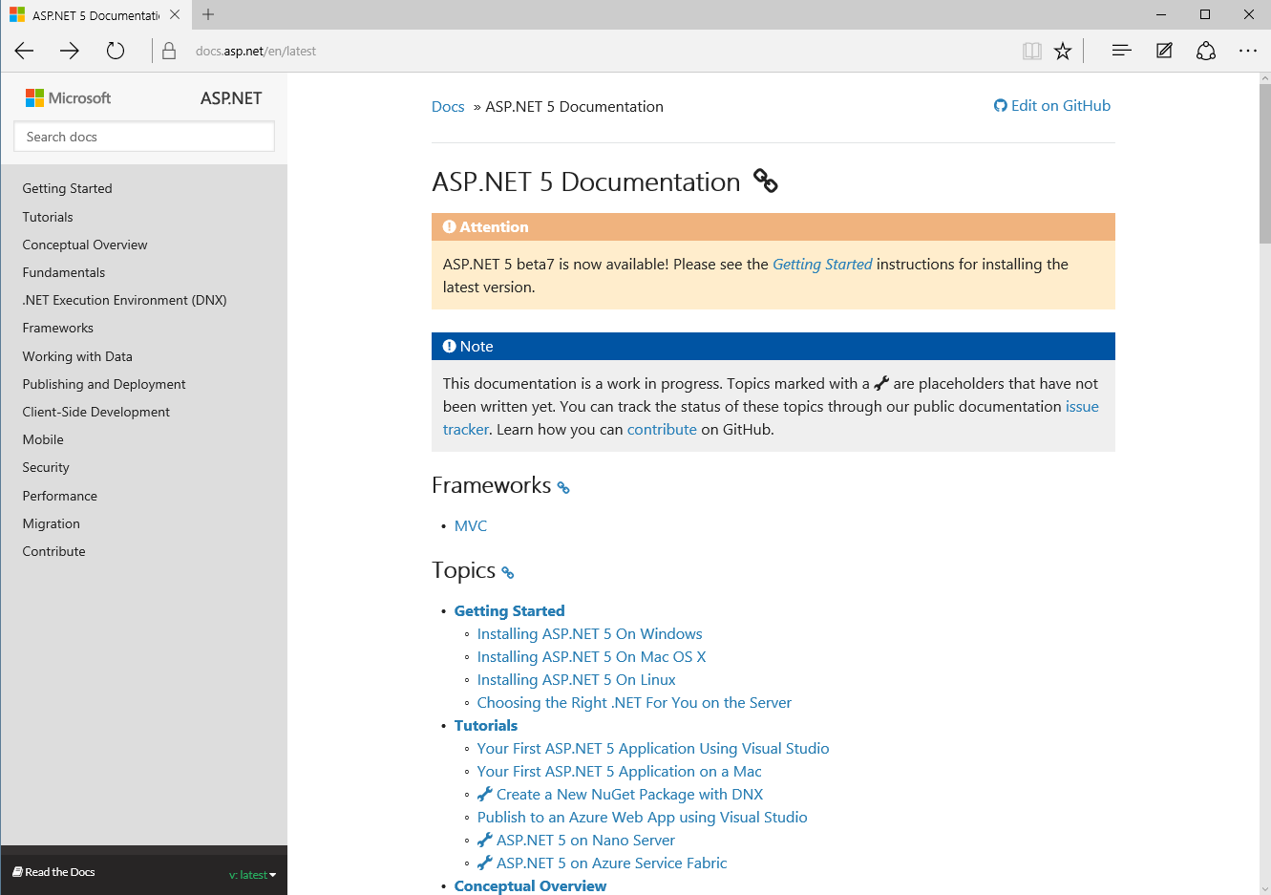
http://docs.asp.net

Slide 19
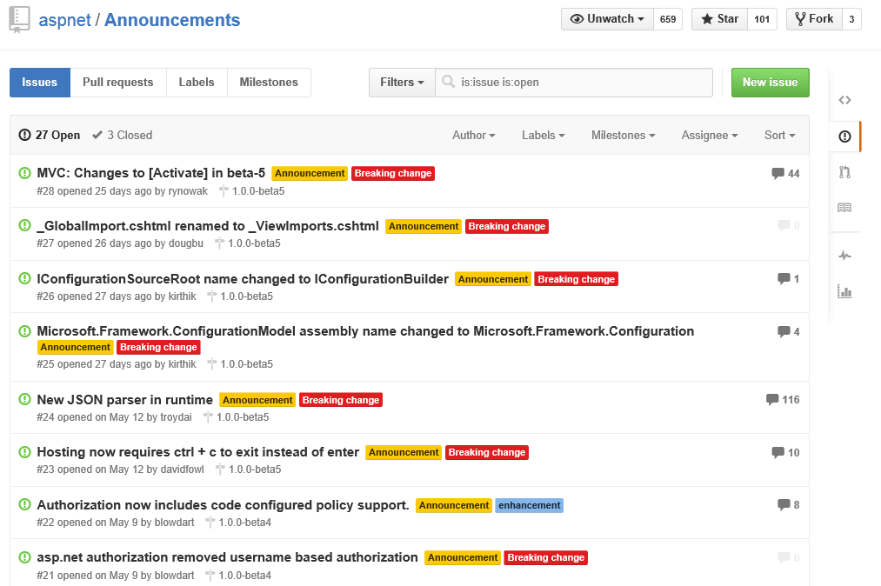
https://github.com/aspnet/announcements/issues

