Slide 1
NOTES:
Certain slides have been slightly changed, along with the order of a few slides has been altered
This is very new – we would love to know the good and bad parts of this

Slide 2
Prerequisites
Windows 10
Ngrok (or other tunneling service)
Office 365 – with access to Teams and sideloading enabled by the tenant administrator
Access to GitHub in order to clone the repository – having GitHub for Windows (or Mac) is highly recommended https://git-for-windows.github.io/
Highly Recommended – ability to open Power Point Presentation
For C# developers
Visual Studio 2017 for developing C#
For Node developers
Node.js
Visual Studio Code

Slide 3
Clone GitHub Repo and Load Solution
NOTE: We have changed the repo from what was on the slides
Clone the repo
In the Git bash shell run the command:
git clone https://github.com/OfficeDev/microsoft-teams-template-bot-CSharp.git
(if you are Git savy and want to use the ability to diff files and see additions as we go, then you can actually fork the repo above to have your own working copy)
Load the project into Visual Studio 2017 by loading the .sln file located at the top level of the directory you just pulled from GitHub

Slide 4
Tenant Setup
Main link to see options and possibilities for tenant setup: https://msdn.microsoft.com/en-us/office/office365/howto/setup-development-environment
Page to compare Office 365 subscriptions: https://products.office.com/en-us/compare-all-microsoft-office-products?tab=2
Page describing more about Office Administrator role: https://support.office.com/en-us/article/About-the-Office-365-admin-center-758befc4-0888-4009-9f14-0d147402fd23
Login as an administrator to see tenant settings: https://www.office.com/
.

Slide 5
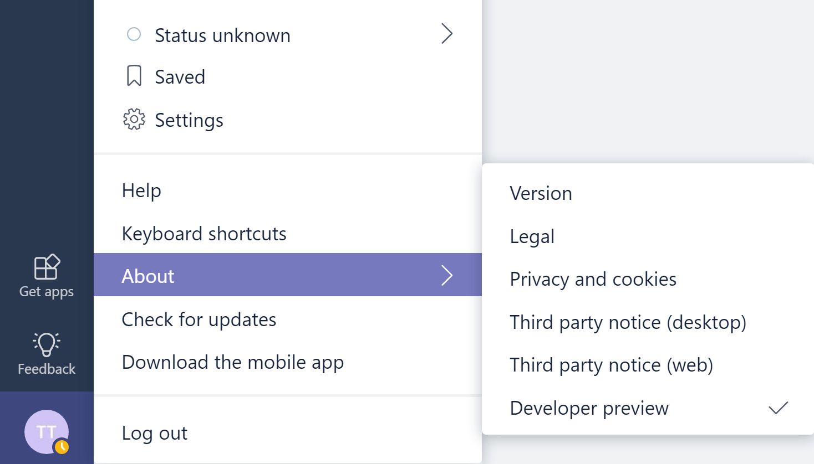
Move Teams to ‘Developer preview’ mode
Click circle of user in the lower left hand corner
Click ‘About’
Click ‘Developer
preview’
~

Slide 6
Microsoft Teams Lab/Working Session
Tokyo, Japan
Teams.Microsoft.com
https://github.com/officedev/microsoft-teams-template-bot-csharp

Slide 7






Tabs
Bots
Surface rich content within Teams
Help users get tasks done in conversations
A powerful, extensible platform for higher performing teams
Compose Extensions
Connectors
Post rich updates to channels
Allow users to query and share rich cards in conversations
Build apps with a rich set of capabilities to reach your users in their chats, channels, notifications, and personal workspace.
Microsoft Graph
Build in intelligence and connect to data that drives productivity
Activity Feed
Actionable Messaging
Engage users via feed notifications
Add rich interaction to your connector cards

Slide 8




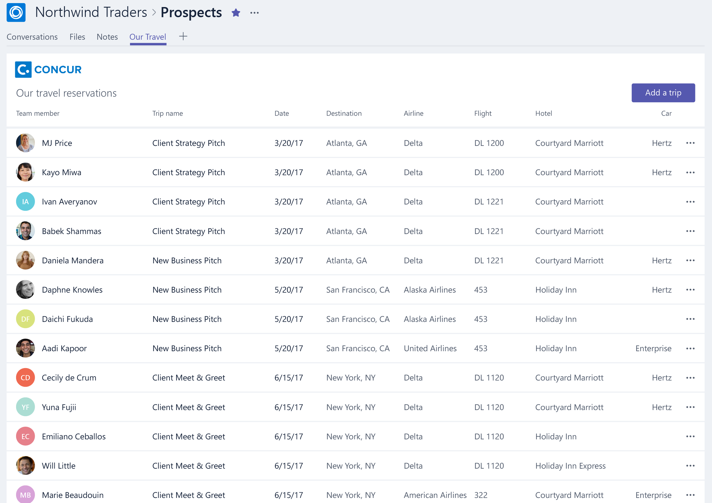
Tabs
Rich surface area for your app
As simple as embedding your existing web app
Team and personal productivity
Example: benefits dashboard

Slide 9


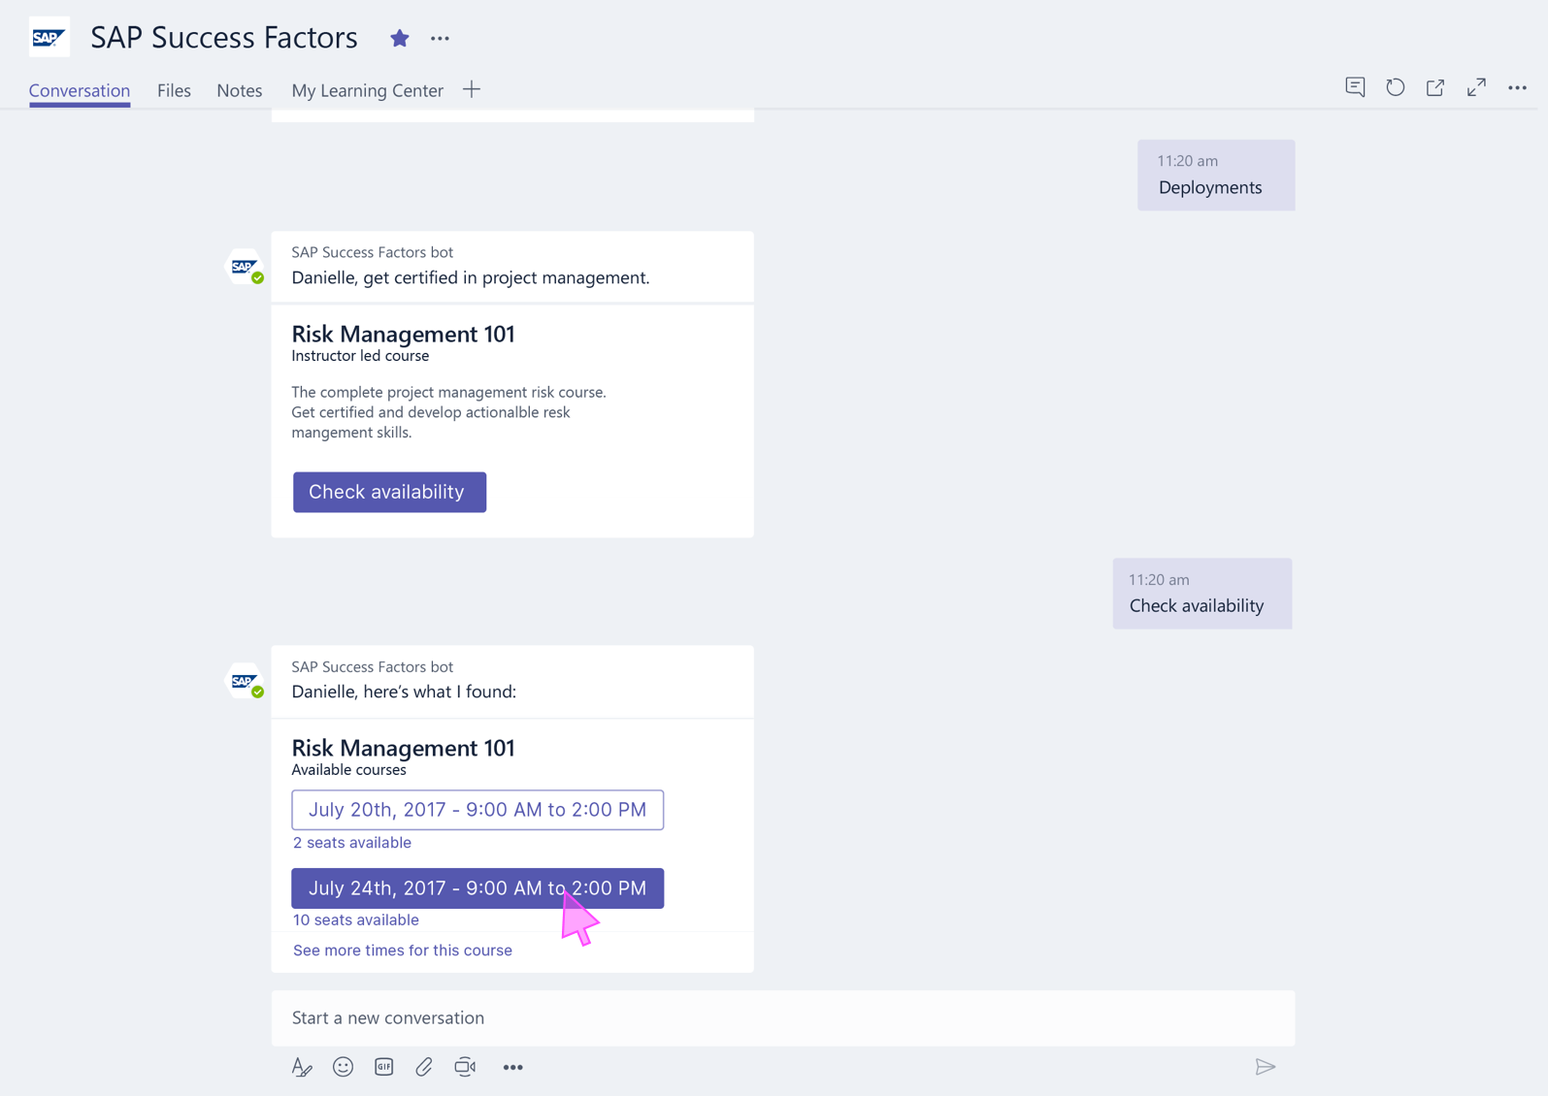
Bots
Bots make it easy for users to interact with your app in Team conversations or 1:1
Built using Microsoft Bot Framework
Complete tasks via basic commands, menu, natural language, or cards
Example: time and absence entry and reporting

Slide 10

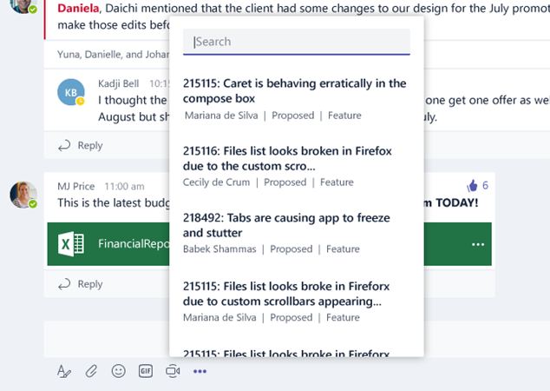
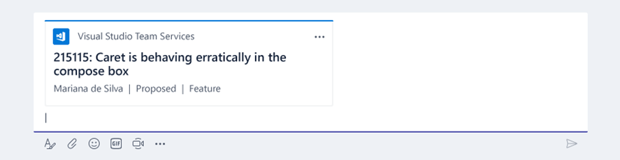
Compose Extensions
Personalize Teams Compose box with your App & Services content
Users can query and insert your app content into conversations
Example: lookup and share information from the team knowledge base

Slide 11

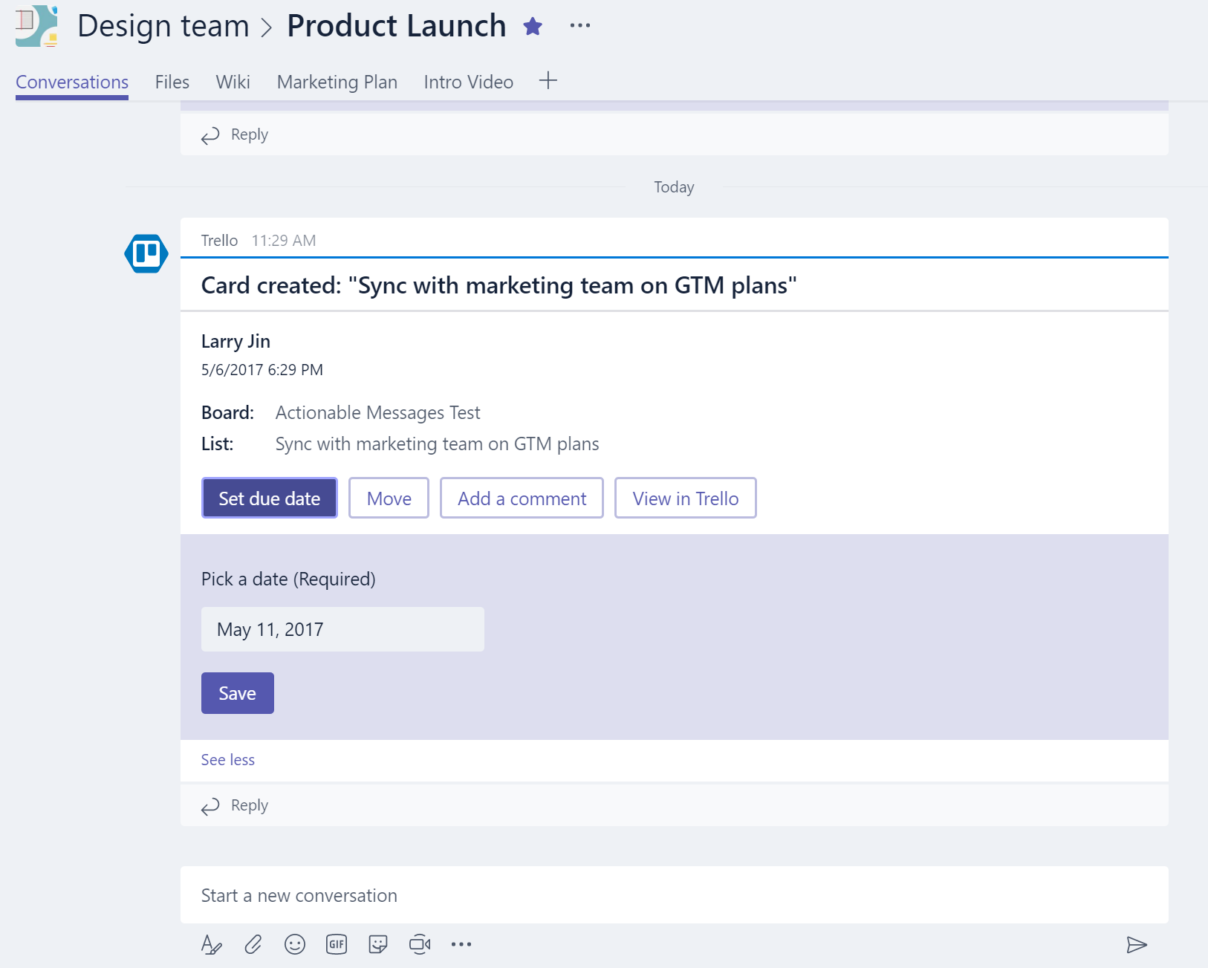
Connectors
Push rich interactive cards into channels
Users can take quick actions like comment, select options, set a date
Fully supported in both Teams and Outlook

Slide 12
Building, packaging, and distributing an app
Implement capabilities
Define your app
Test your app
Upload to the Store
Build a bot, tab, connector, or compose extension
Implement your web content or server application
Leverage Teams helper libraries
Describe app and metadata via manifest.json
Specify which capabilities your app has
Create your app’s zip package
Include manifest and icons
Side load to any team
Upload your package to the Microsoft Store!

Slide 13
App Manifest basics
JSON file describing your app
Name, icon, description, and other properties
List of capabilities and supported contexts
Tab URLs
Bot ID and commands
Compose extension ID and commands
Connector ID
Permissions and security metadata
Complete reference

Slide 14
Deploy to Azure from Visual Studio
https://docs.microsoft.com/en-us/azure/app-service/app-service-web-get-started-dotnet

Slide 15
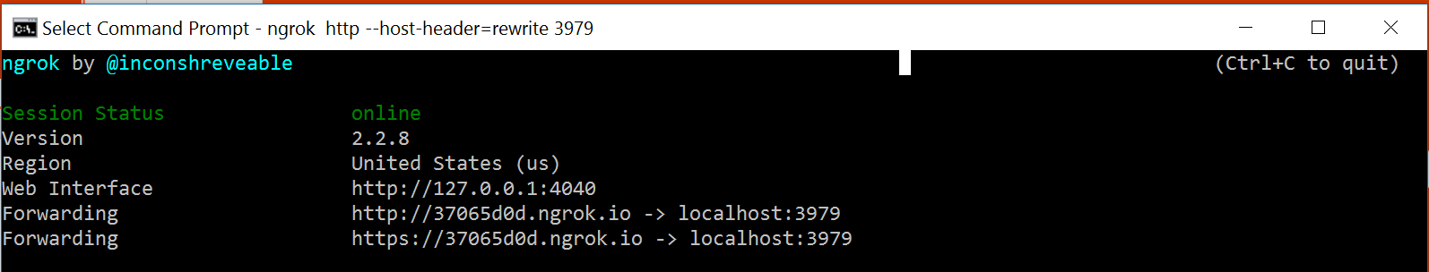
Launch ngrok
Ngrok is an awesome tool that opens up localhost and a port as a publicly available URL
Open up the command line
Navigate to where you downloaded and extracted ngrok
Run this command: ngrok http 3979 --host-header=localhost
Navigate to the HTTPS forwarding URL
Note: 3979 can be replaced with the port you are running on

Slide 16
Move Teams to ‘Developer preview’ mode
Click circle of user in the lower left hand corner
Click ‘About’
Click ‘Developer
preview’

Slide 17
Clone GitHub Repo and Load Solution
NOTE: We have changed the repo from what was on the slides
Clone the repo
In the Git bash shell run the command:
git clone https://github.com/OfficeDev/microsoft-teams-template-bot-CSharp.git
(if you are Git savy and want to use the ability to diff files and see additions as we go, then you can actually fork the repo above to have your own working copy)
Load the project into Visual Studio 2017 by loading the .sln file located at the top level of the directory you just pulled from GitHub

Slide 18
Run the project in Visual Studio
Debug your project (play button at the top)
VS will run a debug IIS server on localhost:3979
Check that things are working in the browser (should have opened a default page automatically)

Slide 19
Flow of Lab
Run the project
Navigate a browser to localhost:3979 (should open automatically)
Read the information there about the changes you just received and any exercises listed there
Make any changes you want, but be sure to commit them all after the end of a section (except changes to the Web.config file)
Move on to the next section by creating a new local branch based on the next section’s remote branch
(for Visual Studio – navigate to the Team Explorer and double
click the next section’s branch under “remotes/origin”)

Slide 20
Tab
There are two types
Configurable tabs – currently these show up in a channel
Static tabs – currently these show up in the personal app scenario
NOTE: this will not always be the case. Eventually, configurable tabs will be able to be used in a personal scope and static tabs will be able to be used in a channel scope.
.

Slide 21
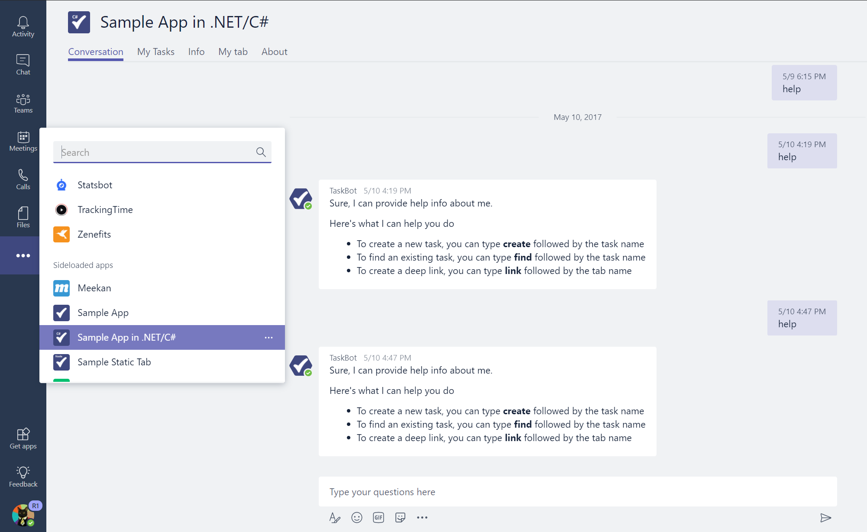
Note: Using the App in personal context

Slide 22
Static Tab – (this is a few slides lower)
What is in the manifest is the content URL
That is about it… sort of

Slide 23
Add to Microsoft Teams
Add to manifest
Package manifest
Sideload and run in Teams

Slide 24
Package the manifest
Once your changes are made to the manifest.json file, navigate to the ‘manifest’ directory located that the top level of the project directory
Select the manifest.json file and the bot_blue.png icon at the same time
NOTE: this is not best practice – there should be two – there is one here for
simplicity
Right click, click ‘Send to’, and click ‘Compressed folder’ to zip the files together
NOTE: the zip file can be named anything, but the manifest.json file must keep this exact name

Slide 25
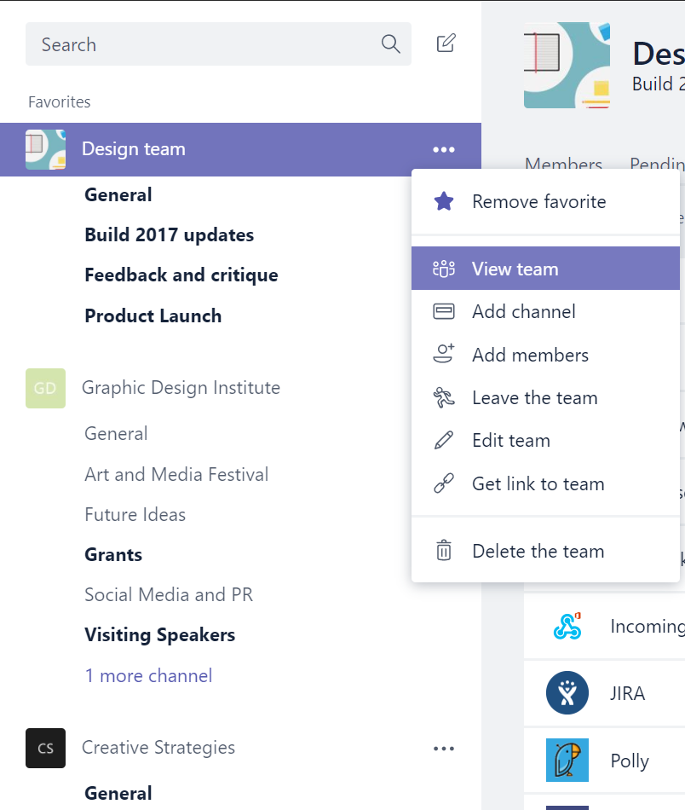
Sideload your app package
Go to your Microsoft Teams client
Find your test team and go to the Team Properties page (the three dots)
Click Manage team and then click the Apps tab
At the lower right, click on Sideload an app
Select and upload your .zip file
.

Slide 26
Note: Using the App in personal context

Slide 27
End of Day 1

Slide 28
Flow of a Configurable Tab
Defined in the manifest
What is in manifest actually points to the configuration experience
It is the configuration page’s job to set up the actual tab

Slide 29
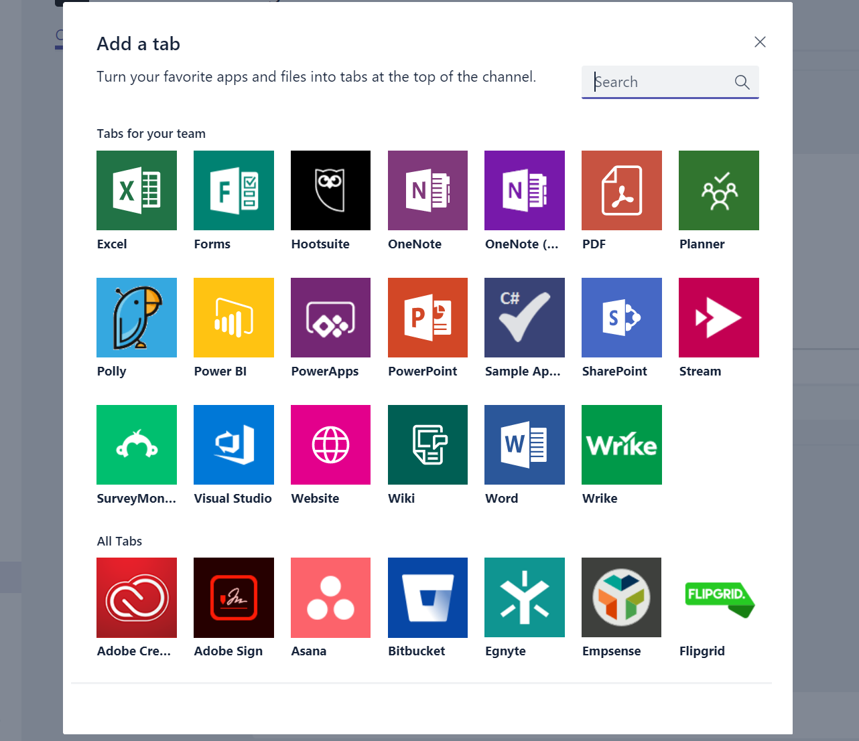
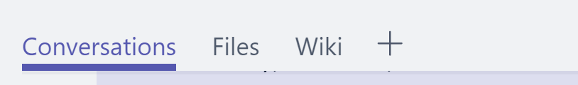
Adding a tab
?
Your App

Slide 30
Add to Microsoft Teams
Add to manifest
Package manifest
Sideload and run in Teams

Slide 31
Package the manifest
Once your changes are made to the manifest.json file, navigate to the ‘manifest’ directory located that the top level of the project directory
Select the manifest.json file and the bot_blue.png icon at the same time
NOTE: this is not best practice – there should be two – there is one here for
simplicity
Right click, click ‘Send to’, and click ‘Compressed folder’ to zip the files together
NOTE: the zip file can be named anything, but the manifest.json file must keep this exact name

Slide 32
Sideload your app package
Go to your Microsoft Teams client
Find your test team and go to the Team Properties page (the three dots)
Click Manage team and then click the Apps tab
At the lower right, click on Sideload an app
Select and upload your .zip file

Slide 33
Bots

Slide 34
Bots
These are currently running on your machine

Slide 35
Bot Emulator
Bot Emulator
Is helpful when first getting started (especially on your own)
Is nice for testing the functionality of your bot before you are familiar with it
BUT we have had many people fall into problems by using it because it does not function the same way as Teams (tools are different, there are certain things that are not supported, etc.)
Instead we are moving straight to the Bot Framework registration

Slide 36
Bots
This connection happens because of your bot being registered in Microsoft Bot Framework

Slide 37
Register your bot
Go to the Bot Framework portal to register your bot
Log in with your MSA or Org ID
Click on Create a Bot > Register an existing bot and fill out the form
Icon, name, description
Messaging endpoint: this is your https URL from ngrok + “/api/messages”
Click the Create Microsoft App ID and password button
Click the Generate an app password to continue button – SAVE YOUR APP.ID AND PASSWORD!
Click the Finish and go back to Bot Framework button
Make sure to click Register at the end!
Note: at this point it may take a few minutes to get your bot set up – feel free to grab a quick coffee!

Slide 38
Bots
You are now registered, but your bot must validate to your newly registered bot

Slide 39
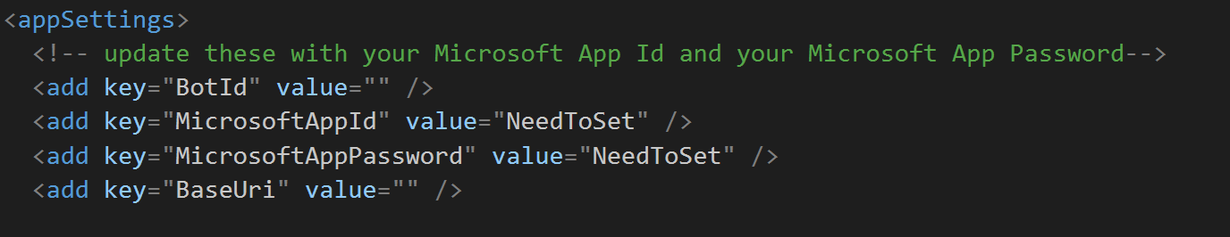
Add ID and Secret to bot
Override “NeedToSet” with your app.ID and secret in your Web.config file

Slide 40
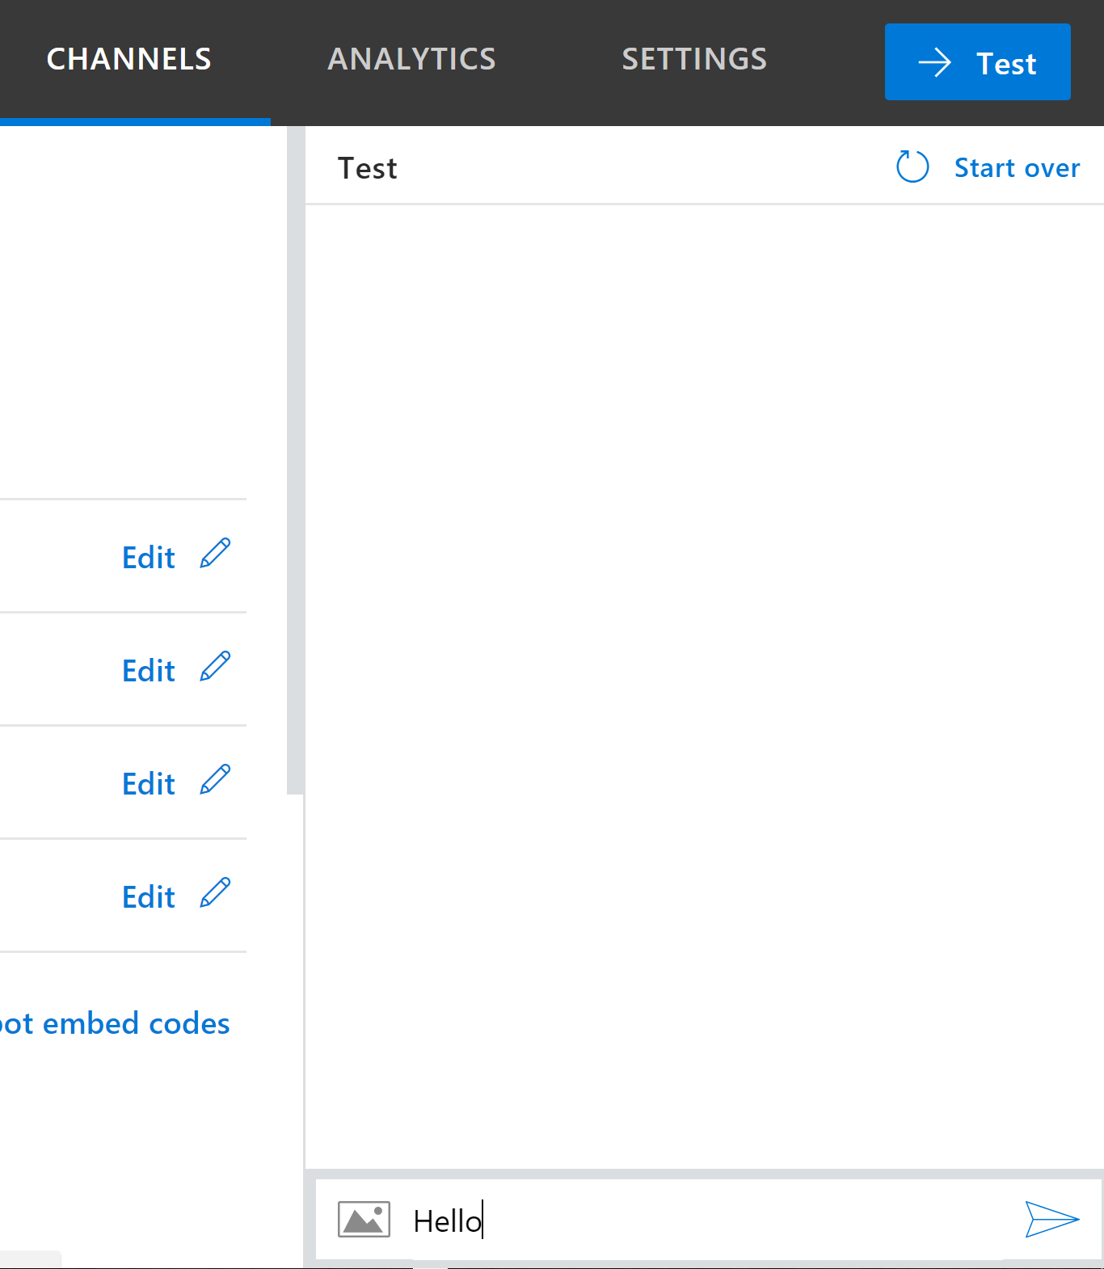
Test in the Bot Framework registration page’s chat window
Say “hello”

Slide 41
Bots
Now, we need Microsoft Teams to know to talk with the registered bot.
This is done by adding your bot’s ID to the app’s manifest.

Slide 42
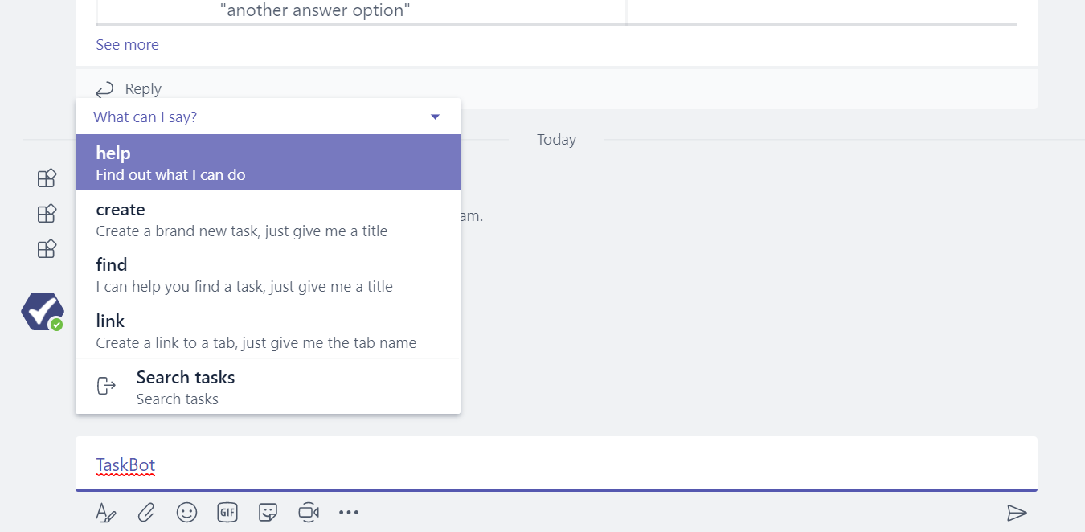
At-Mentioning the bot in a channel

Slide 43
Microsoft Teams Integration/Capabilities
Fetch roster
At-mention a user
Deeplinks to tabs
Proactive Messaging
Updating Messages

Slide 44
Add to Microsoft Teams
Add to manifest
Package manifest
Sideload and run in Teams

Slide 45
Compose Extensions
Special Invoke payload

Slide 46
Configuration/Sign In Experience
Two types
One goes through the “query/results box”
One goes through the “three dots” settings for the app

Slide 47
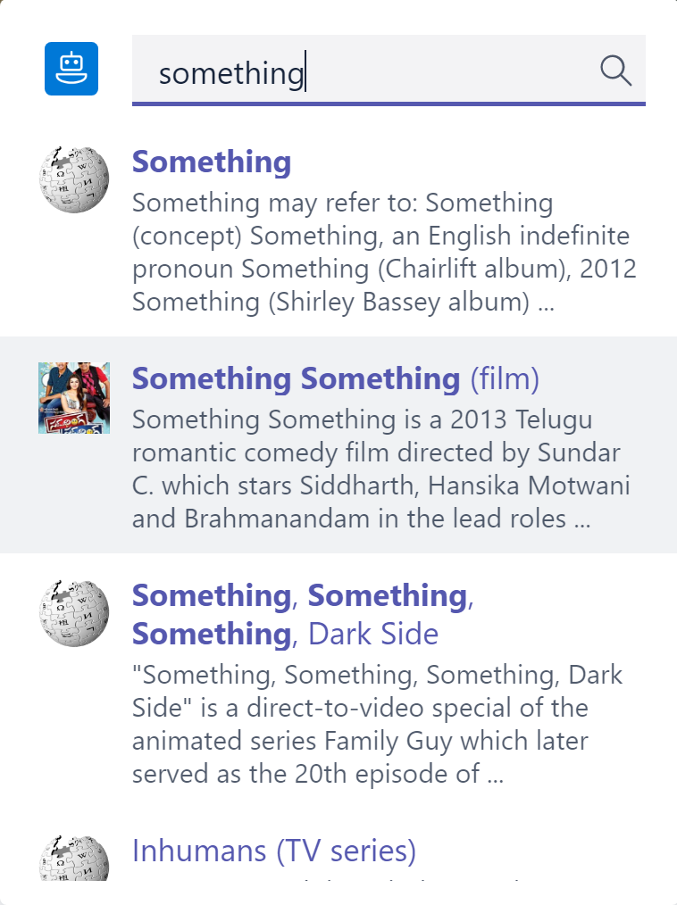
Typical Query
For this query to work, the user’s query passes through the composeExtension/query hook to return responses

Slide 48
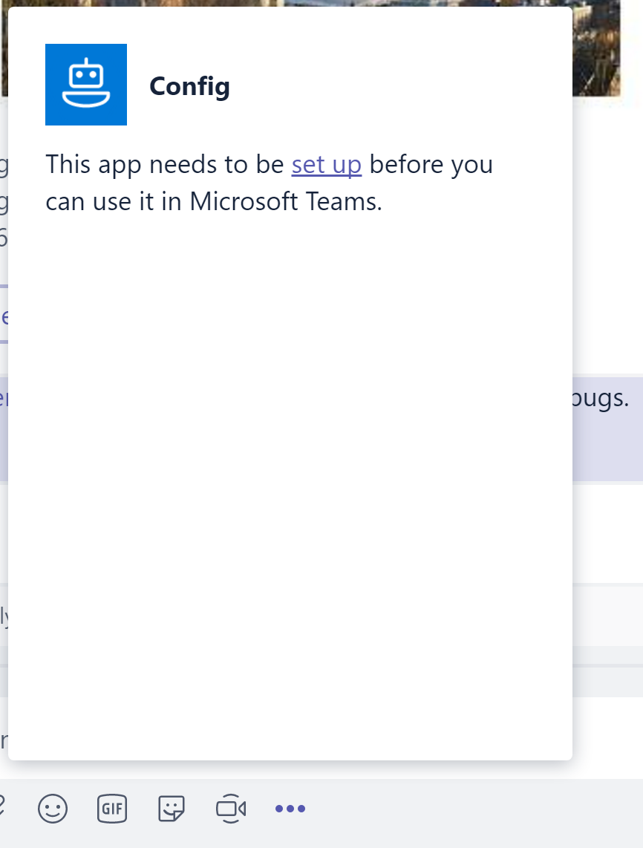
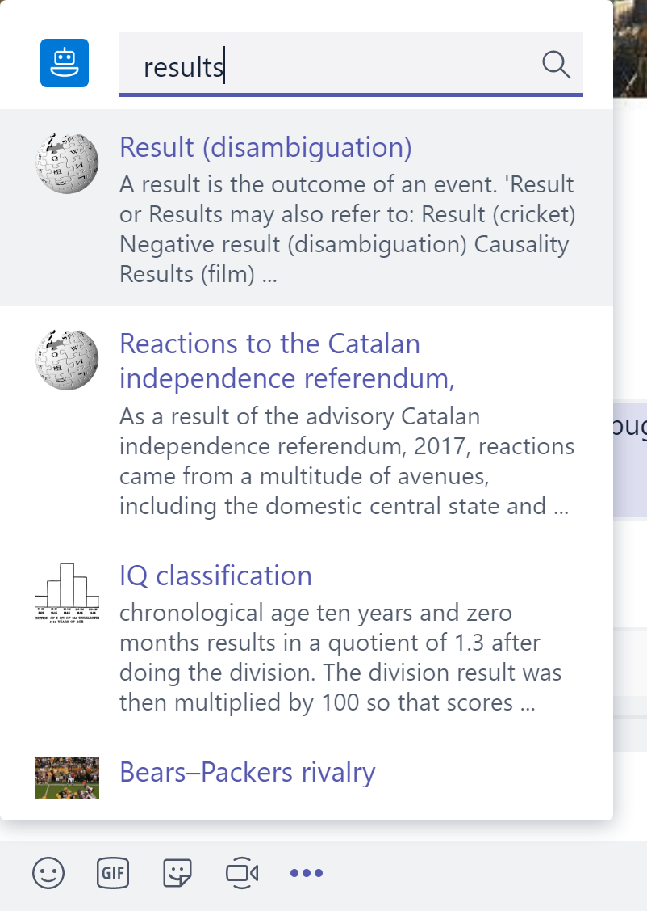
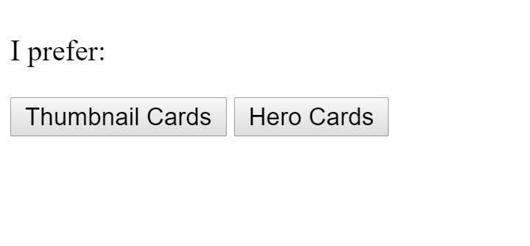
Configuration from query/results box
Just like a user’s query, the results from a configuration experience started in the query/results box pass back through the composeExtension/query hook in order to produce results

Slide 49
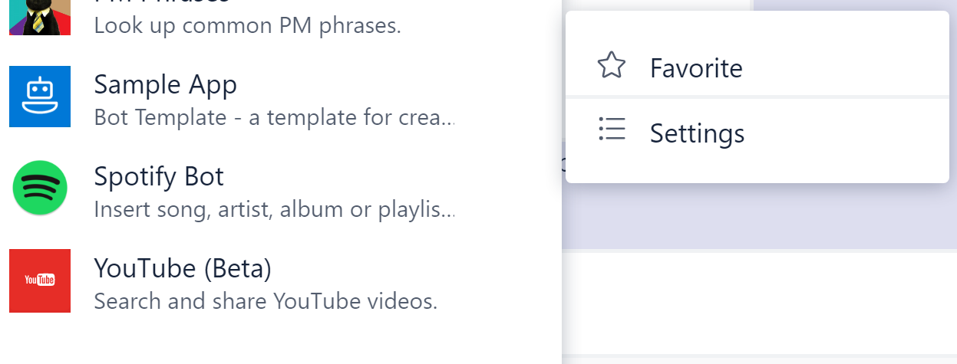
Configuration from the “three dots” settings
Popup closes
In this flow, after the user finishes the configuration flow, no results are expected. Because of this, this flow passes through different hooks. To get the URL for the popup, the request passes through the composeExtension/querySettingUrl hook. The user’s response from the configuration will then come back to the bot in the composeExtension/setting hook. Although both configuration experiences appear similar, they travel different paths through the bot.

Slide 50
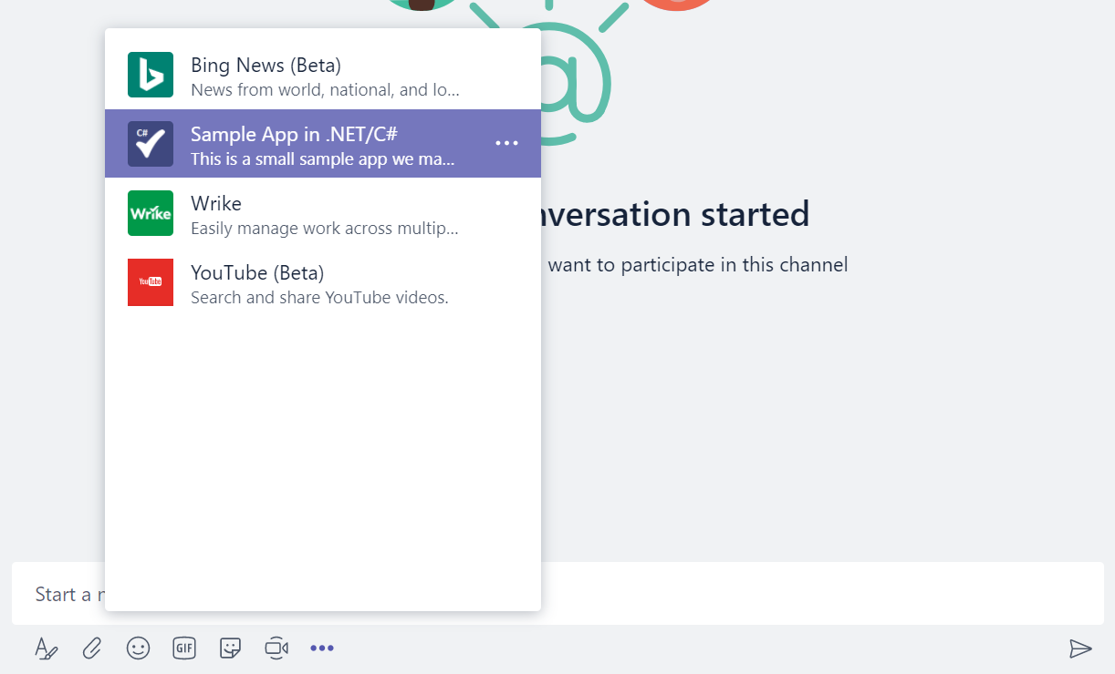
Using the compose extension

Slide 51
Add to Microsoft Teams
Add to manifest
Package manifest
Sideload and run in Teams

Slide 52
Connector
A notification feature for a Microsoft Teams channel
Notifies channels by posting cards to webhook URLs
Can get some input from users by sending Office 365 Connector Cards with actions

Slide 53
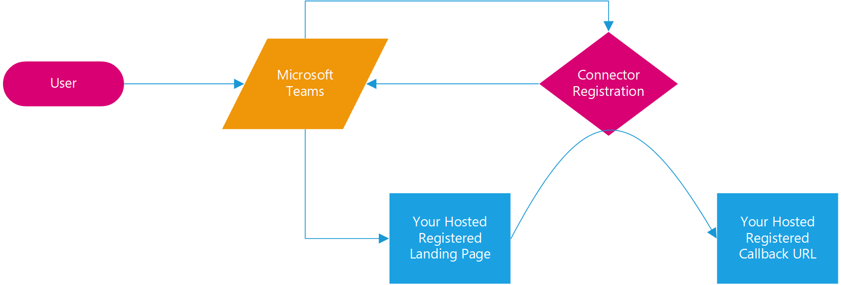
Connector
Get Registered Landing Page
Teams Pops up Landing Page
A button click with information from the Connector Registration portal routes through the Connector service to end up on the Registered Callback URL with the webhook associated with that channel

Slide 54
Registering a Connector
https://outlook.office.com/connectors/publish
Landing Page – page that will start the configuration flow
Callback URL – URL that will receive your Connector configuration information including the webhook URL for that channel

Slide 55
Add to Microsoft Teams
Add to manifest
Package manifest
Sideload and run in Teams

Slide 56
Authentication in Microsoft Teams
Tab – popup (either from the tab or part of the configuration)
Bot – moves user out to browser (popup coming soon!)
Compose Extension – popup
Connector – popup as part of configuration

Slide 57
Tab Authentication
Begin popup – have host page set up handlers
Popup must start on a page you host
Redirect to the login page
Have login redirect back to a page you host
This last page closes the popup to return to the main page

Slide 58
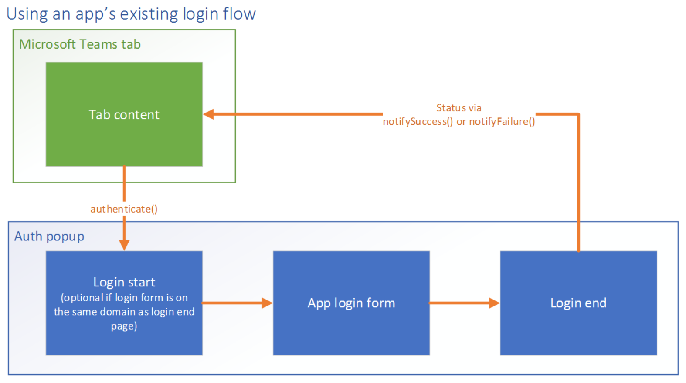
Visually what that means…

Slide 59
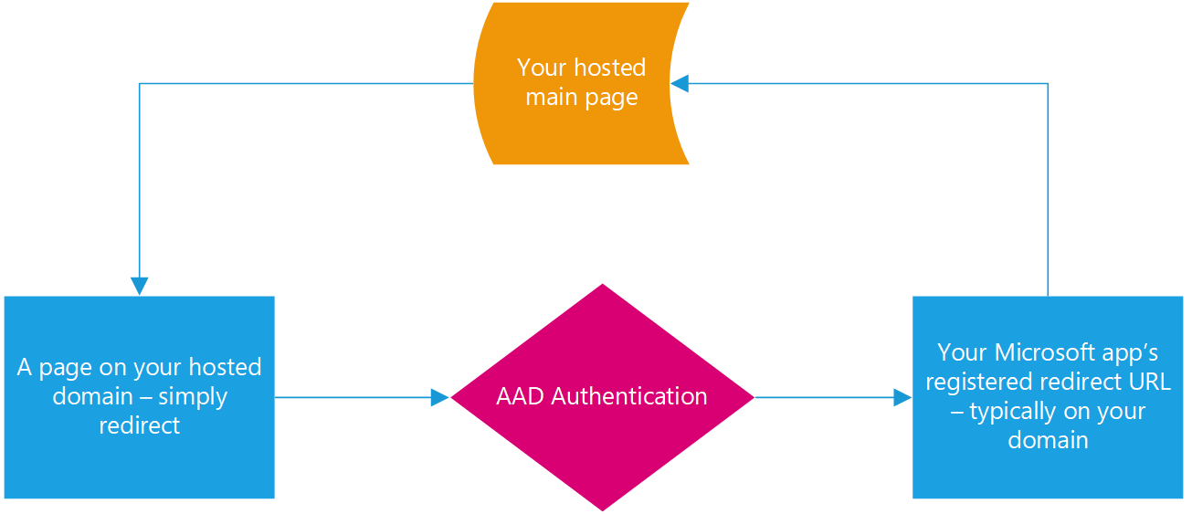
Azure Active Directory (AAD) Authentication
authenticate()
notifySuccess()

Slide 60
Why would you do this?
Sharing of state – this is a complicated subject. One way to have all of your features share state is to have them all be based on the same ID. One ID that can be the same across all of the features is the AAD object ID.
Graph calls – an app can get tokens so that it can make Graph calls for various things.

Slide 61
Graph Call
Use a simple Graph Call to get some of the user's information

Slide 62
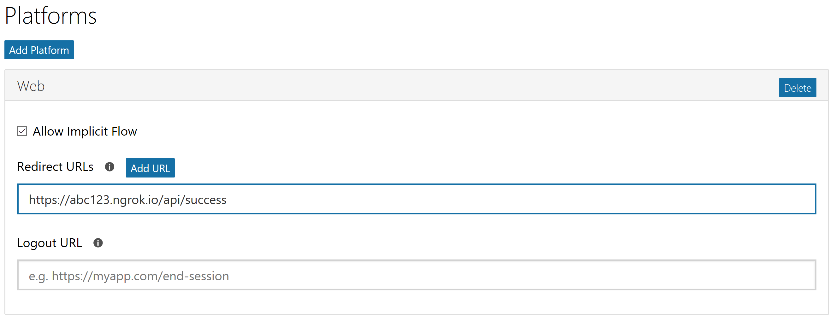
App Portal and Permissions
https://apps.dev.microsoft.com

Slide 63
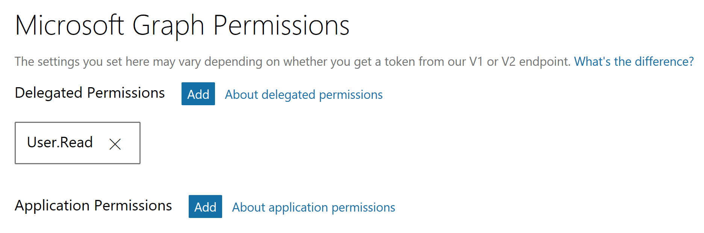
App Portal and Permissions
https://apps.dev.microsoft.com

Slide 64
Add to Microsoft Teams
Add to manifest
Package manifest
Sideload and run in Teams

Slide 65
Office Store Submission
https://sellerdashboard.microsoft.com
Note: For "Office" store submissions, a Microsoft Account is required
Polish your app
Logout Scenario
Usability

