Slide 1


Department of Computer Science & Engineering
A Major Project Stage2 Presentation
On
Agricultural Crop Recommendation Based
On
Productivity and Season
Internal Guide
Mr.M.Prabhakar,
Assistant Professor,
Dept. of CSE.
By
P.Kamal kumar :(218r1a05o1)
S.Rajender :(218r1a05p3)
B.Vidya Sagar Rao :(218r1a05k3)
S.Ashmitha :(218r1a05o9)
A.Y 2024-2025

Slide 2
Table of Contents
Abstract
Introduction
Literature Survey
Existing System
Existing System with limitations
Proposed System
Proposed System & Advantages
Software Requirements
Hardware Requirements
UML Diagrams
System Architecture
Testing Strategies
Test Cases
Screenshots of the project
Conclusion
Future Enhancements
Bibliography

Slide 3
Abstract
Agriculture is essential to India’s economy, and accurate yield prediction helps farmers anticipate their crop output effectively. This project recommends the most suitable crop based on land conditions, utilizing straightforward parameters like state, district, season, and area to provide yield predictions in advance. By leveraging data mining for crop yield analysis, the project offers valuable insights, empowering farmers to make informed decisions for better planning and increased productivity.The system comes with a model to be precise and accurate in predicting crop yield and deliver the end user with proper recommendations about required fertilizer ratio based on atmospheric and soil parameters of the land which enhance to increase the crop yield and increase farmer revenue.

Slide 4
Introduction
The agricultural economists focused on how agriculture can contribute to the whole economic growth and modernization.
It is believed that the robust agricultural growth and productivity are vital aspect to sustained economic development.
There are several policy makers, policy analyst and academic in developing countries.
In agriculture, one of the critical problems faced by farmers is the management of pest and diseases for the crops under cultivation.
Usually, there is significant increase in the cost of production along with high health hazards due to excess application of pesticides which is mainly due to the lack of information of diseases and pests that emerge in farms.

Slide 5
LITERATURE SURVEY
AUTHOR NAME | PAPER TITLE AND PUBLISHING YEAR | JOURNAL NAME | METHODOLOGY | OVERVIEW
Tianjun Wu, Jiancheng Luo, Wen Dong, Yingwei Sun, Liegang Xia, Xuejian Zhang | Geo-Object-Based Soil Organic Matter Mapping Using Machine Learning Algorithms,2022 | IEEE | Geo-objects extracted using CNN from remote sensing images. | The method improvessoilorganic matter mapping accuracy and provides more detailed, fine-scale maps.
Dr. N. Ananthi, M.E, Ph.D., Divya J., Divya M., Janani V. | IoT-Based Smart Soil Monitoring System for Agricultural Production 2019 | IEEE | pH sensor, temperature sensor, humidity sensor to monitor soil conditions. Sensor data sent to the field manager via Wi-Fi | The system aids farmers by automating soil monitoring and irrigation, providing crop recommendations, and thereby improving agricultural productivity.
P. Garcia, R. MillerNidhi H. Kulkarni, Dr. G. N. Srinivasan, Dr. B. M. Sagar, Dr. N. K. Cauvery | Improving Crop Productivity Through A Crop Recommendation System Using Ensembling Technique, 2021 | IEEE | Combines predictions from multiple machine learning models (Random Forest, Naive Bayes, Linear SVM) to recommend the right crop. | Combines predictions from multiple machine learning to recommend the right crop.

Slide 6
Existing System
In existing system have indicated that the yield of the crop depends on the seasonal climate. In India, climate conditions vary unconditionally.
In the time of drought, farmers face serious problems. So this taken into consideration they used some machine learning algorithms to help the farmers to suggest the crop for the better yield.
They take various data from the previous years to estimate future data.
They used SMO classifiers in WEKA to classify the results. The main factors that take into consideration are minimum temperature, maximum temperature, average temperature, and previous year’s crop information and yield information. Using SMO tool they classified the previous data into two classes that are high yield and low yield.

Slide 7
Existing System with Limitations
Lack of Knowledge on formers
Rapid Changes in environment conditions
Increase in Earth Disorder Count
No interaction between formers and Technical Team

Slide 8
Proposed System
In the proposed system, we develop Recommendation of the crop using the efficient algorithm.
The challenge in it is to build the efficient model to predict the most efficient model to predict the output of the crop so try with the different algorithms and compare all the algorithms and which one has the less error and loss chose that model and predict the yield of that particular crop.
We implement the Deep Learning baased prediction system, so the results will be in dynamic and will vary according to the day to day scenarios.

Slide 9
Proposed System & Advantages
Achieving the maximum crop at minimum yield is the ultimate Aim of the project.
Early detection of problems and management of that problems can help the farmers for better crop yield.
For the better understanding of the crop yield, we need to study of the huge data with the help of machine learning algorithm so it will give the accurate yield for that crop and suggest the farmer for a better crop.

Slide 10

Software Requirements
Operating system: Windows 7/10/11
Coding Language: Python 3.3(or above)
Software: Pandas, Matplotlib etc.

Slide 11

Hardware Requirements
System:PentiumDual Core.
Hard Disk : 120 GB.
Monitor : 15’’ LED
Input : Devices : Keyboard, Mouse
Ram : 1 GB

Slide 12
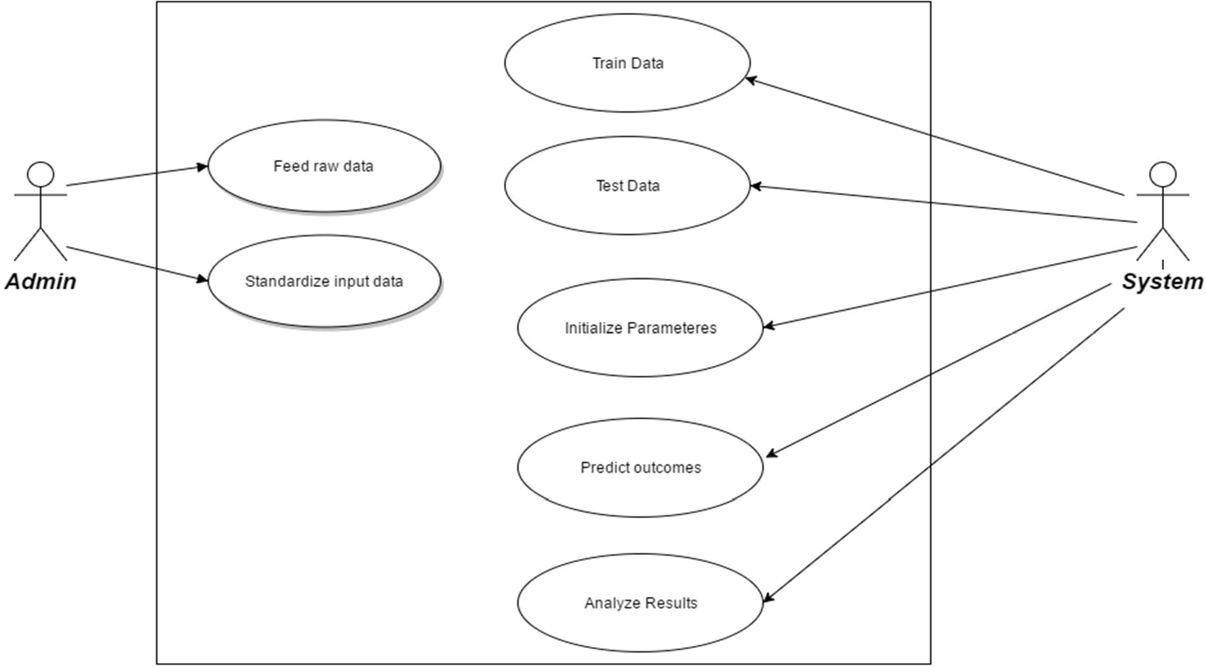
Use Case Diagram

Slide 13
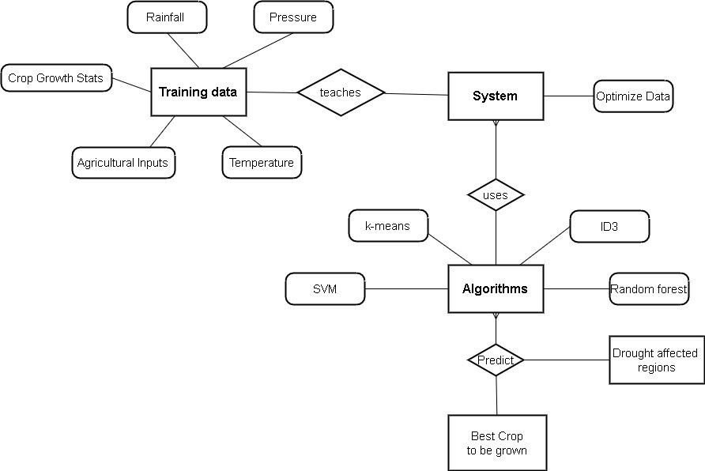
E-R Diagram

Slide 14
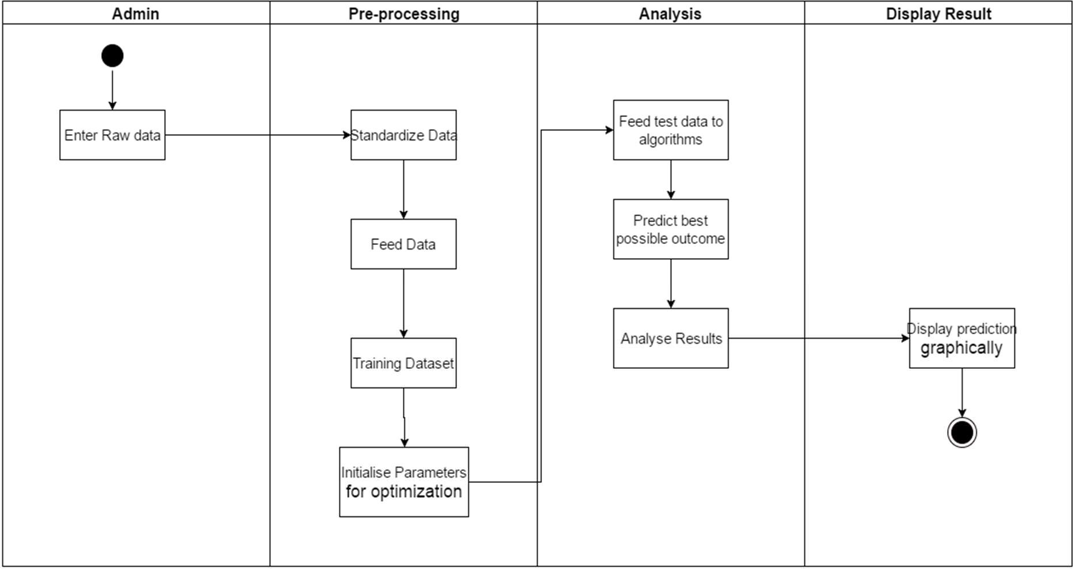
Activity Diagram

Slide 15




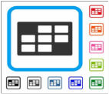

System Architecture
Crop prediction
(Extracted soil data
set from soil)
Machine learning classifier
Dynamic data
set

Slide 16
Testing Stratergies
Unit Testing:
The source code is normally divided into modules, which in turn are divided into smaller units called units.
These units have specific behavior. The test done on these units of code is called unit test.
Unit test depends upon the language on which the project is developed.
System Testing:
System testing ensures that the entire integrated software system meets requirements.
It tests a configuration to ensure known and predictable results.

Slide 17
Test Cases:
Input: Select a crop that is suitable for the current season and region. Expected Output: The system should recommend the selected crop with a high productivity score.
Input: Select a crop that is not suitable for the current season. Expected Output: The system should either not recommend the crop or display a low productivity score.
Input: Provide incorrect or missing inputs (e.g., an invalid region or season). Expected Output: The system should display an error message or prompt for correct input.
Input: Choose a high-demand cash crop for a given season and location. Expected Output: The system should provide productivity insights and suggest the best time for planting.
Input: Enter a specific soil type and check the crop recommendation. Expected Output: The system should recommend crops that thrive in that soil type.

Slide 18
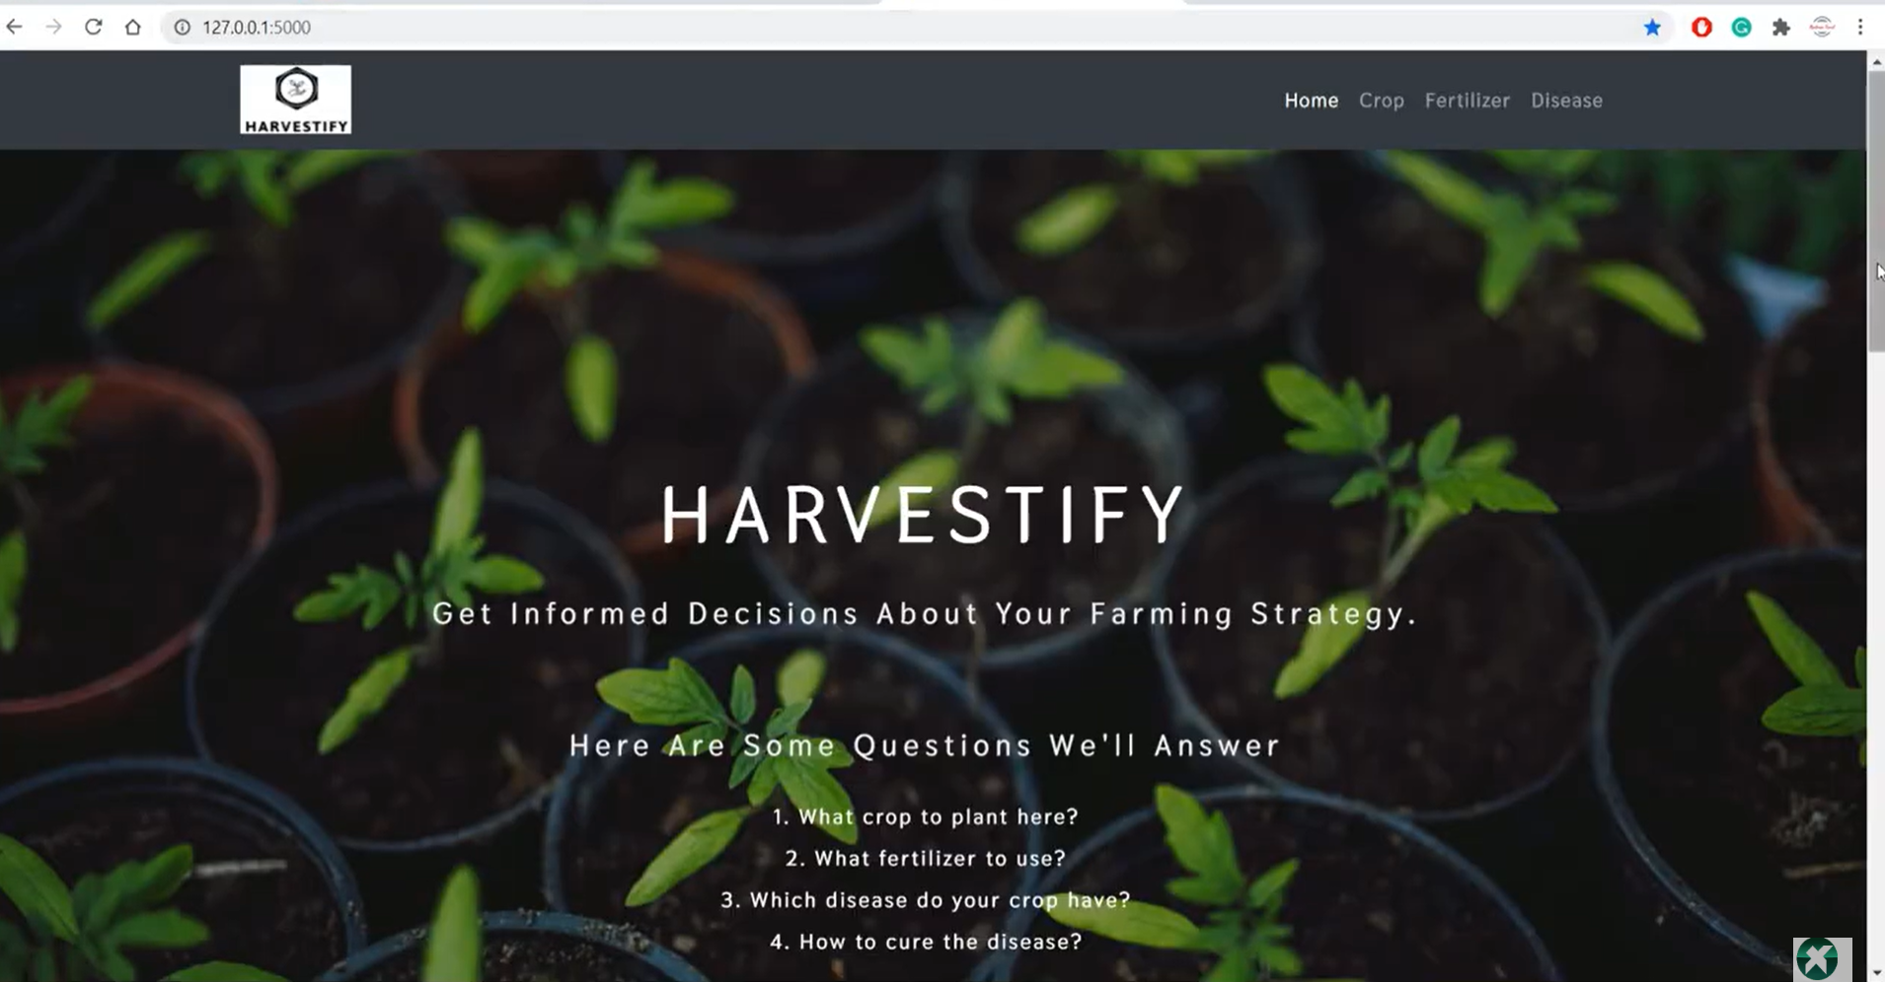
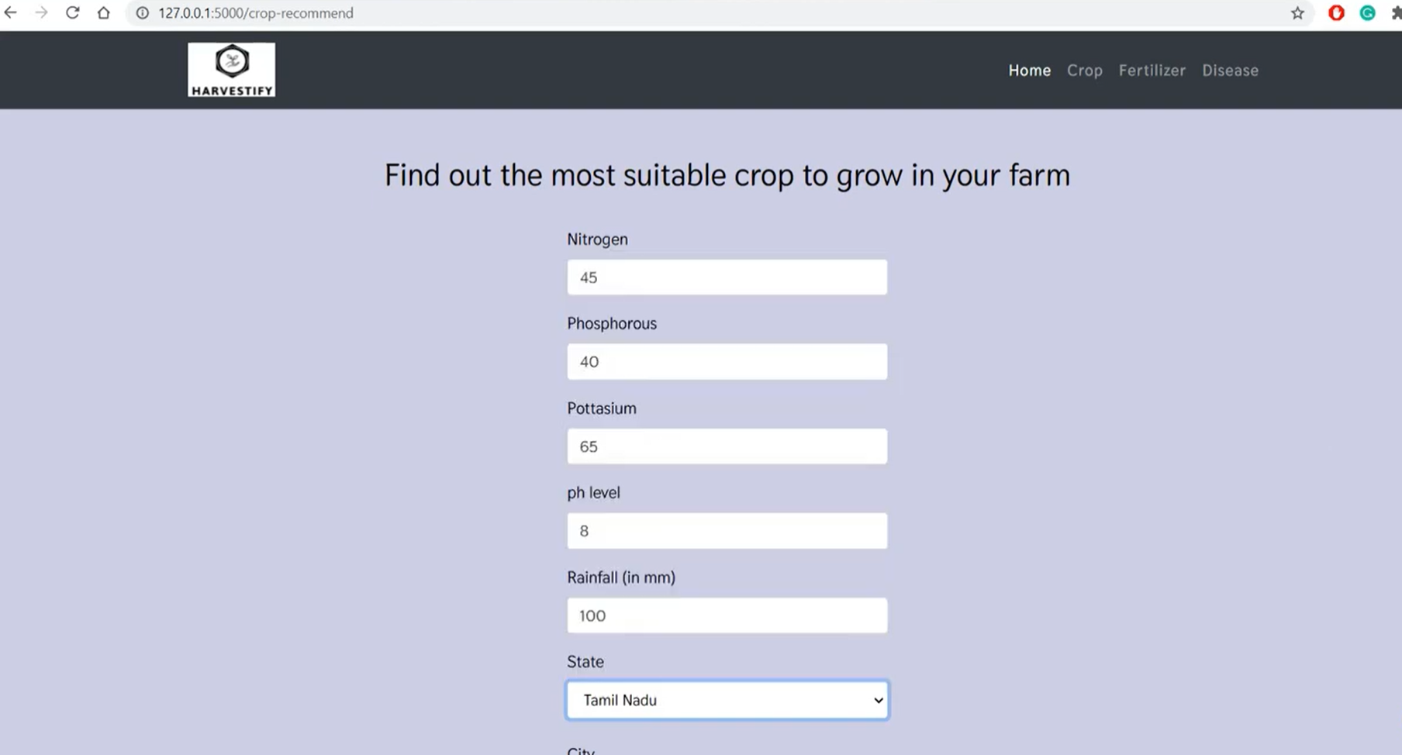
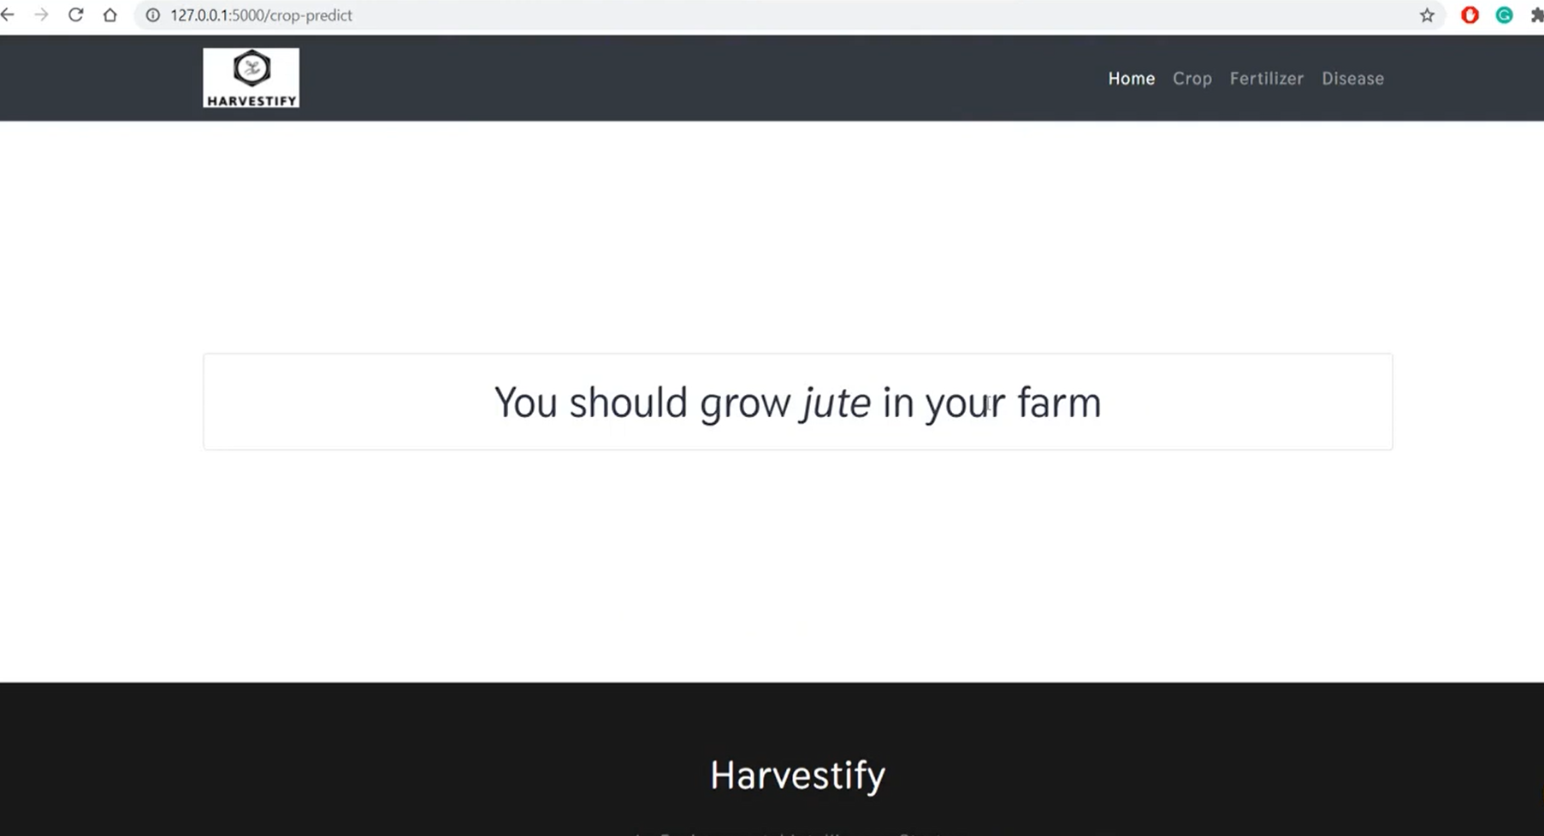
Screenshots of the project:

Slide 19
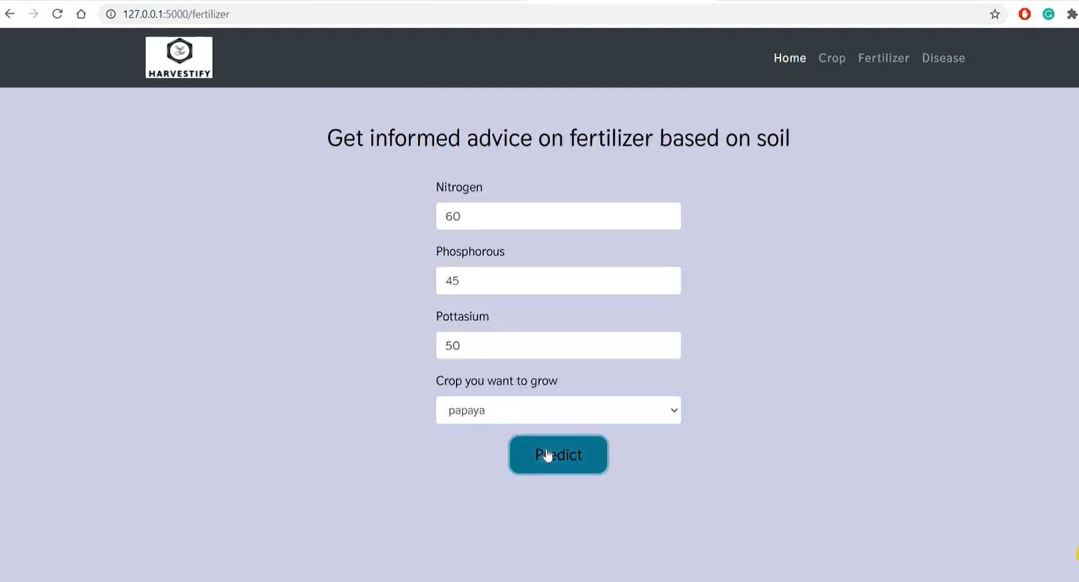
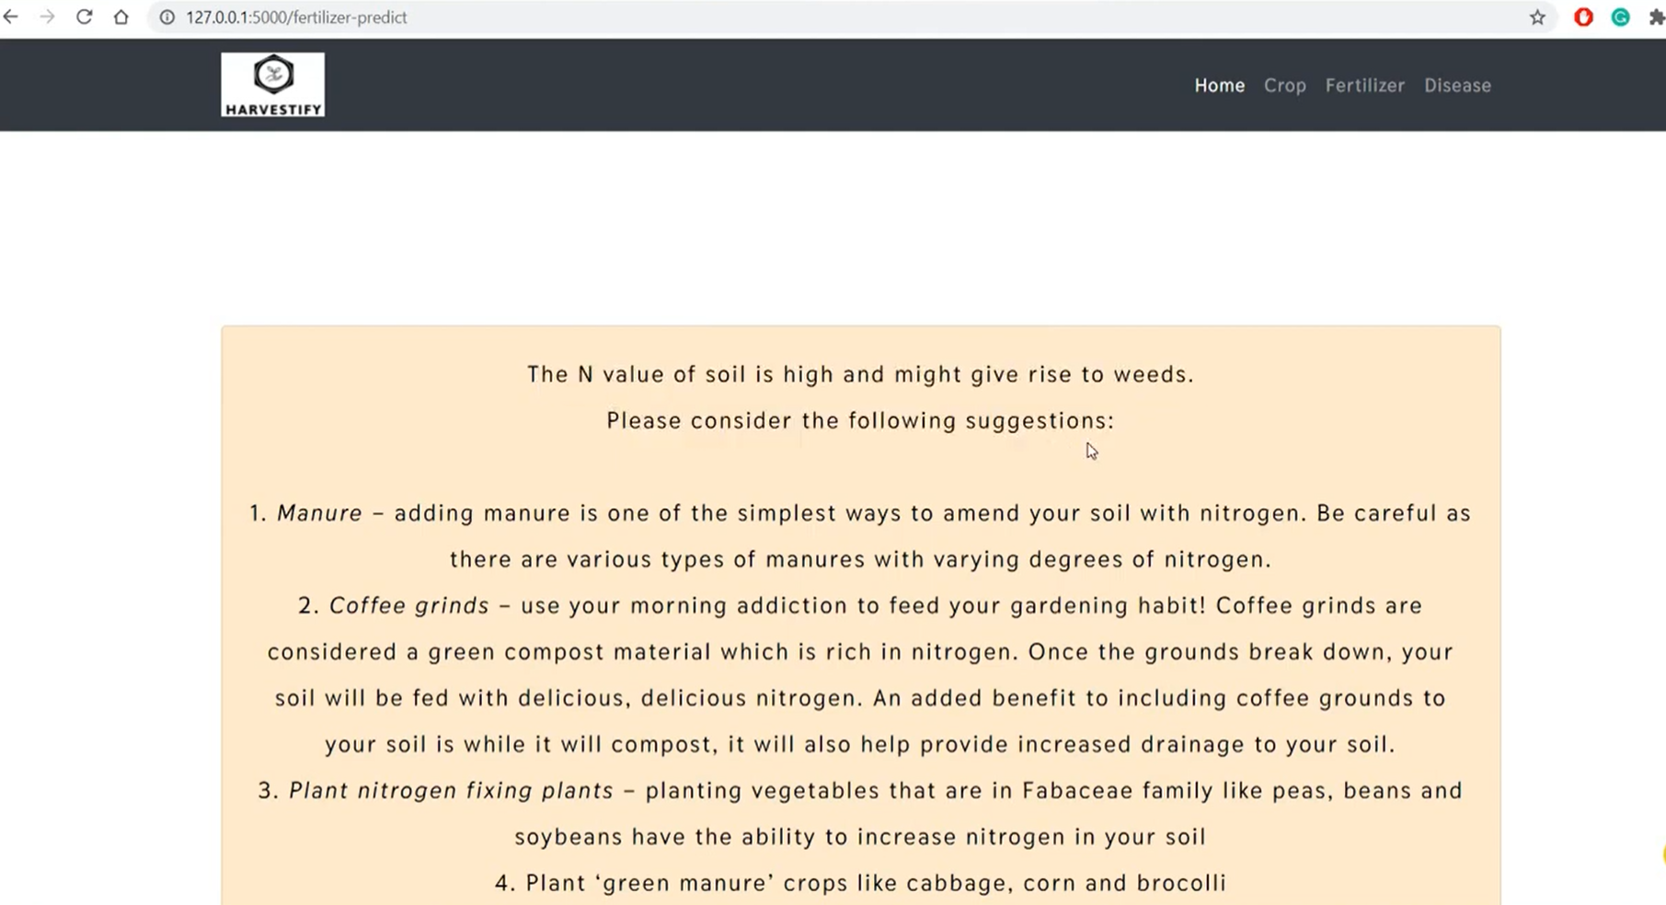
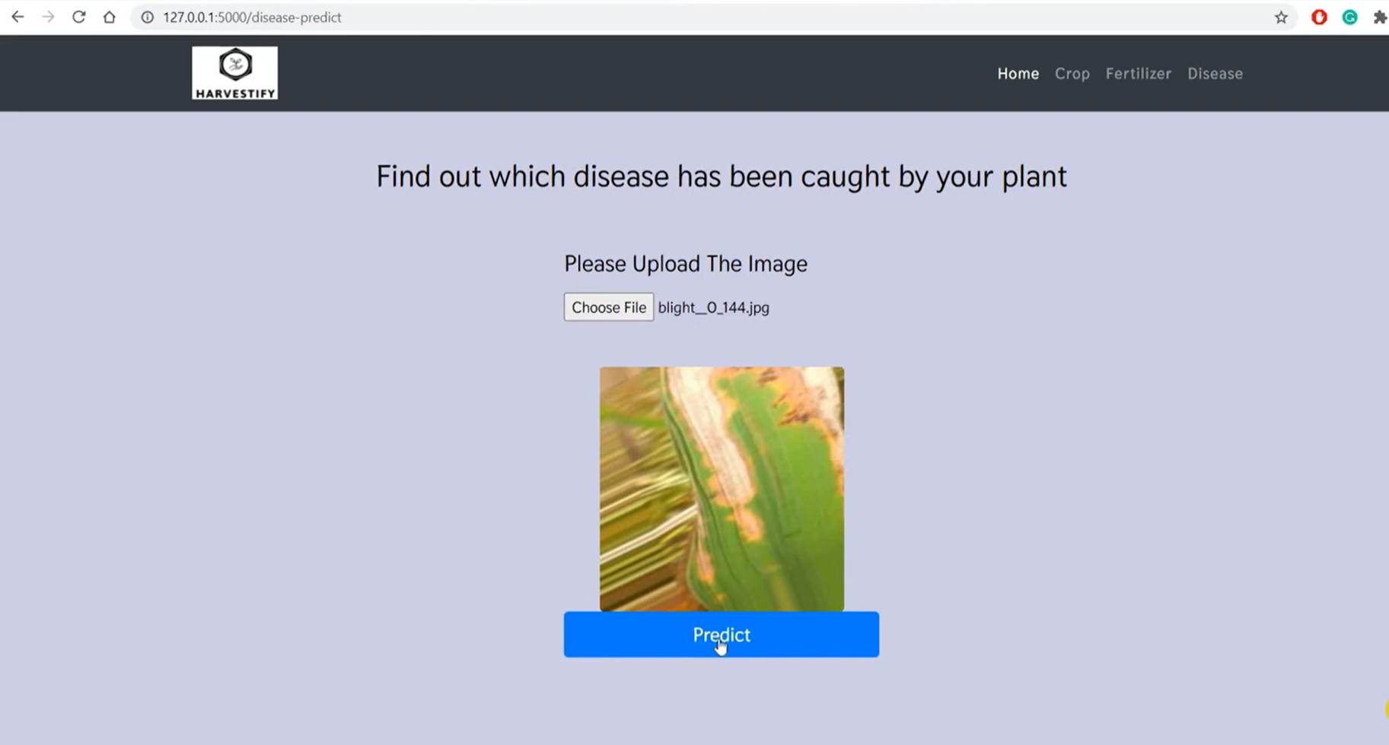
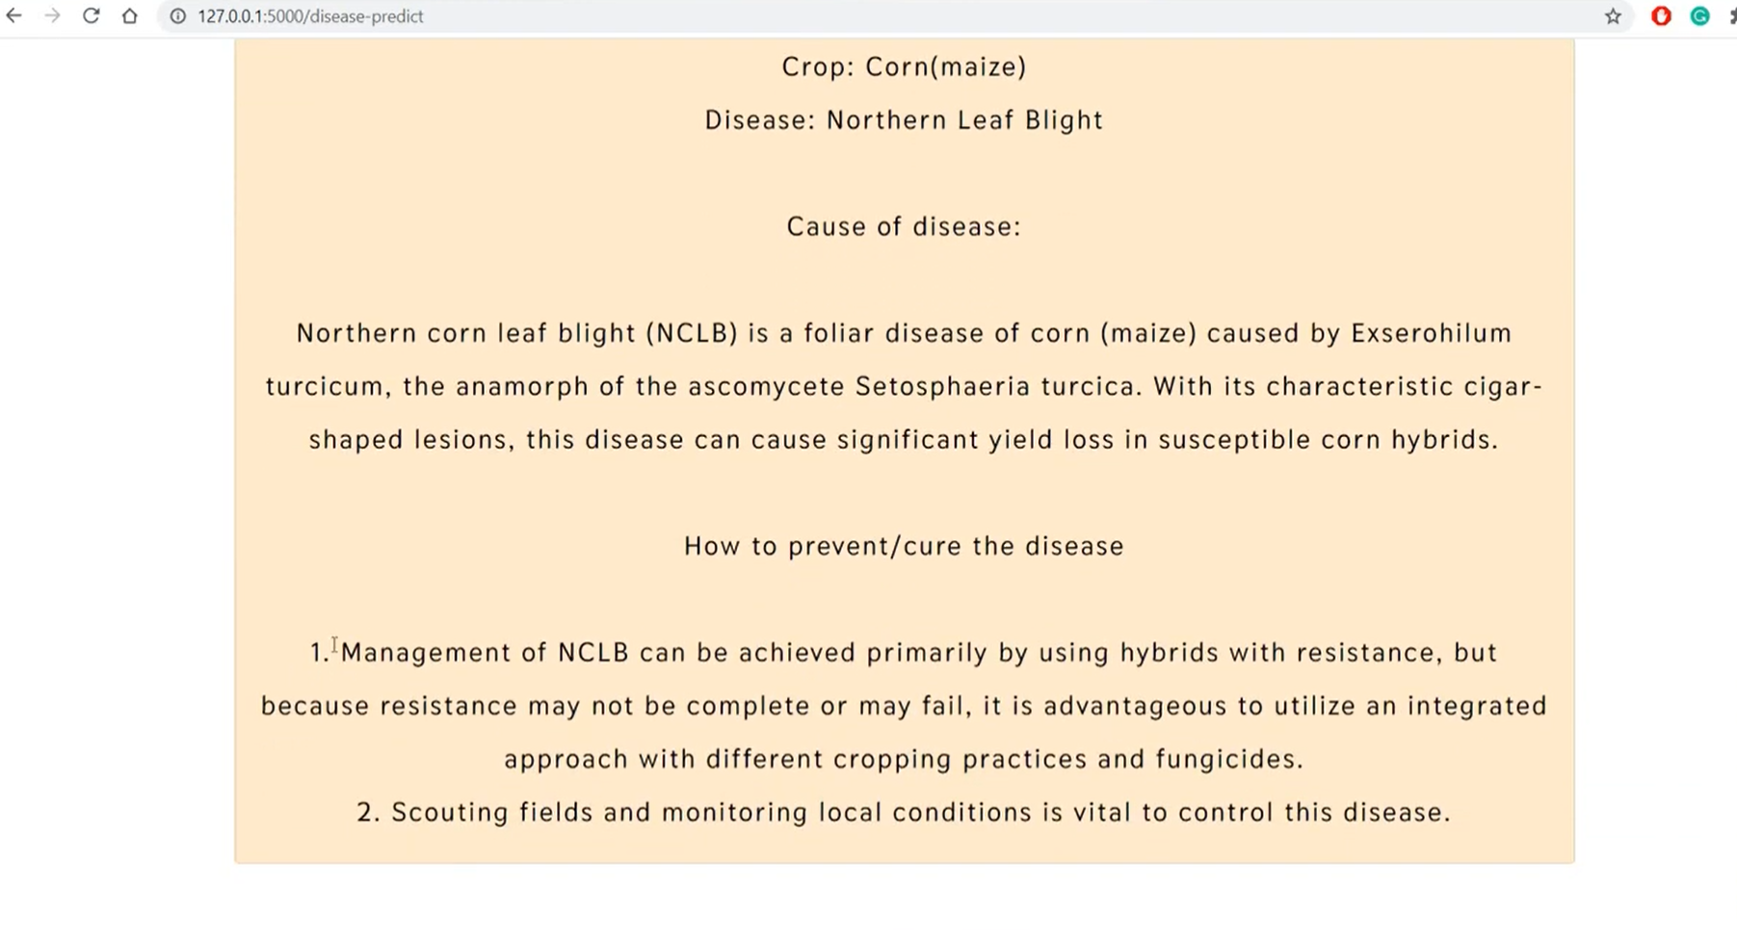

Slide 20
Conclusion
This thesis analyzes agricultural soil data using data mining techniques to improve crop yield predictions. By studying different regression algorithms, it identifies the best approach for analyzing soil data. The system is designed to prevent abnormal conditions from impacting production and manages energy and resources effectively. A remote control feature reduces the farmer's workload by allowing easy monitoring and adjustments in the field. The system also supports wireless monitoring with low power usage, making it accessible for farmers. Key benefits include reducing manual work, handling large data volumes, andmaintaining a smooth workflow. Additionally, farmers can optimize soil by adding nutrients as needed to support specific crop yields

Slide 21
Future Enhancements
In future, we can plan to build Fertilizer Recommendation System which can be utilized effectively by the Soil Testing Laboratories. This System will recommend appropriate fertilizer for the given soil sample and cropping pattern. We can add module if any queries are there, the staff can directly interact with the administrator very easily. We can also determine the efficient algorithm based on their accuracy metrics that will helps to choose an efficient algorithm for crop yield prediction.

Slide 22
Bibliography
[1] Abd Rahman, A., 1992, ‗Agricultural Development in Malaysia: Retrospect and Prospects‘, Journal of Economic Cooperation among Islamic Countries, 13:3-4: pp 51-86.
[2] Wong, L. C. Y., 2006, ‗Implications of Regional and Global Developments on Agriculture and Its Competitiveness in CLMV: Increasing Importance of Supply Chanis and International Trading Networks‘, paper presented at SEARCA Policy Round Table on ‗ Shoring and Sharing Capabilities to Improve Agriculture and its Competitiveness in Transition Southeast Asia‘, Siem Reap, Cambodia, 24-25 April, 2006.
[3] FAO, 2008a. The state of food insecurity in the world: High food prices and food security – threats and opportunities. http://www.fao.org/SOF/sofi/.
[4] NKEA-Agriculture@pemandu.gov.my.
[5] Abdullah Chek Sahamat, Native Customary Right Land Development: An Approach to Improve the Rural Native Wellbeing of Sarawak, Seminar Kebangsaan Perancangan Bandar dan Wilayah Ke-23 (Skudai: UTM, 21 September 2005).
[6] http://www.pbs.org/newshour/rundown/2013/05/in-south-africa-using-mobile-technology-To improve-maternalhealth-access.html.
[7] http://etp.pemandu.gov.my/annualreport2012/upload/Eng_ETP2012_07_NKEA05_POR.pdf.

Slide 23


