Slide 1




A cryptographically secure DepartmentAL resource server
“Designing and constructing a departmental resource server for the Department of Computing Science, with implementation of attribute-based encryption to provide a cryptographically secure service”
Chris Watson (2190594w)
Notes:
Good morning. My name is Christopher Watson and for my Level 4 Individual Project I designed and implemented a departmental resource server for the University of Glasgow’s Department of Computing Science. Security was a key criteria for this service, meaning that the implementation had to be “cryptographically secure” and as such employed an attribute-based encryption system for storage of uploaded resources.

Slide 2



Why do we need resource servers? What can they do?
Organisations are large & complex in structure
DCS — 500+ members (staff & students)
Different roles, teams, groups etc.
Members often separated for security
Staff & students need to share some resources
Users need to upload & download resources
Users can grant access to other users
Access to resources must be granular
Communication and resources must be secure
Notes:
Organisations - large & complex
Organisation hierarchy => many roles/teams/groups
DCS alone is over 500 members incl. staff + students
DCS staff split into research groups
such as the (GIST) & (FATA) groups
and within, split into themes
such as the (IR), (IDI) & (MOG) themes.
within these themes, staff are often split into smaller, focused teams as well
With organisation member roles so carefully defined
Members of Org are often digitally separated for security
In DCS, a clear separation lies between staff & students
Yet some resources are shared with staff & students
for example lecture notes
A resource server needs to:
Allow uploading of own resources & downloading resources of others
assuming they have access
Let users grant access to their uploads
Access should be granular
grant access to individuals, roles, groups etc.
Communication with server must be secure
Resources should be stored securely [TRANSITION TO NEXT SLIDE]
GIST - Glasgow Interactive Systems
FATA - Formal Analysis, Theory and Algorithms
IR - Information Retrieval
IDI - Information, Dynamics and Interaction
MOG - Modelling and Optimisation with Graphs

Slide 3


how secure does a resource server need to be?
Depends on organisation e.g. financial
Depends on information e.g. HR files
Department resources can be confidential
Must be protected against 3rd parties
DCS resources may be private; not top secret
Exam scripts example of confidential resource
Resources encrypted during transmission
HTTPS with SSL/TLS cert
Resources must also be encrypted at-rest
Notes:
…but just how secure does a resource server need to be?
Security of resource server depends on the organisation
Financial institutes will probably have more stringent requirements (FCA accredited)
than a private company
Also depends on the purpose of the server
HR file storage should be confidential and restricted
Department memos and newsletters could be public and unrestricted
Resources could be confidential to department and
Must be protected from unknown, 3rd party access
For the DCS, resources are unlikely to be top secret, mostly “Internal”
Will be restricted from general access
Exam scripts & marking schemes are examples of confidential resources
Must not be accessible to students
Resource must be encrypted for transmission
HTTPS w/ SSL certificate
This is not enough for an organisation and so
Resources must also be encrypted at-rest [TRANSITION TO NEXT SLIDE]

Slide 4



at-rest Encryption & Attribute-based encryption (ABE)
Services often leave uploaded resources unencrypted
Slack, Facebook, Instagram, Twitter etc.
Leaves resources vulnerable if a breach occurs
Organisations require at-rest encryption — AES 128-bit & above
Google Drive, OneDrive etc. store symmetric AES keys themselves
ABE encryption only requires a stored public key
Embeds access policies into encrypted resources
Only private user keys can decrypt; embedded attributes as proof
Notes:
Most services don’t consider resources as private
Store uploads unencrypted for simple sharing/processing
Slack, Facebook, Instagram, Twitter keep resources public
Unencrypted resources are vulnerable to breaches
Not acceptable for business/organisation use - need at-rest encryption
Encrypted files can be stolen by hackers without risk of information breach
Google Drive, OneDrive etc. offer AES encryption (for business)
But store AES symmetric keys themselves
Stored separately - still vulnerable
ABE encryption avoids this risk since user keys are private
Server only stores a public key (for distribution)
Instead embeds policies into encrypted resources
User keys then use embedded attributes to prove access
Decryption is then a local process by users
Deployment of a resource server is extremely important [TRANSITION TO NEXT SLIDE]

Slide 5


Deployment & User enrolment
Deployed resource server is a ‘dumb’ service by design
Unaware of contents of resources
Distributes the master public key
Allows upload & download of any resource
Never performs encryption/decryption tasks
Users need their private user key generated
Enrolment requires DCS members visit Teaching Office
Member of Admin then verifies identity; generates user key
Embedding attributes extracted from MyCampus
Notes:
…and in this case, the deployed resource server offers a ‘dumb’ service by design
Unaware of resource contents & unable to access information
Server also distributes the master public key
on behalf of Master Key Server (offline system)
Server allows users to upload & download any resource
safe as the resources are encrypted and cannot be interpreted
The server is incapable of encrypting or decrypting resources
has no keys, no ABE library etc.
Users must enrol for the service, acquire their user key
Has to be generated/signed by the offline Master Key Server
For DCS deployment, Master Key server would be in locked room
Physical access only for Admin Staff
DCS members must visit Teaching Office for key
Admin staff verify identity then generate key
Attributes for the key extracted from MyCampus system
Process diagram next slide [TRANSITION TO CONCLUSION SLIDE]

Slide 6
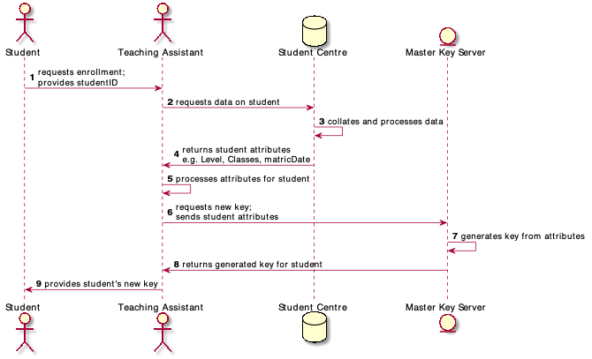
User Enrolment Process
Notes:
Users must enrol for the service, acquire their user key
Has to be generated/signed by the offline Master Key Server
For DCS deployment, Master Key server would be in locked room
Physical access only for Admin Staff
DCS members must visit Teaching Office for key
Admin staff verify identity then generate key
Attributes for the key extracted from MyCampus system

Slide 7


Conclusions
Designed and created a resource server for the Department of Computing Science
Resource server was cryptographically secure in implementation
Analysed the structure of the DCS
Implemented an Attribute-Based encryption system
Created an infrastructure for deployment
Developed a deployment process
Including an enrolment process for users
Producing a complete & secure product for future use
Notes:
To conclude, over the course of the project I…
Res server
DCS structure
ABE system
Infrastructure
Deployment
Enrolment
Thank you for listening to me today and are there any questions?

Slide 8



Questions?

Slide 9
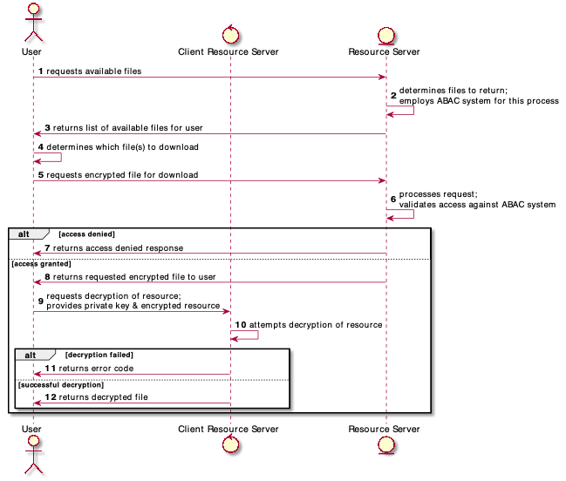
Notes:
Download & Decryption process

Slide 10
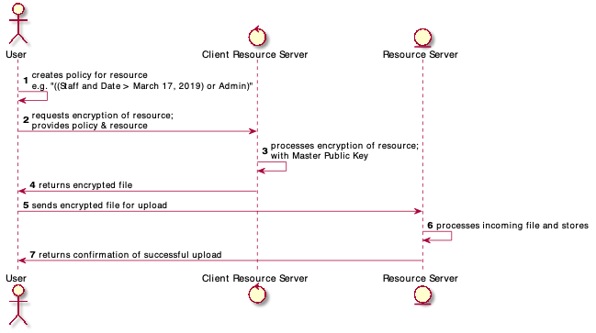
Notes:
Encryption & Upload process

Slide 11
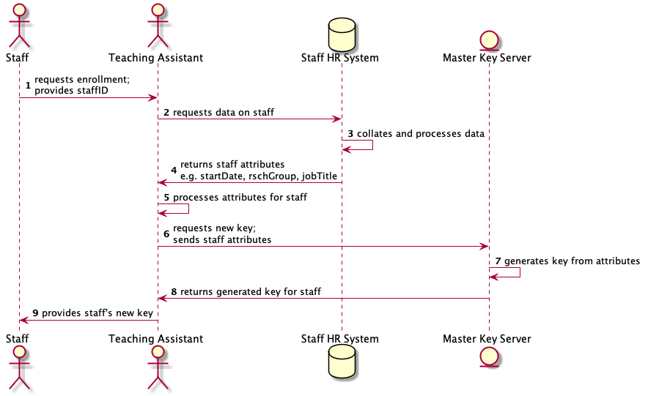
Notes:
Staff Enrolment process

Slide 12
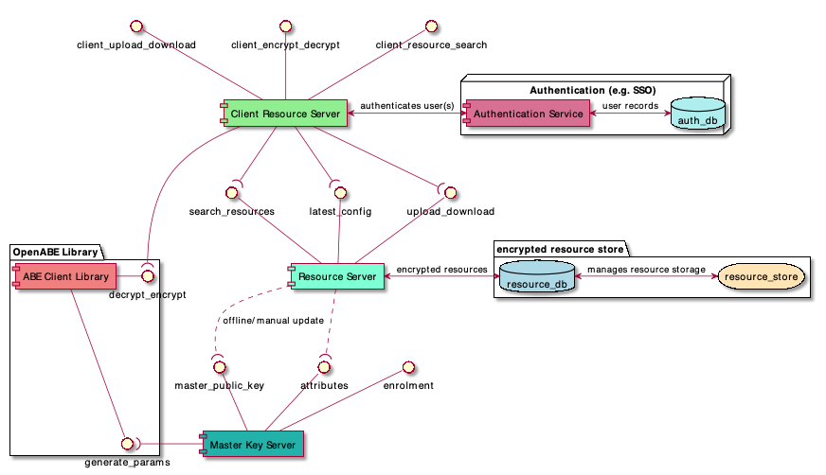
Notes:
Deployment Diagram

