Slide 1
betXchange
BetXchange Data Analyst Assessment
Customer behaviour, product performance, retention, risk, and growth analysis
[Your Name Here]
Date: 2026-10-18
Data-driven view of customer value, loyalty, profitability, and risk exposure (May-July 2024)

Slide 2
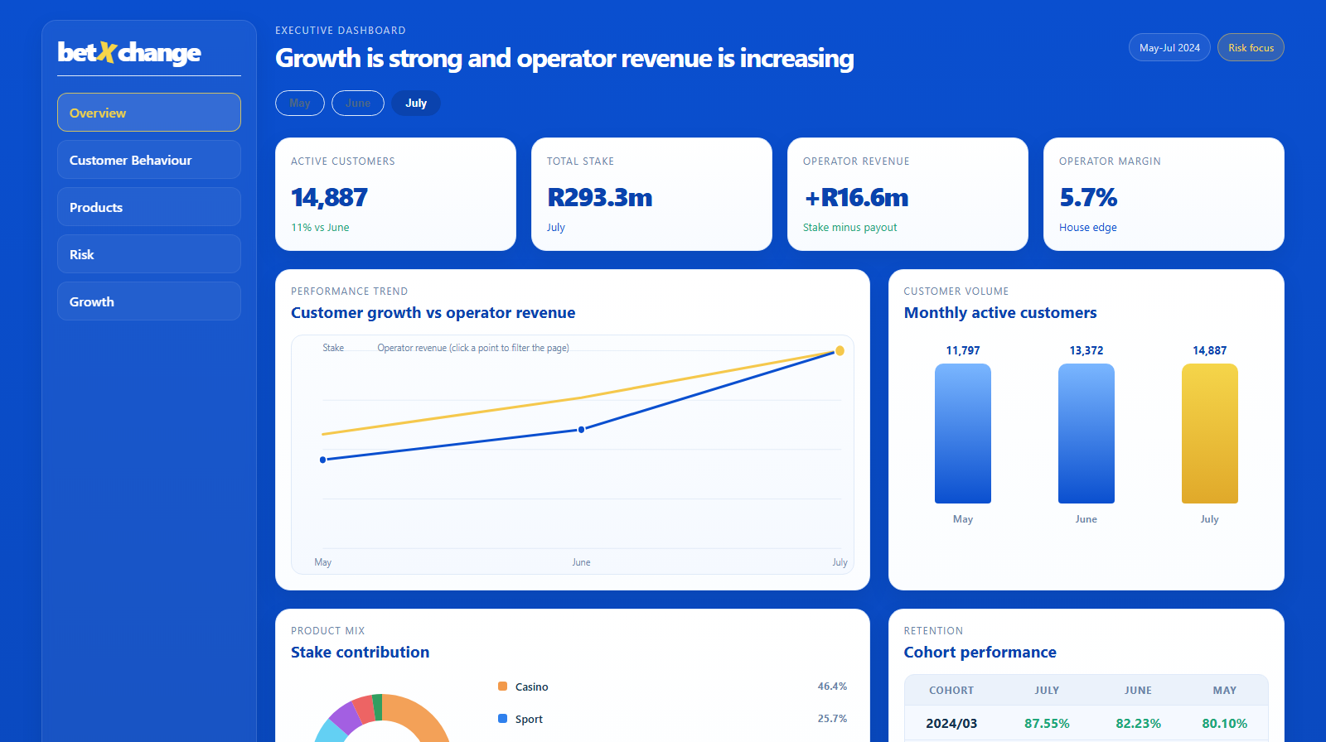
EXECUTIVE SUMMARY
Revenue is positive and growing; the real story is concentration
• Operator revenue (stake minus payout) is positive and growing every month: +R7.4m (May) -> +R9.9m (June) -> +R16.6m (July), margin ~4.4%-5.7%.
• Retention is strong: cohort-based retention rates are above 80% across the period, with newer cohorts retaining even better (90%-100%).
• Revenue is highly concentrated: the top 1% of users (148 in July) generate 77% of that month's stake -- a dependency signal, not evidence of losses.
• Key management focus: concentration risk, not profitability. A small group of high-stake users drives most volume and payout volatility.
betXchange

Slide 3
DATA OVERVIEW & METHODOLOGY
Four verified sources, fully reproducible KPI pipeline
• Sources: Users, Slips, and Transactions (3 monthly files each) plus GA4 website traffic exports -- the GA4 data was never ingested in the original pipeline and is now included.
• Fixed a duplicate-row bug in the slip export (Total rows re-counted daily activity) and a join fan-out bug that had inflated product-level stake to impossible, trillion-rand figures.
• Replaced unexplained fixed risk thresholds with documented, data-derived percentile thresholds that adapt to monthly volume.
• Found a real data-governance gap: only 33% of transacting customers (7,918 of 24,142) have a matching row in the raw Users files -- the rest have no age/country on record at all.
• Every KPI table and view is reproducible end-to-end from raw files; full methodology and every assumption is logged in docs/assumptions.md.
betXchange

Slide 4
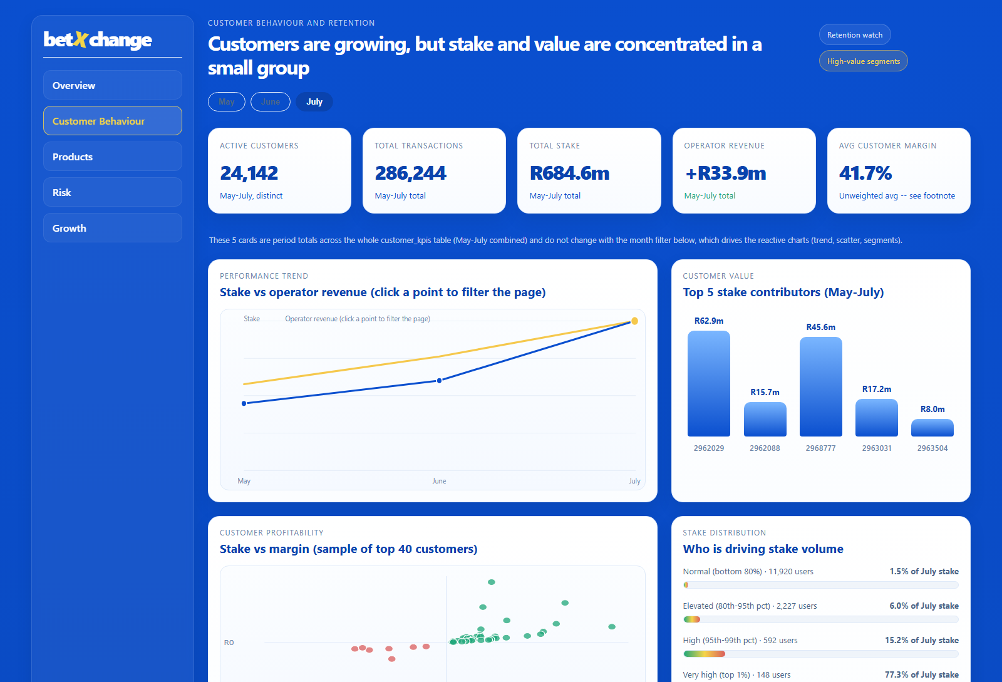
CUSTOMER ANALYSIS
24,142 customers -- but age/country data only covers 33% of them
• 24,142 distinct customers, 286,244 transactions, and R684.6m total stake across May-July.
• Coverage limit: only 7,918 customers (33%) have a matching age/country record; the figures below describe that matched subset only, not the full customer base.
• Among matched customers: the 35-44 age band is 49.3% of stake and 57.5% of operator revenue; South Africa is 97.8% of matched stake.
• Average customer margin is 41.7% (unweighted) -- skewed upward by many small-stake customers; the revenue-weighted company margin is ~5%-6%.
betXchange

Slide 5
BETTING ACTIVITY ANALYSIS
Casino leads, but the mix is broad and diversified
• Casino is the largest product by modeled stake share (46.4% of July), followed by Sport (25.7%) and Aviator (14.2%).
• Product-level figures are a modeled allocation (by each customer's slip-count share), not a direct measurement -- the raw transactions have no product field.
• Transaction volume and active-customer counts both rise materially from May to July (+26% active customers).
• Product mix supports both marketing investment and category-level commercial decisions.
betXchange

Slide 6
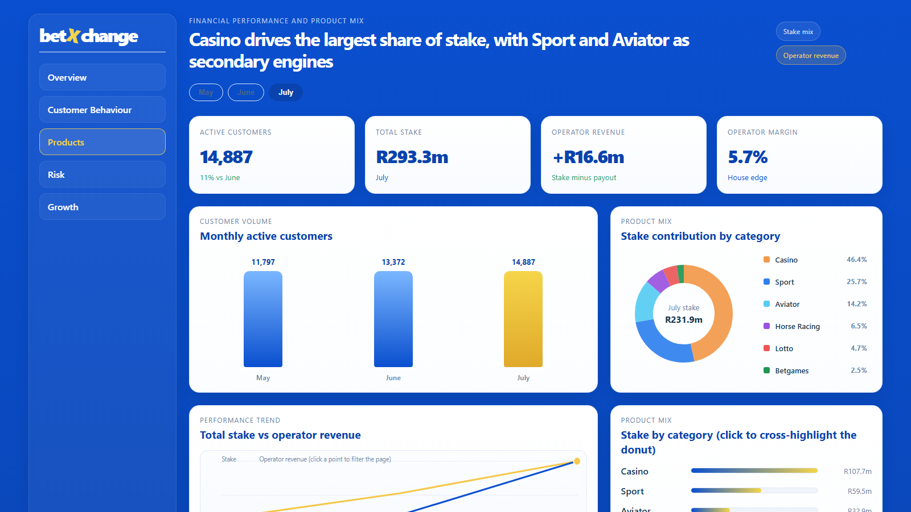
FINANCIAL PERFORMANCE
Operator revenue is healthy and accelerating
• Total stake grew from R168.2m (May) to R293.3m (July).
• Operator revenue (BetXchange's gross gaming revenue) grew from +R7.4m to +R16.6m over the same period.
• Operator margin improved from 4.4% to 5.7% -- within a typical bookmaker range.
• This is healthy, expected bookmaker economics: customers losing money on balance is how a sportsbook/casino earns revenue, not a sign of distress.
betXchange

Slide 7
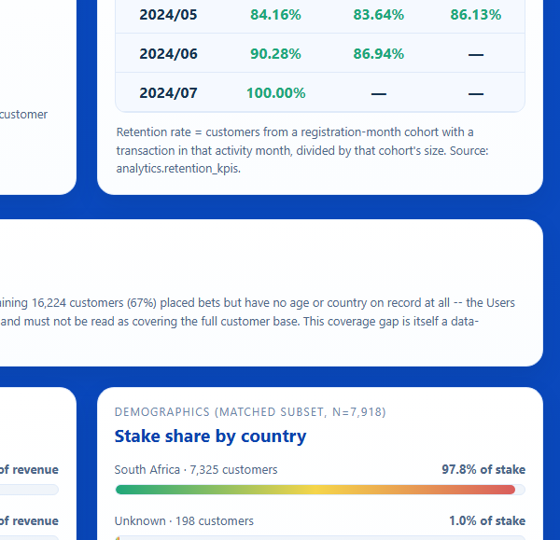
RETENTION ANALYSIS
Repeat activity is strong and improving in newer cohorts
• March 2024 cohort: 80.1% (May) -> 82.2% (June) -> 87.6% (July) retention.
• Newer cohorts retain even better: the June 2024 cohort reaches 90.3% retention in July.
• Retention is a strategically important, directly actionable lever for Warren (Operations) and Ryan (Growth).
• Recommendation: protect high-retention cohorts with experience quality, and target engagement programmes at the lower-retention cohorts (2024/04, 2024/05).
betXchange

Slide 8
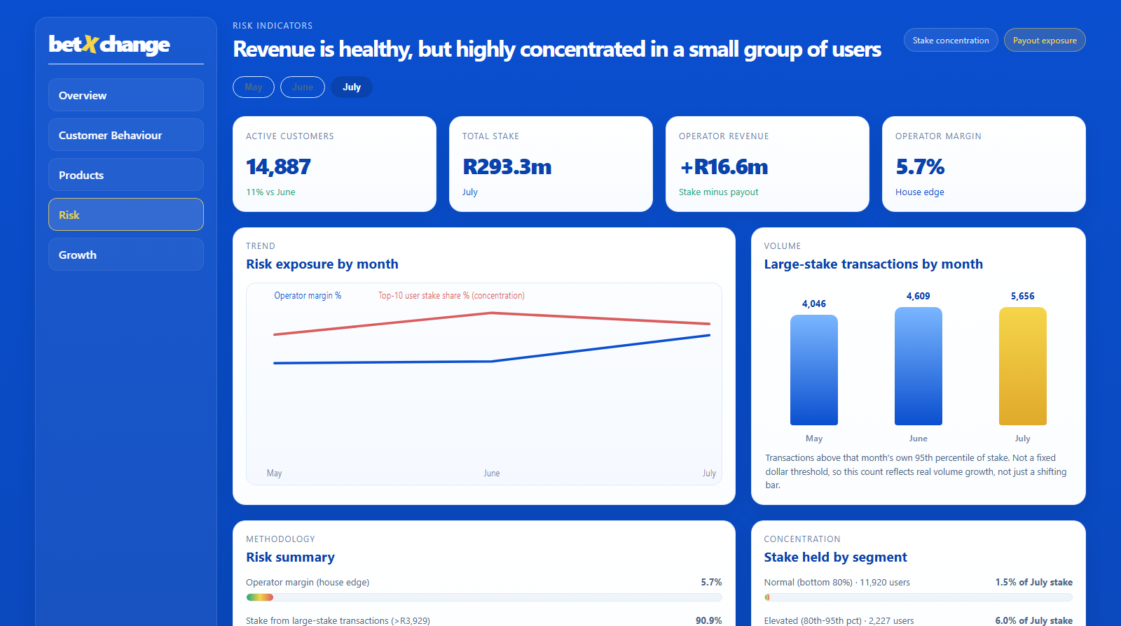
RISK & CONCENTRATION ANALYSIS
Not losses -- concentration and payout exposure
• Large-stake transactions (above that month's own 95th percentile, R3,929 in July) account for 90.9% of stake volume.
• The top 10 users hold 36.3% of July's stake; the top 1% (148 users) hold 77.3%.
• 11.6% of July transactions were customer wins -- the operator's real payout exposure.
• This methodology cannot detect fraud, collusion, or multi-accounting: the data has no device, IP, payment-method, or account-linkage fields.
betXchange

Slide 9
MARKETING ANALYSIS
Website traffic is growing; channel-level claims are out of scope
• GA4 website traffic grew from ~7.1m monthly page views (May) to ~8.7m (July), broadly in line with transaction growth.
• ~96% of website traffic comes from South Africa every month, consistent with BetXchange's core market.
• This export has NO campaign, channel, or source/medium field, and cannot be linked to the betting user_id -- campaign effectiveness and acquisition-channel ROI cannot be measured from this data.
• Recommendation for Gracia / governance: add UTM tagging and a login-linked identifier if channel-level marketing evaluation is required going forward.
betXchange

Slide 10
STAKEHOLDER RECOMMENDATIONS
Tailored actions for each business owner
• Ryan (Growth): prioritise the strongest product categories; invest in retention for high-value cohorts.
• Warren (Retention): focus engagement actions on lower-performing cohorts (2024/04, 2024/05).
• Craig (Risk): monitor top-1%/top-10 stake share and large-payout review -- the priority is concentration, not losses.
• Holly (Marketing): use verified traffic trends for funnel review; do not claim channel ROI without UTM-tagged data.
• Gracia (Governance): maintain the raw-to-cleaned-to-KPI audit trail; keep docs/assumptions.md as the methodology source of truth.
betXchange

Slide 11
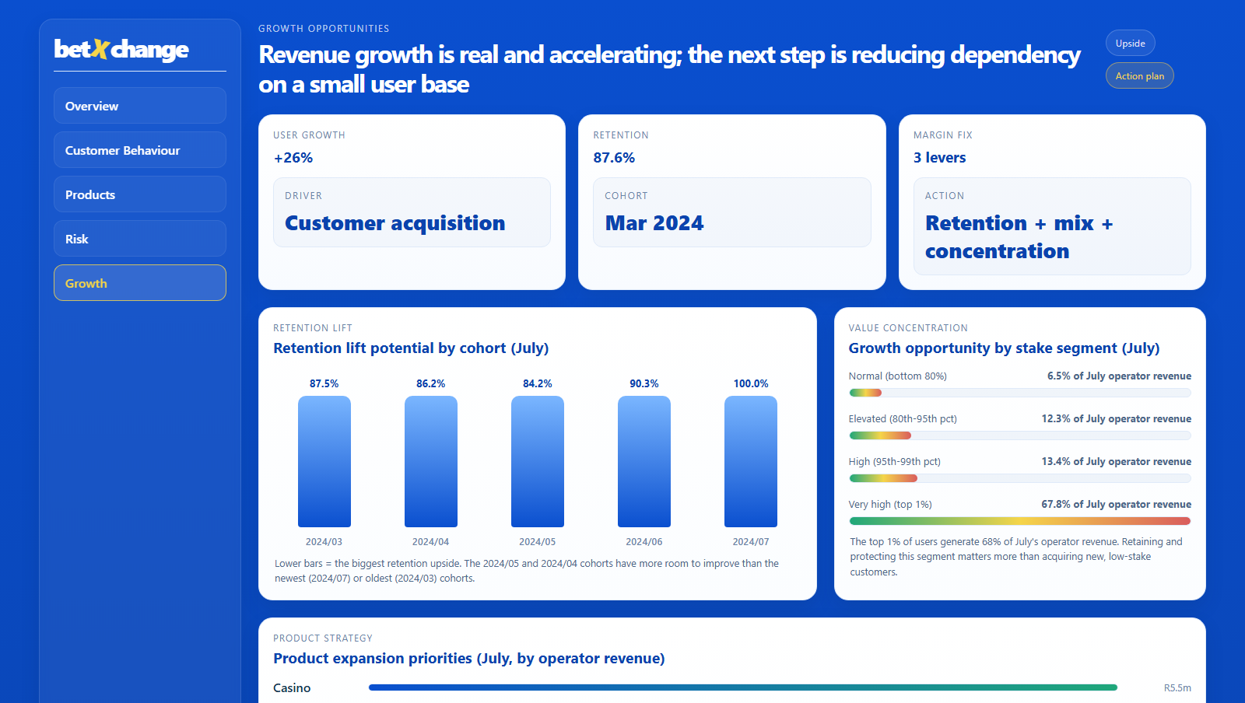
30 / 60 / 90 DAY ACTION PLAN
From validated insight to operational practice
• 30 days: finalise dashboard/KPI review with stakeholders; validate retention and concentration-risk metrics with business owners.
• 60 days: launch a targeted retention campaign; introduce a monitoring process for large individual payouts and top-user stake concentration.
• 90 days: formal performance review cycle with stakeholder scorecards; quantify retention uplift, product growth, and concentration-risk reduction.
betXchange

Slide 12
EXPECTED BUSINESS IMPACT
Predictable growth through retention and concentration management
• Revenue: stronger product contribution and reduced dependency on the top 1% of users supports more predictable, sustainable growth.
• Retention: cohort-based retention is a strong lever for customer lifetime value.
• Operations: cleaner, standardised KPI reporting improves stakeholder decision quality and speed.
• Risk: stake-concentration monitoring (top-10/top-1% share) enables earlier intervention on dependency and payout-volatility risk.
betXchange

Slide 13
CONCLUSION & NEXT STEPS
Revenue is healthy; concentration is the risk to manage
• BetXchange shows growing customer activity and positive, growing operator revenue (+R7.4m to +R16.6m, May-July) -- the earlier 'weak profitability' conclusion was based on an inverted metric and has been corrected.
• Revenue and stake volume are highly concentrated in a small number of users -- this is the real exposure to manage, not a loss-making business.
• Next steps: finalise stakeholder review of dashboard outputs; confirm concentration-risk thresholds and retention definitions with business owners; prepare the data appendix and AI-assistance disclosure for governance sign-off.
betXchange

